Slide 1
Introduction to Apache Pig

Slide 2
What is Apache Pig
Apache Pig is a high-level platform for creating programs that run on Apache Hadoop.
The language for this platform is called Pig Latin.

Slide 3
Short History of Apache Pig
Apache Pig was originally developed at Yahoo Research around 2006 for researchers to have an ad-hoc way of creating and executing MapReduce jobs on very large data sets.
In 2007, it was moved into the Apache Software Foundation.

Slide 4
Apache Pig Features
Ease of programming. It is trivial to achieve parallel execution of simple, "embarrassingly parallel" data analysis tasks. Complex tasks comprised of multiple interrelated data transformations are explicitly encoded as data flow sequences, making them easy to write, understand, and maintain.
Optimization opportunities. The way in which tasks are encoded permits the system to optimize their execution automatically, allowing the user to focus on semantics rather than efficiency.
Extensibility. Users can create their own functions to do special-purpose processing.

Slide 5
Apache Pig Execution Modes
Local Mode - (pig -x local) To run Pig in local mode, you need access to a single machine; all files are installed and run using your local host and file system.
Tez Local Mode -(pig -x tez_local) It is similar to local mode, except internally Pig will invoke tez runtime engine..
Spark Local Mode - (pig -x spark_local) It is similar to local mode, except internally Pig will invoke spark runtime engine.
Mapreduce Mode - (pig OR pig -x mapreduce) You need access to a Hadoop cluster and HDFS installation. Mapreduce mode is the default mode.
Tez Mode - (pig -x tez) You need access to a Hadoop cluster and HDFS installation. Specify Tez mode using the -x flag (-x tez).
Spark Mode - (pig -x spark) To run Pig in Spark mode, you need access to a Spark, Yarn or Mesos cluster and HDFS installation.

Slide 6
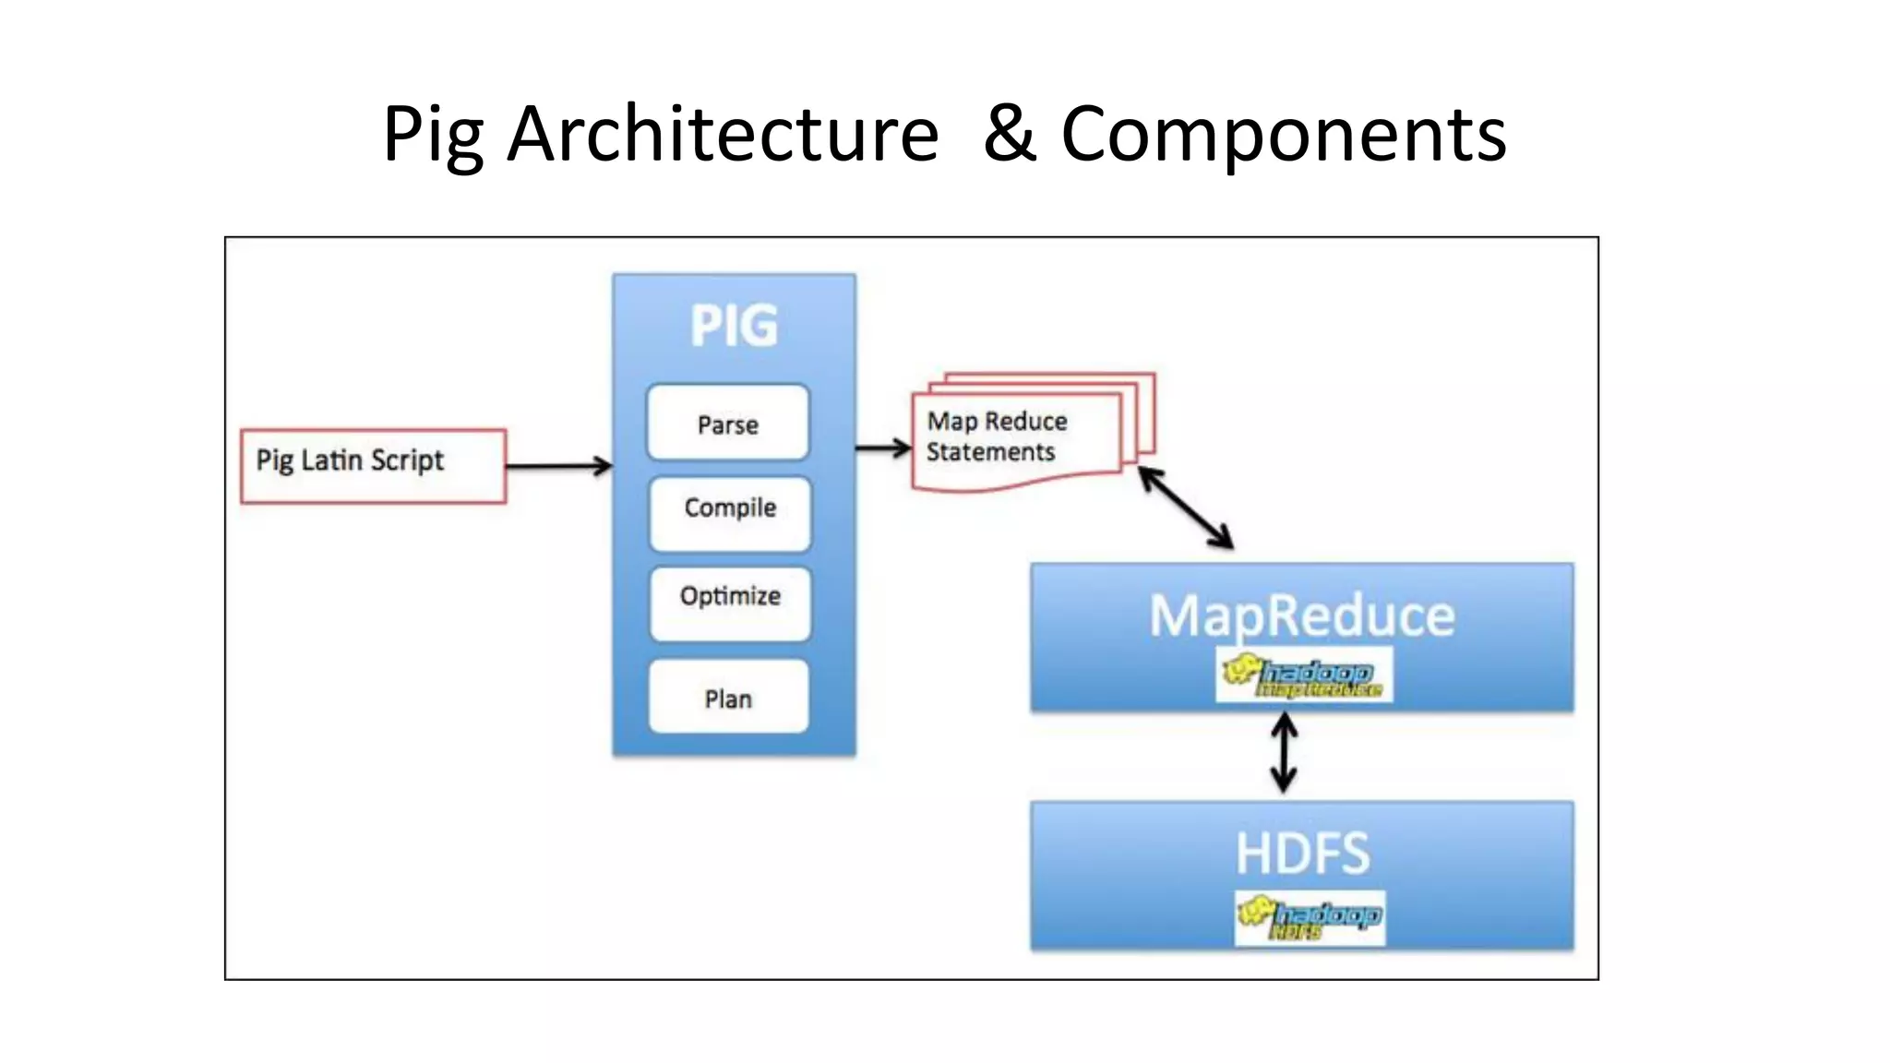
Architecture and Components

Slide 7
Structure
A Pig Latin program consists of a collection of statements(operations or commands).
E.g.
grouped_records = GROUP records BY year;
GROUP is an operation.
2. ls / - is a command

Slide 8
Syntax
Statements that have to be terminated with a semicolon can be split across multiple lines for readability:
records = LOAD 'input/ncdc/micro-tab/sample.txt'
AS (year:chararray, temperature:int, quality:int);

Slide 9
Execution
No data processing takes place while the logical plan of the program is being constructed. For example in :
records = LOAD 'input/ncdc/micro-tab/sample.txt' using PigStorage(',') AS (year:chararray, temperature:int, quality:int);
filtered_records = FILTER records BY temperature != 9999 AND quality IN (0, 1, 4, 5, 9);
grouped_records = GROUP filtered_records BY year;
max_temp = FOREACH grouped_records GENERATE group,
MAX(filtered_records.temperature);
DUMP max_temp;

Slide 10
Execution
When the Pig Latin interpreter sees the first line containing the LOAD statement, it confirms that it is syntactically and semantically correct and adds it to the logical plan, but it does not load the data from the file (or even check whether the file exists).
The point is that it makes no sense to start any processing until the whole flow is defined. Similarly, Pig validates the GROUP and FOREACH...GENERATE statements, and adds them to the logical plan without executing them. The trigger for Pig to start execution is the DUMP(or STORE) statement.

Slide 11
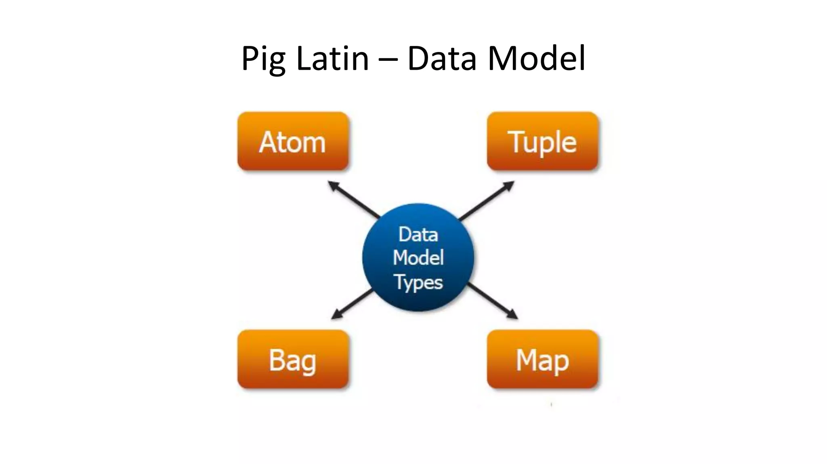
Pig Latin Data Model

Slide 12
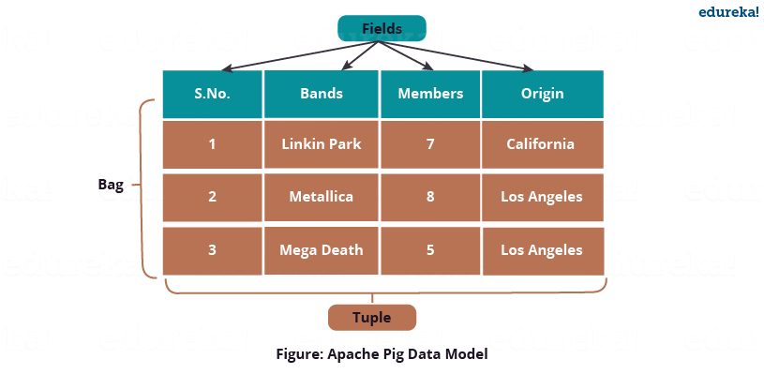
Pig Latin Data Model

Slide 13
Pig Latin Relational Operators
Loading and storing: LOAD, STORE, DUMP ( \d )
Filtering: FILTER, DISTINCT, FOREACH...GENERATE, MAPREDUCE, STREAM, SAMPLE, ASSERT
Grouping and Joining: JOIN, COGROUP, GROUP, CROSS, CUBE
Sorting: ORDER, RANK, LIMIT
Combining and splitting: UNION, SPLIT
Diagnostic operators: DESCRIBE, EXPLAIN, ILLUSTRATE

Slide 14
Schemas
A relation in Pig may have an associated schema, which gives the fields in the relation names and types.
grunt> records = LOAD 'input/ncdc/micro-tab/sample.txt'
>> AS (year:int, temperature:int, quality:int);
grunt> DESCRIBE records;
records: {year: int,temperature: int,quality: int}

Slide 15
No Schema
Fields in a relation with no schema can be referenced using only positional notation: $0 refers to the first field in a relation, $1 to the second, and so on. Their types default to bytearray :
grunt> projected_records = FOREACH records GENERATE $0, $1, $2;
grunt> DUMP projected_records;
(1950,0,1)
grunt> DESCRIBE projected_records;
projected_records: {bytearray,bytearray,bytearray}

Slide 16
Examples
//Calculate most frequent ip addresses in a web log file
records = LOAD 'data/input/nasa' using PigStorage(' ');
grouped_records = group records by $0;
nums = foreach grouped_records generate group, COUNT(records.$0);
ordered_nums = order nums by $1 desc;
dump ordered_nums;

