Slide 1


Florent Fayollas
Antoine Vacher
TLS-SEC
one drone to rule them all

Slide 2
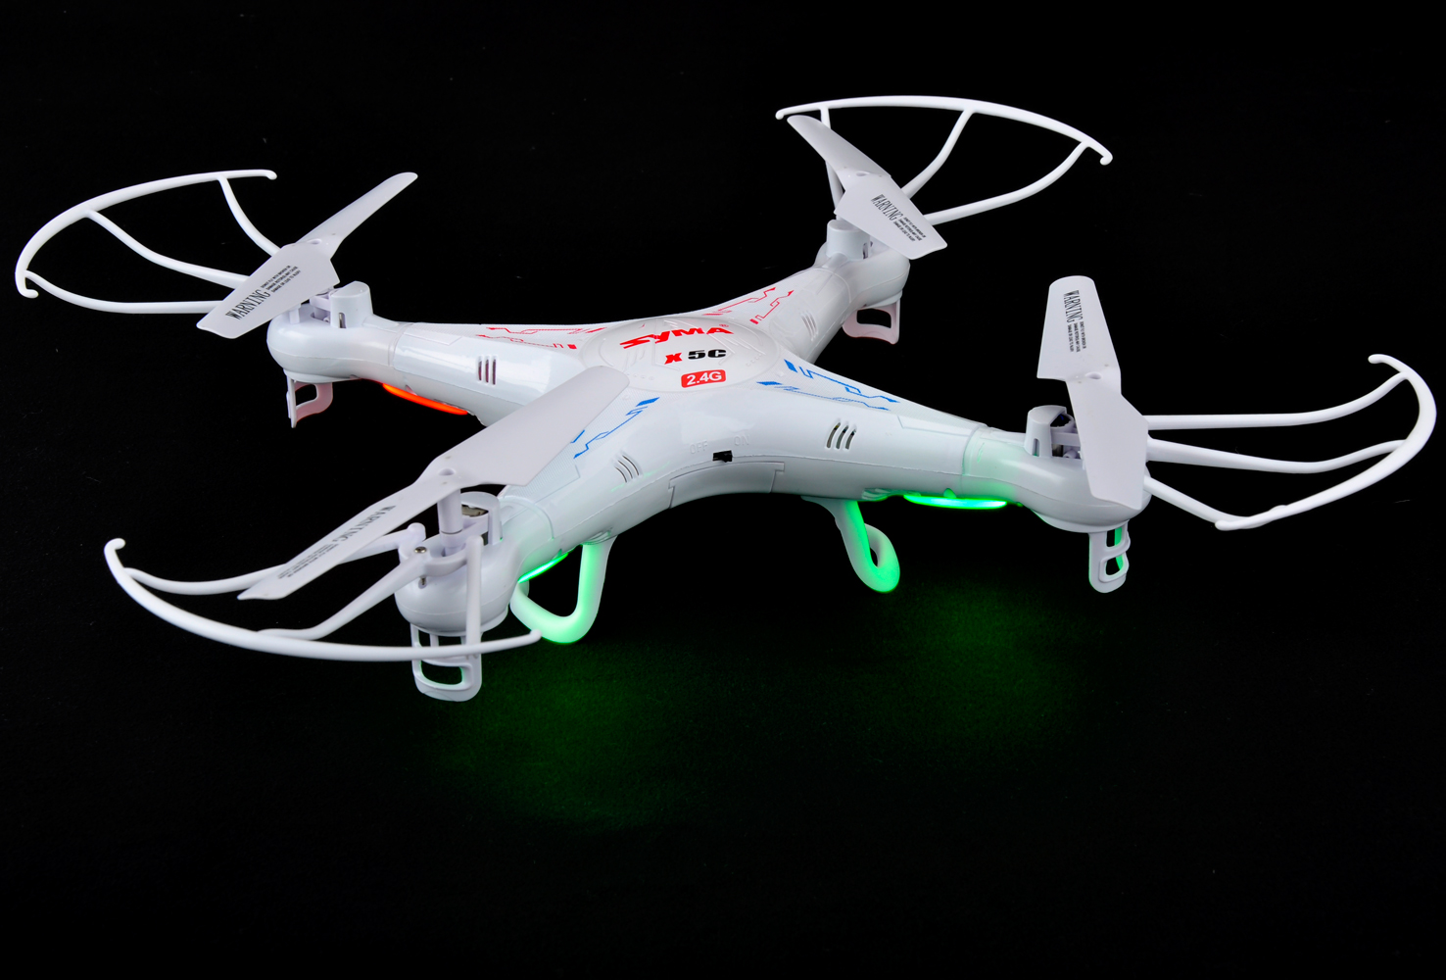
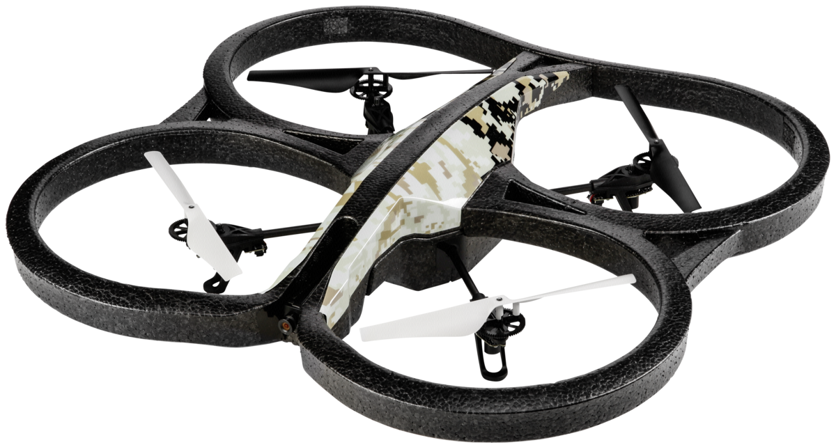

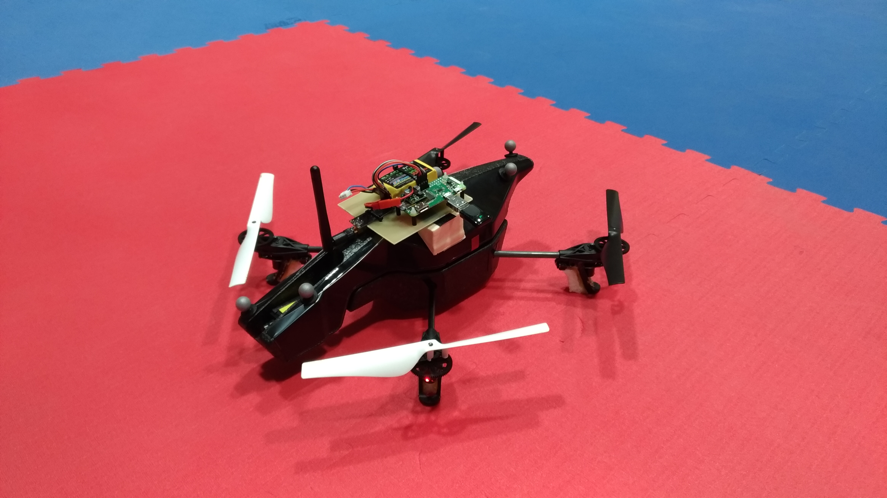
Project overall goal
Our goals:
  Reduced cost
  No drone falling implied
  High number of compatible drones
  Usable on public events, by civilians
Take control of multiple drones
  Some existing military solutions
  No civil solution

Slide 3



The Parrot AR.Drone 2.0
Developed by a French company
Released in 2012
Features:
  OS: Linux 2.6.32
  CPU: ARM Cortex A8
  Autonomy: 12”
  Optional GPS
Controlled by WiFi
  Opened WiFi network
  iOS/Android app
Vulnerable!

Slide 4



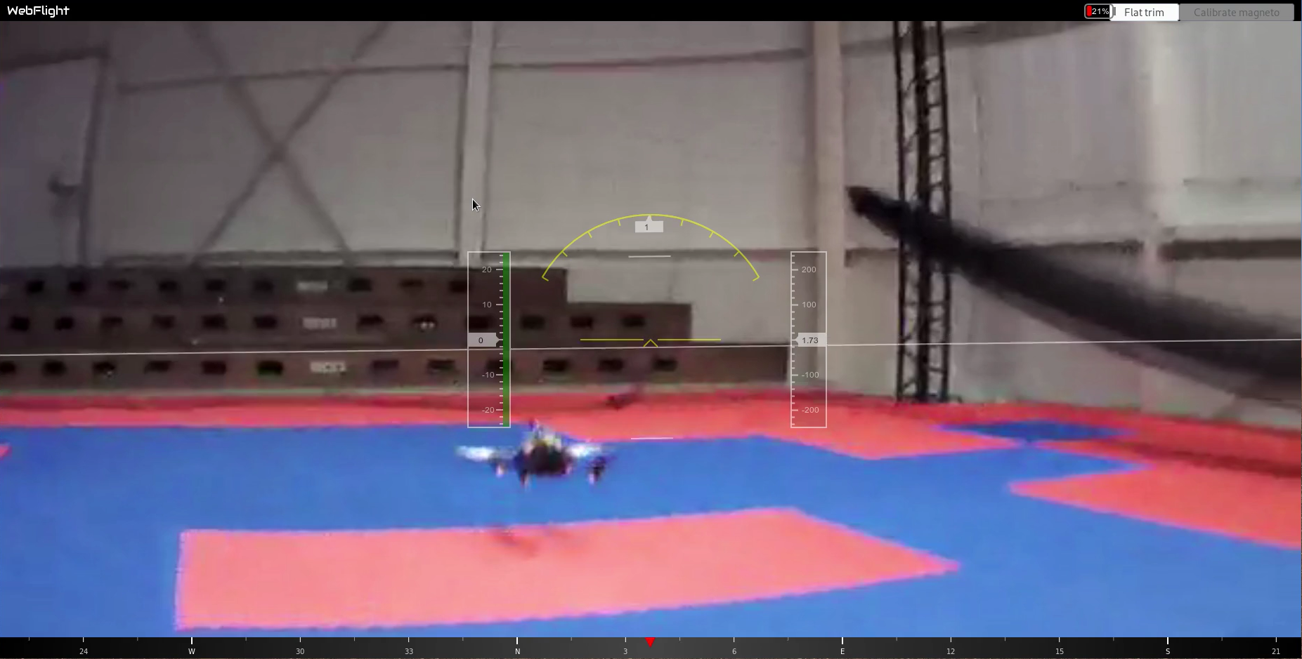







Attack principle
Based on a existing attack (Samy Kamkar)
  Discover drones’ WiFi network and clients
    Scapy sniff instead of airodump-ng
  Disconnect client from network
    aireplay-ng
  Connect to network
  Control the drone
    ardrone-webflight
Hacked connection
Real connection
Deauth. attack

Slide 5
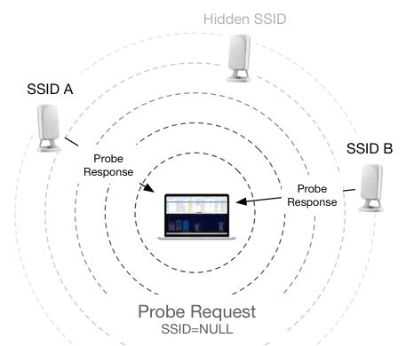
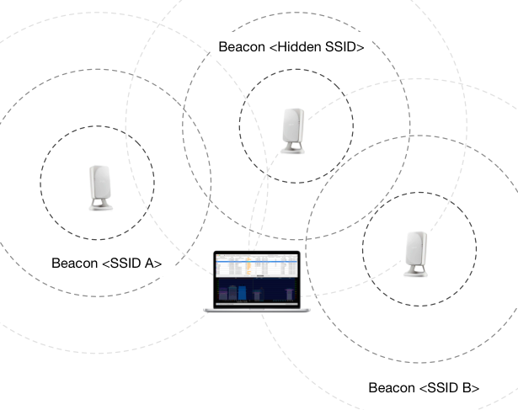
WiFi network discovering with Scapy
Active scan
Passive scan
90:03: b7:c8 :68: d0
Manufacturer filtering
Organisationally Unique Identifier (OUI)
Network Interface Controller (NIC) specific

Slide 6
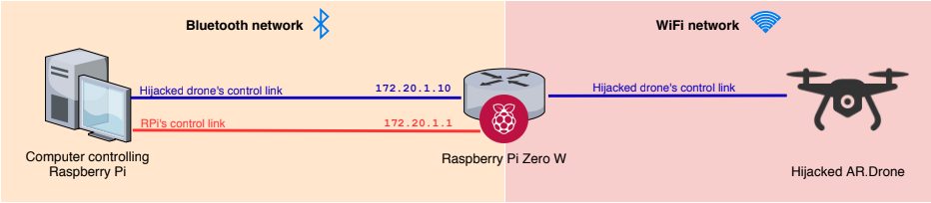
Embedding tool on a predator drone
Embedded tool on a Raspberry Pi Zero W
Tried reducing network adapter
  3 USB WiFi dongles tested
  Blacklisted driver
Network to control board:
  Bluetooth PAN
  ardrone-webflight moved to attacker’s computer

Slide 7


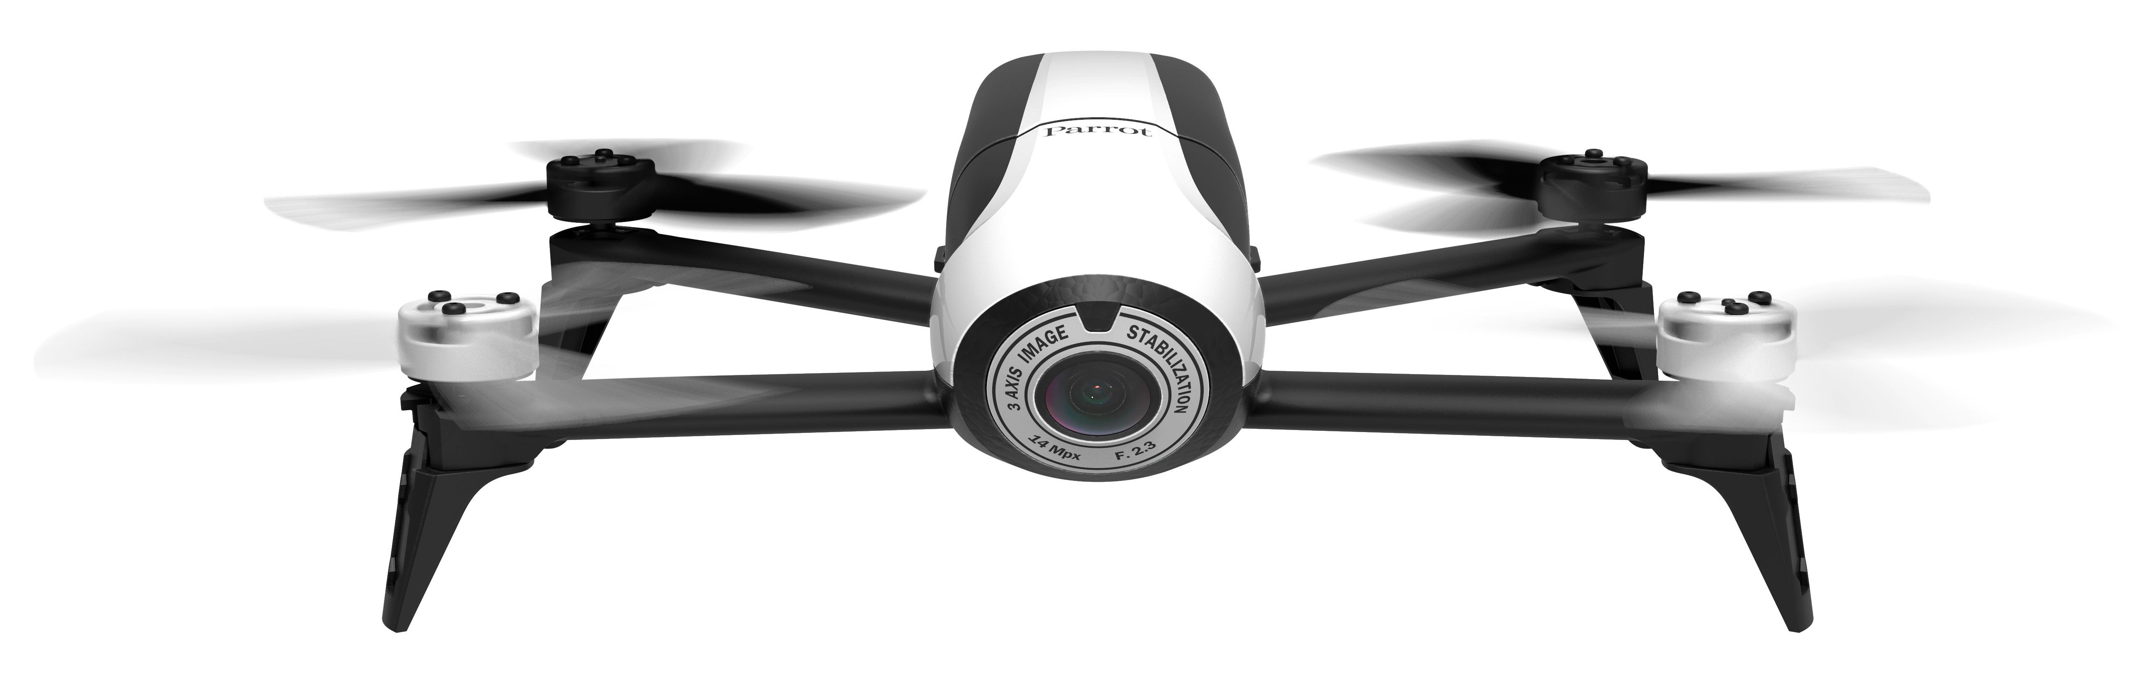
Protection means
Use Parrot’s solution
  Associate MAC address of real pilot
  Bypassed by MAC spoofing
Do not send beacon frames
  Active search of WiFi networks
  Eventually brute-force searching
Encrypt WiFi trafic
  Using WPA
  Parrot Bepop example
Parrot Bepop

Slide 8
Demo

