Slide 1


Florent Fayollas
Antoine Vacher
TLS-SEC
Syma X5C-1

Slide 2
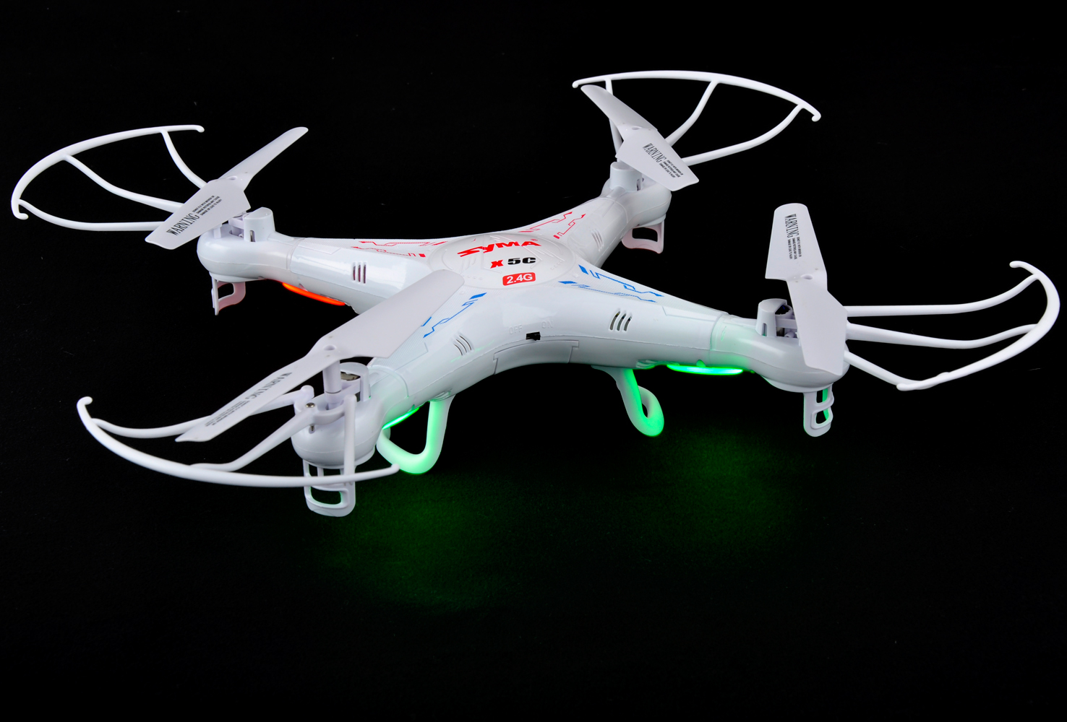
Introduction
The goal of the attack is to highjack a Syma X5C-1 Drone in flight
Documentation and markings tell us:
Not WIFI
Frequency band 2.4 GHz
4 Channels

Slide 3
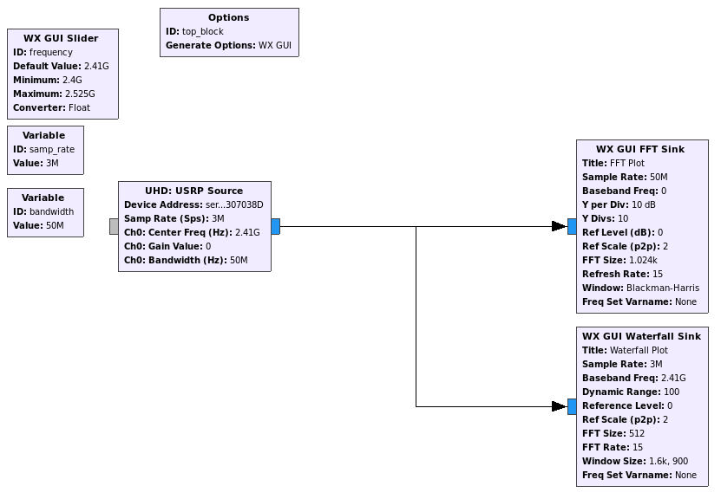
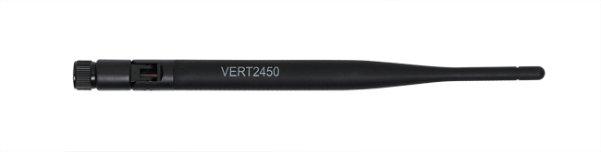
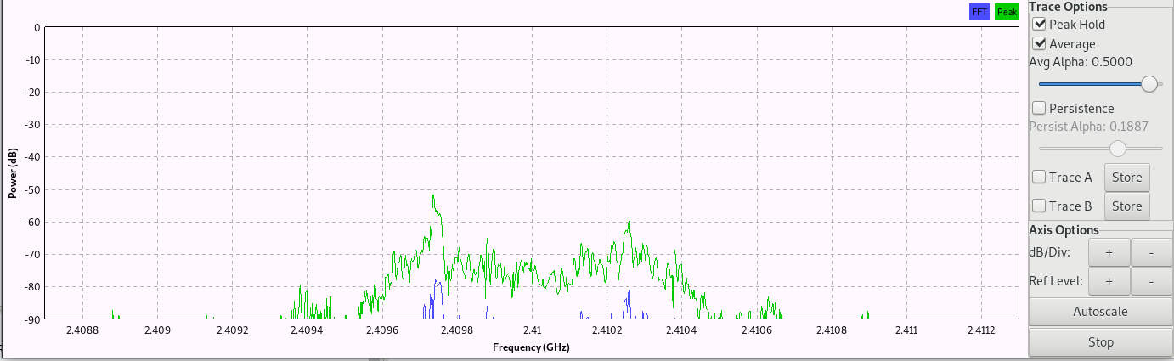
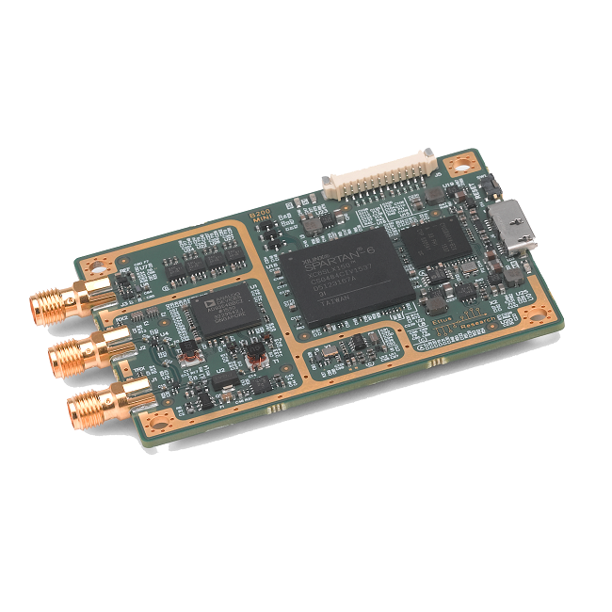
Step 1 – Finding Radio Channels
Using an USRP B200 SDR with GnuRadio :
USRP Source
FFT and Waterfall Sinks
Browse all channels by 1MHz steps
→ Tx power received on channels :
10 : 2.410 GHz
31 : 2.431 GHz
42 : 2.442 GHz
66 : 2.466 GHz

Slide 4
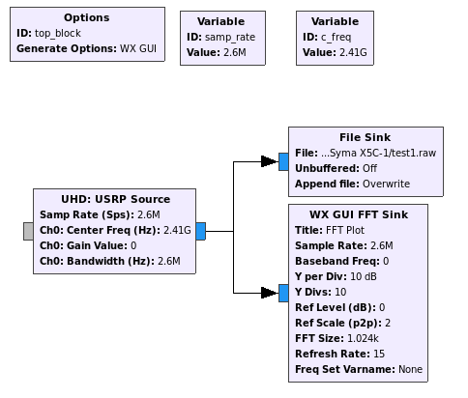
Step 2 – Finding Radio Modulation
Using an USRP B200 SDR with GnuRadio :
USRP Source
File Sink
Opening file with Baudline :
Constant amplitude → Not ASK. Could be (G)FSK or PSK

Slide 5
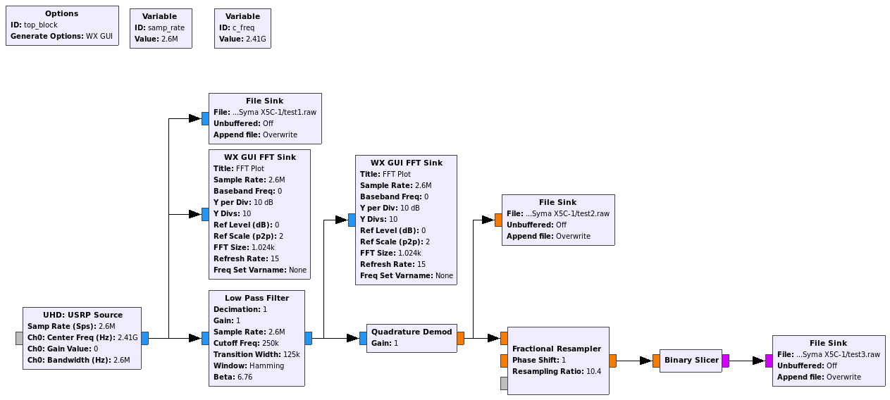
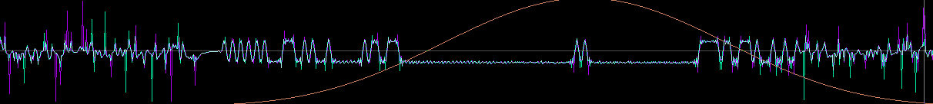
Step 2 – Finding Radio Modulation
Trying GFSK as it is widely used for small electronics
USRP Source
Low Pass Filter
Quadrature Demod
File Sink
Save bit stream
Opening file with Baudline :
Signal looked clean. Demodulation seemed to be correct : GFSK 250 Kbit/s

Slide 6
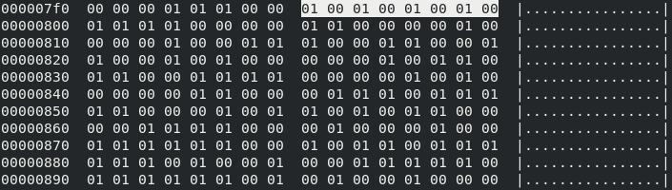
Step 3 – Understanding Data Link Layer
Noise
Tx
Init
0xAA
Data
We spot 1 byte 0b10101010 (0xAA)
→ This kind of preamble is mostly used for Rx synchronisation
Message is 18 bytes (including preamble)
hexdump -C test3.raw (recorded bit stream)

Slide 7
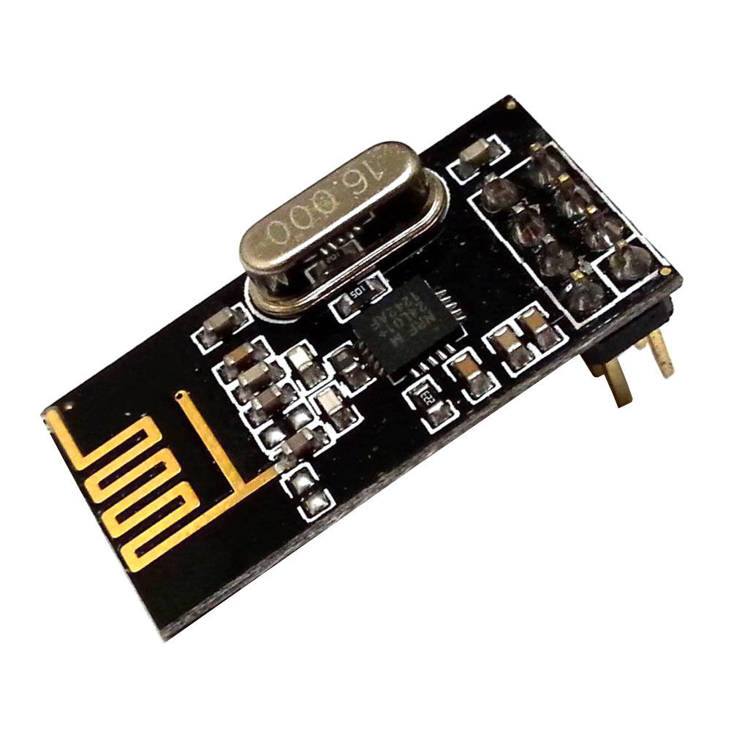

Step 3 – Understanding Data Link Layer
Introducing the nRF24l01+ module :
Transceiver GFSK 2.4GHz on SPI bus
Very popular module (on drones, RF mouses, DIY projects, …)
Come with 2 predefined packet based datalink layers (Basic or Enhanced Shockburst)
Using 0xAA or 0x55 as preamble
Using 3 to 5 bytes address
Using variable payload length (up to 32 bytes in basic mode)
Can use CRC on 1 or 2 bytes (optional)
Drone preamble is 0xAA which may mean that it is using a nR24l01+
→ Need to see if the rest of the frame matches

Slide 8
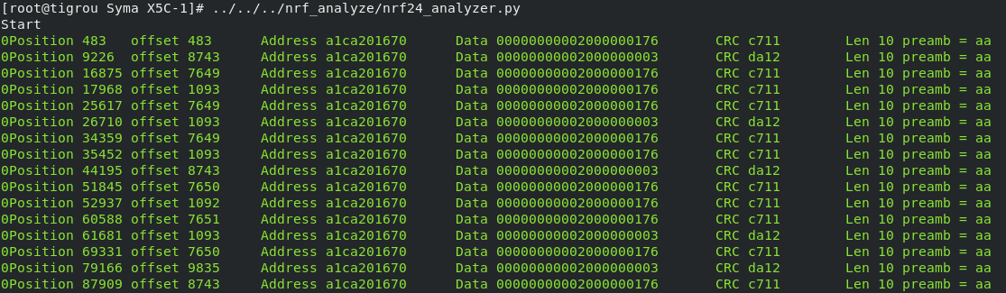
Step 3 – Understanding Data Link Layer
With the help of a python script, we guessed the field sizes from the bit stream recorded with GnuRadio
https://github.com/chopengauer/nrf_analyze/blob/master/nrf24_analyzer.py
In a nutshell :
Note : If we would not have had a SDR, we could have used a pseudo-promiscuous mode of the nRF24l01+ by tuning the module out of its specification. This is quite tricky. Refer to the full report for more information.

Slide 9
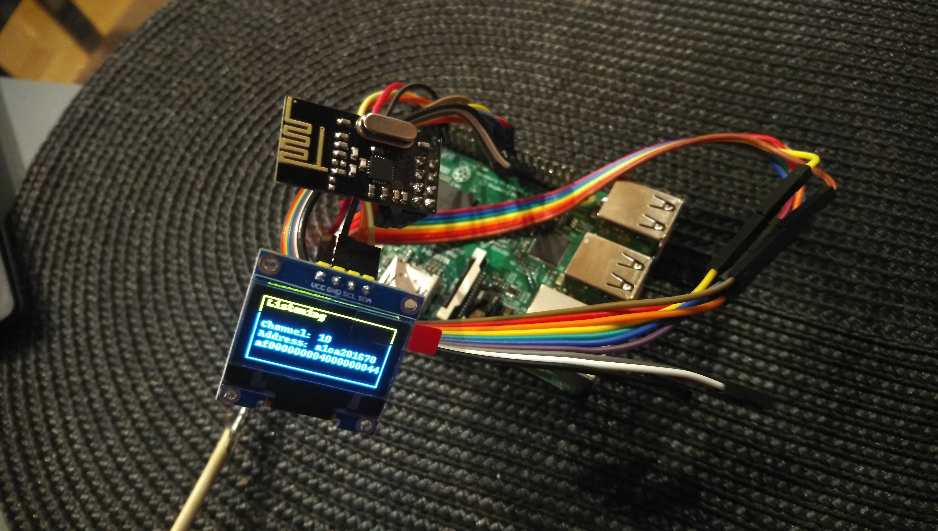
Step 4 – Understanding Syma Protocol
We built a live analyser
With Raspberry PI and nRF24l01+
OLED Screen added for THCon
→ By moving the RC controls, we could observe the payload.
Finally, Syma Protocol is quite simple...*
*Except Byte 10 : A pseudo CRC built as a XOR of bytes 1 to 9 and added to 0x55
… Now we were ready to implement !
… so we added a USB Gamepad, tuned the code …
… and finally attacked !

Slide 10
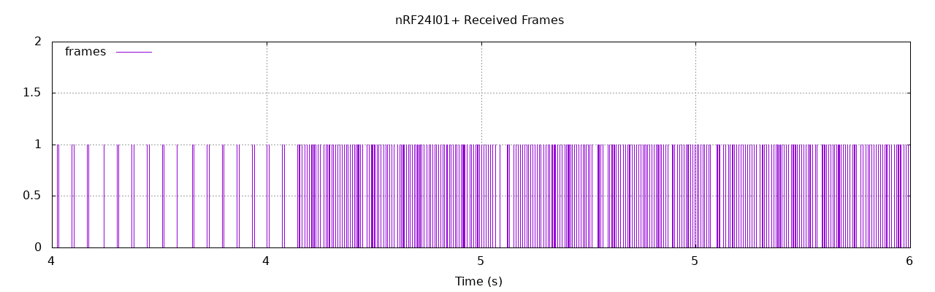
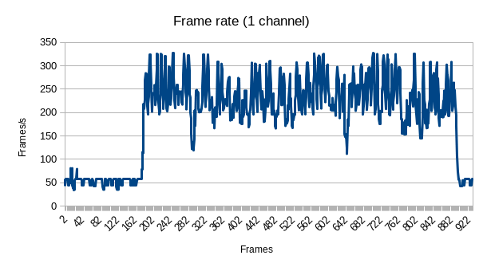
Attack Characteristics
Attack is only working when the drone is already paired with a controller
→ Some binding protocol exists (out of scope)
Drone receives orders both from legit pilot and from predator
→ Attack succeeds because the predator emits a lot more frames than the official remote
We created a logger with RPI and nRF24l01+ to visualize the difference
Start of Attack

Slide 11
Conclusion
Syma Protocol quite simple (1 byte per command, no encryption, ...)
Highjacking a Syma X5C-1 requires very few ressources :
  1 Raspberry Pi Zero W (~10€)
  1 nRF24l01+ (~0.5€)
  A few cables
  1 USB Gamepad (~5€)
Attack is :
  Hard to detect by the pilot
  Easy to detect by an engineer (SDR, ...)
  Almost impossible to stop without jamming and thus loosing the drone

