Slide 1


Florent Fayollas
Antoine Vacher
TLS-SEC
one drone to rule them all

Slide 2

Project overall goal
Take control of multiple drones
  Some existing military solutions
  No civil solution

Slide 3
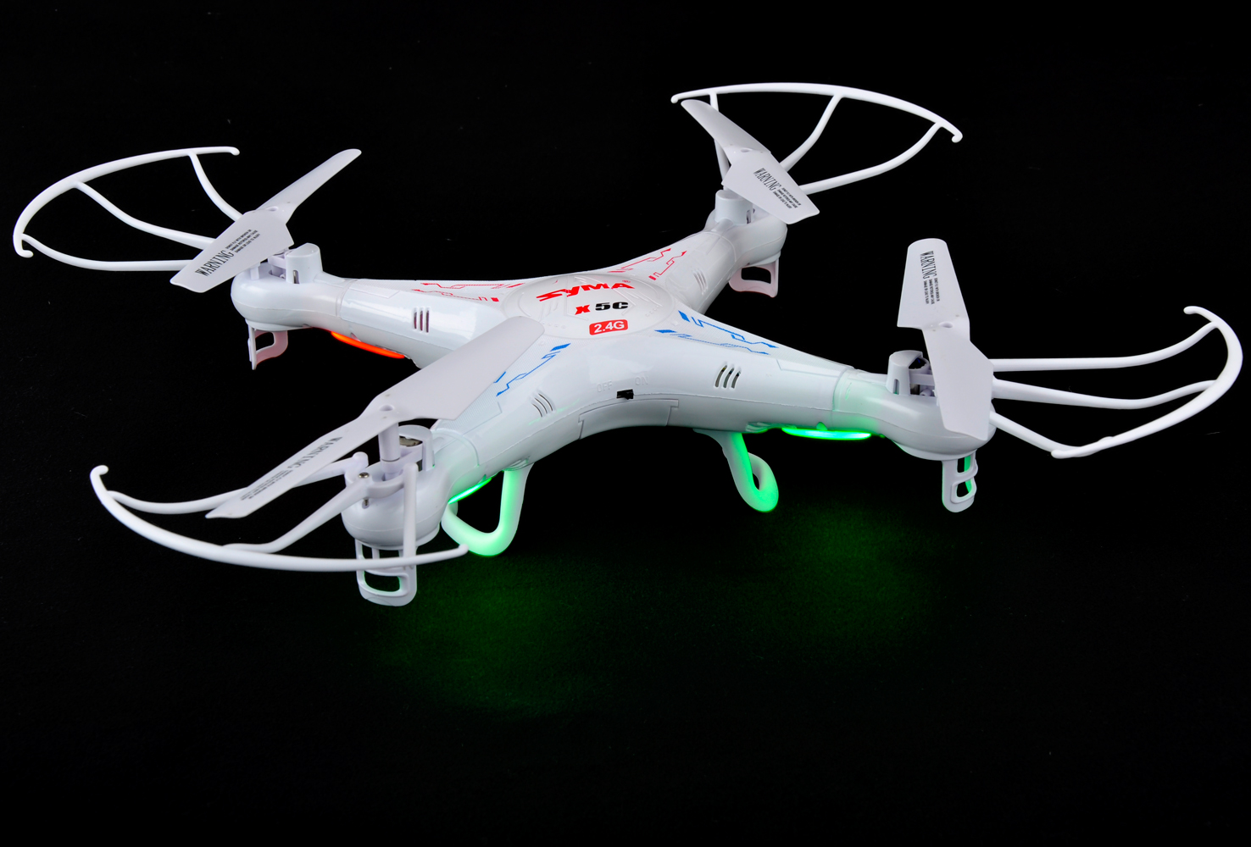
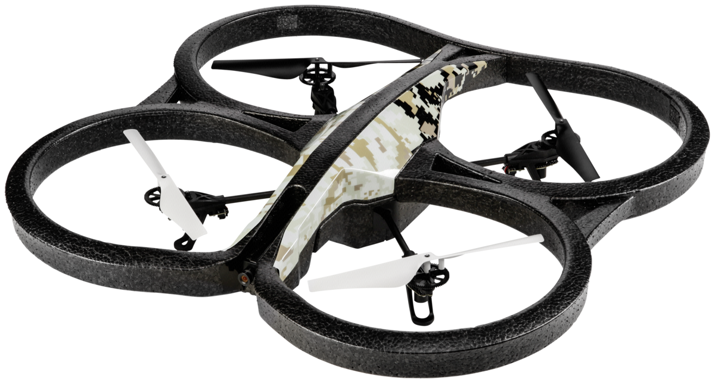
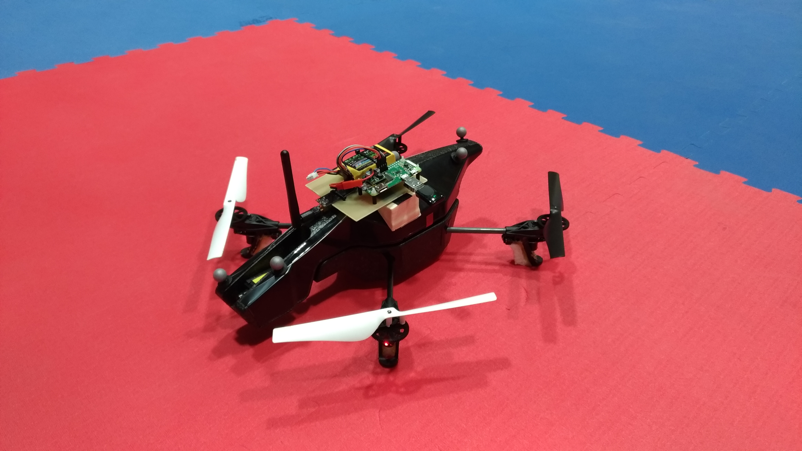
Project overall goal
Our goals:
  Reduced cost
  No drone falling implied
  High number of compatible drones
  Usable on public events, by civilians
Take control of multiple drones
  Some existing military solutions
  No civil solution

Slide 4
Syma – Introduction
The goal of the attack is to highjack a Syma X5C-1 Drone in flight
Documentation and markings tell us:
Not WIFI
Frequency band 2.4 GHz
4 Channels

Slide 5
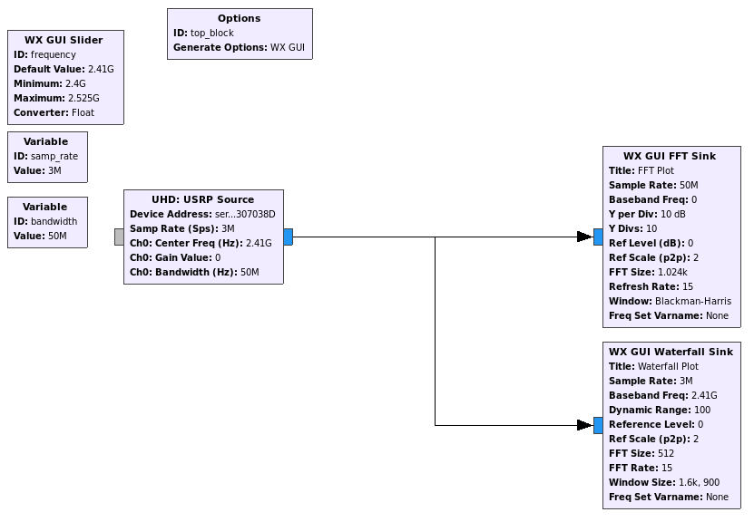
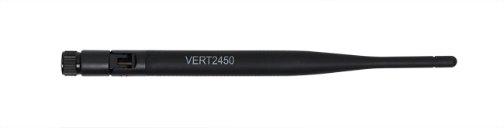
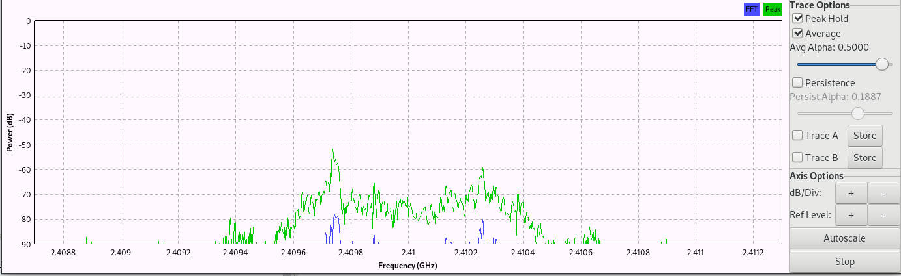
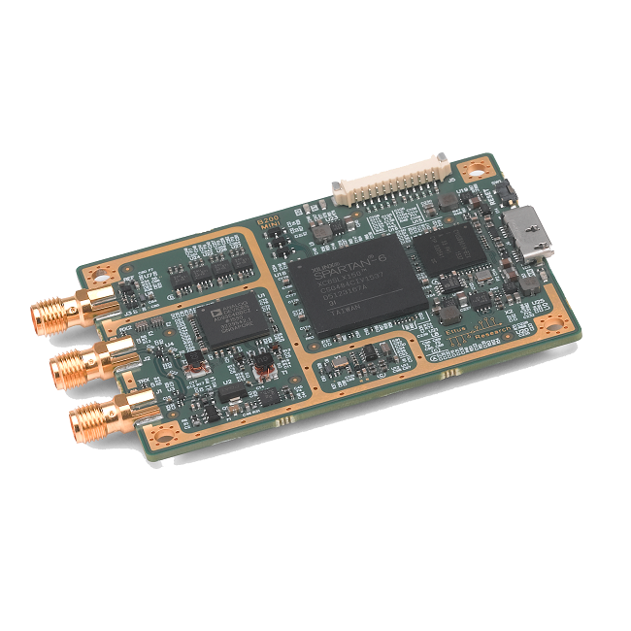
Syma – Step 1 – Finding Radio Channels
Using an USRP B200 SDR with GnuRadio :
USRP Source
FFT and Waterfall Sinks
Browse all channels by 1MHz steps
→ Tx power received on channels :
10 : 2.410 GHz
31 : 2.431 GHz
42 : 2.442 GHz
66 : 2.466 GHz

Slide 6
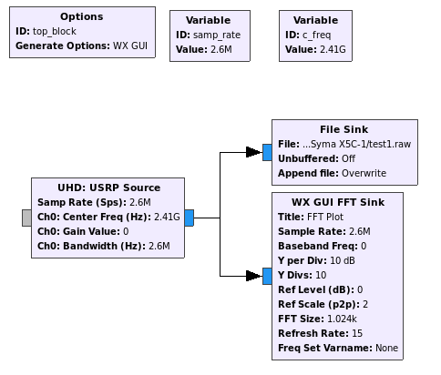
Syma – Step 2 – Finding Radio Modulation
Using an USRP B200 SDR with GnuRadio :
USRP Source
File Sink
Opening file with Baudline :
Constant amplitude → Not ASK. Could be (G)FSK or PSK

Slide 7
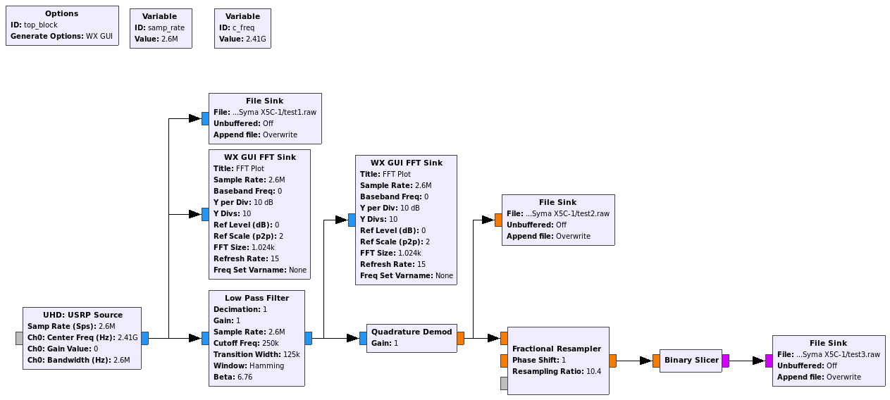
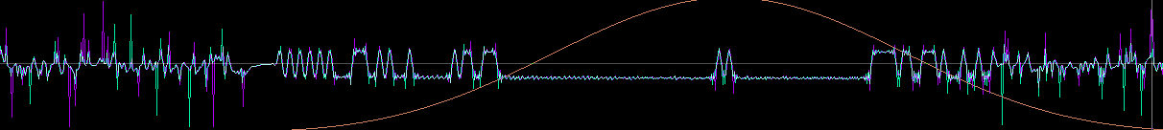
Syma – Step 2 – Finding Radio Modulation
Trying GFSK as it is widely used for small electronics
USRP Source
Low Pass Filter
Quadrature Demod
File Sink
Save bit stream
Opening file with Baudline :
Signal looked clean. Demodulation seemed to be correct : GFSK 250 Kbit/s

Slide 8
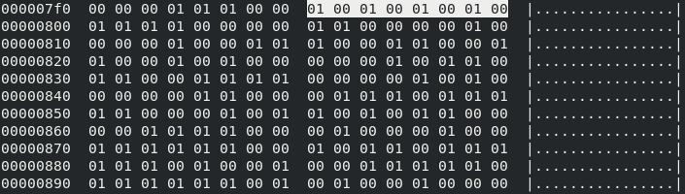
Syma – Step 3 – Understanding Data Link Layer
Noise
Tx
Init
0xAA
Data
We spot 1 byte 0b10101010 (0xAA)
→ This kind of preamble is mostly used for Rx synchronisation
Message is 18 bytes (including preamble)
hexdump -C test3.raw (recorded bit stream)

Slide 9
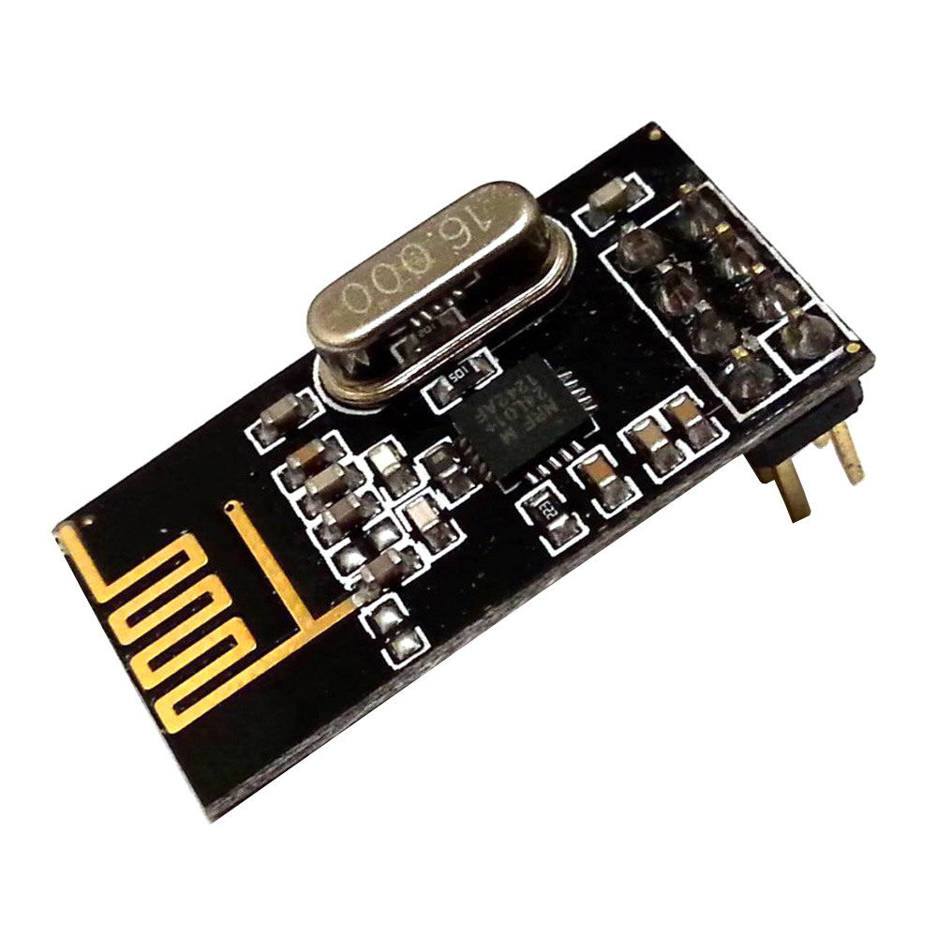

Syma – Step 3 – Understanding Data Link Layer
Introducing the nRF24l01+ module :
Transceiver GFSK 2.4GHz on SPI bus
Very popular module (on drones, RF mouses, DIY projects, …)
Come with 2 predefined packet based datalink layers (Basic or Enhanced Shockburst)
Using 0xAA or 0x55 as preamble
Using 3 to 5 bytes address
Using variable payload length (up to 32 bytes in basic mode)
Can use CRC on 1 or 2 bytes (optional)
Drone preamble is 0xAA which may mean that it is using a nR24l01+
→ Need to see if the rest of the frame matches

Slide 10
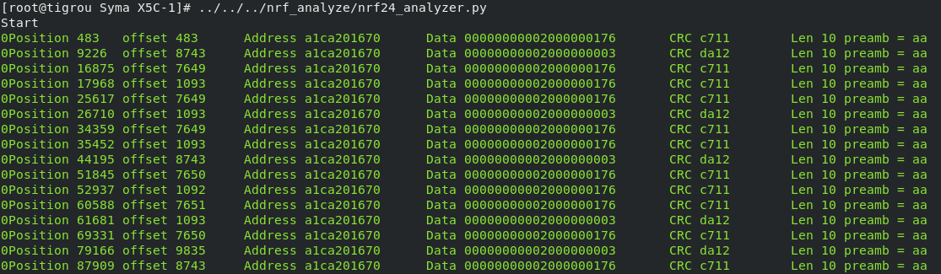
Syma – Step 3 – Understanding Data Link Layer
With the help of a python script, we guessed the field sizes from the bit stream recorded with GnuRadio
https://github.com/chopengauer/nrf_analyze/blob/master/nrf24_analyzer.py
In a nutshell :
Note : If we would not have had a SDR, we could have used a pseudo-promiscuous mode of the nRF24l01+ by tuning the module out of its specification. This is quite tricky. Refer to the full report for more information.

Slide 11
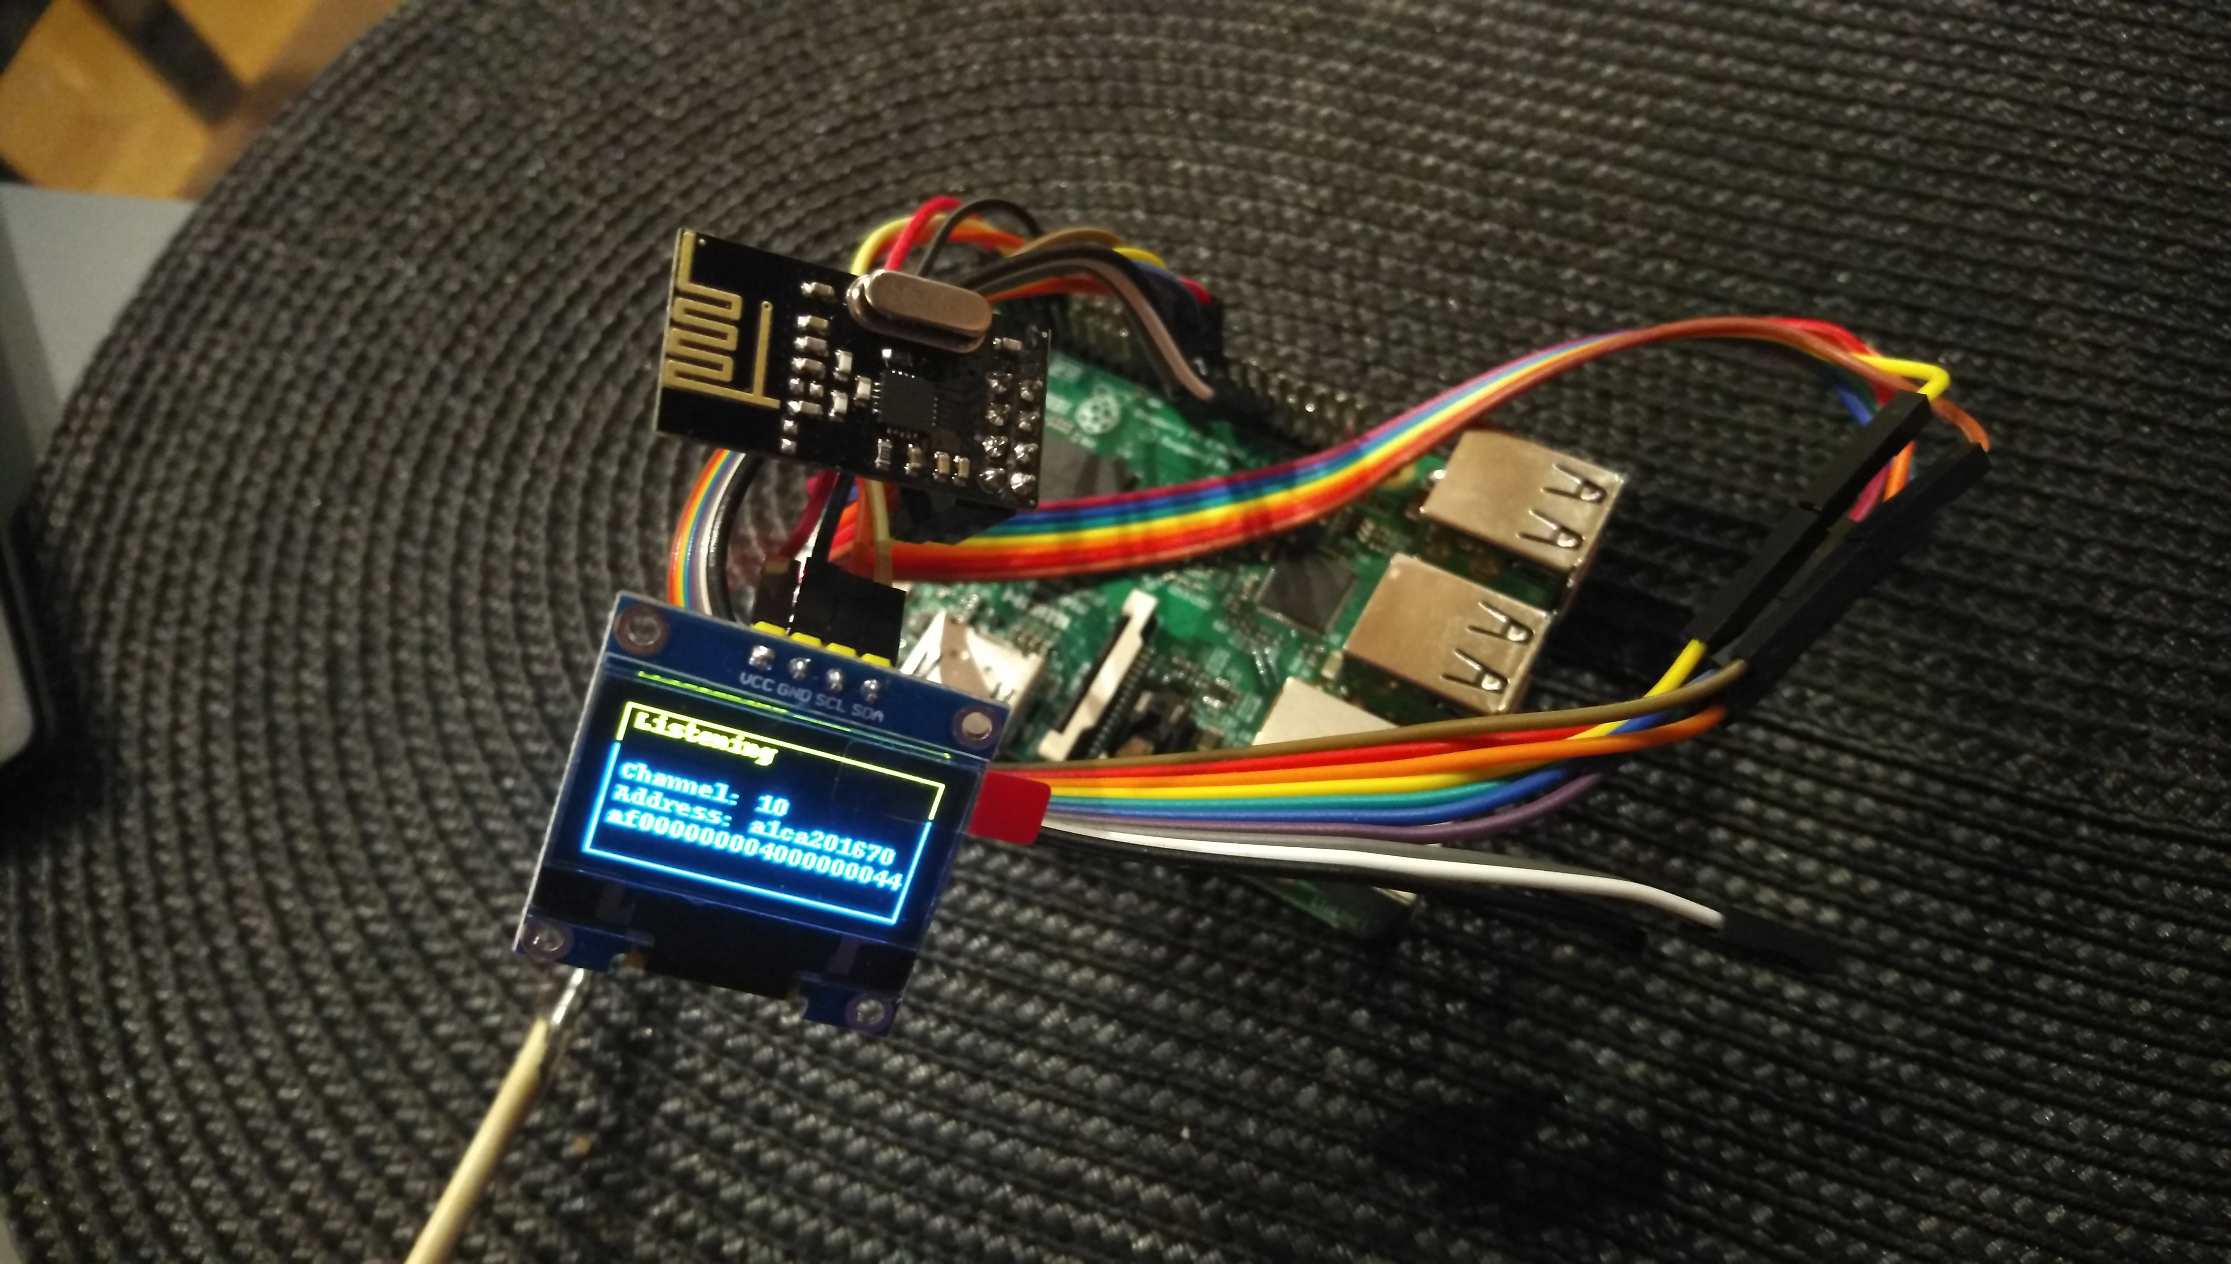
Syma – Step 4 – Understanding Syma Protocol
We built a live analyser
With Raspberry PI and nRF24l01+
OLED Screen added for THCon
→ By moving the RC controls, we could observe the payload.
Finally, Syma Protocol is quite simple...*
*Except Byte 10 : A pseudo CRC built as a XOR of bytes 1 to 9 and added to 0x55
… Now we were ready to implement !
… so we added a USB Gamepad, tuned the code …
… and finally attacked !

Slide 12
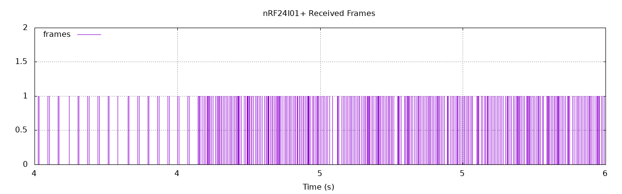
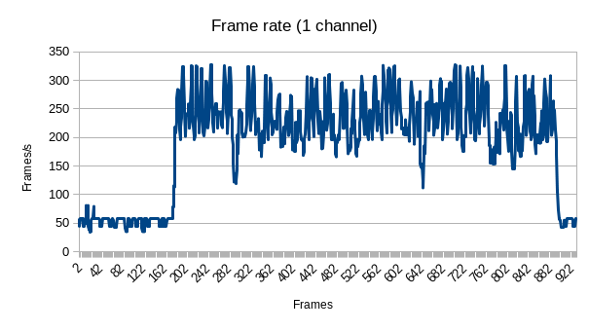
Syma – Attack Characteristics
Attack is only working when the drone is already paired with a controller
→ Some binding protocol exists (out of scope)
Drone receives orders both from legit pilot and from predator
→ Attack succeeds because the predator emits a lot more frames than the official remote
We created a logger with RPI and nRF24l01+ to visualize the difference
Start of Attack

Slide 13
Syma – Conclusion
Syma Protocol quite simple (1 byte per command, no encryption, ...)
Highjacking a Syma X5C-1 requires very few ressources :
  1 Raspberry Pi Zero W (~10€)
  1 nRF24l01+ (~0.5€)
  A few cables
  1 USB Gamepad (~5€)
Attack is :
  Hard to detect by the pilot
  Easy to detect by an engineer (SDR, ...)
  Almost impossible to stop without jamming and thus loosing the drone

Slide 14


The Parrot AR.Drone 2.0
Developed by a French company
Released in 2012
Features:
  OS: Linux 2.6.32
  CPU: ARM Cortex A8
  Autonomy: 12”
  Optional GPS
Controlled by WiFi
  Open WiFi network
  iOS/Android app

Slide 15

The Parrot AR.Drone 2.0
Developed by a French company
Released in 2012
Features:
  OS: Linux 2.6.32
  CPU: ARM Cortex A8
  Autonomy: 12”
  Optional GPS
Controlled by WiFi
  Open WiFi network
  iOS/Android app
Vulnerable!

Slide 16


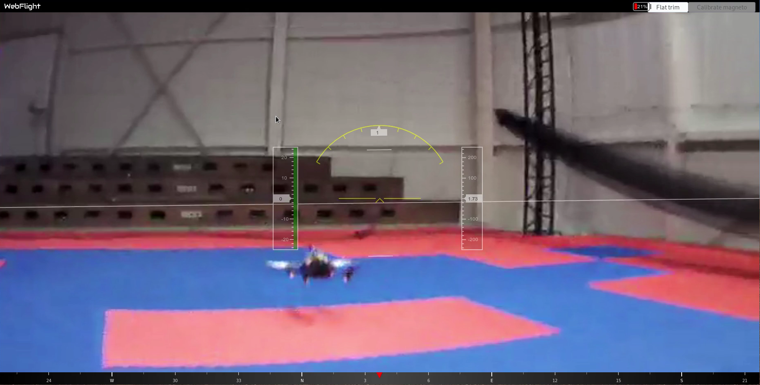




Parrot – Attack principle
Based on a existing attack (Samy Kamkar)
  Discover drones’ WiFi network and clients
    Scapy sniff instead of airodump-ng
  Disconnect client from network
    aireplay-ng
  Connect to network and control the drone
    ardrone-webflight
Real connection
Notes:
+ 2 wifi dongles

Slide 17


Parrot – Attack principle
Based on a existing attack (Samy Kamkar)
  Discover drones’ WiFi network and clients
    Scapy sniff instead of airodump-ng
  Disconnect client from network
    aireplay-ng
  Connect to network and control the drone
    ardrone-webflight
Real connection
Deauth. attack
Notes:
+ 2 wifi dongles

Slide 18


Parrot – Attack principle
Based on a existing attack (Samy Kamkar)
  Discover drones’ WiFi network and clients
    Scapy sniff instead of airodump-ng
  Disconnect client from network
    aireplay-ng
  Connect to network and control the drone
    ardrone-webflight
Hacked connection
Deauth. attack
Notes:
+ 2 wifi dongles

Slide 19
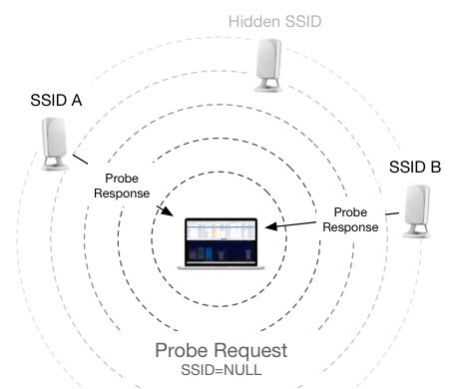
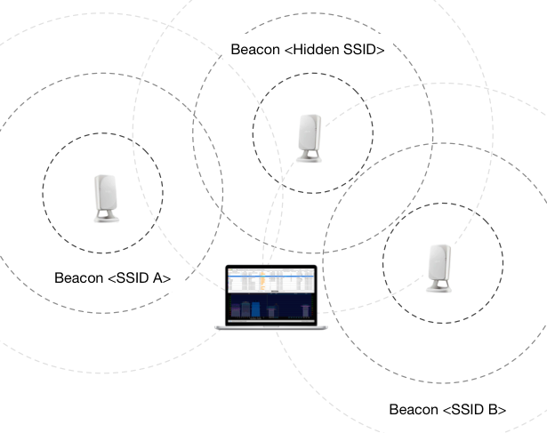
Parrot – WiFi network discovering with Scapy
Active scan
Passive scan

Slide 20
Parrot – WiFi network discovering with Scapy
Active scan
Passive scan
90:03: b7:c8 :68: d0

Slide 21
Parrot – WiFi network discovering with Scapy
Active scan
Passive scan
90:03: b7:c8 :68: d0
Organisationally Unique Identifier (OUI)
Network Interface Controller (NIC) specific

Slide 22
Parrot – WiFi network discovering with Scapy
Active scan
Passive scan
90:03: b7:c8 :68: d0
Manufacturer filtering
Organisationally Unique Identifier (OUI)
Network Interface Controller (NIC) specific

Slide 23
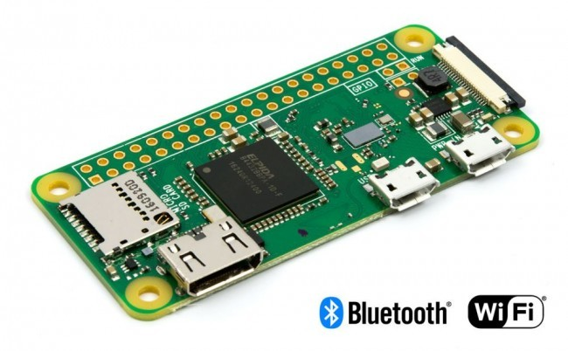
Parrot – Embedding tool on a predator drone
Raspberry Pi Zero W
  Bluetooth adapter
  WiFi adapter
  SPI bus
  Lightweight
Notes:
- tried to use only one WiFi adapter
+ 3 dongles
+ driver blacklisted

Slide 24
Parrot – Embedding tool on a predator drone
Raspberry Pi Zero W
  Bluetooth adapter
  WiFi adapter
  SPI bus
  Lightweight
Tried reducing network adapter count
Notes:
- tried to use only one WiFi adapter
+ 3 dongles
+ driver blacklisted

Slide 25
Parrot – Embedding tool on a predator drone
Raspberry Pi Zero W
  Bluetooth adapter
  WiFi adapter
  SPI bus
  Lightweight
Tried reducing network adapter count
Network to control board:
  Bluetooth PAN
  SSH connection
Notes:
- tried to use only one WiFi adapter
+ 3 dongles
+ driver blacklisted

Slide 26
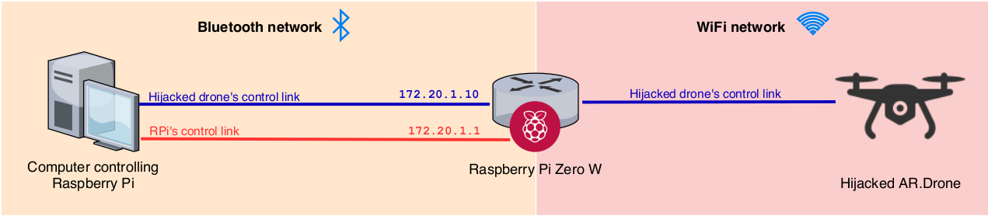
Parrot – Embedding tool on a predator drone
Raspberry Pi Zero W
  Bluetooth adapter
  WiFi adapter
  SPI bus
  Lightweight
Tried reducing network adapter count
Network to control board:
  Bluetooth PAN
  SSH connection
ardrone-webflight moved to attacker’s computer
Notes:
- tried to use only one WiFi adapter
+ 3 dongles
+ driver blacklisted

Slide 27



Parrot – Protection means
Use Parrot’s solution
  Associate MAC address of real pilot
  Bypassed by MAC spoofing
Do not send beacon frames
  Active search of WiFi networks
  Eventually brute-force searching
Encrypt WiFi trafic
  Using WPA
  Parrot Bepop example
Parrot Bepop

Slide 28
Drone-predator hacking Parrot – Demo

Slide 29
Conclusion
Objective reached
Learned a lot of things (WiFi, RF, Electronics, …)
Ressources from n7 and ENAC
And it is always fun to fly drones :-)

Slide 30
Questions
questions

Slide 31
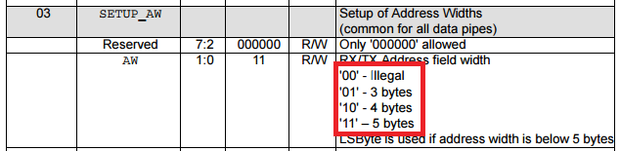
Promiscous mode with nRF24l01+
No promiscuous mode but :
- Receiver does not check for preamble (0xAA), just checking the address
- Part before preamble is often interpreted as 0x00
- Configuration register can be set at ‘00’ even if it is out of spec. In this case the addess is 2 bytes
→ We can configure pseudo-promiscous mode by setting 0x00AA as a receiver address.

