Slide 1
Default Probability Prediction
Valeriia Klimova, Tigran Oganesian, Jan Pikman, Juraj Žilt
December 2023

Slide 2

Introduction
For financial institutions, accurately predicting loan repayment is crucial for prudent decision-making and risk management.
Our case study is to estimate the probability of default for people who have obtained a loan through Bondora.
Bondora
Peer-to-peer lending platform that facilitates loans between borrowers and investors.
Aims to help individuals who face barriers to accessing traditional bank loans.
Has been known to operate in Estonia, Finland, Spain, the Netherlands and Slovakia.

Slide 3
Dataset
LoanData.csv Overview
OurLoanData.csv Overview
344 021 rows, 112 columns
From 2009-02-28 to 2023-11-30
Successfully repaid: 102 917
Defaulted: 112 731
344 021 rows, 112 columns
34 745 rows, 22 columns
From 2009-02-28 to 2017-06-02 (due to GDPR)
Successfully repaid: 15 198
Defaulted: 19 547
Dataset contains data only about the applicants who received the loan. (!)

Slide 4
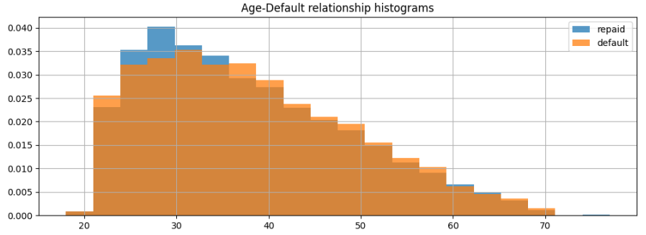
Dataset
Overlay histograms constructed from the age predictor for repaid and defaulted loans.
As we can see, borrowers aged 23-35 show higher likelihood of successful loan repayment, while older borrowers are somewhat more likely to default.

Slide 5
Other Approaches
We examined four distinct approaches, and in each case, identified a mistake that significantly altered the outcomes.
These approaches leveraged machine learning techniques, including XGBoost and Decision Tree Classifier, resulting in an AUC of 99%.
Most common mistake: Utilization of features that may not be known before the default.
Thus, meaningful comparisons with their work may be challenging, given their methodologies overlook certain nuances and subtleties.

Slide 6
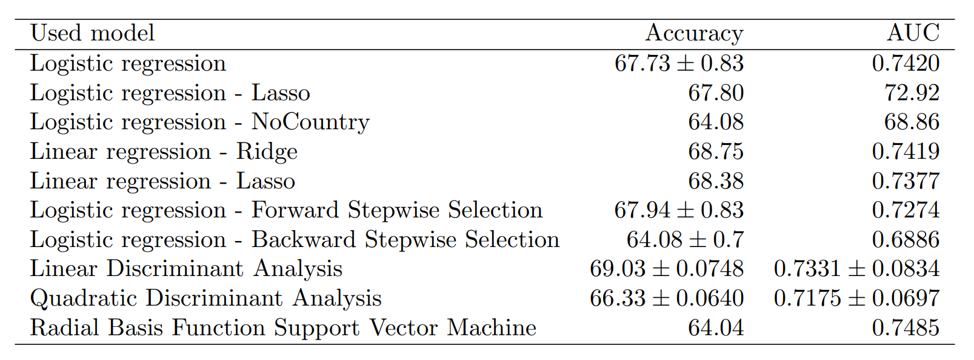
Models and Results
We used a variety of methods studied in SAN course to complement our analysis, including:
Logistic regression.
Lasso and Ridge regressions.
Forward and Backward stepwise selections.
Dimension reduction by LDA and QDA.

Slide 7
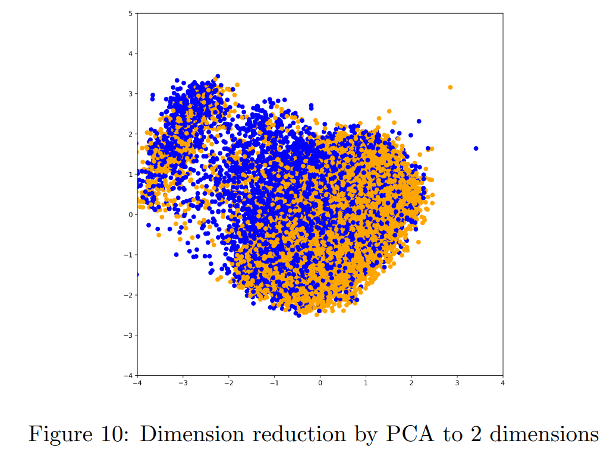
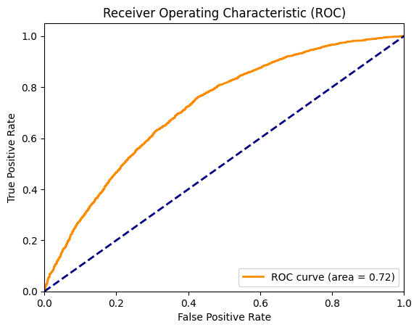
Conclusion
Dimensionality reduction techniques reveal the intricate data structure, making it challenging to distinctly separate default and non-default cases.
Despite the complexity, we were able to reasonably predict the default using linear models w.r.t. data complexity.

Slide 8
Thank You for Your Attention
The Google Drive link for the project can be found here.

