Slide 1

Microsimulation comparison with EAGLES placebo data
clinical trial data
function ALACRITY_Markov_CA_PPA
%----------------------------------------------------------------------------------------------
% Simple Markov model to produce the CA and PPA results of the EAGLES trials
%----------------------------------------------------------------------------------------------
% Parameters
% j = person (1~N)
% i = week (1~24)
% Prob[person j will abstain in week i] = probs(j) is constant (for each person j)
% probs(j) is shown in the right of figure 100
% modelNumber = 1 or 2 depending on the model for probs(j)
% = 1 for a polynomial model (probs(j) is a polynomial function of j)
% = 2 for a step-wise model (probs(j) is a step function of j)
% S(i,j) = state in week i, person j
% = 1 if abstain or 0 if smoke
%----------------------------------------------------------------------------------------------
nt = 24; % number of weeks
N = 1026; % number of patients
S0 = zeros(nt,N); % states, steady-state probabilities
S = S0; % non-steady-state
modelNumber = 2; % choose the type of model for the probabilities
models = {'polynomial','step'}; % model names
model = models{modelNumber}; % model
switch model
case 'polynomial'
p0 = [0.00 0.99]; % parameters for polynomial model
case 'step'
p0 = [0.022 1.00 % Prob[abstain] = 100% for 4% of population
0.12 0.945 % Prob[abstain] = 97% for 8% of population
1.00 0.045]; % Prob[abstain] = 5% for 88% of population
end
[ probs,rhos ] = probA((1:N)/N,p0,model); % probs = piA, rhos = pS/pA for each patient
rate = 0.4; % rate towards equilibrium, pS = rho*pA, pA = piA*rate
for j=1:N % for each patient
for i=1:nt % for each week
p = probs(j); % get the probability of A
pA = p*rate;
pS = rhos(j)*pA;
S0(i,j) = rand(1,1)<p; % indicator for A (1=abstain, 0=smoke during week i)
if i==1
S(i,j) = 0; % initial condition
else
S1 = S(i-1,j); % previous condition
if S1 % abstain
S(i,j) = rand(1,1)<1-pS; % Prob[abstain|abstain] = 1-pS
else % smoking
S(i,j) = rand(1,1)<pA; % Prob[abstain|smoking] = pA
end
end
end
end
CA12 = all(S0(9:12,:)); % indicator for CA (weeks 9~12)
CA24 = all(S0(9:24,:)); % indicator for CA (weeks 9~24)
PPA = mean(S0,2); % weekly PPA
ca12 = all(S( 9:12,:)); % indicator for CA (weeks 9~12)
ca24 = all(S( 9:24,:)); % indicator for CA (weeks 9~24)
ppa = mean(S, 2); % weekly PPA
t = 1:nt; % time (weeks)
%----------------------------------------------------------------------------------------------
% Compare with placebo result (PPA = 15%, CA12 = 11%, CA24 = 8%)
%----------------------------------------------------------------------------------------------
fig = figure(100); fig.Name = 'PPA and prob'; fig.Color = 'w';
subplot(1,3,[1 2])
plot(t,100*PPA,'bo-',t,100*ppa,'ro-'), xlabel('week'), ylabel('7-day PPA')
title(sprintf('PPA versus time, CA (weeks 9~12) = %.1f%%, %.1f%%, CA (weeks 9~24) = %.1f%%, %.1f%%',...
mean(CA12)*100,mean(ca12)*100,mean(CA24)*100,mean(ca24)*100))
ax = gca; ax.YLim = [0 50];
subplot(1,3,3)
area((1:N)/N*100,probs*100)
xlabel('proportion of patients (%)'), ylabel('probability'), title('Probability of 1-week abstinance')
ax = gca; ax.YLim = [0 100];
fig = figure(110); fig.Name = 'PPA'; fig.Color = 'w';
plot(t,100*ppa,'ro-')
ax = gca; ax.YLim = [0 50]; ax.XLim = [0 24]; ax.YTickLabel = {}; ax.XTickLabel = {};
figure(99), imagesc(S');
fig = figure(120); fig.Name = 'individuals'; fig.Color = 'w';
iks = [90 92 94 100 120 123 124]; % indices of individuals to plot
for i=1:length(iks) % for each individual
ik = iks(i); % get the index
Sik = S(:,ik); % get the states over time
for j=1:nt % for each time interval
if Sik(j)==1
plot([j-1 j],[1 1]*i,'b-','Linewidth',6), hold on
end
end
end
ax = gca; ax.XLim = [0 nt]; ax.XTick = [0:4:24]; hold off
ax.FontSize = 16; xlabel('Week'); ylabel('simulated individual ID'), grid on
title(sprintf('Sample of microsimulation results\n'))
keyboard
function [ p,rho ] = probA( x, param, type )
%----------------------------------------------------------------------------------------------
% Probability of abstaining in one week
%----------------------------------------------------------------------------------------------
switch type
case 'polynomial'
p = param(2)*x.^4 + param(1)*(1-x.^4);
case 'step'
for i=1:length(x)
j = find(x(i)<=param(:,1),1,'first'); % last column of param(1,:) less than x(i)
p(i) = param(j,2); % get Prob[abstain]
end
end
rho = (1-p)./p; % rho = pS / pA
microsimulation
code

Slide 2
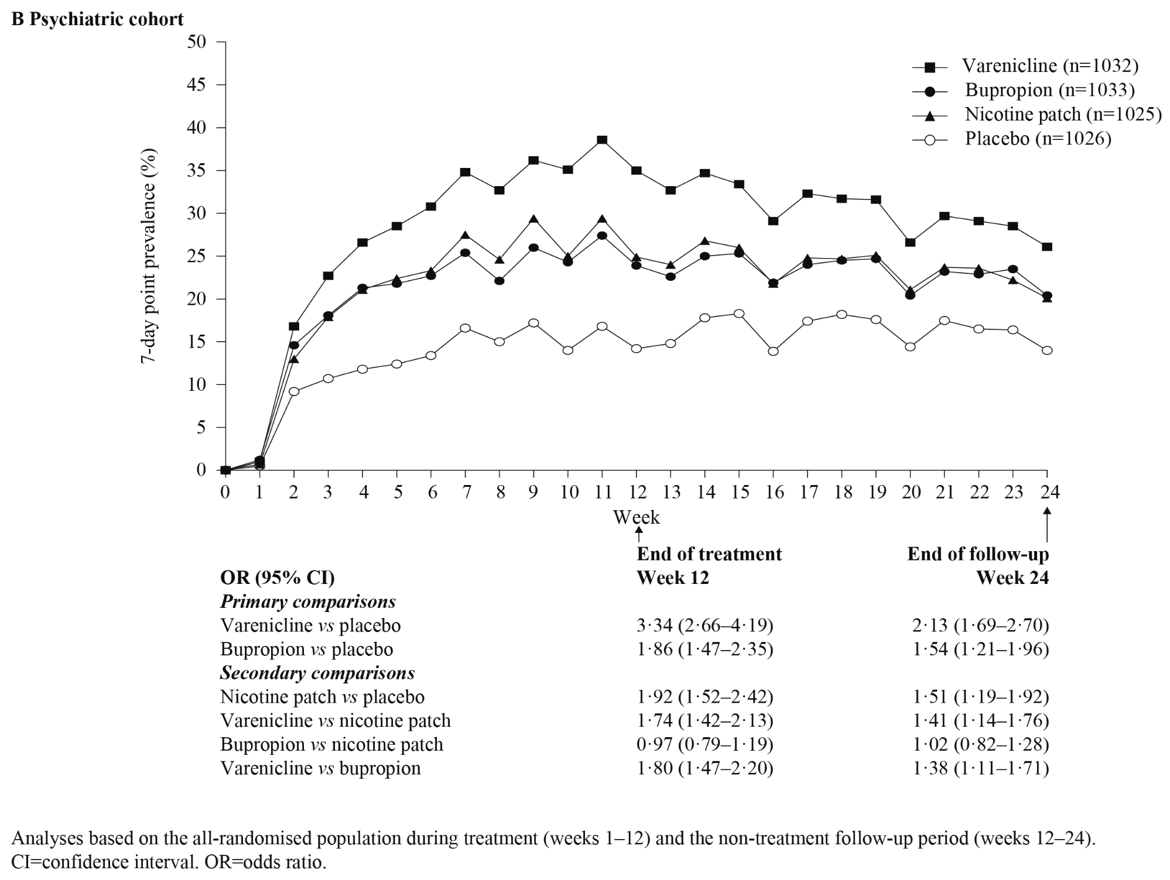
Microsimulation comparison with EAGLES placebo: 7-day PPA
microsimulation

Slide 3
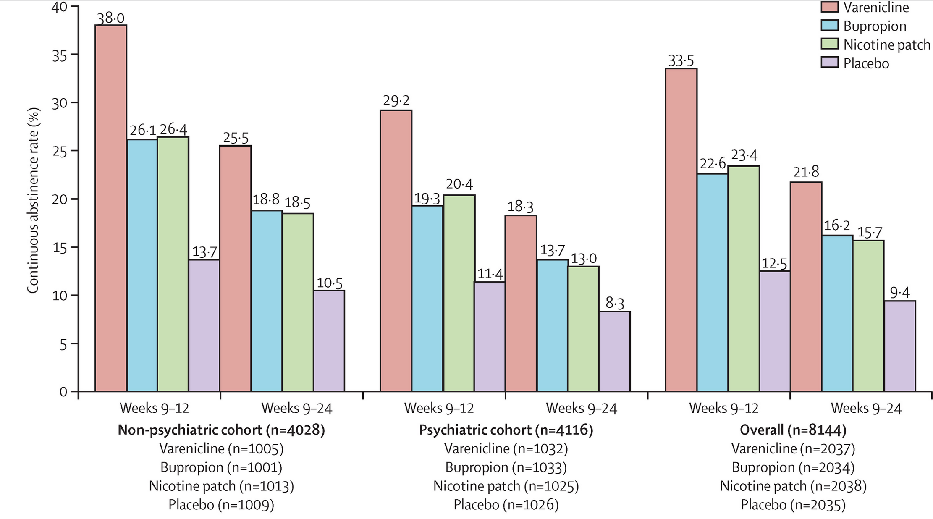
Microsimulation comparison with EAGLES placebo: CA (weeks 9-12, 9-24)
microsimulation
11.3
8.0

Slide 4
Microsimulation sample data
CA Weeks 9-12
CA Weeks 9-12
CA Weeks 9-24

Slide 5
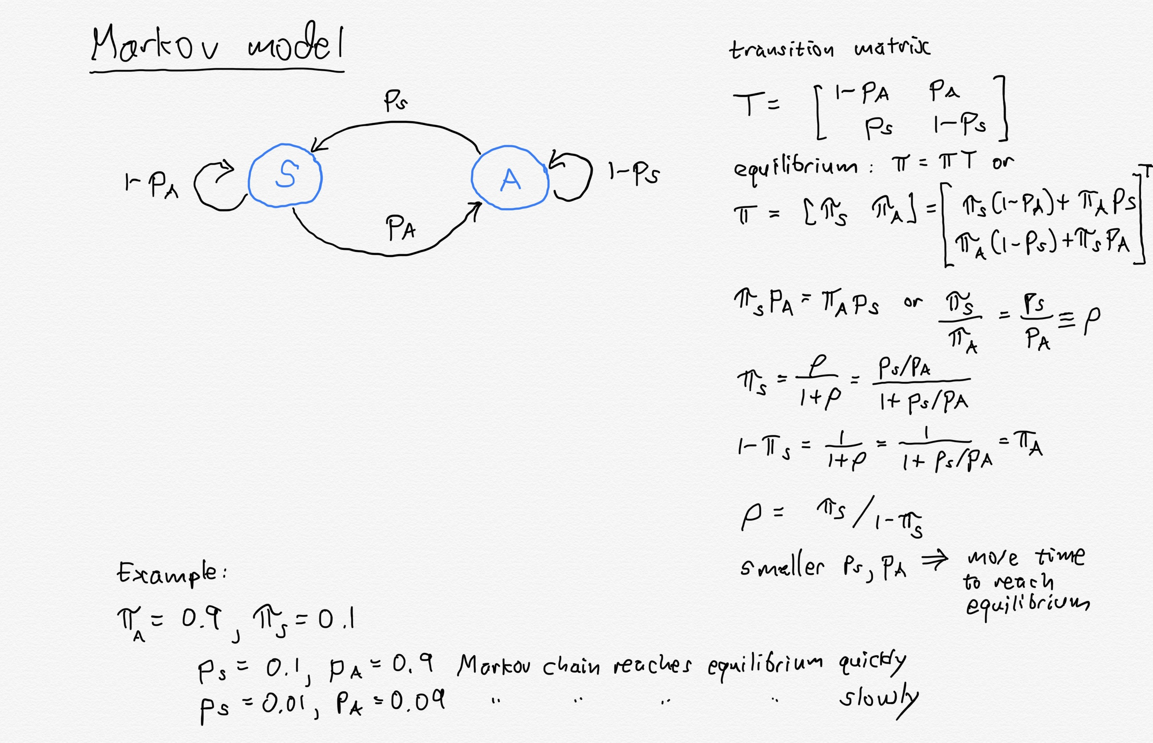
Markov model: need transition probabilities

Slide 6
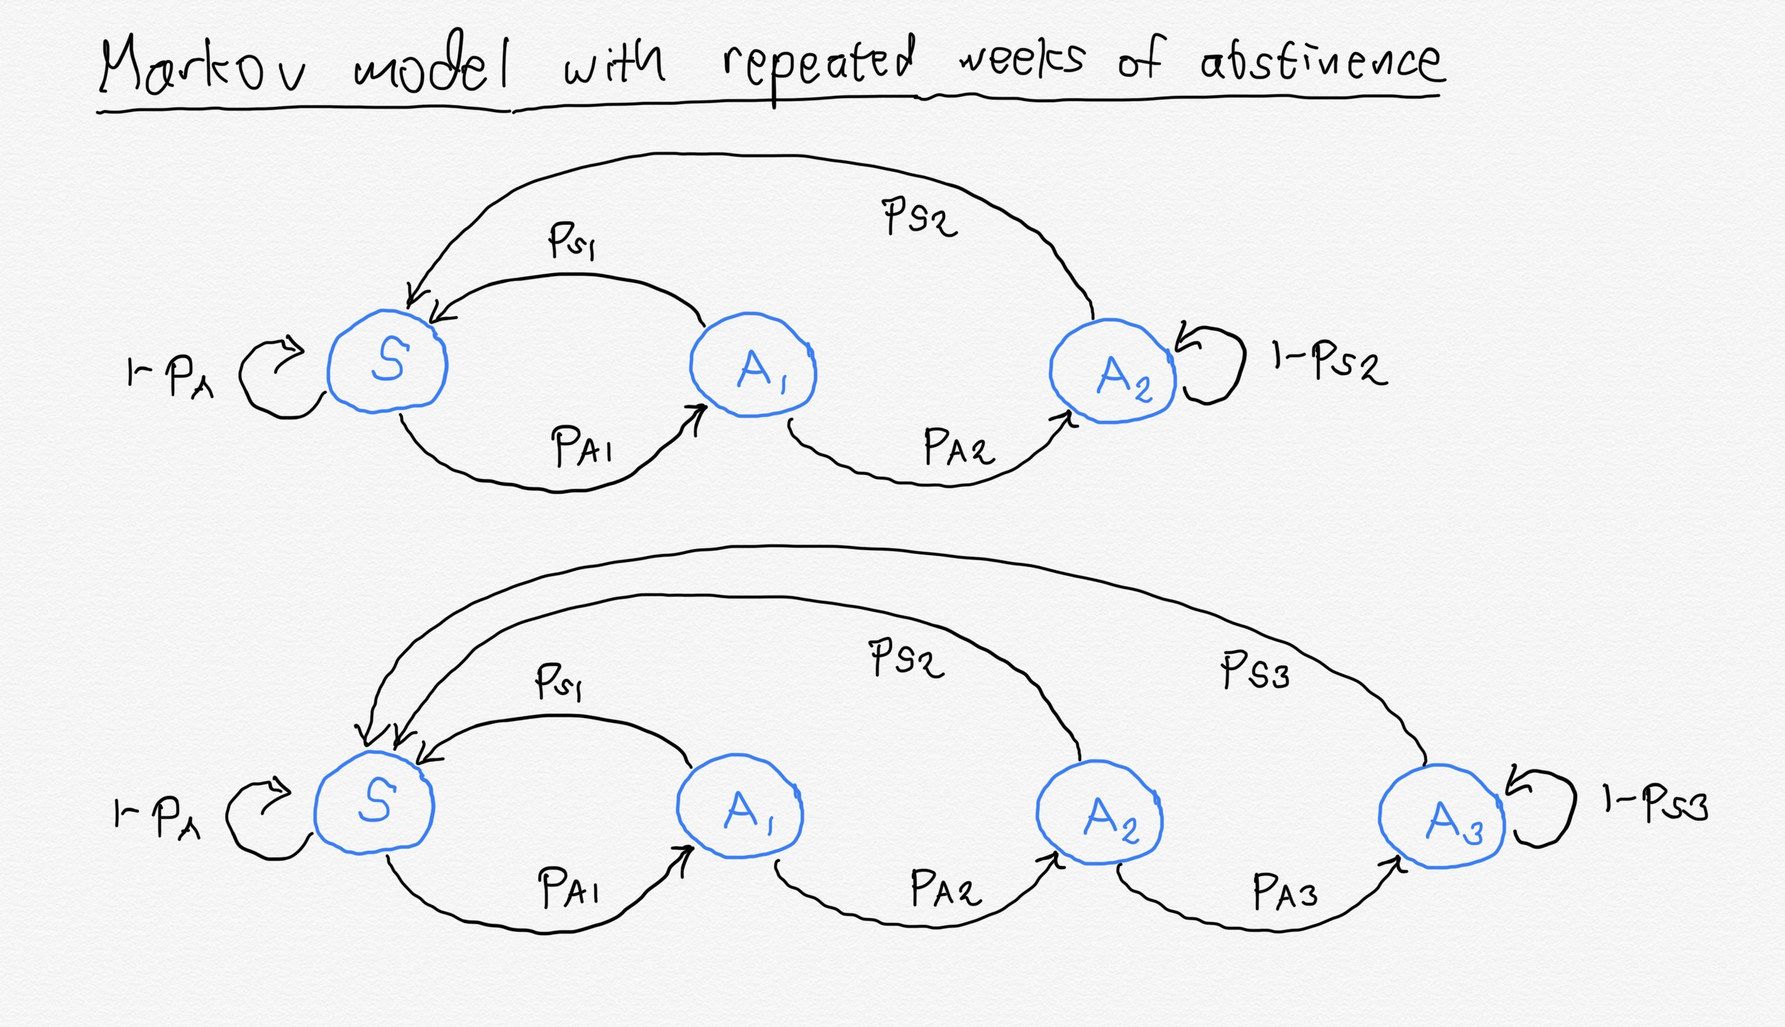
Markov model with consecutive abstinence weeks

Slide 7
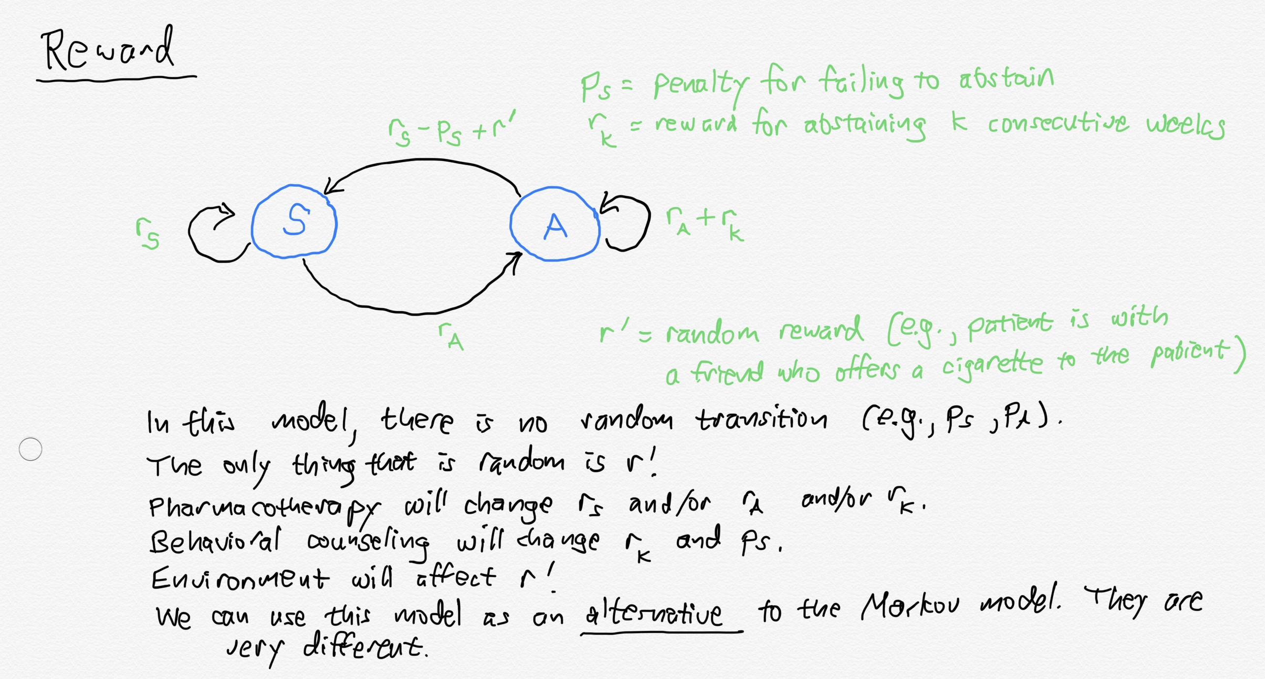
Reward model: need relative rewards for smoking and abstinence

