Slide 1
Healthcare Application in Blockchain
Implementation using the HyperLedger Fabric
Participants:
Michael Tsao,
Sai Nidumukkala

Slide 2
Blockchain
Blockchain is a decentralized ledger system.
Improves processing speed and security while simultaneously decreasing risks and costs.
Blockchain utilizes peer-to-peer (P2P) network.
Security implemented through cryptographic keys.
Metadata is recorded into a block and cannot be modified, removed or disputed.
Validated block is added to chain of other blocks and will remain unchanged.
Notes:
Allows for independent agents to collaborate within an ecosystem that allows transparency and time-stamped recordings.
Involves having multiple copies of the same data stored in different locations and devices.
Transaction requests are validated

Slide 3
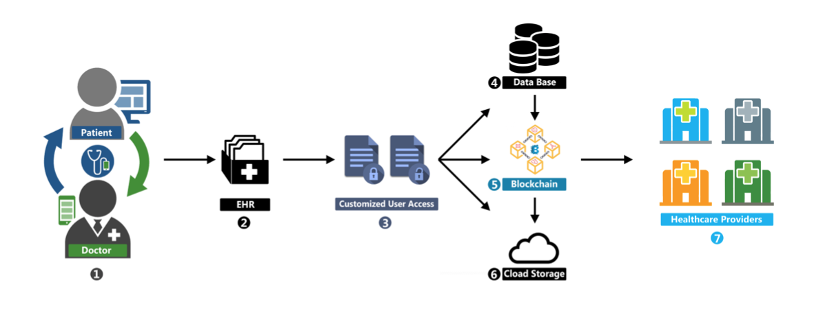
Blockchain in Healthcare
Immutability, a key feature offered by blockchain is desired by the Healthcare industry.
Secure health records and clinical records while maintaining regulatory compliances
Example: Health Insurance Portability and Accountability Act (HIPAA).
Applications also include pharmaceuticals.
Notes:
Allows healthcare systems to maintain secure health records and clinical records while maintaining regulatory compliances
EHR: Electronic Health Record
Citation for picture: Khezr, Seyednima & Moniruzzaman, Md & Yassine, Abdulsalam & Benlamri, Rachid. (2019). Blockchain Technology in Healthcare: A Comprehensive Review and Directions for Future Research. Applied Sciences. 9. 1736. 10.3390/app9091736.

Slide 4
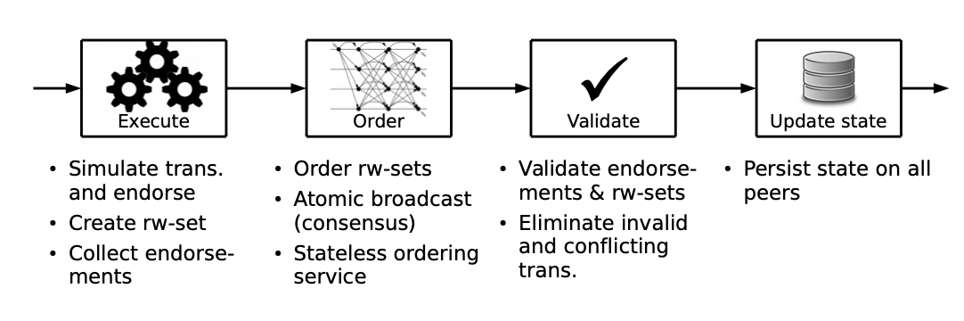
HyperLedger Fabric
Fabric is a distributed operating system for permissioned blockchains
Tracks the execution history in an append-only ledger structure
Fabric operates in an execute-order-validate architecture
Notes:
No built in cryptocurrency.
Citation for picture: Androulaki, Elli et al. “Hyperledger Fabric.” Proceedings of the Thirteenth EuroSys Conference on - EuroSys ’18 (2018): n. pag. Crossref. Web.

Slide 5
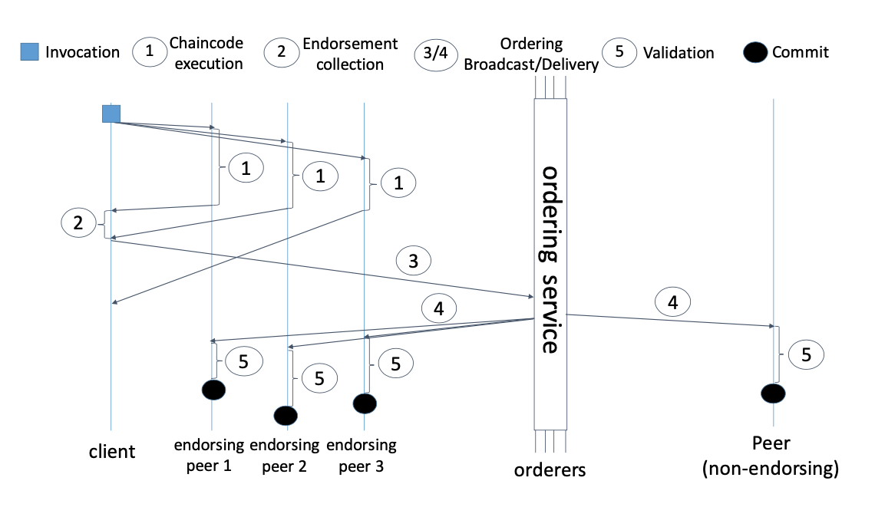
HyperLedger Transaction Flow
A client sends transactions to the peers as listed in the endorsement policy.
Each transaction is executed by the peers and its output is recorded as an endorsement.
Transactions enter Ordering Phase using Protocols and then grouped in blocks
Broadcasted to all the peers and each peer then validates the state changes of transactions
Notes:
Smart Contract, also known as the chaincode. It mainly includes the program code that consists of the complex application logic that runs during the execution phase.
Endorsement Policy, which runs during the validation phase is a static library that is usually referenced during the transaction validation process.
Citation for Picture: Androulaki, Elli et al. “Hyperledger Fabric.” Proceedings of the Thirteenth EuroSys Conference on - EuroSys ’18 (2018): n. pag. Crossref. Web.

Slide 6
Use Cases

Slide 7
Use Case 1 - Initial Setup
Participants
Patients - Joe Lee
Healthcare Provider - Dr. Smith
A patient has recently signed up to an electronic health record and filled in the consent information. They later schedule an appointment with their doctor for a checkup. Doctor prescribes a prescription and completes the records.
Notes:
Today we will talk about a blockchain based electronic health records proof of concept solution
Here we explore two use cases that we designed our blockchain solution around
Use case 1
We have patients and health care providers
We have a patient who just signed up for a electronic health records
They schedule some appointment for a routine checkup and finally physician completes the record

Slide 8
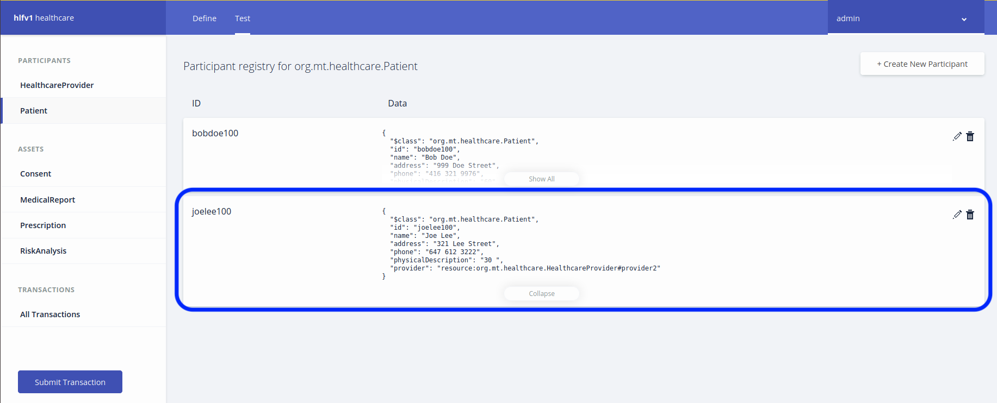
Participants: Patients
Notes:
Update consent
The UI we see here is the Hyperledger playground which is a prebuilt frontend for itnernacting with the hyperledger fabric blockhcains
It is current showing our newly added participants
Joe and bob
If we wanted to add a new participants, we will need to click “create new participant”

Slide 9
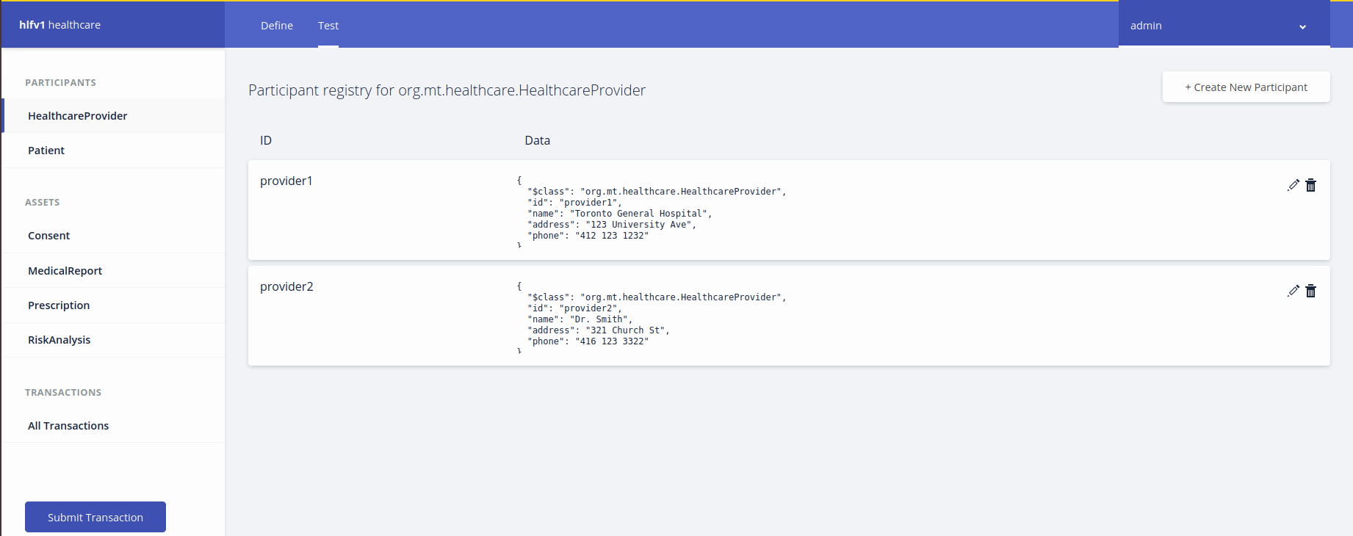
Participants: Healthcare Providers
Notes:
And similarily for healthcare providers
We have two
Toronto gerneal and dr smith

Slide 10
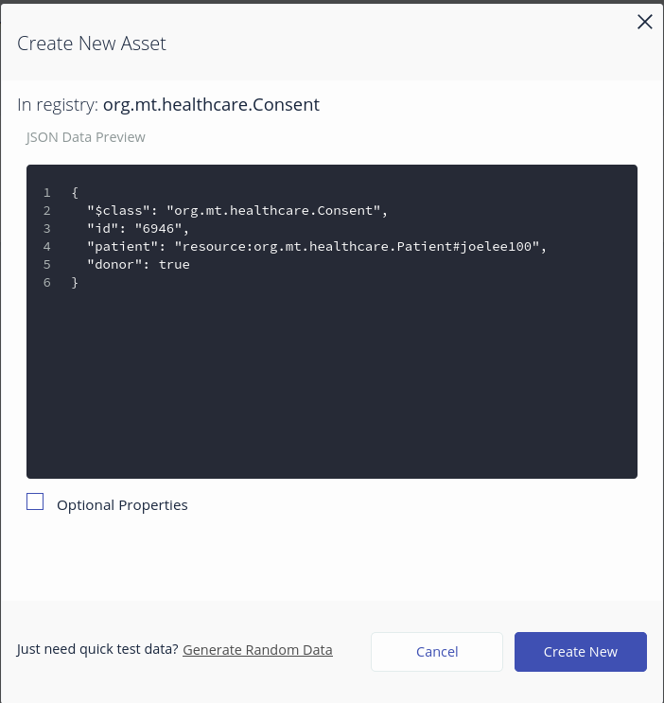
Use Case 1 - Patient Updates Consent
Notes:
We create some assets to contain information
This JSON should be generated by some front end web application and sent to the blockchain
but for the purposes of demo we are going to show us entering the information manually
Generally, some sort medical consent such as organ donation is asked at service ontario when we renew health cards or drivers license. This allows it to be captured online
As a result of creating this new asset, We have a record here for a new after death organ donor
Notice that the user here is for Joe Lee

Slide 11
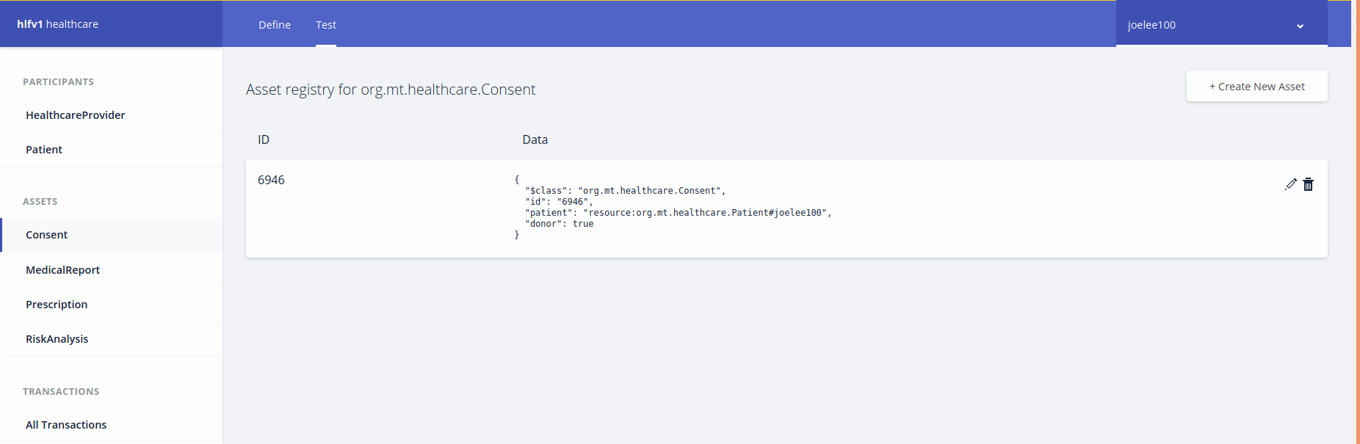
Use Case 1 - Patient Updates Consent
Notes:
This gets captured into the asset registry
We have configured the blockchain such that only the owner and any healthcare provider can see this consent.

Slide 12
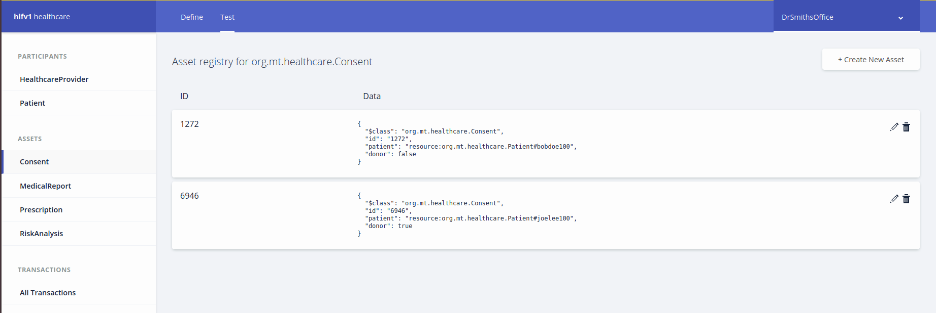
Use Case 1 - Patient Updates Consent Cont’
Notes:
Here we see that there are two consents in the system. This is from Dr. Smiths office view who can view all consents
BUT notice previously Bob can only see his own consent

Slide 13
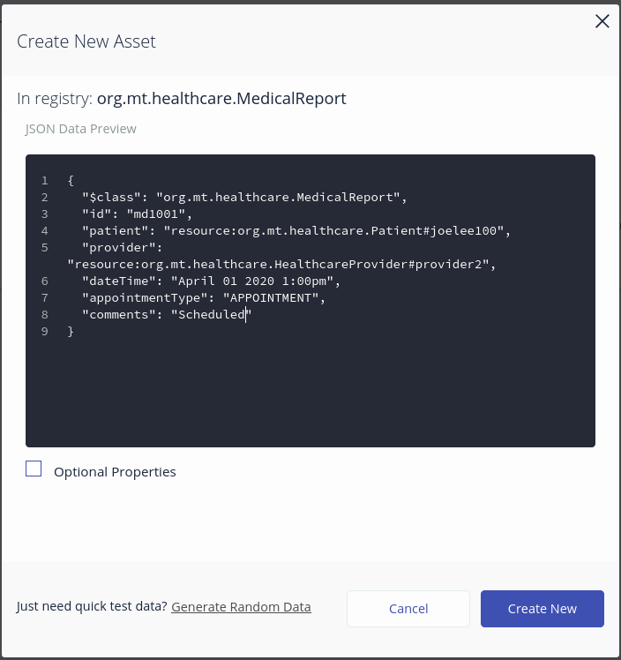
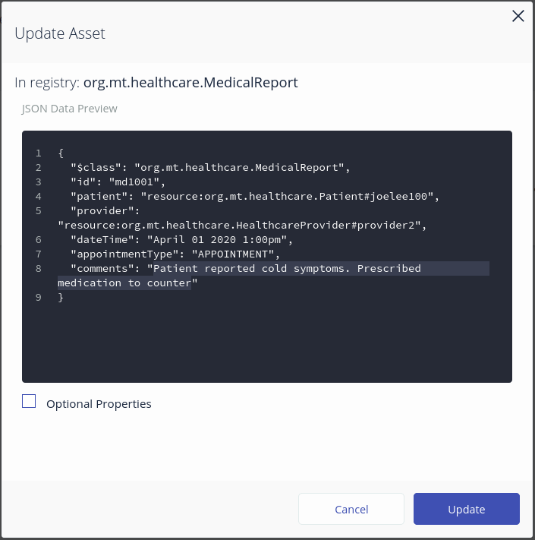
Use Case 1 - Patient Schedules a Appointment
Notes:
Doctors office would create a new medical report.
Doctor will update this record later of results of the appointment.
Joe is experiencing cold flu symptoms

Slide 14
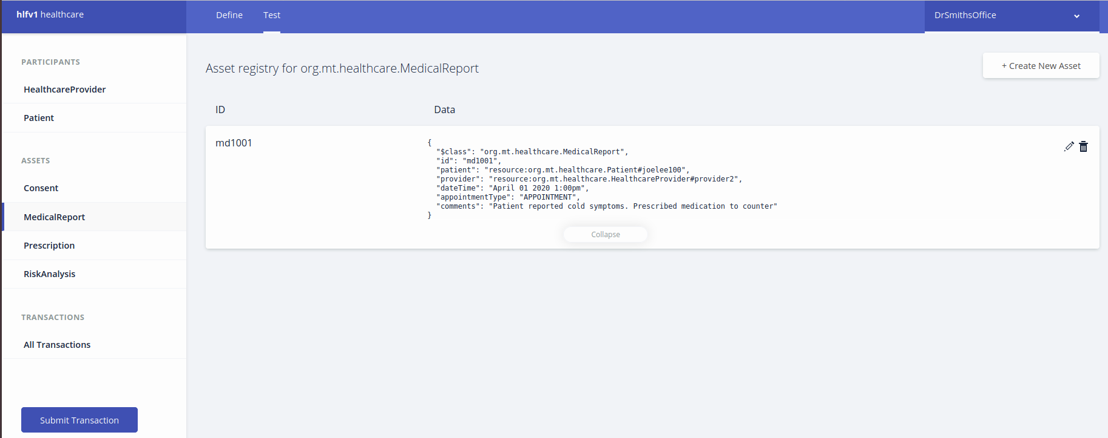
Use Case 1 - Doctor Updates Appointment
Notes:
Result gets saved

Slide 15
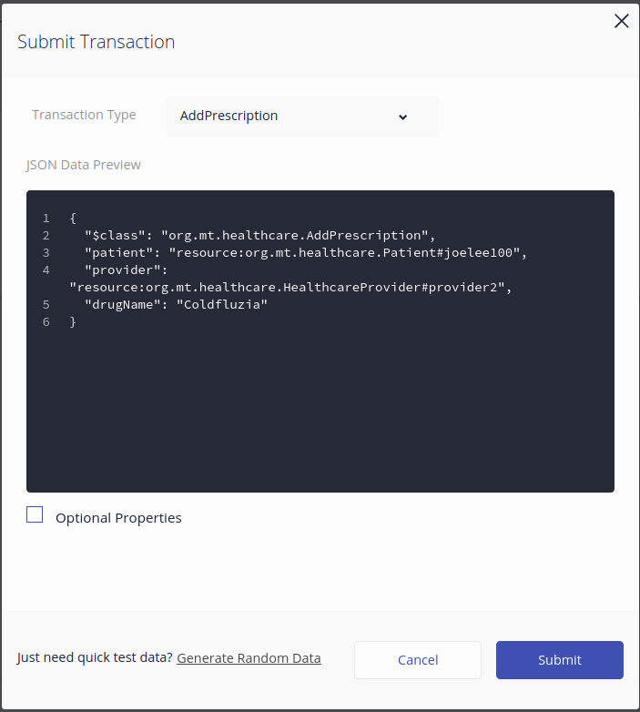
Use Case 1 - Doctor Prescribes New Prescription
Notes:
Doctor create record in prescriptions record
This transaction executes some chaincode seen in the next slide

Slide 16
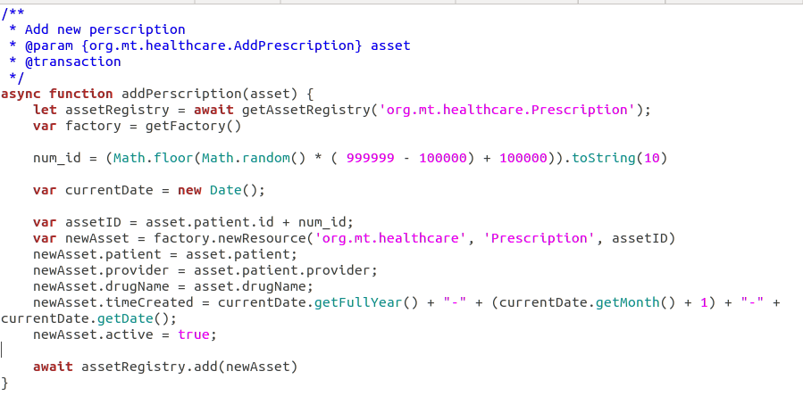
Use Case 1 - Transaction Chaincode
Notes:
Here we have a transaction that formats the date to YEAR MONTH DAY format and constructs the prescription object to be added
We could also do some data validation here but chose with the date for simplicity
Ensuring record formats can make data more uniform which not only prevents misunderstanding of the data and can allow other automated processing such as totaling the amount prescribed drugs are required by a certain population.

Slide 17
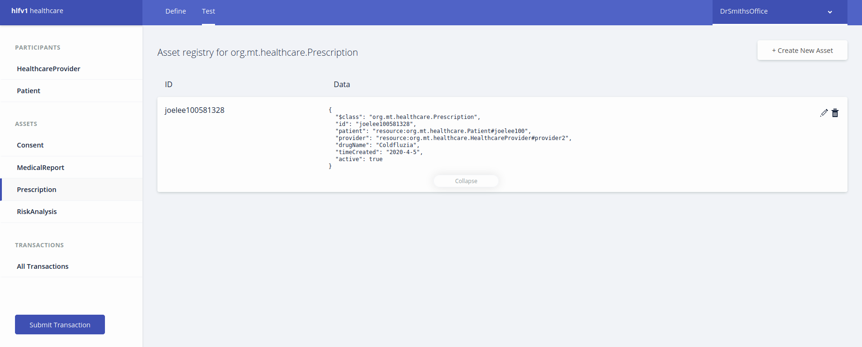
Use Case 1 - Doctor Prescribes New Prescription
Notes:
Record gets saved

Slide 18
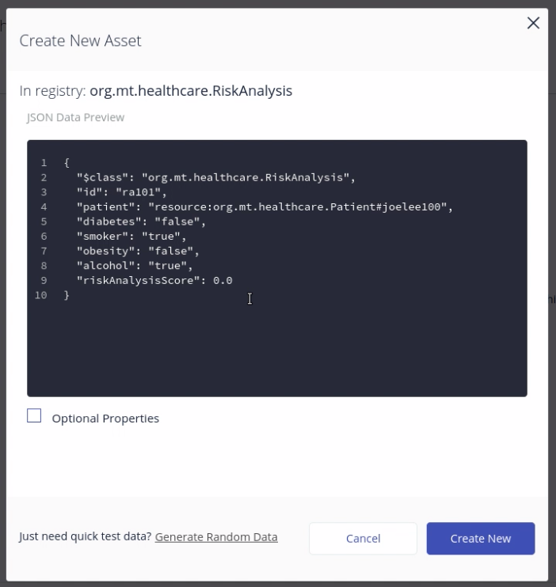
Use Case 1 - Risk Analysis
Notes:
The doctor next records any documented conditions and risk factors.
These metrics are generally useful for paramedics

Slide 19
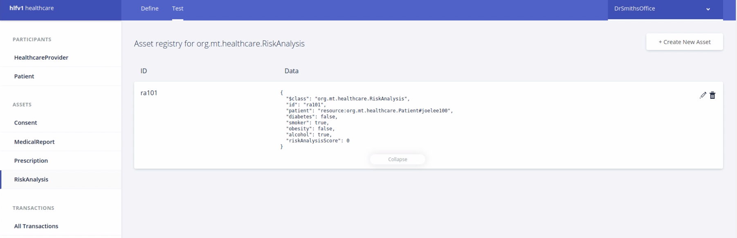
Use Case 1 - Risk Analysis
Notes:
This gets saved

Slide 20
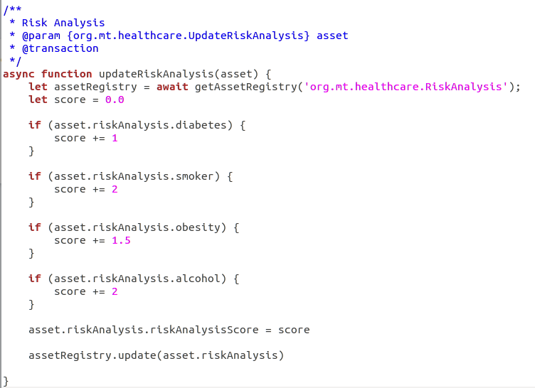
Use Case 1 - Risk Analysis
Notes:
and we let a transaction perform the risk scoring for us.
This is again to ensure uniformity in the data
We just look at conditions and add to a running score

Slide 21
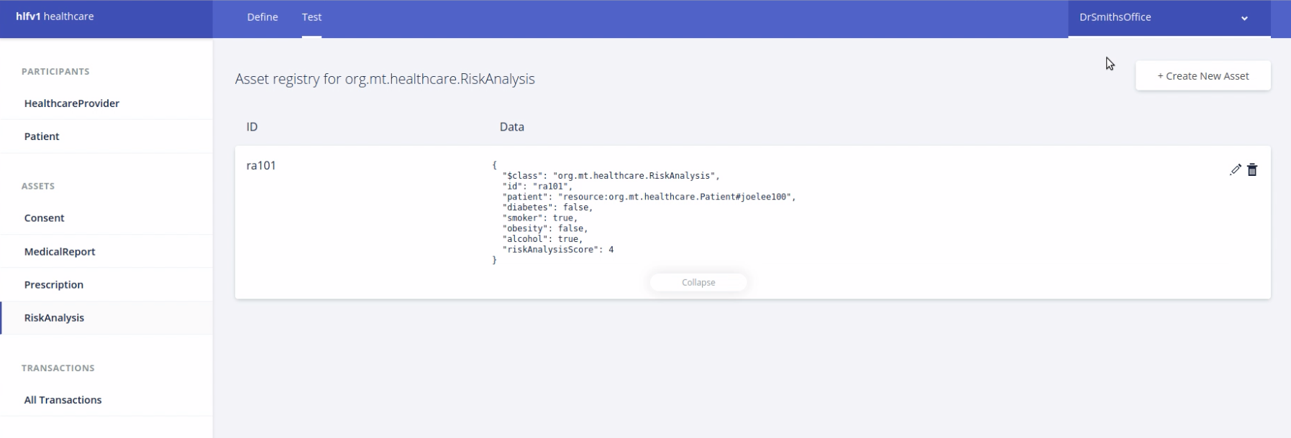
Use Case 1 - Risk Analysis
Notes:
This gets updated by the system

Slide 22
Use Case 2 - Medical Emergency
Participants
Patients - Joe Lee
Healthcare Providers - Toronto General Hospital
A patient was admitted to an emergency room. The Healthcare provider looks up patient’s record to see conditions, current prescriptions and any recent medical appointments for their diagnostics, before performing the treatment.
Notes:
Our next use case demontrates
We still have patients and health care providers
This time toronto general hospital is our healthcare provider
Toronto general hospital just received joe lee in the emergency room.
This use case occurs most often and can save lives as unknown pharmaceuticals can cause initial treatments in the emergency room to fail.

Slide 23
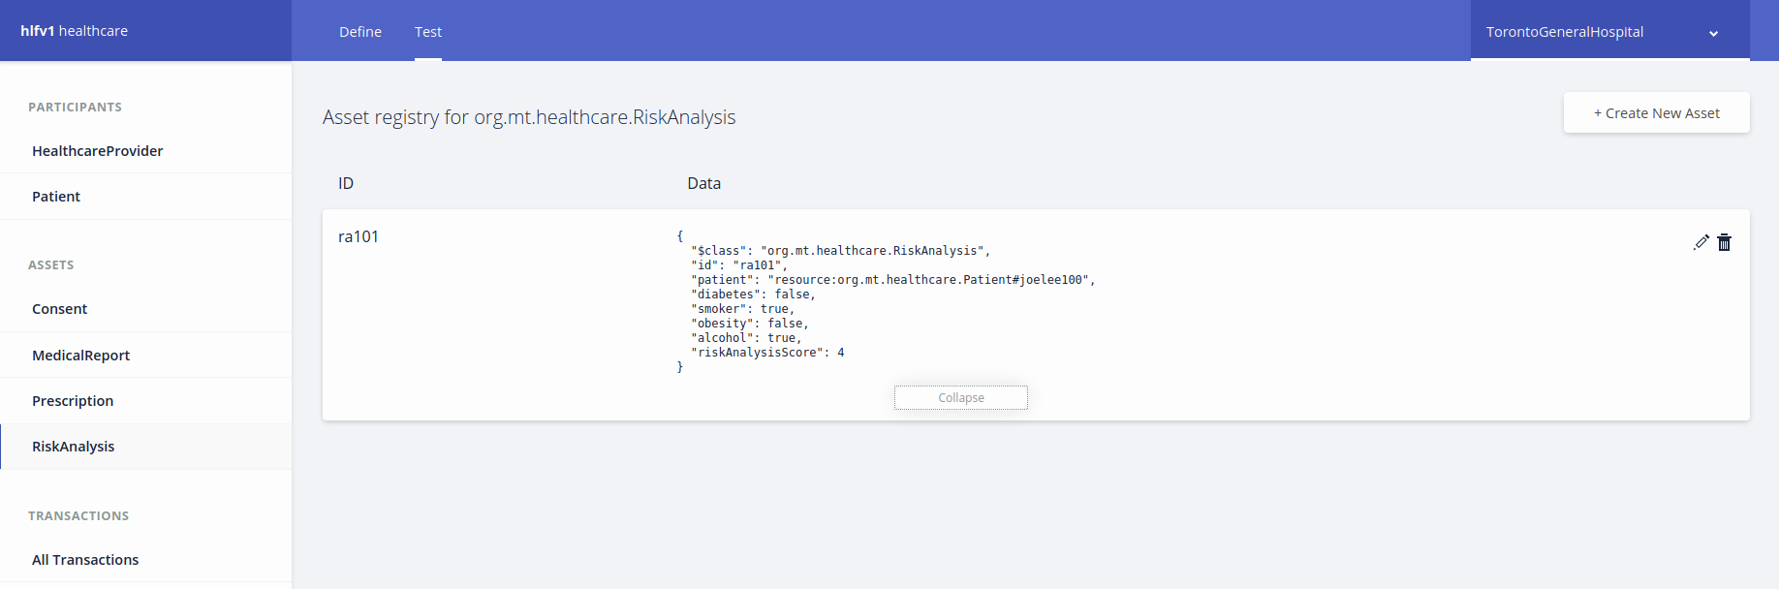
Use Case 2 - Risk Analysis
Notes:
Doctors can easily lookup joe lee’s medical conditions and his risk scores

Slide 24
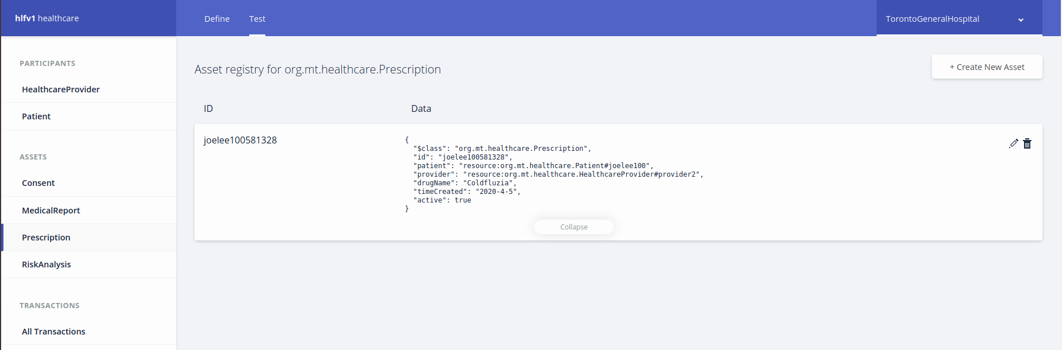
Use Case 2 - Current Prescriptions
Notes:
And finally any prescriptions
This allows docotors to make more informed diagnostics more easily

Slide 25
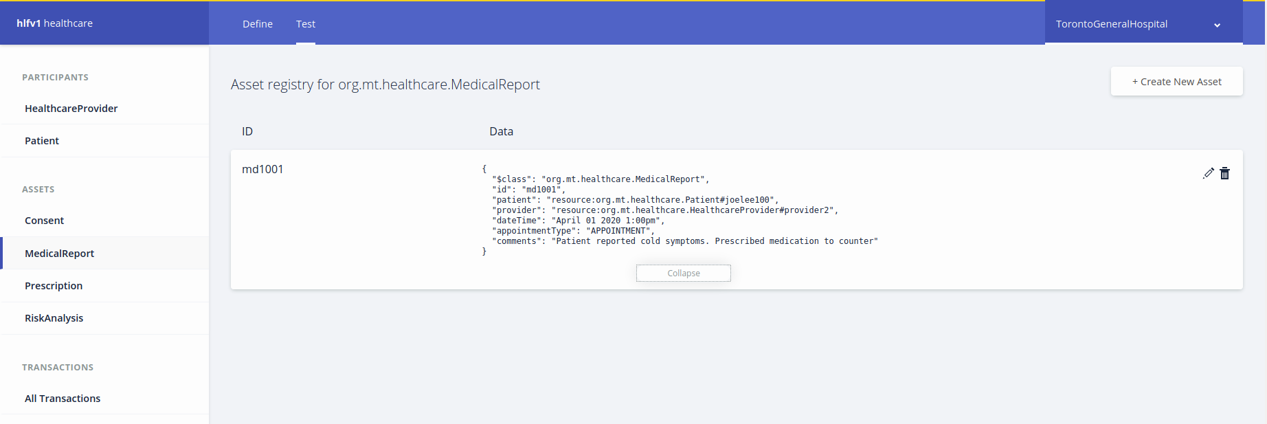
Use Case 2 - Medical Reports
Notes:
Additionally, doctors may lookup any previous doctors visits easily from the reports in their history

Slide 26
Live Demos of Use Cases
Please see the included files
NOTE: Loading between accounts can take around 1 minute to properly log in
Notes:
This concludes our demo
We have also included video versions of the demo
Do note there are some significant load times due to running in a virtualized enviroment

