Slide 1
Shibboleth/Federation Operator Tutorial
TIIME Workshop 2018
Speaker: David Hübner,
DAASI International
Date: 6 Feb 2018

Slide 2
Agenda
Welcome and Introduction to the Workshop
Introduction to Shibboleth
Federation Tools from Shibboleth
PyFF as an Alternative
Shibboleth IdP Hosting
Plugin Interfaces of Shibboleth IdP V3
Hands-On Session

Slide 3
Hands-On Session

Slide 4
Goals of this session
Install Shibboleth SP
Get to know Shibboleth SP (and IdP) w.r.t. metadata, certificate and attribute management
Understand metadata aggregation with some practical examples
Identify common errors and learn how to fix them

Slide 5
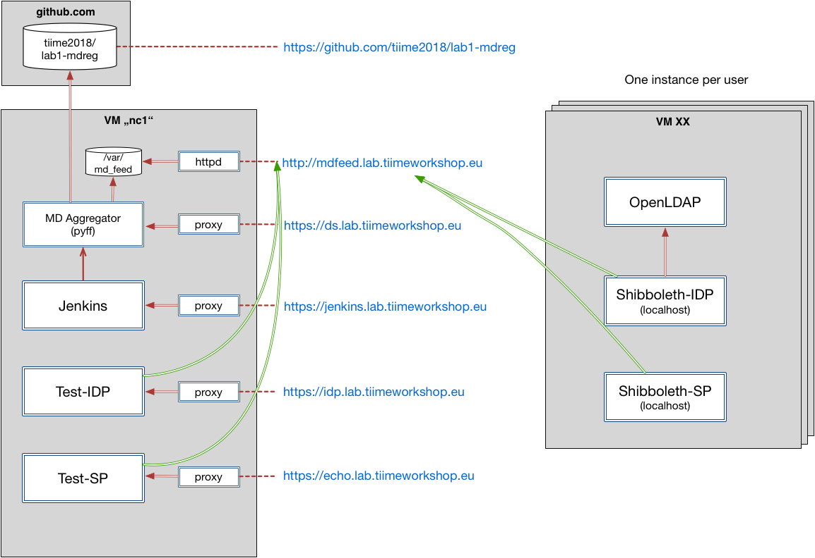
Lab components

Slide 6
VM Software Stack
CentOS7
Apache Webserver
Tomcat 7
OpenLDAP with some example users
Shibboleth IdP V3.3.2
CentOS7 Repository for Shibboleth SP
Minimal pre-configuration

Slide 7
Lab Exercise Step 1
Download VM image [add link]
Import in VirtualBox
Boot into headless mode
Connect via ssh root@localhost -p 2222
Access https://localhost:1443 in your browser
  IdP Status page should already work
  SP quicklinks do not work (no SP installed yet)
Install Shibboleth SP: yum install shibboleth
Start shibd: systemctl enable shibd --now
Restart Apache: systemctl restart httpd
Now all the quicklinks should work

Slide 8
Lab Exercise Step 2
Every entity (IdPs and SPs) in SAML is identified by a unique Entity ID
In order for this lab exercice to work, every participant needs a unique Entity ID
Configuration of SP in [/etc/shibboleth/shibboleth2.xml]
  Change entityID in line 23 to something unique
  e.g. https://localhost/shibboleth/[XX]
Configuration of IdP in [/opt/shibboleth-idp/conf/idp.properties]
  Change entityID in line 5 to something unique
  e.g. https://localhost/idp/shibboleth/[XX]
  Do the same for the IdP metadata in [/opt/shibboleth-idp/metadata/idp-metadata.xml]

Slide 9
Lab Exercise Step 3
Restart shibd and tomcat
Generate metadata and save it to some local folder
  Rename the file to something meaningful
  e.g user[XX]_sp.xml and user[xx]_idp.xml
  Verify at https://mdval.test.portalverbund.at/
  Upload to git at https://github.com/tiime2018/lab1-mdreg/tree/master/metadata/upload

Slide 10
Lab Exercise Step 4
Generate new SP certificates
  ./etc/shibboleth/keygen.sh -f
  chown shibd:shibd /etc/shibboleth/sp-*
systemctl restart shibd

Slide 11
Lab Exercise Step 5
Let‘s create the aggregated metedata!

Slide 12
Lab Exercise Step 6
The SP and IdP on your VM need to load the aggregated metadata
Aggregated metadata is available here: http://mdfeed.lab.tiimeworkshop.eu/metadata.xml
MD signing certificate: http://mdfeed.lab.tiimeworkshop.eu/metadata_crt.pem
Discovery service (DS): https://ds.lab.tiimeworkshop.eu/role/idp.ds
Configure SP
  Download certificate
  Adapt [/etc/shibboleth/shibboleth2.xml]:
    Load metadata with above URLs
    Change <SSO> Handler to DS
Configure IdP
  Adapt [/opt/shibboleth-idp/conf/metadata-providers.xml]

Slide 13
Lab Exercise Step 7
Restart shibd and tomcat
Access protected resource on localhost
Choose *your* IdP Entity ID
Login
  a.test
  secret
Give consent
Whoops.
Hint: [/var/log/shibboleth/shibd.log]

Slide 14
Lab Exercise Step 8
Generate new SP metadata
Edit IdP metadata and add some info in the <Extensions> element
  <mdui:UIInfo>
  <mdui:DisplayName xml:lang="en"></mdui:DisplayName>
  <mdui:Description xml:lang="en"></mdui:Description>
  </mdui:UIInfo>
Save IdP and SP metadata
Check validity
Upload to git

Slide 15
Lab Exercise Step 9
Let‘s generate updated aggregated metadata :)

Slide 16
Lab Exercise Step 10
Make your SP and IdP reload the metadata
  Quick and dirty: just restart shibd and tomcat
Once again access the protected resource on localhost

Slide 17
Lab Exercise Step 11
Recall: configuration of attributes needs to happen on IdP and SP
IdP in [/opt/shibboleth-idp/conf/attribute-filter.xml]
  e.g. just to your SP‘s entityID or CoCo
SP in [/etc/shibboleth/attribute-map.xml]
  Uncomment the relevant attributes
  Change REMOTE_USER in [/etc/shibboleth/shibboleth2.xml]
Restart shibd and tomcat

Slide 18
Lab Exercise Step 12
Once again access the protected resource

Slide 19
Thanks!
https://www.daasi.de

