Slide 1
Shibboleth/Federation Operator Tutorial
TIIME Workshop 2018
Speaker: David Hübner,
DAASI International
Date: 6 Feb 2018

Slide 2
Agenda
Welcome and Introduction to the Workshop
Introduction to Shibboleth
Federation Tools from Shibboleth
PyFF as an Alternative
Shibboleth IdP Hosting
Plugin Interfaces of Shibboleth IdP V3
Hands-On Session

Slide 3
Introduction to Shibboleth

Slide 4

Shibboleth Project
„Shibboleth is a standards based, open source software package for web single sign-on across or within organizational boundaries.“
Began as an Internet2 activity in 2000
SAML (2.0)
Maintained by the Shibboleth Consortium
Widespread useage in research & education

Slide 5
Shibboleth Project
Several products
  Identity Provider
  Service Provider
  OpenSAML Libraries (C++ & Java)
  Metadata Aggregator
  Centralized Discovery Service
  Embedded Discovery Service

Slide 6
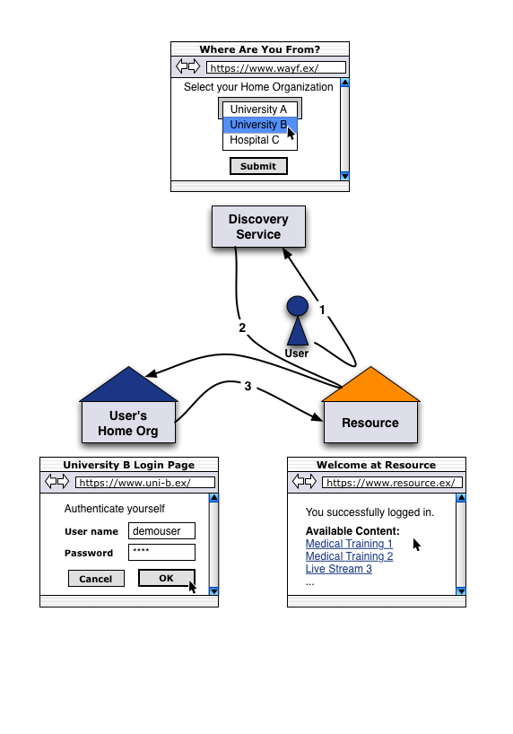
Short introduction to Web SSO...
Most important use case: Web Browser SSO
Identity Provider (IdP) authenticates users and issues assertions
Service Provider (SP) relies on assertions from IdO and uses this information to control access to protected services
Discovery service (DS) lets users choose their home organization (and therefore IdP)
© Switch.ch

Slide 7
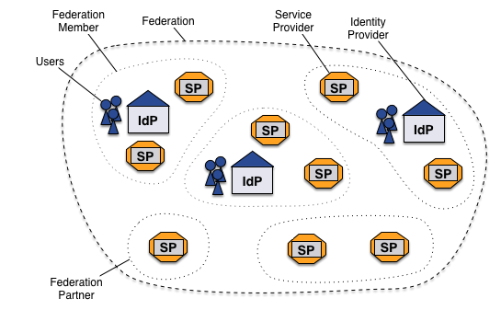
… and federations
Federations as collection of organizations
Federation operator as trusted third party
Scalable way to allow SSO across organizational boundaries
SAML Metadata to connect entities

Slide 8
Shibboleth IdP
Implements the Identity Provider (IdP) Component
AuthN of users from an organisation happens centrally at its IdP
Assertions (SAML) to convey identity informations (AuthN result + attributes) to Relying Parties (RP)
Shibboleth IdP is a Java application
Protocol Support includes SAML 1.1, most SAML 2.0 profiles, CAS
Based on Spring for configuration & wiring of components
Current release: V3.3.2

Slide 9
Shibboleth IdP
Higly configurable
  Authentication sources
  Attribute Resolution
  Attribute Filtering
  Metadata Management
  Per-RP Configuration
  Policies
  Backend / Storage

Slide 10
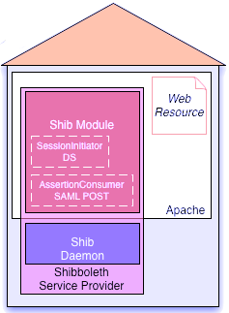
Shibboleth SP
Implements the SP component
There are two parts
  C++ daemon (shibd)
    Keeps states, evaluates protocol mesages
  Webserver module (mod_shib)
    Protects Locations/Directories, defines Access Rules
Current release: V2.6
Binaries for Windows, OSX, RPM-based Linux
Switch Repository for Ubuntu/Debian
(c) Switch

Slide 11
Shibboleth SP Overview
General configuration in /etc/shibboleth/shibboleth2.xml
Applications as „containers“ to group common configuration
Configuration of <Session> properties (e.g. duration)
  <SessionInitiator> define how the SP should get a session (some shorthands for e.g. <SSO> and <Logout> exist)
  <Handler> provide various endpoints
<ApplicationDefaults entityID="https://example.org/shibboleth“
REMOTE_USER="eppn persistent-id targeted-id">
<Sessions lifetime="28800" timeout="3600" relayState="ss:mem"
checkAddress="false" handlerSSL="true" cookieProps="https">
<SSO discoveryProtocol="SAMLDS"
discoveryURL="https://example.org/ds">
SAML2 SAML1
</SSO>
<Handler type="MetadataGenerator" Location="/Metadata"
signing="false"/>
<Handler type="Status" Location="/Status" acl="127.0.0.1 ::1"/>
<Handler type="Session" Location="/Session"
showAttributeValues="false"/>
</Sessions>

Slide 12
Shibboleth SP Overview
General configuration in /etc/shibboleth/shibboleth2.xml
Load metadata (static or dynamic)
Configure how the SP should provide attributes to applications
Keys and Certificates
Possible ApplicationOverrides to run multiple logical SPs with one installation
<MetadataProvider type="XML" validate="true"
uri="http://example.org/fed-metadata.xml"
backingFilePath="fed-metadata.xml" reloadInterval="7200">
<MetadataFilter type="Signature"
certificate="md_federation.pem"/>
</MetadataProvider>
<AttributeExtractor type="XML" validate="true"
reloadChanges="false" path="attribute-map.xml"/>
<AttributeFilter type="XML" validate="true"
path="attribute-policy.xml"/>
<CredentialResolver type="File"
key="sp-key.pem" certificate="sp-cert.pem"/>
<!--<ApplicationOverride /> -->
</ApplicationDefaults>

Slide 13
Processing attributes
/etc/shibboleth/attribute-map.xml to extract attributes and provide them internally
Simple mapping from incoming name to internal id
You can then use them as apache environment variables in protected applications, e.g. $_SERVER[‘mail‘]
/etc/shibboleth/attribute-policy.xml to define processing policies
Default configuration includes e.g. scope checking of ePPN, ePSA etc.
<Attribute name="urn:oid:0.9.2342.19200300.100.1.3" id="mail"/>

Slide 14
Processing attributes
Attributes can be changed various times on their way to the application
  IdP resolves attributes
  IdP filters attributes on a per-RP basis
  SP accepts or rejects attributes…
  ...filters them accoring to policies…
  ...and maps them to internal variables
  Webserver provides variables as environment variables
Be aware that names might change and attributes might get lost

Slide 15
Protecting Applications
Three common options
  Directly in the webserver via Apache Access Rules
  In shibboleth2.xml configuration via SPXMLAccessControl
  Use application („lazy session“ or „passive protection“)
<Location /application>
AuthType shibboleth
ShibRequestSetting requireSession 1
require shib-session
</Location>
<Location /lazy>
AuthType shibboleth
ShibRequestSetting requireSession 0
require Shibboleth
</Location>

Slide 16
Protecting Applications
Usually Apache Access Rules is the easiest approach
Require shib-attr allows to decide based on attributes
<Location /application>
AuthType shibboleth
ShibRequestSetting requireSession 1
require shib-session
require shib-attr affiliation student
</Location>

Slide 17
Shibboleth DS
Two pieces still missing
SP uses Discovery Service (DS) to allow users to choose their IdP
Shibboleth did provide Centralized Discovery Service (CDS)
  Central as in „not on every SP“
  The federation operator might run this
  Shibboleth CDS is no longer maintained
Shibboleth does provide Embedded Discovery Service (EDS)
  Embedded as in „runs on every SP host“
  Can be combined with Metadata management of Shibboleth SP
<SSO discoveryProtocol="SAMLDS"
discoveryURL="https://example.org/ds">
SAML2 SAML1
</SSO>

Slide 18
Shibboleth Metadata Aggregator
And the other missing piece:
Metadata Aggregation means:
<MetadataProvider type="XML" validate="true"
uri="http://example.org/fed-metadata.xml"
backingFilePath="fed-metadata.xml" reloadInterval="7200">
<MetadataFilter type="Signature"
certificate="md_federation.pem"/>
</MetadataProvider>

Slide 19
Thanks!
https://www.daasi.de

