Slide 1
Shibboleth/Federation Operator Tutorial
TIIME Workshop 2018
Speaker: David Hübner,
DAASI International
Date: 6 Feb 2018

Slide 2
Agenda
Welcome and Introduction to the Workshop
Introduction to Shibboleth
Federation Tools from Shibboleth
PyFF as an Alternative
Shibboleth IdP Hosting
Plugin Interfaces of Shibboleth IdP V3
Hands-On Session

Slide 3
What‘s possible with Shibboleth IdP

Slide 4
What is this session about?
We will look at various parts of Shibboleth IdP and see what‘s possible beyond just obvious configuration
This session is about
  More advanced configuration
  Existing extensions that might be worth considering
  Inspiration what can be done with your own extensions
This session is not about
  Learning to actually implement this stuff

Slide 5
Some general remarks
Shibboleth IdP uses Spring to wire together various components
  In general you can just write your own Java Beans that do stuff and just use the existing IdP structure to load them and let them do stuff
    e.g. define a CustomViewContext in global.xml and use it in views
Shibboleth IdP uses Spring Web Flow to define flows that involve user interaction
  In general everything in system/ must not be touched
  Bust usually you can just copy and write your own flow :)
Most java classes are part of the public API

Slide 6
Authentication

Slide 7
Authentication
Common Login flows include Password, X509 and SPNEGO
authn/Password provides a JAASAuthn module that can be used for various methods
authn/External provides an interface to support arbitrary authentication sources
  In general this involves writing your own code, that manages the external authentication process and connects back to the IdP
  Extend net.shibboleth.idp.authn.ExternalAuthentication
  You need to come up with a principal that the IdP can use to create a session, the rest is pretty much up to you
authn/MFA or authn/Duo provides support for Multi Factor Authentication

Slide 8
Examples of External Authentication
Shib-cas: https://github.com/Unicon/shib-cas-authn3
  Uses an external CAS to obtain authentication
  Registers its own flow (that is based on External Authentication)
  The flow uses some properties that can be configured within the IdP to talk to the CAS server and validates the response

Slide 9
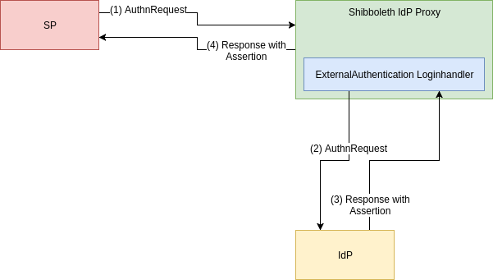
Examples of External Authentication
Proxy solution based on Shibboleth IdP
ExternalAuthentication Loginhandler implements basic functionality of a SAML SP
Once again based on authn/ExternalAuthentication
After validation principal is extracted from received SAML assertion

Slide 10
Multi Factor Authentication
Shibboleth IdP provides two login flows to support MFA
authn/Duo
  Implements the DuoWeb (3rd party) authentication interface into Shibboleth
  Not free (>10 user)
authn/MFA
  Scriptable flow to multiple other flows
  And define conditions when to use which conbination (e.g. based on AuthnContextClassRef)
  The actual 2nd factor (i.e. TOTP) flow still needs to be implemented
  There are extensions available (can‘t comment on them though)

Slide 11
Interceptors

Slide 12
Interceptors
Defined as Spring Web Flows
Can be used as „hooks“ at specific points in the profile flow
  Inbound message
  Post-authentication
  Outbound message
Often provide an easy way to modify behaviour, attributes or messages without too much implementation work
Post-authentication interceptor has access to most variables, including authentication result and attributes
Can be includes on a per-RP basis

Slide 13
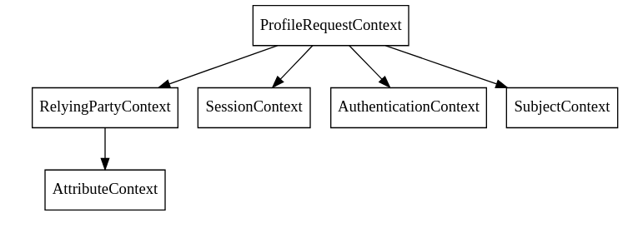
Interceptors

Slide 14
Post-authentication interceptor
Some flows are provided by Shibboleth IdP
  Attribute Release Consent
  Terms of Use Consent
  Expiring Password
  Impersonate
  Context Check

Slide 15
Example of post-authentication intercept
The context check interceptor can be easily extended
Use case:
  Terms of use are managed externally
  IdP needs to evaluate if user can pass or should be blocked
  This might also depend on the SP
Most of this could also be implemented elsewhere
Custom intercept flow provides an elegant way to do this

Slide 16
Example of post-authentication intercept
Step 1: define bean for evaluation
  Can be „scripted“ or provided by custom class
Step 2: define flow
  Evaluate using the custom bean
  Positive result: proceed
  Negative result:
    Remove authentication result
    Display view and inform the user
    Redirect user to external application to accept terms of use
Step 3: Include flow for relevant RPs

Slide 17
Proccessing attributes

Slide 18
Processing Attributes
Resolving attributes consists of two parts
Data Connector defines data sources to get attribute sets from (most commonly LDAP)
Attribute Definitions extract the actual attributes from these sets
Attribute Encoders define how to put these attributes into the assertion
Shibboleth IdP provides commonly used types
Data Connectors and Attribute Definitions can also be scripted
  It‘s possible to inject external beans
  Can get a bit confusing rather quickly ;)

Slide 19
Processing Attributes
Shibboleth V3.4 will add the HTTPDataConnector that allows to query e.g. external APIs
Currently you either need a custom Data Connector or write some pretty long scripts

Slide 20
Protocol Support

Slide 21
OIDC in Shibboleth
shibboleth-oidc (University of Chicago)
  https://github.com/uchicago/shibboleth-oidc
  Based on MitreID Connect (Java)
  Features include Authorization Code Flow, Implicit Flow, Dynamic Discovery, …
  Configuration wired into Shibboleth
  Not officially part of Shibboleth IdP and therefore no official support
shibboleth-idp-oidc-extension (CSCfi)
  https://github.com/CSCfi/shibboleth-idp-oidc-extension
  Development as (part of) the GEANT GN4-2 project
  Currently only Implicit Flow is implemented
  There is some co-operation and „Code-Review“ from the Shibboleth developers
  Goal is to eventually add this to core

Slide 22
Thanks!
https://www.daasi.de

