Slide 1

BookID | Title | Author | AuPhone | Publisher
-----------------------------------------------------------------------------
1 | Book1 | John Doe | 123-456-7890 | ABC Publishing
2 | Book2 | Jane Smith | 987-654-3210 | XYZ Publishing

Slide 2
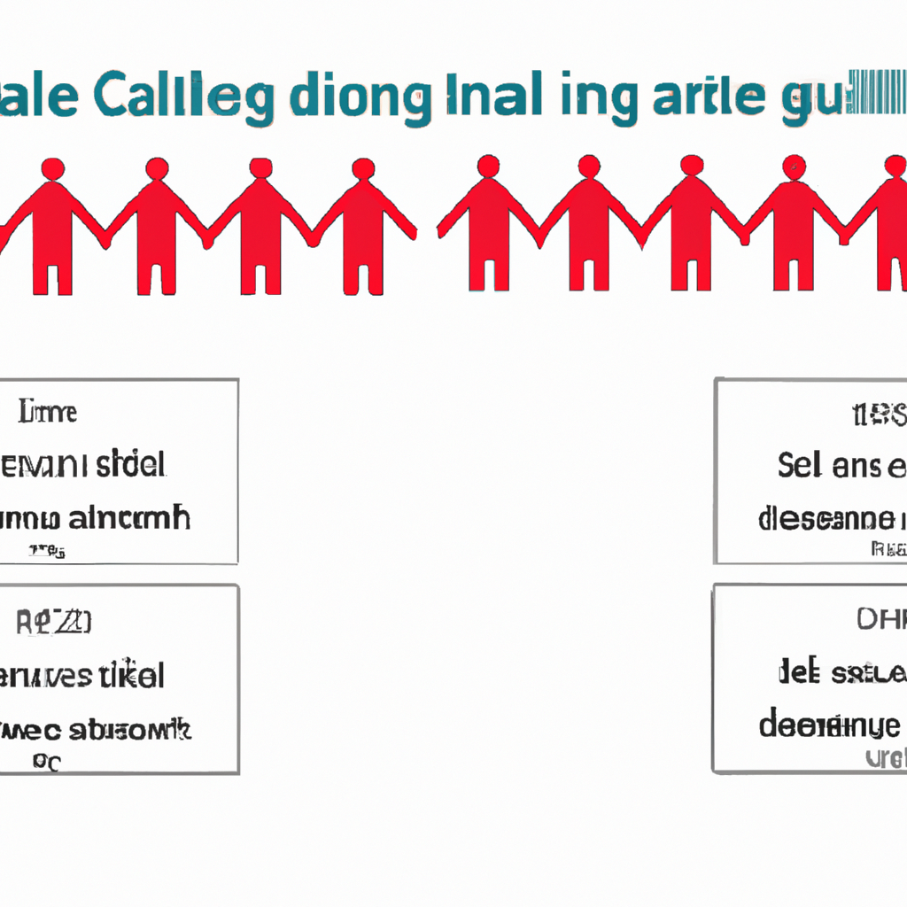
Original table:
Order ID | Customer Name | Item 1 | Item 2 | Item 3
---------------------------------------------------------
101 | John Smith | Shirt | Pants | Shoes
New table for repeating group:
Order ID | Item
------------------
101 | Shirt
101 | Pants
101 | Shoes
Primary key for new table: Order ID, Item

