Slide 2
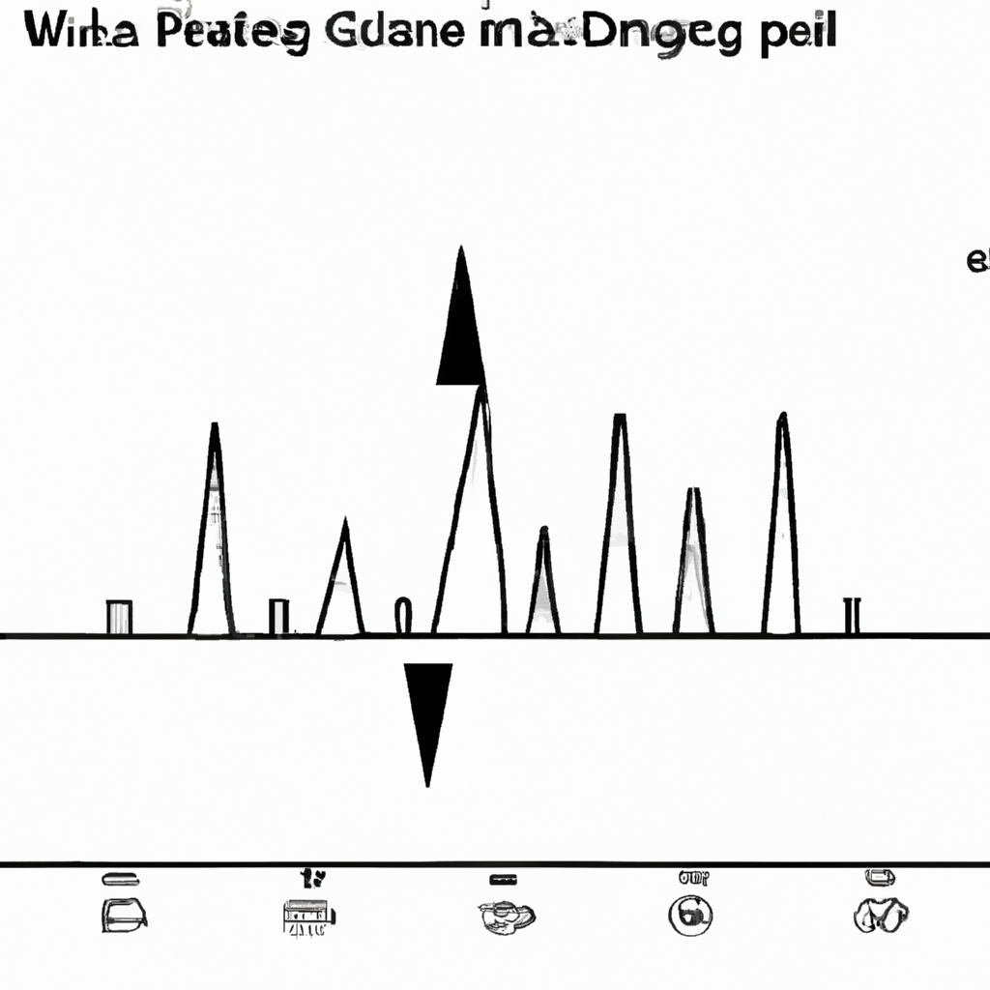
PWM is widely used in various applications such as controlling the speed of motors, regulating the intensity of lights, and in power management circuits. It is also commonly used in digital-to-analog converters and in audio amplifiers to generate analog signals from digital sources.
The duty cycle of a PWM signal refers to the percentage of time the signal is in the high state (ON) compared to the total period of the signal. The duty cycle determines the average power delivered to the load. A higher duty cycle corresponds to a higher average power, while a lower duty cycle results in a lower average power.
The frequency of the PWM signal refers to the rate at which the signal repeats itself. A higher frequency allows for smoother control and can reduce the effects of electromagnetic interference

