Slide 1


Slide 2
Introduction to workshop
>> What is special about this project?
>> Why this workshop?

Slide 3

Program for workshops
Wednesday:
>> Introduction to Lego Mindstorms and LeJos
>> Installing Intellejos
Thursday:
>> Basic LeJos concepts
>> Intellejos assignment 1
Friday:
>> Advances LeJos concepts
>> Intellejos assignment 2

Slide 4
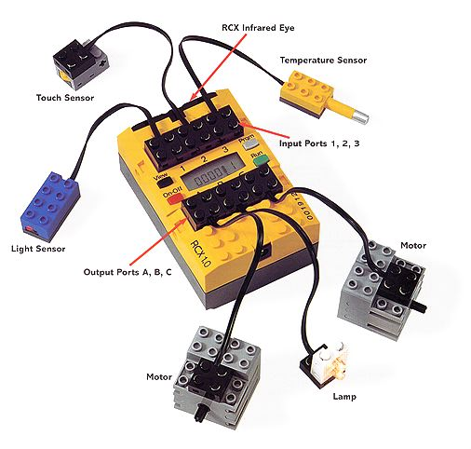
Mindstorms H/W functionalities
>> Sensor input
>> Button input
>> Actuator output
>> LCD output
>> IR communication
>> Computation

Slide 5
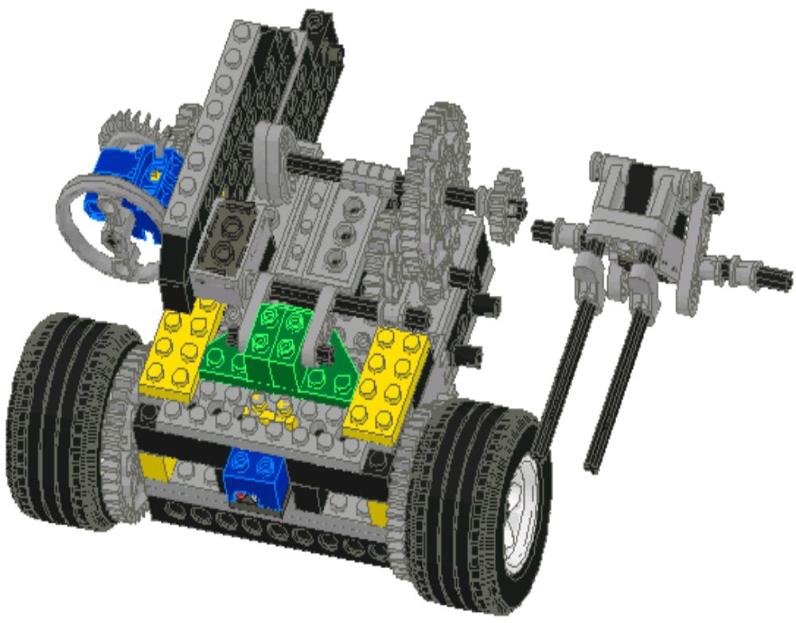

Basic Mindstorms procedure
>> Build lego

Slide 6
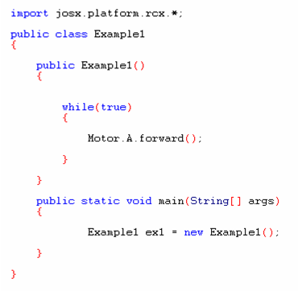
Basic Mindstorms procedure
>> Build lego
>> Write Java code

Slide 7
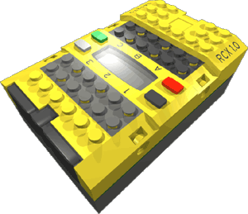
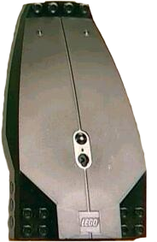
Basic Mindstorms procedure
>> Build lego
>> Write Java code
>> Upload software

Slide 8
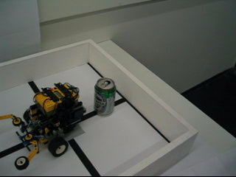
Basic Mindstorms procedure
>> Build lego
>> Write Java code
>> Upload software
>> Run robot

Slide 9
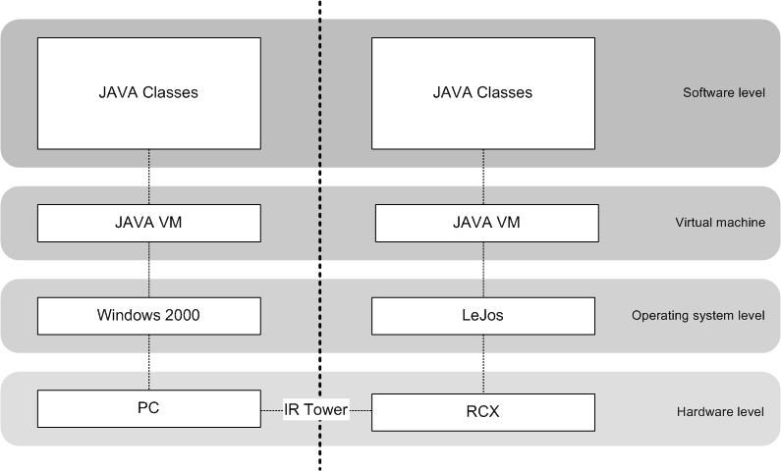
System architecture

Slide 10
What is LeJos?
Lego Java Operating System
Write Java code
Upload software

Slide 11

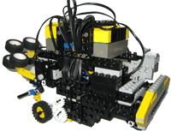
Lego Mindstorms and Industrial Design?

Slide 12
Lego Mindstorms and Industrial Design?
>> Rapid prototyping of mechanical solutions
>> Tool for learning JAVA programming
>> Getting used to embedded systems

