Slide 1


Slide 2
The LeJOS API
Application Programming Interface
Collection of packages with classes and interfaces that can be used within your classes by using the “import”-statement.
e.g.: import josx.platform.rcx.*;
import josx.util.*;
API documentation
This is your programming guide and library. Learn to work with this documentation as soon as possible and use it during your software development.
Refer to Java book chapter 6.13 for Java API
View documentation >>

Slide 3
Introduction
Solving problems within the restrictions of Lego Mindstorms requires a sophisticated strategy, a lot of creativity and even more energy!
Some restrictions…
>> Limited toolbox
>> 16 Kb memory for software
>> Battery power
>> Low processing speed
>> Restricted JAVA API
… lead to opportunities!

Slide 4

Problem strategy
Here you have most of your freedom. Be sure to use this!
Hardware strategy
Software strategy

Slide 5
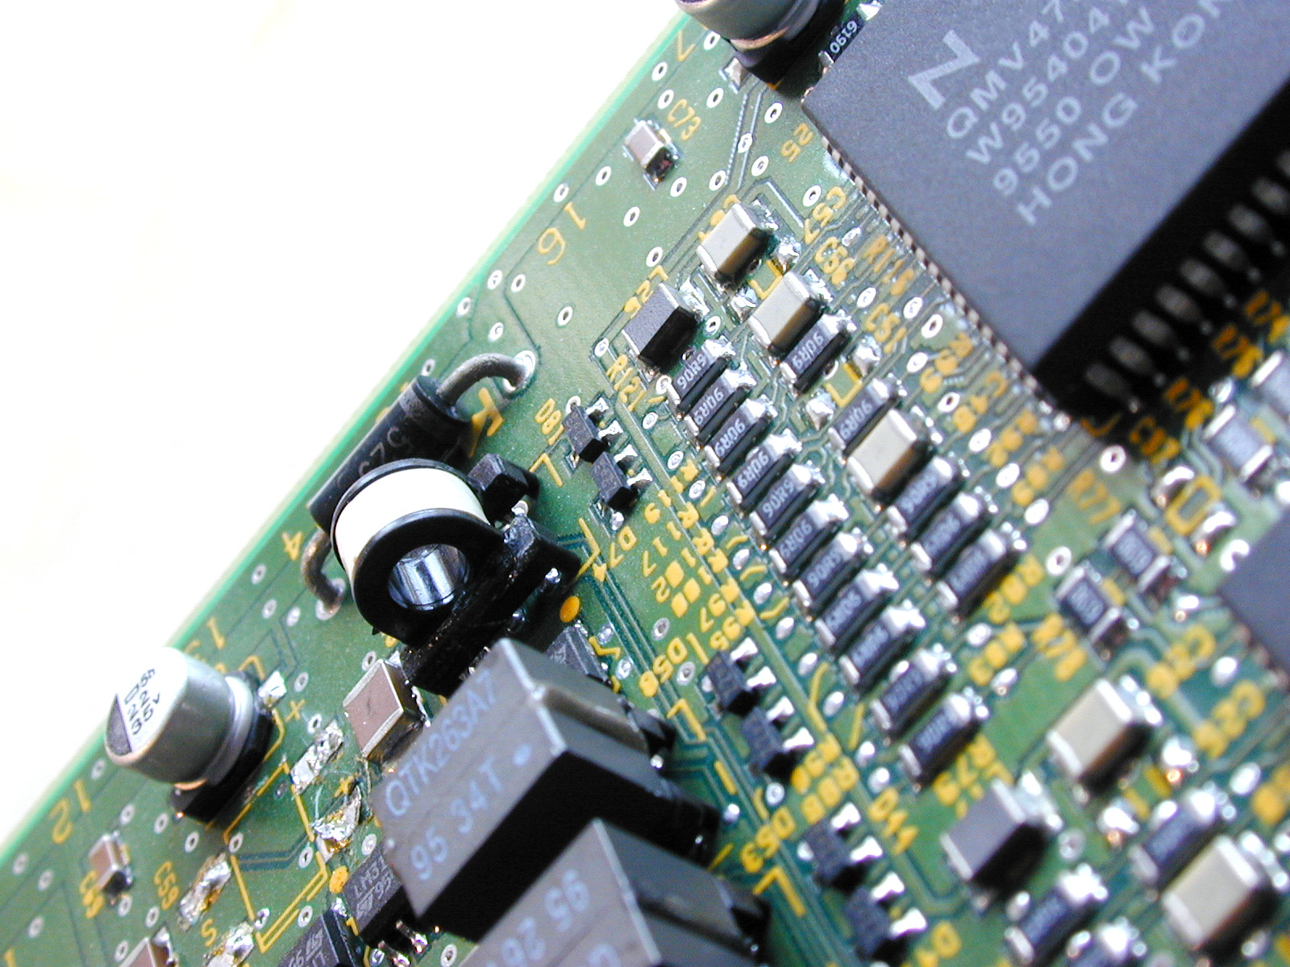
Problem strategy
Here you have most of your freedom. Be sure to use this!
Hardware strategy
Translate your game strategy into a hardware plan.
Software strategy

Slide 6
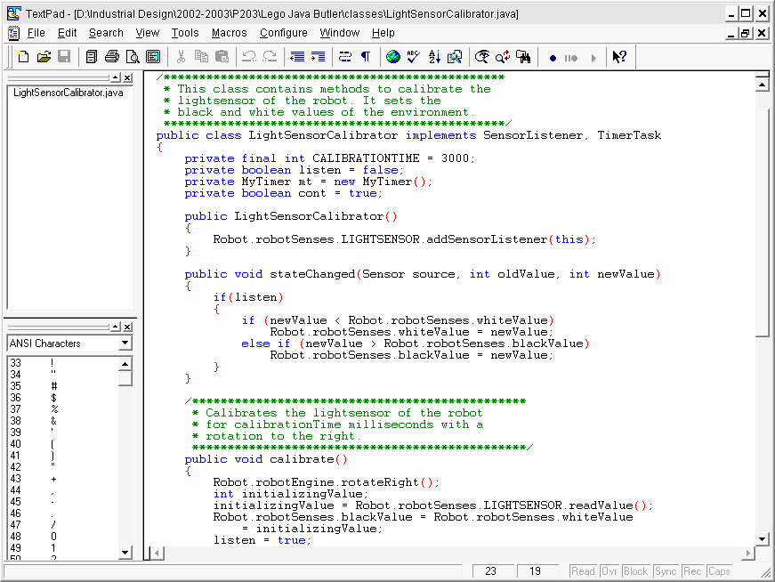
Problem strategy
Here you have most of your freedom. Be sure to use this!
Hardware strategy
Translate your game strategy into a hardware plan.
Software strategy
Model your classes to finish robot architecture (e.g. UML)

Slide 7
Programming strategies
Start with a plan!
Make a class-model to define the interconnections and relationships of different robot parts. Essential for both planning and task division!
UML specification language
(Unified Modeling Language)
Specific tool for OOP
Appendix G of your Java book
UML example >>

Slide 8
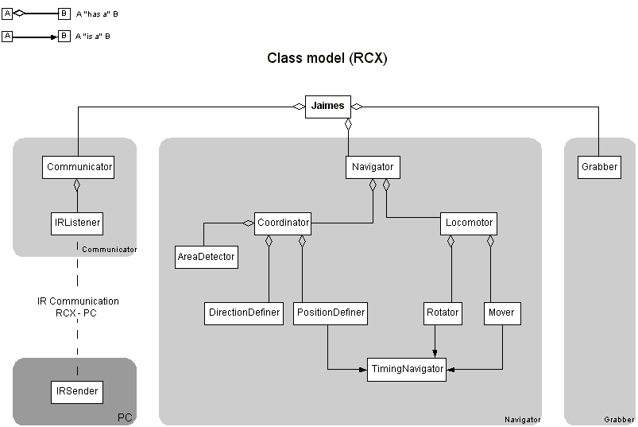

Slide 9
Programming strategies
Example of algorithmic strategy:
How to sort this list of numbers from small to big as fast as possible?
<89, 12, 45, 113, 4, 56, 32, 876, 16, 255>
Design patterns in Java
e.g. Event-driven programming
The use of design patterns in Java can increase the efficiency of your software significantly!
Design patterns example >>

Slide 10
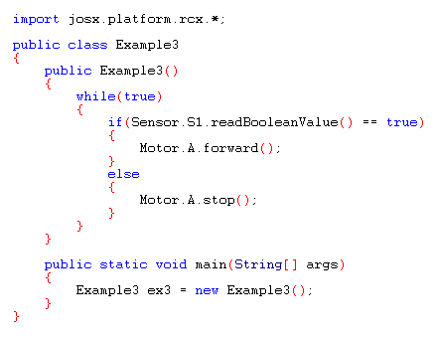
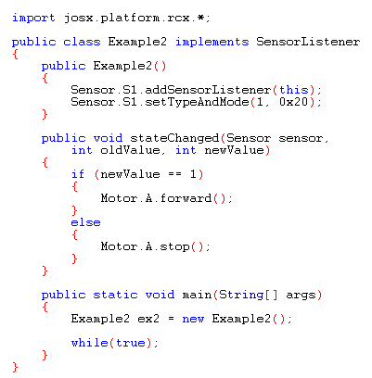
Sensor reading example

Slide 11
Sensor reading example
WARNING:
no perceptable difference
in small programs

Slide 12
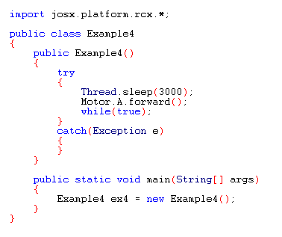
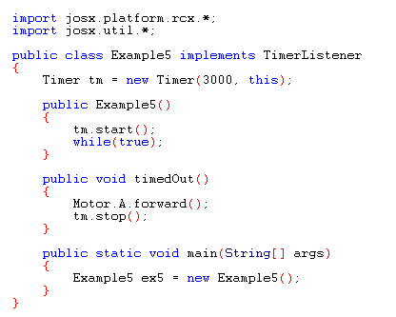
Timing example

Slide 13
Timing example
WARNING:
no perceptable difference
in small programs

Slide 14
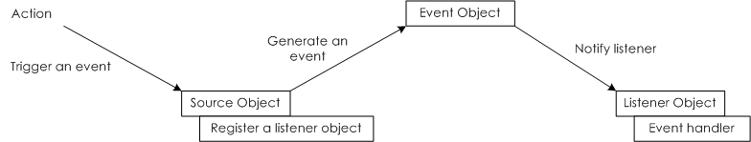
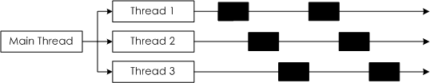
Programming strategy tips
>> Occupy the micro controller as less as possible! This delays timing and processing speed
>> Use the event-driven design pattern (chapter 10.11 of your Java book):
>> Go for multithreading by using the “Thread”-class or “Runnable”-interface (chapter 15)

