Slide 1
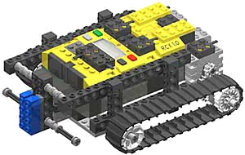
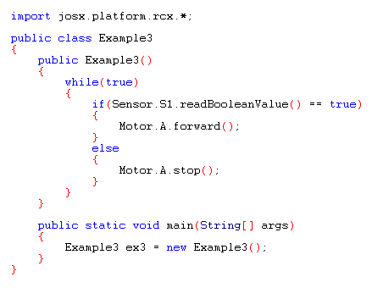

Slide 2
Inheritance
Reusing and extending a certain class in an adjusted form without rewriting it completely.
Superclass
Subclass
class Dier
{
int poten = 0;
void eten()
{
<<method body>>
}
}
class Mens extends Dier
{
int poten = 4; //overridden
int hersens = 3; //added
void lopen() //added
{
<<method body>>
}
}
New methods or instance variables can be added. Existing ones can be used or overrided.

Slide 3
Classes vs. Interfaces
Ways to model data
Class
Definition of properties and methods that are specific for a certain object.
(object = instance of Class)
Interface
An interface says: “This is how all classes that implement this interface look like”.
Provide a “protocol” between classes.
class Dier
{
int poten;
void eten()
{
<<method body>>
}
}
interface Dier
{
void eten(); // no body!
void slapen();
void bewegen();
}

Slide 4
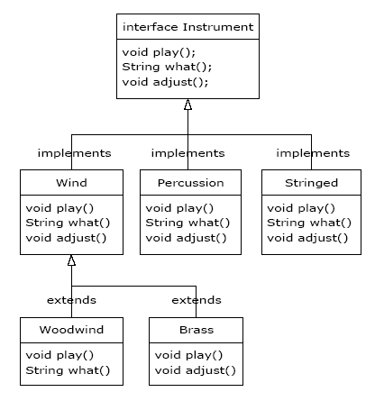
Interfaces examples

Slide 5
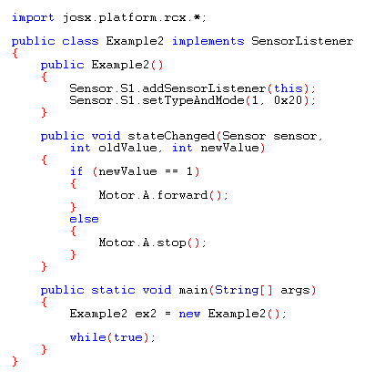
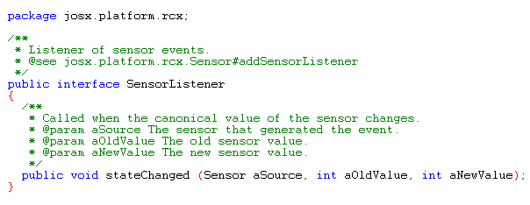
Interfaces examples

Slide 6
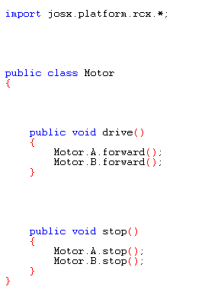
Encapsulation
Very useful to do efficient software development in a team.
How to encapsulate?

Slide 7
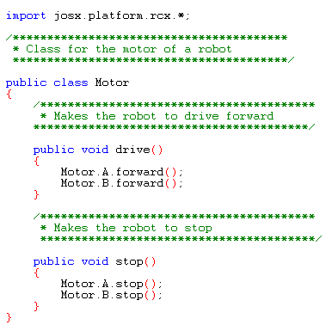
Encapsulation
Very useful to do efficient software development in a team.
How to encapsulate?
>> Document your code!

Slide 8
Encapsulation
Very useful to do efficient software development in a team.
How to encapsulate?
>> Document your code!
>> Use the javadoc program:
javadoc Motor.java
Now use the documentation instead of (sometimes hard to read) Java code to understand and use the class.

Slide 9
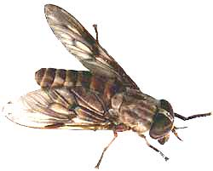
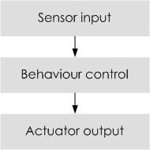
Behavior Control
A very popular design pattern for small, limited memory, “insect”-level programming.
Defined by Rodney Brooks
(MIT Artificial Intelligence Lab)
To react fast to changes in the environment.
Inspired by insects
“Hard-wired” thinking

Slide 10
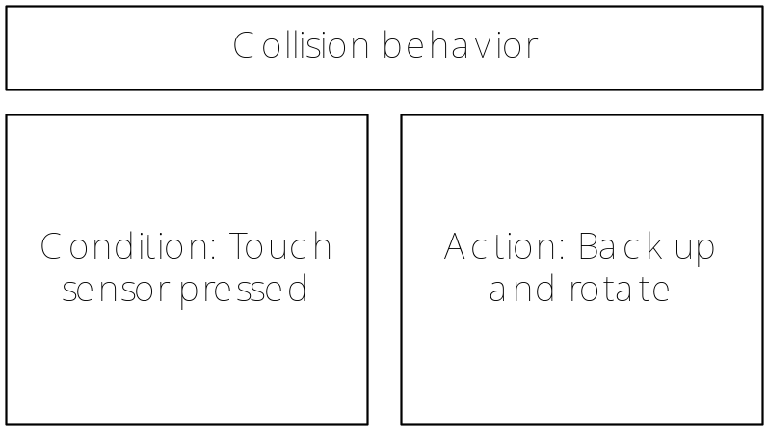
Behavior Theory
A behavior is a program the robot (or organism) follows for a period of time, caused by a certain observation.
Example:

Slide 11
Behavior Theory
Conditions, internal or external to the robot, can activate a behavior.
Behavior control concept = changing modes.
Building up several simple behaviors can theoretically form a complex logical model.
Example: Fire-Fighting Behavior Control
Condition | Behavior | Action | Priority
Temperature hotter in another area | Seak heat | Move toward heat | Low
Ultraviolet light sensor detects flame | Extinguish flames | Spay CO₂ | Medium
Temperature > 160° | Avoid flames | Move away from heat | Highest

Slide 12
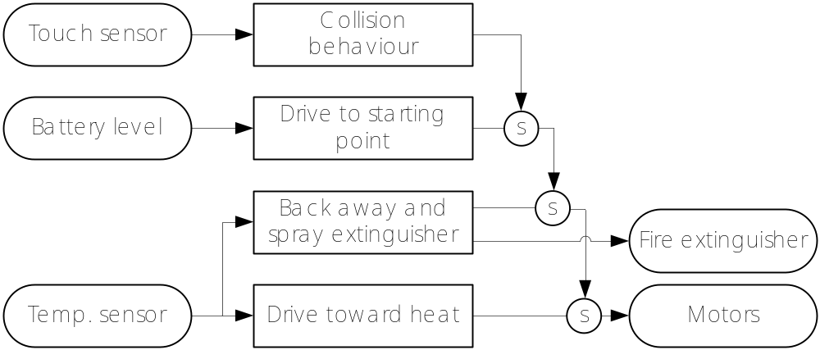
Behavior Theory
Sensors can be shared for determining conditions.
By setting priorities, the robot can determine which mode to break into, when more than one behavior will seek to be activated.
S = suppressed

Slide 13
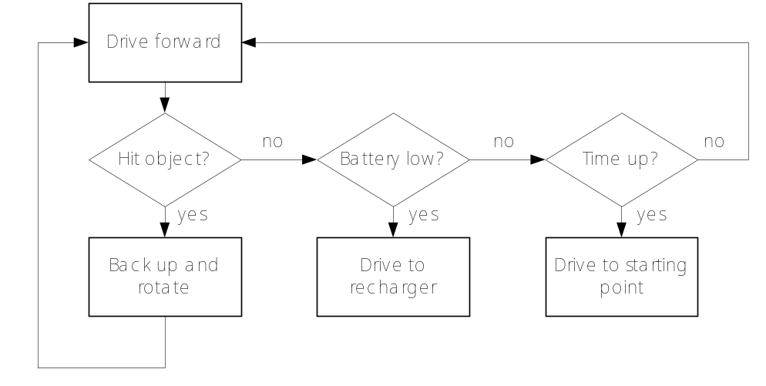
Programming Behavior with leJOS
Use diagrams to visualize behavior control model. This is required for structured programming.
Possible tools: State-transition diagrams and Petri-nets (assignment Interaction Design I)

Slide 14
Programming Behavior with leJOS
Documentation of the Behavior API can be found in the leJOS API documentation
The Behavior API
Behavior interface: implemented by a class that specifies a certain behavior
Arbitrator class: Arbitrator object regulates when each of the behaviors will become active
View documentation >>

Slide 15
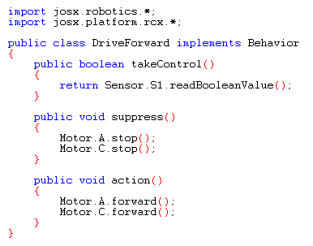
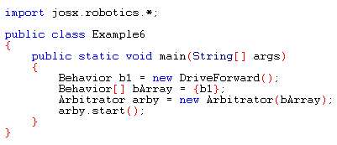
Behavior with leJOS design pattern

Slide 16
Practical Tips & Tricks
Sensors:
>> You can read different types of data from a sensor (boolean, raw, percentage).
>> You can use combinations of standard sensors to make new, powerful sensors.
e.g. a proximity sensor
Programming:
>> Work structured and prevent spaghetti code.
>> Divide programming tasks using class models (UML).
>> Good stealing is better then bad programming.
>> Learn the design patterns. (events, timers, threads, behavior,…)
>> Make plenty use of the API documentation.
>> Document your code thoroughly.

Slide 17
Practical Tips & Tricks
Debugging:
>> Use LCD and sound output for debugging.
>> Learn to check your code thoroughly before downloading it to the RCX to save a lot of time.
Some bottlenecks:
>> Experimenting is fun and very useful, but try not to waste too much time.
>> Assembling the different parts of robot software can take a lot of time.

