Slide 1
MODULE 5 QUESTION PAPER DISCUSSION
Tiju alex
Roll no 56

Slide 2
Explain Money Market? Mention its significance.
Market for short term funds which deals in monetary assets whose period of maturity is up to one year.
Close substitute for money.
Enables the raising of short term funds for meeting the temporary shortages of cash and obligations and the temporary deployment of excess for earning returns
Instruments
T Bills(Treasury Bills)
Commercial paper
Call money
Certificate of deposit
Commercial bill

Slide 3
What is Indian financial system? Explain its components?
the primary function of a financial system is “to provide a link between savings and investment for creation of wealth and to permit portfolio adjustment in the composition of existing wealth”.
It helps in creation of wealth by linking the savings with investments.
It also facilitates the flow of funds from the households (savers) to business firms (inventors) to aid in wealth creation and development of both the parties.

Slide 4
Components Of Indian Financial System
FINANCIAL INSTITUTIONS
FINANCIAL MARKETS
FINANCIAL INSTRUMENTS
FINANCIAL SERVICES

Slide 5
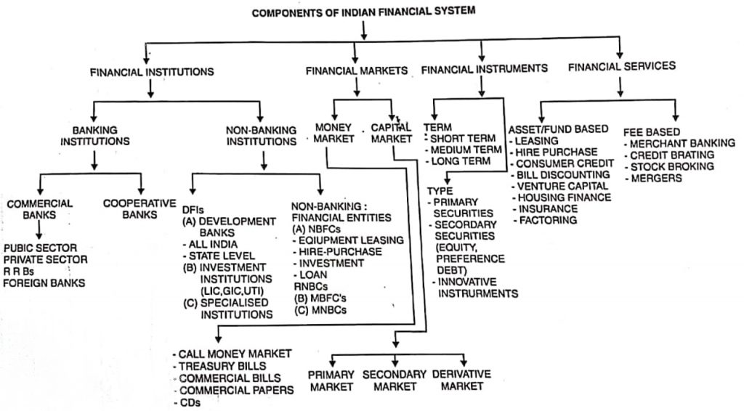

Slide 6
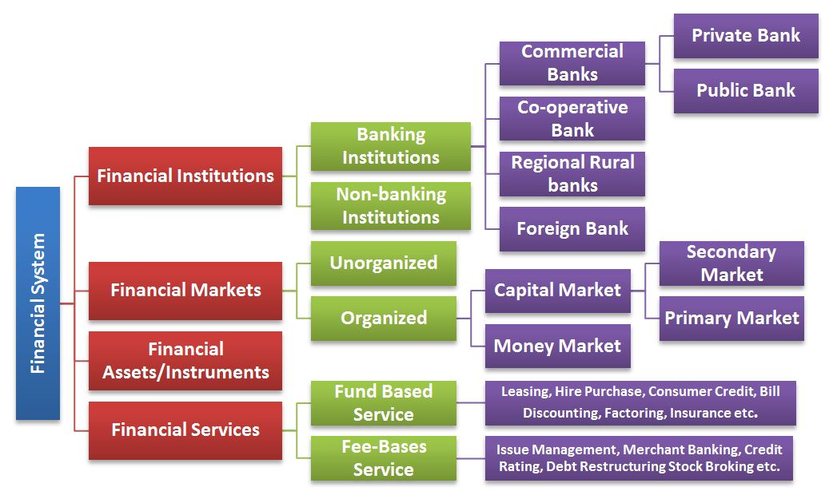

Slide 7
1. Financial Institutions
The financial institutions are intermediaries of financial markets which facilitate financial transactions between individuals and financial customers.
The financial institutions collects the money from individuals and invests that money in financial assets such as stocks, bonds, bank deposits and loans etc.
The following are the financial institutions :
Banking institutions: These are the banks and credit unions that collect money from the public in returns of interest on money deposits and use that money to advance loans of financial customers.
Non-banking institutions: These are brokerage firms, insurance and mutual funds companies that cannot college money as deposits but can sell financial products to financial customers

Slide 8
Regulatory institutions: RBI, SEBI, IRDA etc., which regulate the financial markets and protect the interests of the investors.
Intermediaries: Commercial banks, that provide the short term loans and other financial services to the individuals and corporate customers.
Non-intermediaries: Financial institutions like NABARD, IDBI etc. that provide long-term loans to corporate customers.

Slide 9
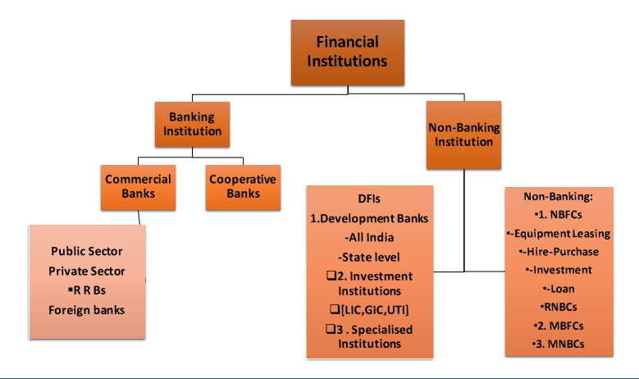

Slide 10
2. Financial Markets
Financial markets are the places where the buyers and sellers participate in trading of assets such as shares, bonds, currencies and other financial instruments.
Divided into capital market and money market.
While the capital market deals in long term securities having maturity period of more than 1 year, the money market deals with the short-terms debt instruments having maturity period of less than 1 year.

Slide 11
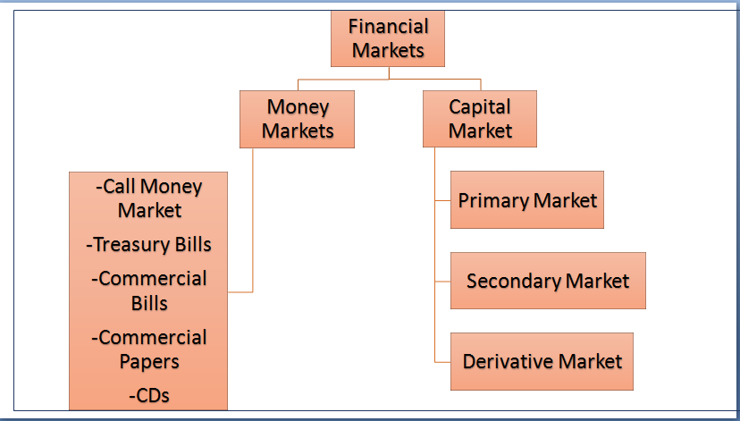

Slide 12
3. Financial Assets/Instruments
“A financial instrument is any contract that gives rise to a financial asset of one entity and a financial liability or equity instrument of another entity.”
– The Association of Chartered Certified Accountants (ACCA)
Financial assets include cash deposits, checks, loans, accounts receivable, letter of credit, bank notes and all other financial instruments that provide a claim against a person or a Financial Institution to pay either a specific amount on a certain future date or to pay the principal amount along with interest.

Slide 13
FINANCIAL INSTRUMENTS
TERM
-SHORT TERM
-MEDIUM TERM
-LONG TERM
TYPE
-PRIMARY SECURITIES
-SECONDARY SECURITIES
[EQUITY,PREFERENCE DEBT]
-INNOVATIVE INSTRUMENTS

Slide 14
4 Financial Services
The financial services are concerned with the design and delivery of financial instruments and advisory services to individuals and businesses with the area of banking and related institutions, personal financial planning, leasing, investment, assets, insurance etc.,

Slide 15
