Slide 1



TuningFork
Team #1

Slide 2
TuningFork
Automatic configuration optimization tool
The tool will find the optimal system configuration based on real inputs to get maximum system utilization and application performance.

Slide 3

Working hard looking for optimal system configuration?

Slide 4

TuningFork saves your time spent on system fine tuning and gives better results in comparison with manual tuning

Slide 5
How it works
Your application will have to implement pre-defined interface in order to run metrics and save results in csv file.
Every application run with different configuration set will create a line in csv file.
TuningFork will
Load csv file
Build model
Find optimal configuration set for the best results
Present metrics and results

Slide 6
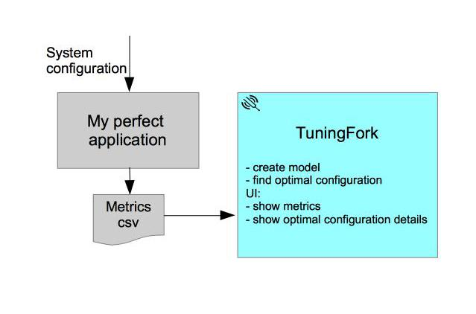
TuningFork flow

Slide 7

Modeling & Optimization
Ridge Regression
Search Optimization for HyperParameter: RandomizedSearch

Slide 8




Tech Stack
Python 3.x
Python libraries: numpy, scipy, sklearn
Test app - springboot app
Docker and Docker Compose for easy deployment
UI: React, C3 and material UI

Slide 9
Thank you!

