Slide 1
Data Science Mid Sem Project
Data Science
Manya Agrawal (2022281)
Tikam(2022542)
Syed Yasser (2022530)
Sunil Kumar(2022516)
Prajil Bhagat(2022359)

Slide 2
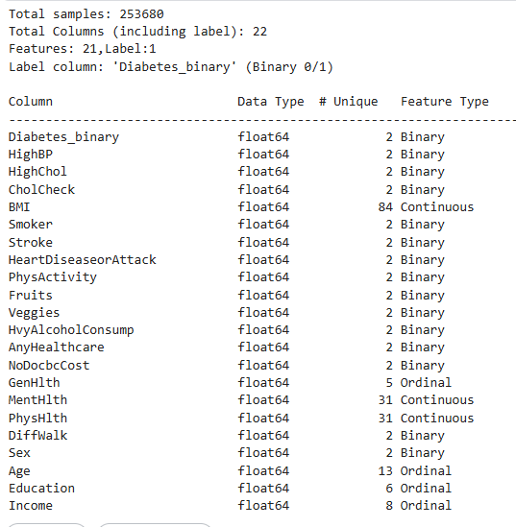
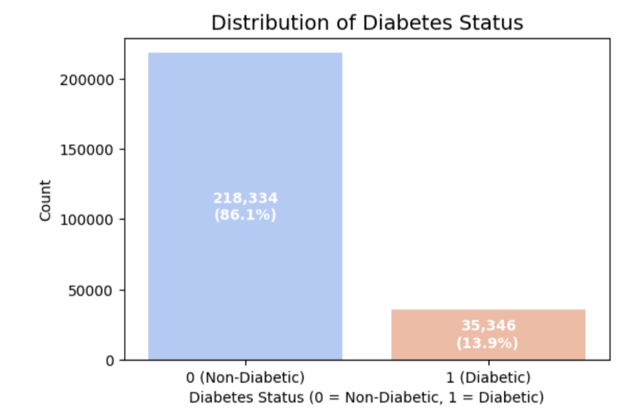
Dataset
Dataset:A dataset from the UCI Machine Learning Repository contains healthcare statistics and lifestyle survey information about people in general along with their diagnosis of diabetes. Link of Dataset.
Size of Dataset: (253680 x 22) ,21 Numerical Features AND 1 Binary Label
Features | Binary features :HighBP, HighChol, CholCheck, Smoker, Stroke, HeartDiseaseorAttack, PhysActivity, Fruits, Veggies, HvyAlcoholConsump, AnyHealthcare, NoDocbcCost, DiffWalk, Sex. Continuous features : BMI, MentHlth, and PhysHlth. Ordinal features :GenHlth, Age, Education, Income.
Label (Binary) | Diabetes_012 as the target label. Non-Diabetic(0): 218,334(86.1%) Diabetic(1): 35,346(13.9%)
Null Values | There is no NULL value in any of the Features and Label.

Slide 3
Problem Statement
Problem:
Analysing the health and lifestyle indicators to identify what are the key features contributing to diabetes.
Objective:
To analyse health, lifestyle, and demographic indicators of individuals.
To identify key features that significantly contribute to diabetes risk.
To understand patterns and correlations between different health factors and diabetes.
To provide insights for early detection and informed preventive strategies.
Importance:
Enables early identification of individuals at risk of diabetes
Helps healthcare professionals design targeted interventions and preventive strategies.
Supports informed decision-making and efficient healthcare resource allocation.
Facilitates personalized recommendations to reduce diabetes prevalence and complications.

Slide 4
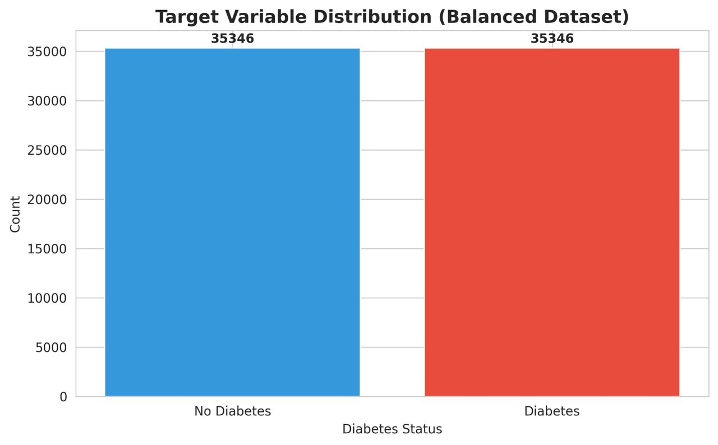
Initial Preprocessing
Balancing Dataset:The original dataset was highly imbalanced with 86.1% of Non-Diabetic and 13.9% Diabetic.
After balancing, both classes have equal representation, preventing the model from being biased toward the majority class and improving predictive performance.So Data now has 70,692 instances with 21 features.Now data has equal no instances of Binary Labels.
Unbalanced to Balanced

Slide 5
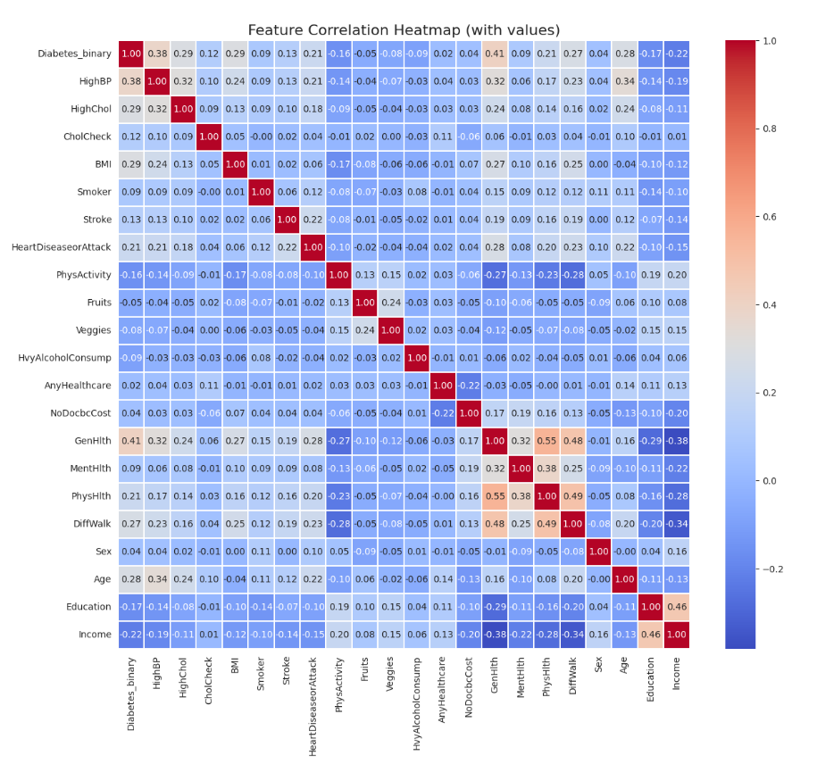
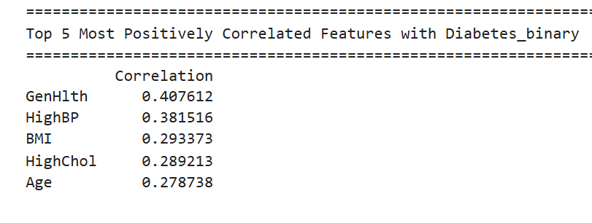
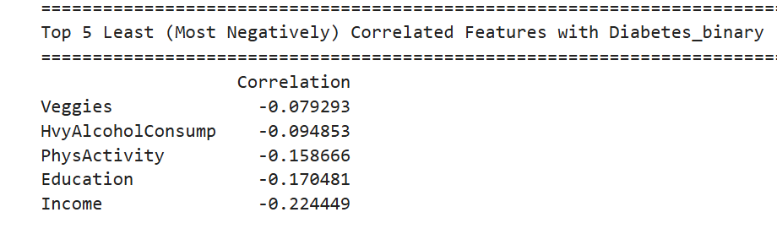
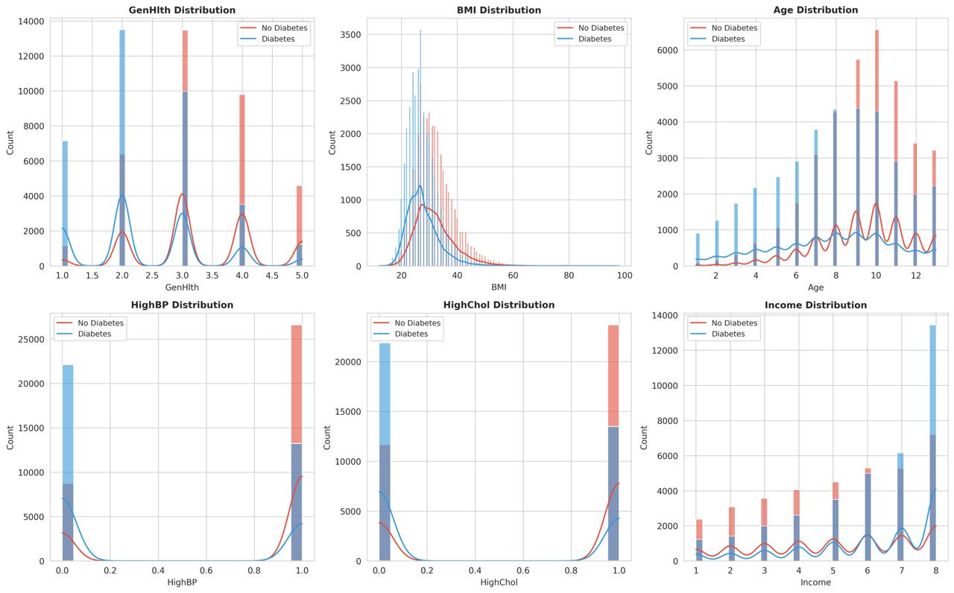
Exploratory Data Analysis

Slide 6
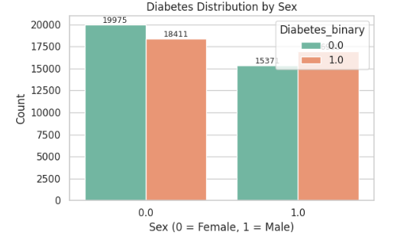
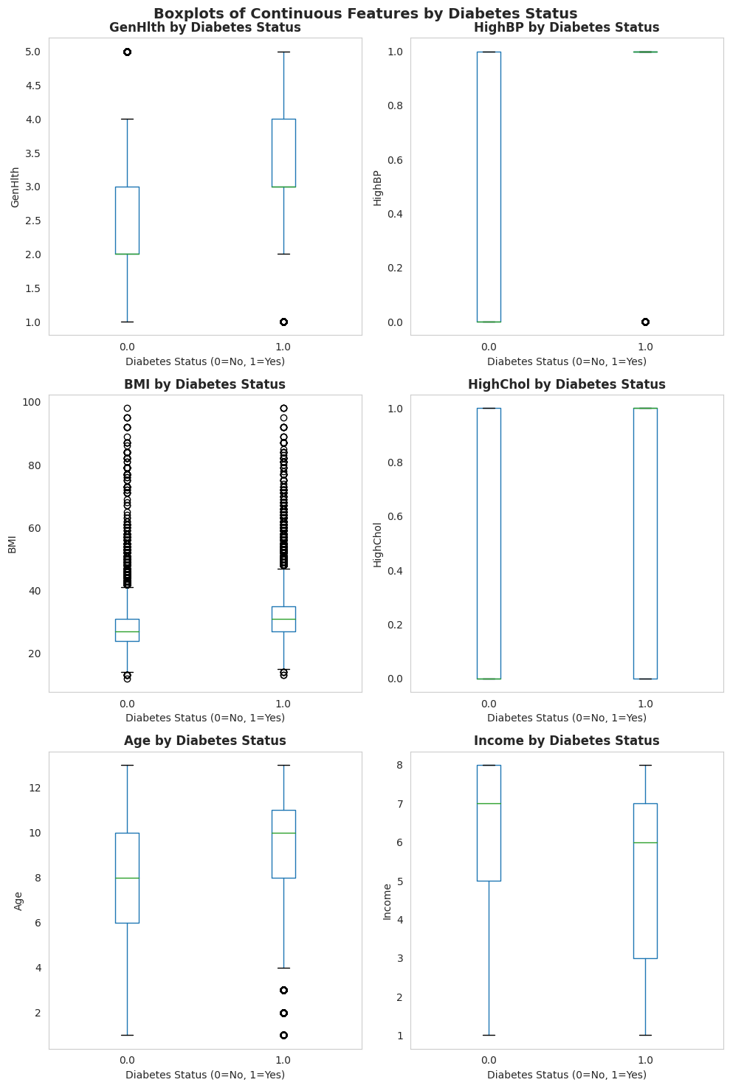
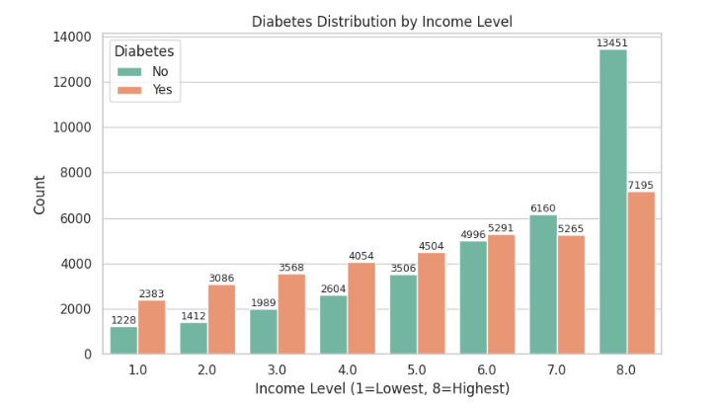
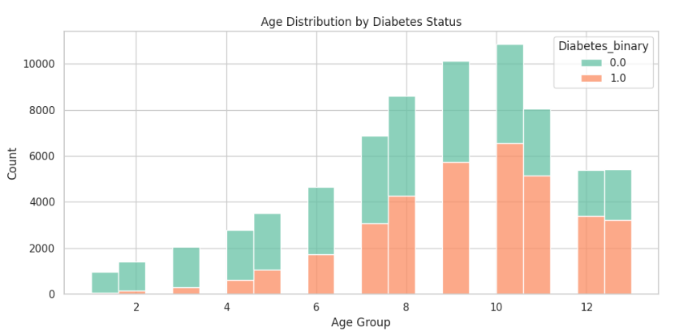
Exploratory Data Analysis
Key Insights from Data Analysis
Duplicate Records: The dataset contains 1635 duplicate rows,These rows needs to be removed.
Dataset does not have any Null Values ,Across All Features and Binary Label
Gender Effect: Males (Sex = 1) show a slightly higher diabetes prevalence compared to females, indicating a mild gender-linked risk difference.
Age Association: Diabetes frequency rises sharply with age, especially among middle-aged and senior groups — consistent with physiological risk factors.
Income Gradient: Lower income levels along with Educational Levels correlate with higher diabetes incidence, suggesting socioeconomic and lifestyle influence.
Correlation Patterns: Variables like BMI, HighBP, HighChol, and PhysActivity show strong positive correlation with diabetes status, confirming their predictive relevance.

Slide 7
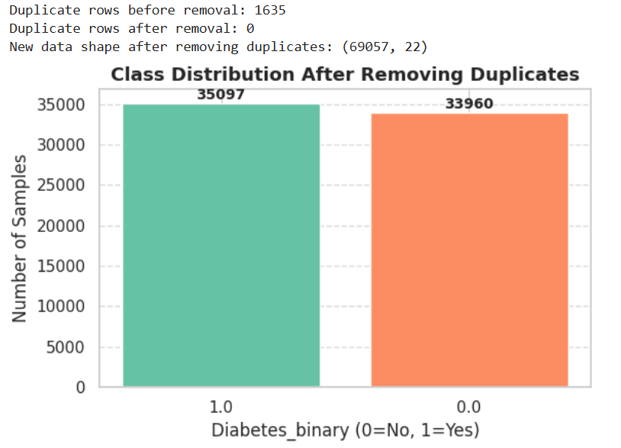
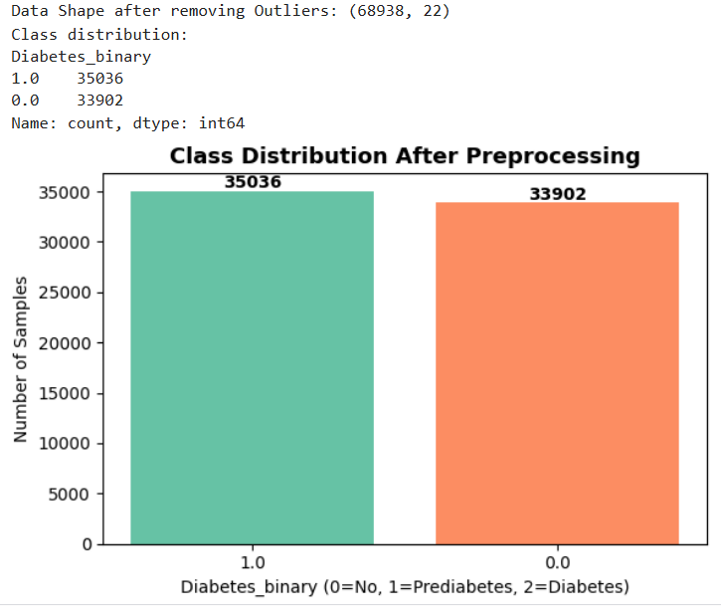
Preprocessing
Duplicate Records:Duplicate rows artificially inflate the dataset, giving the model repeated examples. This can bias the model to learn these repeated patterns, potentially leading to overfitting.Now model learns from unique samples only,which Improves generalization to unseen data.
Extreme outliers in continuous features - especially BMI (119 points removed) i.e beyond 3 standard deviation - were removed to reduce noise and distortion. Features were classified as Binary, Continuous, or Ordinal, cleaning and balancing the dataset for better model performance.

Slide 8
Hypothesis Tests And Validation
BMI vs Diabetes_binary:
Hypothesis 1 :
H₀: Mean BMI is the same for individuals with and without diabetes.
H₁: Mean BMI differs between individuals with and without diabetes.
Test: Independent t-test
Validation: Compare p-value with α = 0.05. If p < 0.05 → reject H₀.
HighBP vs Diabetes_binary
Hypothesis 2 :
H₀: High blood pressure occurrence is independent of diabetes status.
H₁: High blood pressure occurrence depends on diabetes status.
Test: Chi-Square Test of Independence
Validation: Use contingency table; p-value < 0.05 → reject H₀.
Result: t-statistic = 82.677, p-value < 0.0001
Interpretation: The difference in BMI between the two groups is highly significant. Diabetic individuals tend to have higher BMI.
Result: Chi2 = 9531.48, p-value < 0.0001
Interpretation: There is a strong association between high blood pressure and diabetes. Individuals with high BP are more likely to have diabetes.

Slide 9
Hypothesis Tests And Validation
GenHlth (General Health) vs Diabetes_binary
Hypothesis 3 :
H₀: General health rating distribution is independent of diabetes status.
H₁: General health rating distribution depends on diabetes status.
Test: Chi-Square Test of Independence
Validation: p-value < 0.05 indicates association.
Sex vs Diabetes_binary
Hypothesis 4 :
H₀: Sex distribution is independent of diabetes status.
H₁: Sex distribution depends on diabetes status.
Test: Chi-Square Test of Independence
Validation: p-value < 0.05 → reject H₀
Result: Chi2 = 11332.83, p-value < 0.0001
Interpretation: Self-reported general health is significantly associated with diabetes. Poorer health ratings correlate with higher diabetes prevalence.
Result: Chi2 = 125.236, p-value < 0.0001
Interpretation: Sex is significantly associated with diabetes, though the effect is smaller compared to health and BMI factors.

Slide 10
Hypothesis Tests And Validation
Education vs Diabetes_binary
Hypothesis 5 :
H₀: Education level distribution is independent of diabetes status.
H₁: Education level distribution depends on diabetes status.
Test: Chi-Square Test of Independence
Validation: Check p-value; if p < 0.05 → reject H₀.
Income vs Diabetes_binary
Hypothesis 6 :
H₀: Mean income is the same for diabetic and non-diabetic groups.
H₁: Mean income differs between diabetic and non-diabetic groups.
Test: Independent t-test
Validation: p-value < 0.05 → reject H₀.
Result: Chi2 = 1794.186, p-value < 0.0001
Interpretation: Education level has a significant association with diabetes. Lower education levels show higher diabetes prevalence.
Result: t-statistic = -57.136, p-value < 0.0001
Interpretation: There is a significant difference in income between groups. Lower income is associated with higher diabetes prevalence.

Slide 11
References
https://archive.ics.uci.edu/dataset/891/cdc+diabetes+health+indicators
https://www.kaggle.com/datasets/alexteboul/diabetes-health-indicators-dataset

