Slide 1

Servlet

Slide 2
Apache Tomcat
Is an Open Source implementation of :
Web Server - Coyote
Servlet Container - Catalina
JSP Engine - Jasper
Java EL
Web Socket

Slide 3
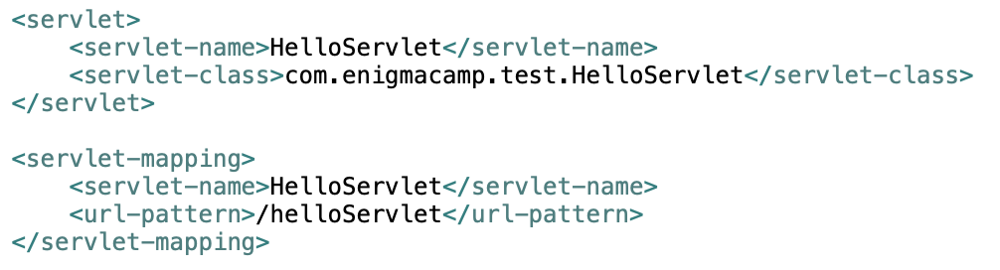
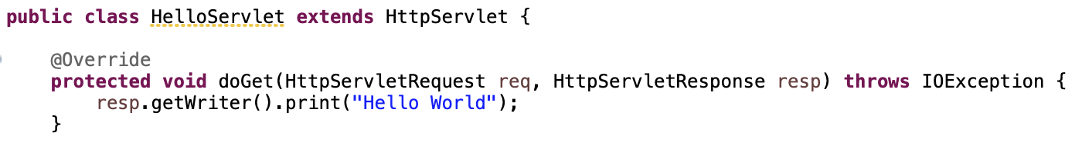
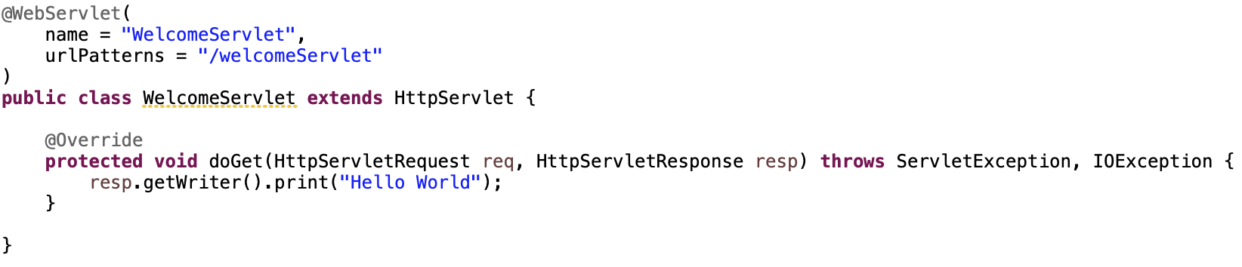
Servlet Declaration
web.xml
Annotation

Slide 4
Servlet Life Cycle

Slide 5
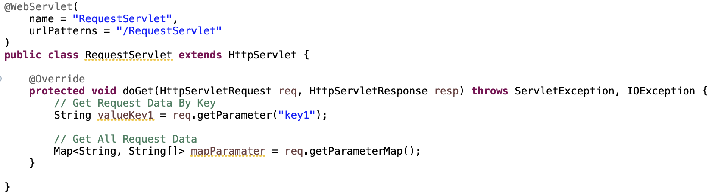
Request Data
http://localhost:8080/RequestServlet?key1=value1&key2=value2

Slide 6
Servlet MVC

Slide 7
forward vs sendRedirect
forward() method | sendRedirect() method
The forward() method works at server side. | The sendRedirect() method works at client side.
It sends the same request and response objects to another servlet. | It always sends a new request.
It can work within the server only. | It can be used within and outside the server.
Example: request.getRequestDispacher("servlet2").forward(request,response); | Example: response.sendRedirect("servlet2");

Slide 8
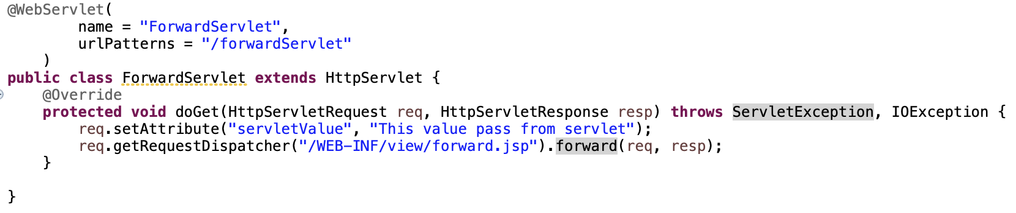
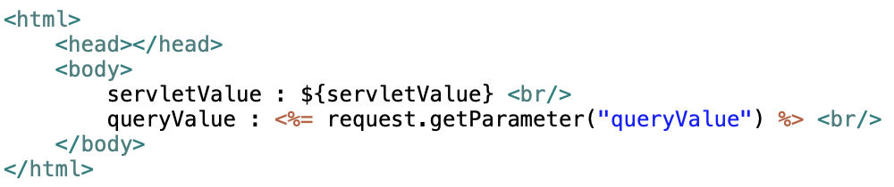
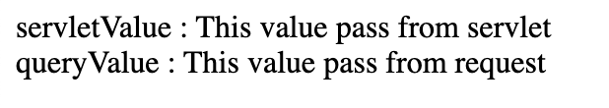
forward
http://localhost:8080/TestServlet/forwardServlet?queryValue=This%20value%20pass%20from%20request
Servlet
JSP
Output

Slide 9
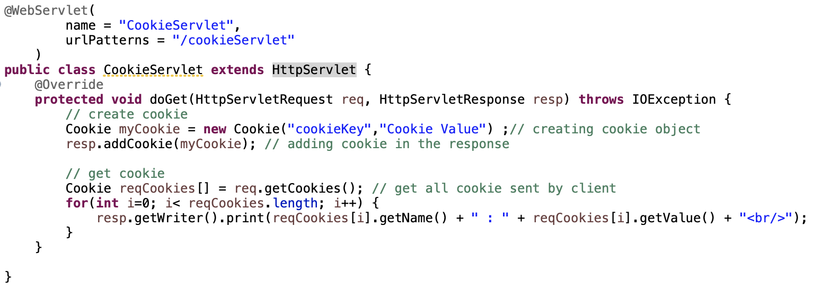
Cookie
Piece of information is persisted between the multiple client requests.
Stored and maintained at client side(browser)
Store textual data

Slide 10
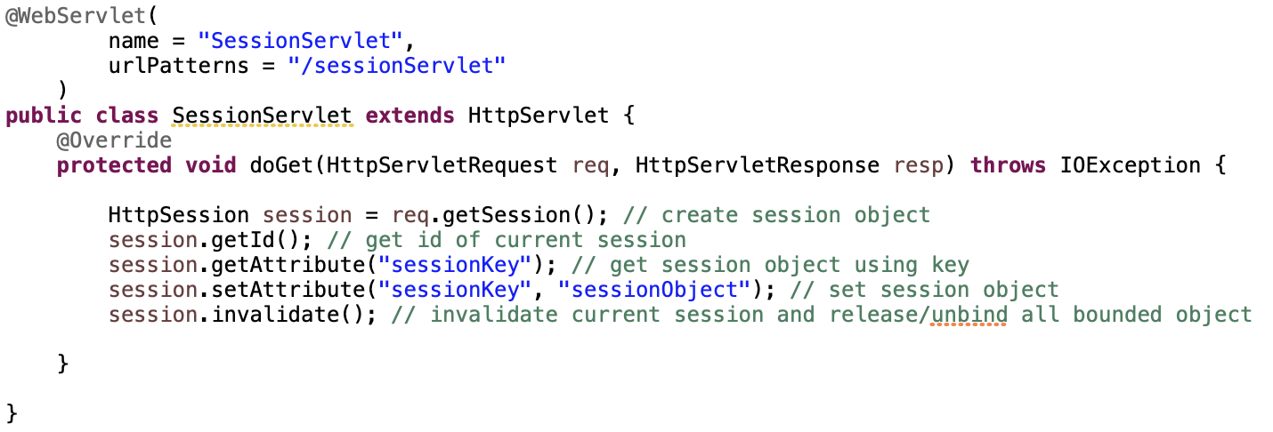
Session
a way to maintain state (data) of an user
Stored and maintained at server side
Store object data

