Slide 1
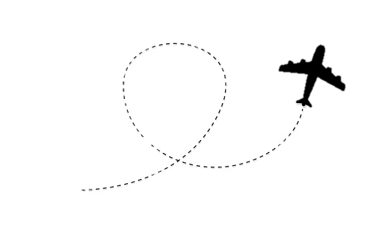
AIRLINE SERVICE PROCESS SYSTEM
PHOENIX AIRLINES (PVT)

Slide 2

About PHOENIX AIRLINES
Currently has a small online booking system.
Most system processes are done manually
User management
Flight management
Ticket management
Due to COVID guidelines, they can’t conduct processes manually

Slide 3
ABOUT US
6 developers
Thiwanki Chamudi Dulari Hasini Arshad Praveen

Slide 4

OBJECTIVES
General
Specific
Simple and elegant
User friendly
Powerful
Ticket reservation
Process management
Administration

Slide 5
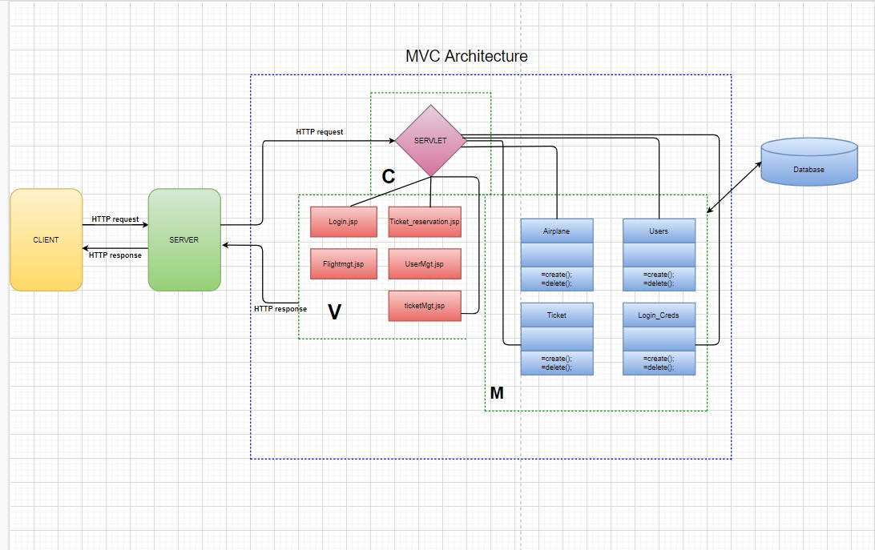
Chosen Architecture MVC
System Design architecture

Slide 6
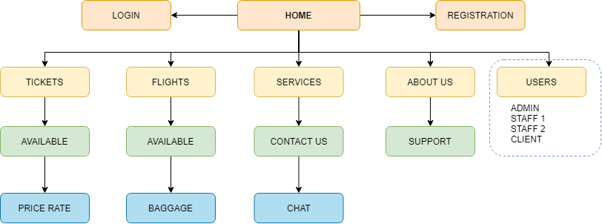
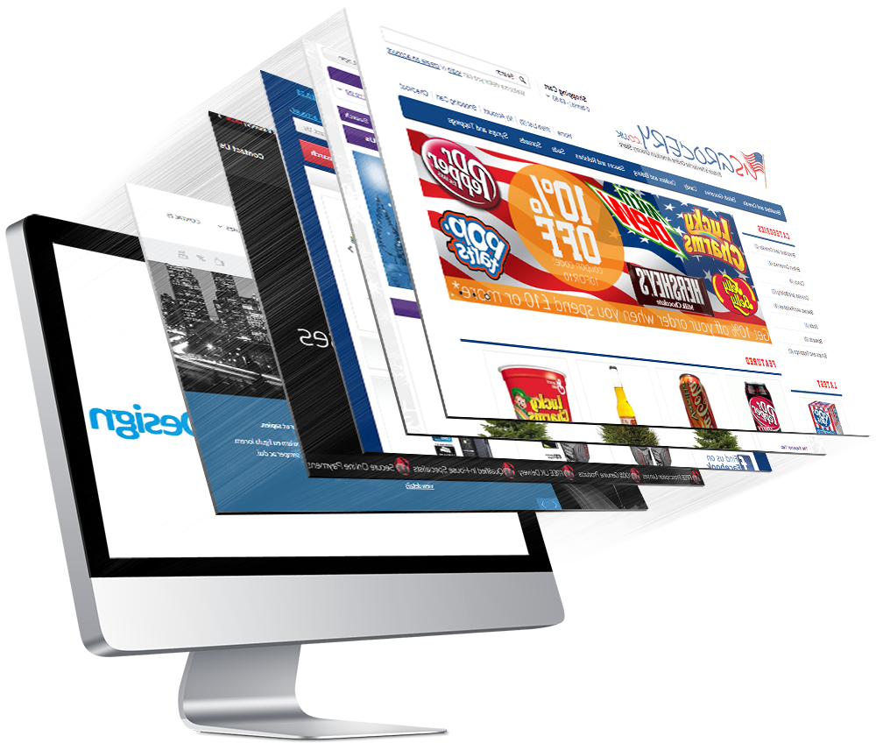
SITE MAP

Slide 7
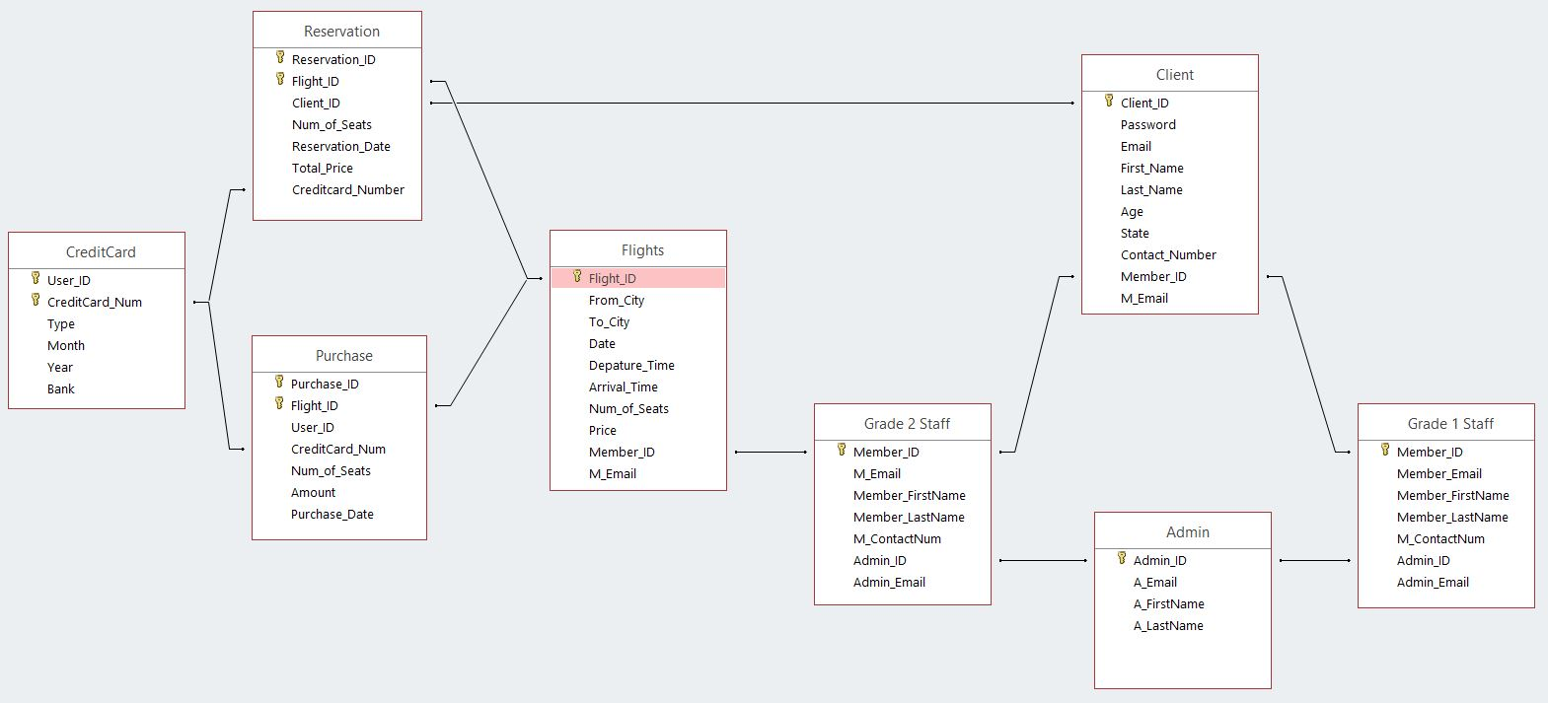
Database of the system

Slide 8

WBS
Phoenix Airline PVT Flight Booking System
Collect Data
Project UI
Servers
Database Tables
Implementation
verification
Requirements
Design
Analysis Function
divide task
Hardware & software
servelet
netbeans
Database
Database Schema
My Sql
Codings
testing

Slide 9
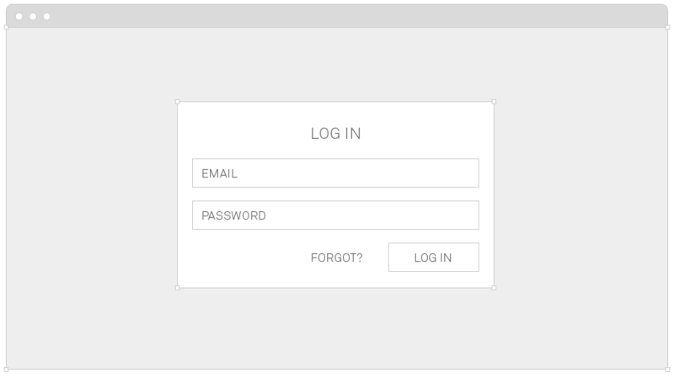
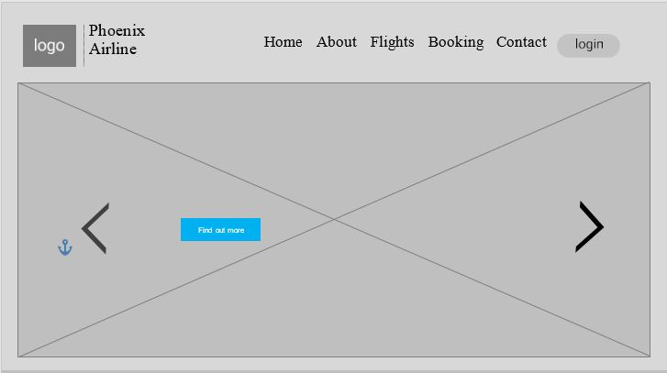
GUI illustration using wireframes

Slide 10
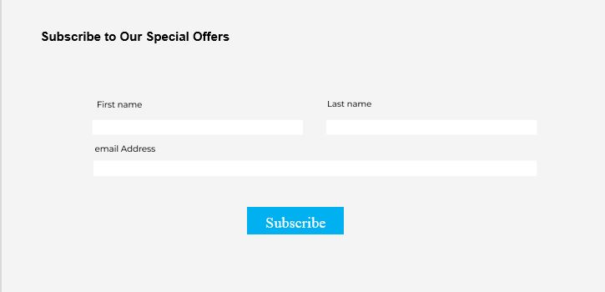
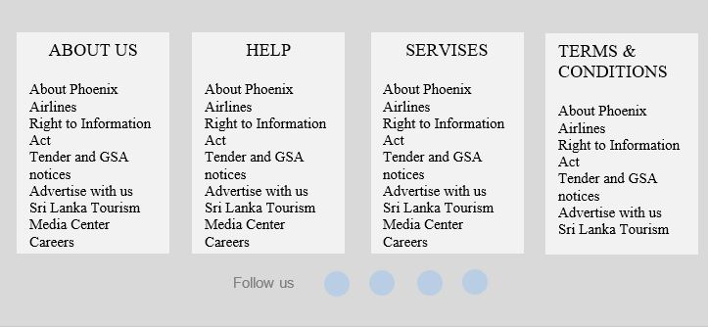
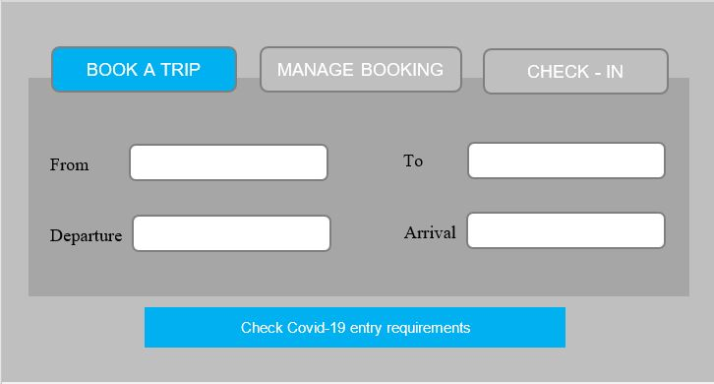
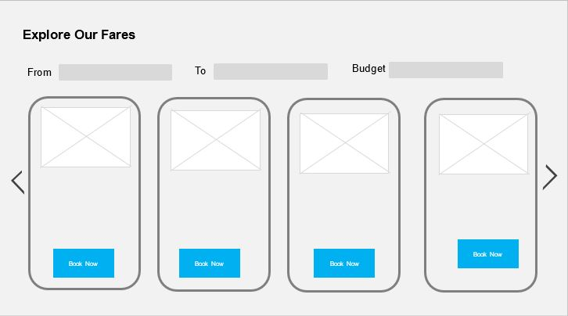

Slide 11
THE END

