Slide 1
What is JSON?
Stands for JavaScript Object Notation
Is a lightweight data-interchange format
Is language independent
Is "self-describing" and easy to understand

Slide 2
Json array
var employees = [
{"firstName": "John", "lastName": "Doe"},
{"firstName": "Anna", "lastName": "Smith"},
{"firstName": "Peter", "lastName": "Jones"}
];

Slide 3
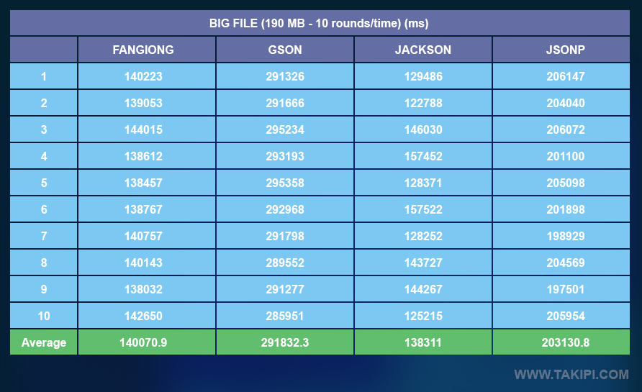

Slide 4
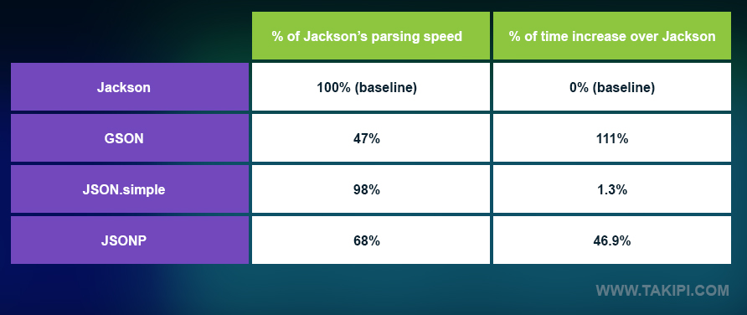

Slide 5


Slide 6


Slide 7
Conclusion
If you have an environment that deals often or primarily with big JSON files, then Jackson is your library of interest. GSON struggles the most with big files.
If your environment primarily deals with lots of small JSON requests, such as in a micro services or distributed architecture setup, then GSON is your library of interest. Jackson struggles the most with small files.
If you end up having to often deal with both types of files, JSON.simple came in a very close 2nd place in both tests, making it a good workhorse for a variable environment. Neither Jackson nor GSON perform as well across multiple files sizes.

Slide 8
Convert Java object to JSON
(Jackson)
ObjectMapper mapper = new ObjectMapper();
User user = new User();
//Object to JSON in file
mapper.writeValue(new File("c:\\user.json"), user);
//Object to JSON in String
String jsonInString = mapper.writeValueAsString(user);

Slide 9
Convert JSON to Java object
(Jackson)
ObjectMapper mapper = new ObjectMapper();
String jsonInString = "{'name' : 'mkyong'}";
//JSON from file to Object
User user =
mapper.readValue(new File("c:\\user.json"), User.class);
//JSON from String to Object
User user = mapper.readValue(jsonInString, User.class);

Slide 10
JSON.Simple
JSONObject obj = new JSONObject();
obj.put("name", "foo");
obj.put("num", new Integer(100));
obj.put("balance", new Double(1000.21));
obj.put("is_vip", new Boolean(true));
System.out.print(obj);

