Slide 1
XML
XML stands for EXtensible Markup Language.
XML was designed to store and transport data.
XML was designed to be both human- and machine-readable.

Slide 2
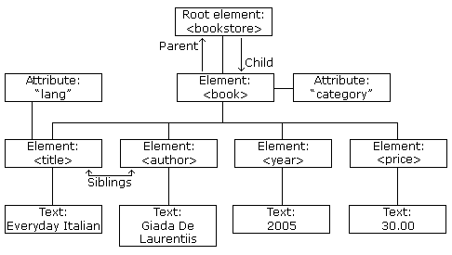
XML Tree

Slide 3
XML Syntax Rules
XML Documents Must Have a Root Element
<root> <child> <subchild>.....</subchild> </child> </root>
This line is called the XML prolog
<?xml version="1.0" encoding="UTF-8"?>
The XML prolog is optional. If it exists, it must come first in the document

Slide 4
XML Syntax Rules
All XML Elements Must Have a Closing Tag
XML Tags are Case Sensitive
XML Attribute Values Must be Quoted
Entity References
If you place a character like "<" inside an XML element, it will generate an error

Slide 5
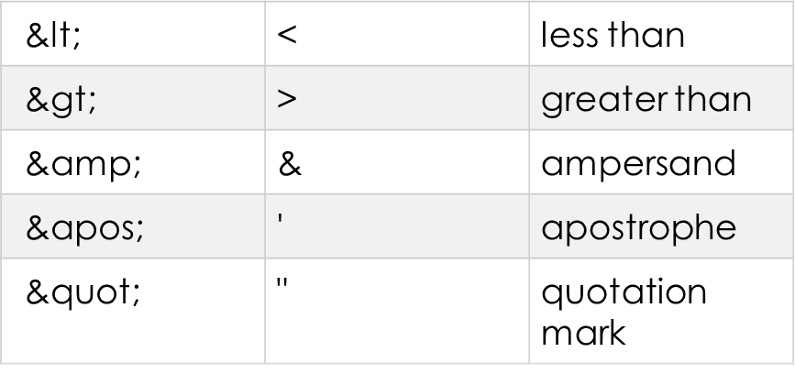

Slide 6
What is an XML Element?
An XML element is everything from (including) the element's start tag to (including) the element's end tag.
An element can contain:
text
attributes
other elements
or a mix of the above

Slide 7
XML Attributes
XML elements can have attributes, just like HTML.
Attributes are designed to contain data related to a specific element.
XML Attributes Must be Quoted
Attributes
<person gender="female"> <firstname>Anna</firstname> <lastname>Smith</lastname> </person>
Elements
<person> <gender>female</gender> <firstname>Anna</firstname> <lastname>Smith</lastname> </person>

Slide 8
XML DTD
An XML document with correct syntax is called "Well Formed".
An XML document validated against a DTD is both "Well Formed" and "Valid".
#PCDATA means parse-able text data.
<!DOCTYPE note [ <!ELEMENT note (to,from,heading,body)> <!ELEMENT to (#PCDATA)> <!ELEMENT from (#PCDATA)> <!ELEMENT heading (#PCDATA)> <!ELEMENT body (#PCDATA)> ]>

Slide 9
An entity has three parts: an ampersand (&), an entity name, and a semicolon (;).
<?xml version="1.0" encoding="UTF-8"?> <!DOCTYPE note [ <!ENTITY writer "Writer: Donald Duck."> <!ENTITY copyright "Copyright: W3Schools."> ]> <note> <to>Tove</to> <from>Jani</from> <heading>Reminder</heading> <body>Don't forget me this weekend!</body> <footer>&writer;copyright;</footer> </note>

Slide 10
XML Schema
XML Schema is an XML-based alternative to DTD:
<xs:element name="note"> <xs:complexType> <xs:sequence> <xs:element name="to" type="xs:string"/> <xs:element name="from" type="xs:string"/> <xs:element name="heading" type="xs:string"/> <xs:element name="body" type="xs:string"/> </xs:sequence> </xs:complexType> </xs:element>

Slide 11
XML Schemas are More Powerful than DTD
XML Schemas are written in XML
XML Schemas are extensible to additions
XML Schemas support data types
XML Schemas support namespaces

Slide 12
<root> <h:table xmlns:h="http://www.w3.org/TR/html4/"> <h:tr> <h:td>Apples</h:td> <h:td>Bananas</h:td> </h:tr> </h:table> <f:table xmlns:f="http://www.w3schools.com/furniture"> <f:name>African Coffee Table</f:name> <f:width>80</f:width> <f:length>120</f:length> </f:table> </root>

Slide 13
Java DOM Parser
an official recommendation of the World Wide Web Consortium (W3C)
It defines an interface that enables programs to access and update the style, structure,and contents of XML documents.
XML parsers that support the DOM implement that interface.

Slide 14
When to use?
We need to know a lot about the structure of a document
You need to move parts of the document around (you might want to sort certain elements, for example)
You need to use the information in the document more than once

Slide 15
When you parse an XML document with a DOM parser, you get back a tree structure that contains all of the elements of your document. The DOM provides a variety of functions you can use to examine the contents and structure of the document.

Slide 16
DOM interfaces
Node - The base datatype of the DOM.
Element - The vast majority of the objects you'll deal with are Elements.
Attr Represents an attribute of an element.
Text The actual content of an Element or Attr.
Document Represents the entire XML document. A Document object is often referred to as a DOM tree.

Slide 17
Common DOM methods
Document.getDocumentElement() - Returns the root element of the document.
Node.getFirstChild() - Returns the first child of a given Node.
Node.getLastChild() - Returns the last child of a given Node.
Node.getNextSibling() - These methods return the next sibling of a given Node.
Node.getPreviousSibling() - These methods return the previous sibling of a given Node.
Node.getAttribute(attrName) - For a given Node, returns the attribute with the requested name.

Slide 18
Java SAX Parser
SAX (the Simple API for XML) is an event-based parser for xml documents.Unlike a DOM parser, a SAX parser creates no parse tree. SAX is a streaming interface for XML, which means that applications using SAX receive event notifications about the XML document being processed an element, and attribute, at a time in sequential order starting at the top of the document, and ending with the closing of the ROOT element.

Slide 19
When to use?
You can process the XML document in a linear fashion from the top down
The document is not deeply nested
You are processing a very large XML document whose DOM tree would consume too much memory
The problem to be solved involves only part of the XML document
Data is available as soon as it is seen by the parser

Slide 20
Disadvantages of SAX
We have no random access to an XML document since it is processed in a forward-only manner
If you need to keep track of data the parser has seen or change the order of items, you must write the code and store the data on your own

Slide 21
ContentHandler Interface
void startDocument() - Called at the beginning of a document.
void endDocument() - Called at the end of a document.
void startElement(String uri, String localName, String qName, Attributes atts) - Called at the beginning of an element.
void endElement(String uri, String localName,String qName) - Called at the end of an element.
void characters(char[] ch, int start, int length) - Called when character data is encountered.
void ignorableWhitespace( char[] ch, int start, int length) - Called when a DTD is present and ignorable whitespace is encountered.
void processingInstruction(String target, String data) - Called when a processing instruction is recognized.
void setDocumentLocator(Locator locator)) - Provides a Locator that can be used to identify positions in the document.
void skippedEntity(String name) - Called when an unresolved entity is encountered.
void startPrefixMapping(String prefix, String uri) - Called when a new namespace mapping is defined.
void endPrefixMapping(String prefix) - Called when a namespace definition ends its scope.

Slide 22
Java StAX Parser
StAX is a JAVA based API to parse XML document in a similar way as SAX parser does with two major differences
StAX is a PULL API where as SAX is a PUSH API. It means in case of StAX parser, client application need to ask StAX parser to get information from XML whenever it needs but in case of SAX parser, client application is required to get information when SAX parser notifies the client application that information is available.
StAX API can read as well as write XML documents. Using SAX API, xml can be only be read.

Slide 23
When to use?
You can process the XML document in a linear fashion from the top down.
The document is not deeply nested.
You are processing a very large XML document whose DOM tree would consume too much memory. Typical DOM implementations use ten bytes of memory to represent one byte of XML.
The problem to be solved involves only part of the XML document.
Data is available as soon as it is seen by the parser, so StAX works well for an XML document that arrives over a stream.
Disadvantages of SAX

Slide 24
XMLEventReader Class
StartElement asStartElement() - used to retrieve value and attributes of element.
EndElement asEndElement() - called at the end of a element.
Characters asCharacters() - can be used to obtain characters such a CDATA, whitespace etc.

Slide 25
XMLEventWriter Class XMLStreamWriter Class
add(Event event) - Add event containing elements to XML.
writeStartElement(String localName) - Add start element of given name.
writeEndElement(String localName) - Add end element of given name.
writeAttribute(String localName, String value) - Write attribute to an element.

