Slide 1

Grocery Store Management
By : Tiksha Chaudhari Date : 18-12-2025

Slide 2
About me
Background
I have recently completed my Master of Science (M.Sc) in Computational Mathematics from Kavayitri Bahinabai Chaudhari North Maharashtra University, Jalgaon, Maharashtra.
Why you want to learn Data Science
I am deeply interested in Python and passionate about working with data to uncover meaningful insights. I want to learn Data Science to develop analytical and predictive models that can transform raw data into valuable information and support informed decision-making.
Share your LinkedIn and GitHub profile URLs
Linkdeln profile : : www.linkedin.com/in/tikshachaudhari
GitHub Profile : https://github.com/tiksh030

Slide 3
Agenda
Project objective
Analysis 1: Top 5 Customers by total purchase amount
Analysis 2: Product Distribution Across Categories
Analysis 3: Monthly Trends in Order Volume and Revenue
Analysis 4: Top Products and Suppliers by Revenue
Analysis 5: Weekday by highest total revenue
Analysis 6: Average price of products by category
Final Business insights
Recommendations
Conclusion
Experience & Challenges

Slide 4
Objective of the Project
Perform data analysis to generate insights
Identify top-performing customers and products.
Analyze sales trends and revenue patterns over time.
Evaluate employee productivity and supplier performance based on sales and order data.

Slide 5
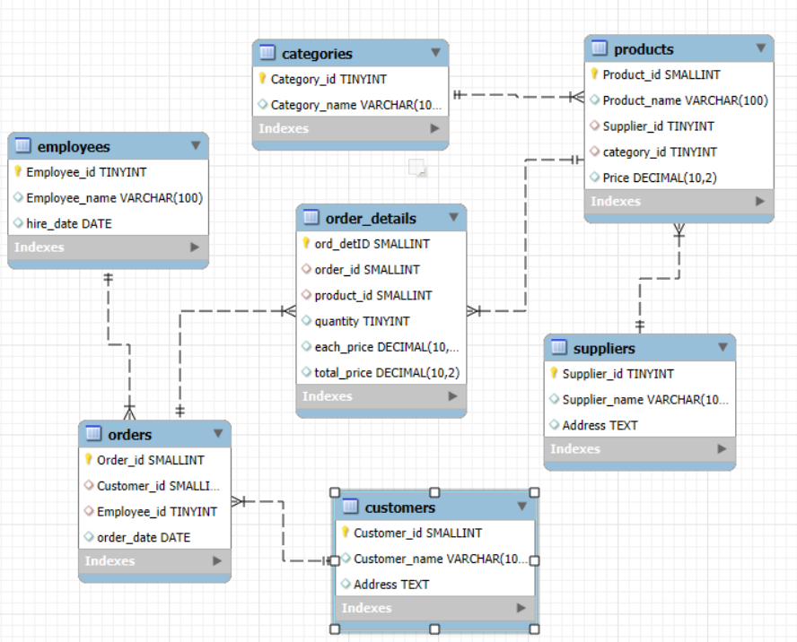
ER Diagram

Slide 6
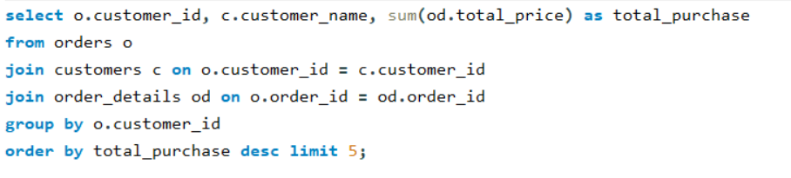
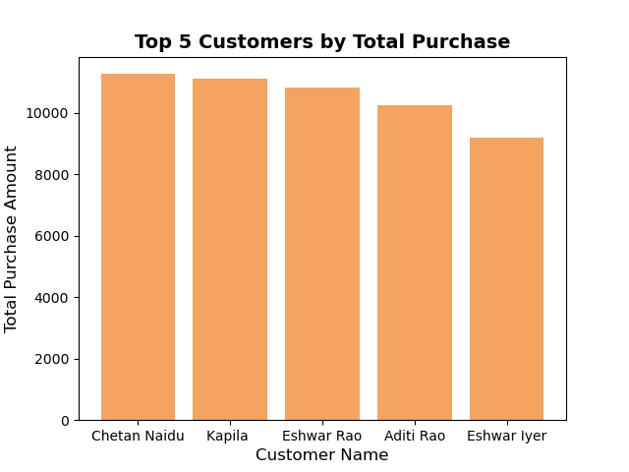
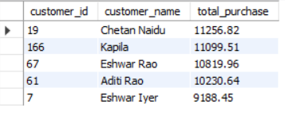
Analysis 1: Top 5 Customers by total purchase amount
Question : Who are the top 5 customers by total purchase amount?
SQL Query :
Query Result :
Insights :
Chetan Naidu is the top customer, contributing the highest purchase amount (₹11,256).
The top 5 customers are key contributors to overall sales, showing a strong and consistent purchase pattern.

Slide 7
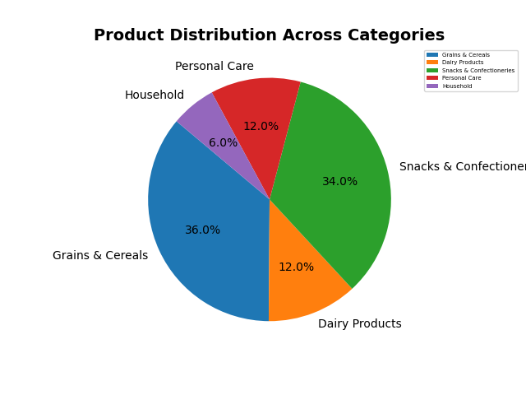
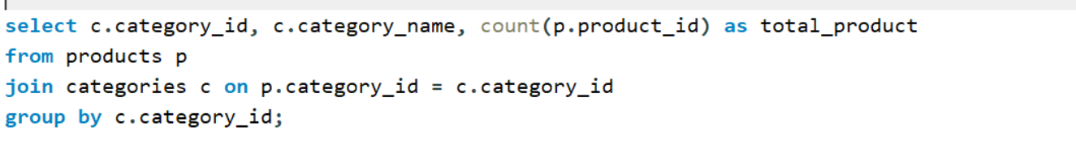
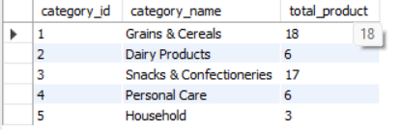
Analysis 2 : Product Distribution Across Categories
Question : How many products exist in each category?
SQL Query :
Query Result :
Insights :
Strong product presence in Grains & Cereals and Snacks.
Balanced variety in Dairy and Personal Care.
Household category shows low product count, offering growth
potential.

Slide 8
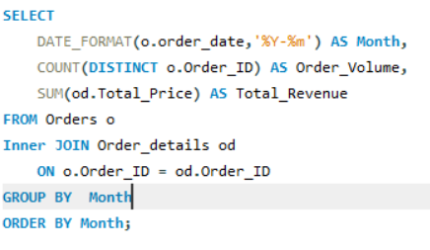
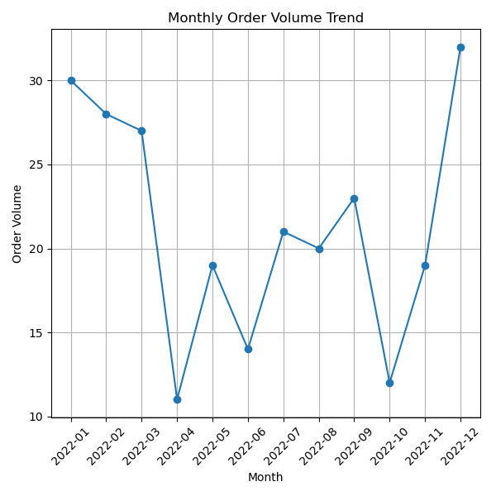
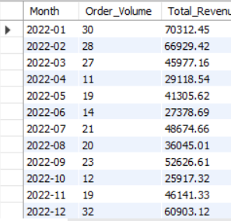
Analysis 3 : Monthly Trends in Order Volume and Revenue
Question : What are the monthly trends in order volume and revenue?
SQL Query :
Query Result :
Insights :
January to March show consistently high order volumes, indicating solid customer demand.
April experiences the lowest orders of the year.

Slide 9
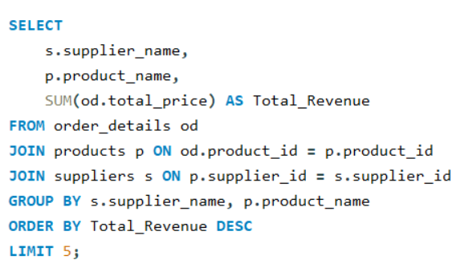
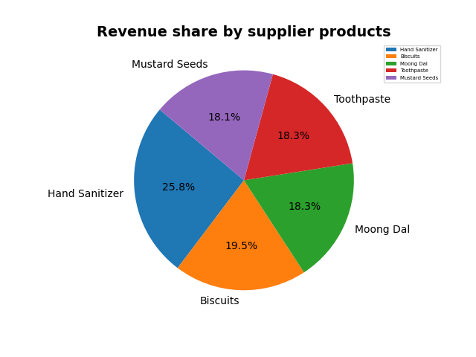
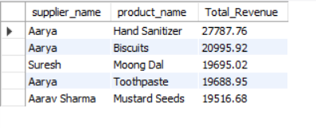
Analysis 4: Top Products and Suppliers by Revenue
Question : Which products and suppliers contribute the most to total revenue?
SQL Query :
Query Result :
Insights :
Supplier Aarya generates the highest total revenue among all suppliers.
Hand Sanitizer and Biscuits are Aarya’s top performing products.

Slide 10
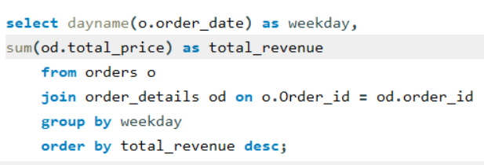
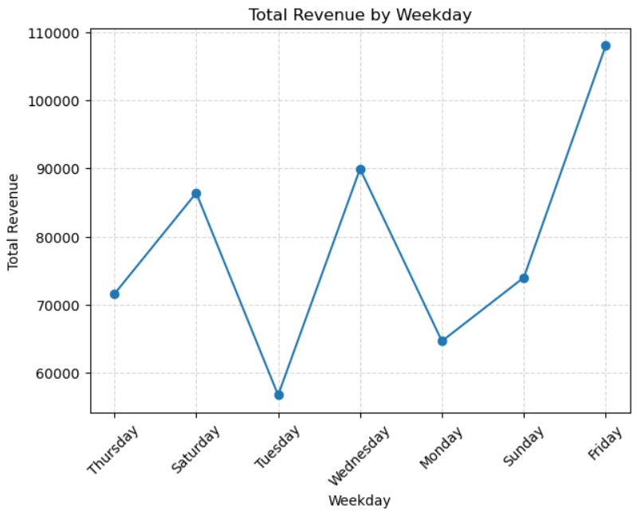
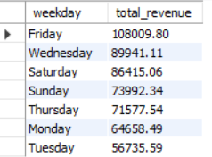
Analysis 5: Weekday by highest total revenue
Question : Which weekdays generate the highest total revenue?
SQL Query :
Query Result :
Insights :
Friday is the top revenue day.
Wednesday & Saturday also perform strong.
Monday & Tuesday show the lowest sales.
Overall trend shows customers prefer shopping towards the end of the week.

Slide 11
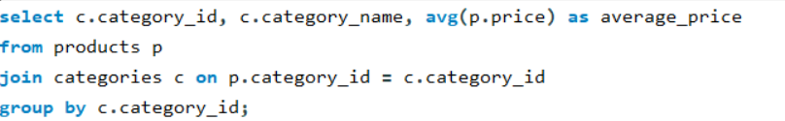
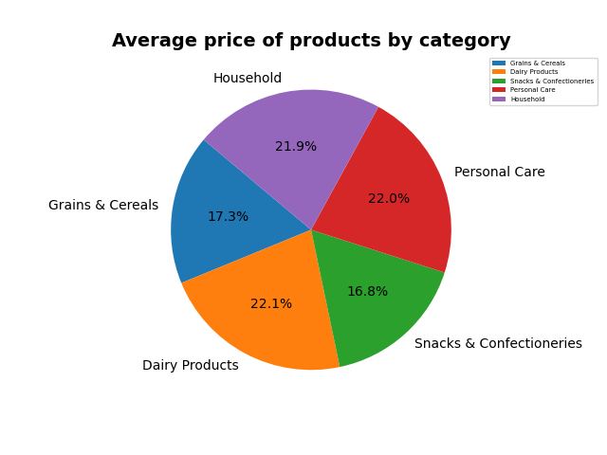
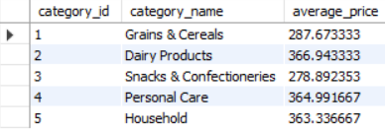
Analysis 6 : Average price of products by category
Question : what is the average price of products by category?
SQL Query :
Query Result :
Insights :
Higher average prices in Personal Care, Dairy, and Household categories.
Snacks & Cereals are the lowest-priced, high-volume categories.

Slide 12
Final business insights and recommendations
Top customers like Chetan Naidu and Kapila contribute a significant share of revenue, showing strong repeat-purchase behavior.
Grains & Cereals and Snacks dominate the product portfolio, while Household has very limited items.
January–March and December show peak monthly sales, highlighting seasonal demand cycles.
Supplier Aarya generates the highest revenue with top products such as Hand Sanitizer and Biscuits.
Friday, followed by Wednesday and Saturday, drives the highest revenue, while Monday and Tuesday remain slow.
Higher-priced categories like Dairy, Personal Care, and Household indicate premium product segments.

Slide 13
Recommendations
Customer Retention: Offer loyalty rewards or personalised discounts to top customers to boost repeat purchases.
Product Expansion: Increase variety in Household and Personal Care categories to balance product distribution.
Seasonal Planning: Stock heavily and launch promotions during January–March and December to maximize revenue.
Supplier Optimization: Strengthen partnership with Aarya, while exploring new suppliers for product diversification.
Sales Strategy: Promote weekend-focused offers and introduce early-week discounts to balance weekday performance.
Profit Maximization: Bundle or upsell premium categories like Dairy and Personal Care for higher margins.

Slide 14
Conclusion
This project demonstrates how a relational database can efficiently manage and analyze grocery store operations.
It provides structured data storage through linked tables for products, orders, suppliers, customers, and employees.
SQL queries help uncover insights on sales, customer behavior, and supplier or employee performance.
These insights support better decision-making, improving efficiency and overall store performance.

Slide 15
Experience & Challenges
Designed and implemented a relational database linking customers, products, suppliers, and orders.
Wrote analytical SQL queries using JOIN, GROUP BY, and DATE_FORMAT() to extract business insights.
Gained hands-on experience in data cleaning, handling date conversions, and ensuring referential integrity.
Faced challenges with complex joins, foreign keys, and optimizing queries for accurate aggregation.
Learned to transform raw sales data into meaningful insights such as customer behavior, product performance, and revenue trends.

Slide 16

THANK YOU

