Slide 1
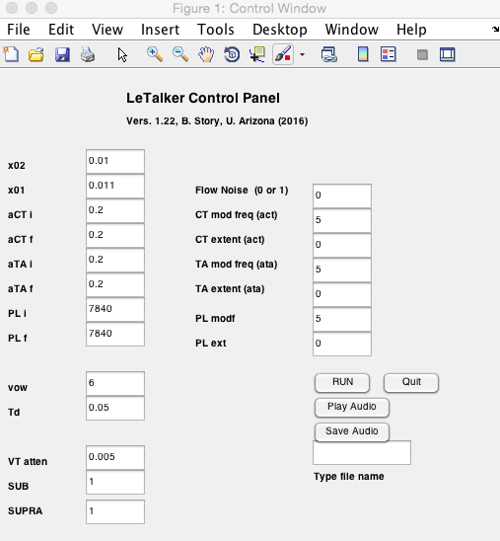
LeTalker 1.2 – B. Story, 2016
LeTalker is a Matlab version of the three mass vocal fold model originally published by Story and Titze (1995) but updated and enhance by Titze and Story (2002). The update implements “rules” that allow for transformation of cricothyroid and thyroarytenoid activation levels to mechanical parameters. Version 1.2 fixes a few bugs, includes an optional noise generator to represent glottal turbulence, and for inclusion or removal of both the subglottal and supraglottal systems.
The name “LeTalker” derives from the fact that the model is one of a collection of lumped-element models of the vocal folds; hence the “Le” part of LeTalker.
x₀₂
m₂
k₂, d₂
m_{b}
m₁
k_{b}, d_{b}
x₀₁
k₁, d₁
Control Panel
x02 = prephonatory distance from midline of the upper cover mass
x01 = prephonatory distance from midline of the lower cover mass
aCT i = initial activation level of the CT muscle; range = [0 1].
aCT f = final activation level of the CT muscle; range = [0 1].
aTA i = initial activation level of the TA muscle; range = [0 1].
aTA f = final activation level of the TA muscle; range = [0 1].
PL i = initial respiratory pressure; range = [2000 20000].
PL f = final respiratory pressure; range = [2000 20000].
Flow noise (0 or 1): 0 switches the noise generator off (default), 1 switches it on. Code for noise generator – lines 187 to 213 in LeTalker.m
vow = choice of ten vowels to set the vocal tract shape. Key: 1=/i/, 2=/ih/, 3=/eh/, 4 = /ae/, 5=/uh/, 6=/ah/, 7=/aw/, 8=/oh/, 9=/U/, 10=/u/, 0 = uniform tube

Slide 2
Control Panel cont’d
Td = duration of simulation. 0.05 seconds is short enough for relatively fast simulation. For listening make Td about 0.5 sec or more, but computation time will be longer.
VT atten = Attenuation factor for wave propagation in the vocal tract.
SUB/SUPRA = when “1” the trachea/vocal tract is included in the simulation. If set to “0” the sub- and/or supra-glottal system is replaced with a constant respiratory pressure (i.e. no wave propagation in the trachea) or 0 pressure in VT.
Note: the parameters below are for modulating muscle activity and respiratory pressure for simulation of vibrato or tremor. These will only be useful if the duration (Td) is set to be at least 0.5 seconds.
CT mod freq = frequency of modulation of CT muscle activity (to create tremor or vibrato).
CT mod ext = extent of the CT muscle modulation; range = [0 1]
TA mod freq = frequency of modulation of TA muscle activity (to create tremor or vibrato).
TA mod ext = extent of the TA muscle modulation; range = [0 1]
PL mod freq = frequency of modulation of respiratory pressure (to create tremor or vibrato).
PL mod ext = extent of the respiratory pressure modulation; range = [0 1]
Buttons:
RUN: press when parameters are set as desired. Simulation will be run.
Quit: Quit the entire program
Play Audio: Press after running to listen to output sound.
Save Audio: First type in a file name in the box below button. Then press to save. Creates a *.wav file.

Slide 3
Waveform window:
After a simulation is completed, several waveforms will be displayed in a new window (see below). From top to bottom, each subplot contains the following:
Po = Pressure radiated at the lips (analogous to a microphone signal)
Ps = Subglottal pressure, Ps (smoothed) = filtered subglottal pressure, Pg = intraglottal pressure.
Ug = Glottal flow
Ag = Glottal area
Disp. = displacements of the two cover masses and body mass.

Slide 4
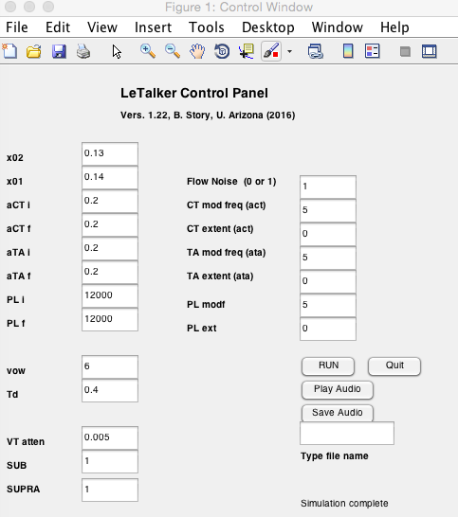
The default parameters (shown in the screenshots on previous pages) will produce vocal fold vibration.
There are three Matlab structures that store information and data during simulations.
“q” contains information gathered from the GUI
“p” contains all input parameter values
“r” contains waveforms generated by the simulation
Any or all can be save to a Matlab file like:
>>save DataFile.mat q r p
Adding the Noise Generator: The parameters shown in the screenshot below will produce a case where glottal noise will be apparent in the waveforms and audible when listened to (however, the vocal folds will not vibrate with these parameters.

Slide 5
Animation Feature
Version 1.1 also contains an m-file that animates the motion of the vocal fold masses in the coronal plane.
To use it, you must run a case with LeTalkerGUI first. Then type this at the command line:
>>M = Animate_3mass(r,10);
You should see an animation that looks like the screenshot below.
In the command, the “r” is the r structure that contains all waveforms. The “10” is a skip factor so that the animation doesn’t generate every sample point as a frame. It can be set to any number that is 1 or greater. Setting this value to 1, however, will be a very slow animation.
The returned variable “M” is a Matlab movie structure that can be replayed with the “movie” command (see help movie for instructions) or written to a movie format such as avi or mpg.

