Slide 1
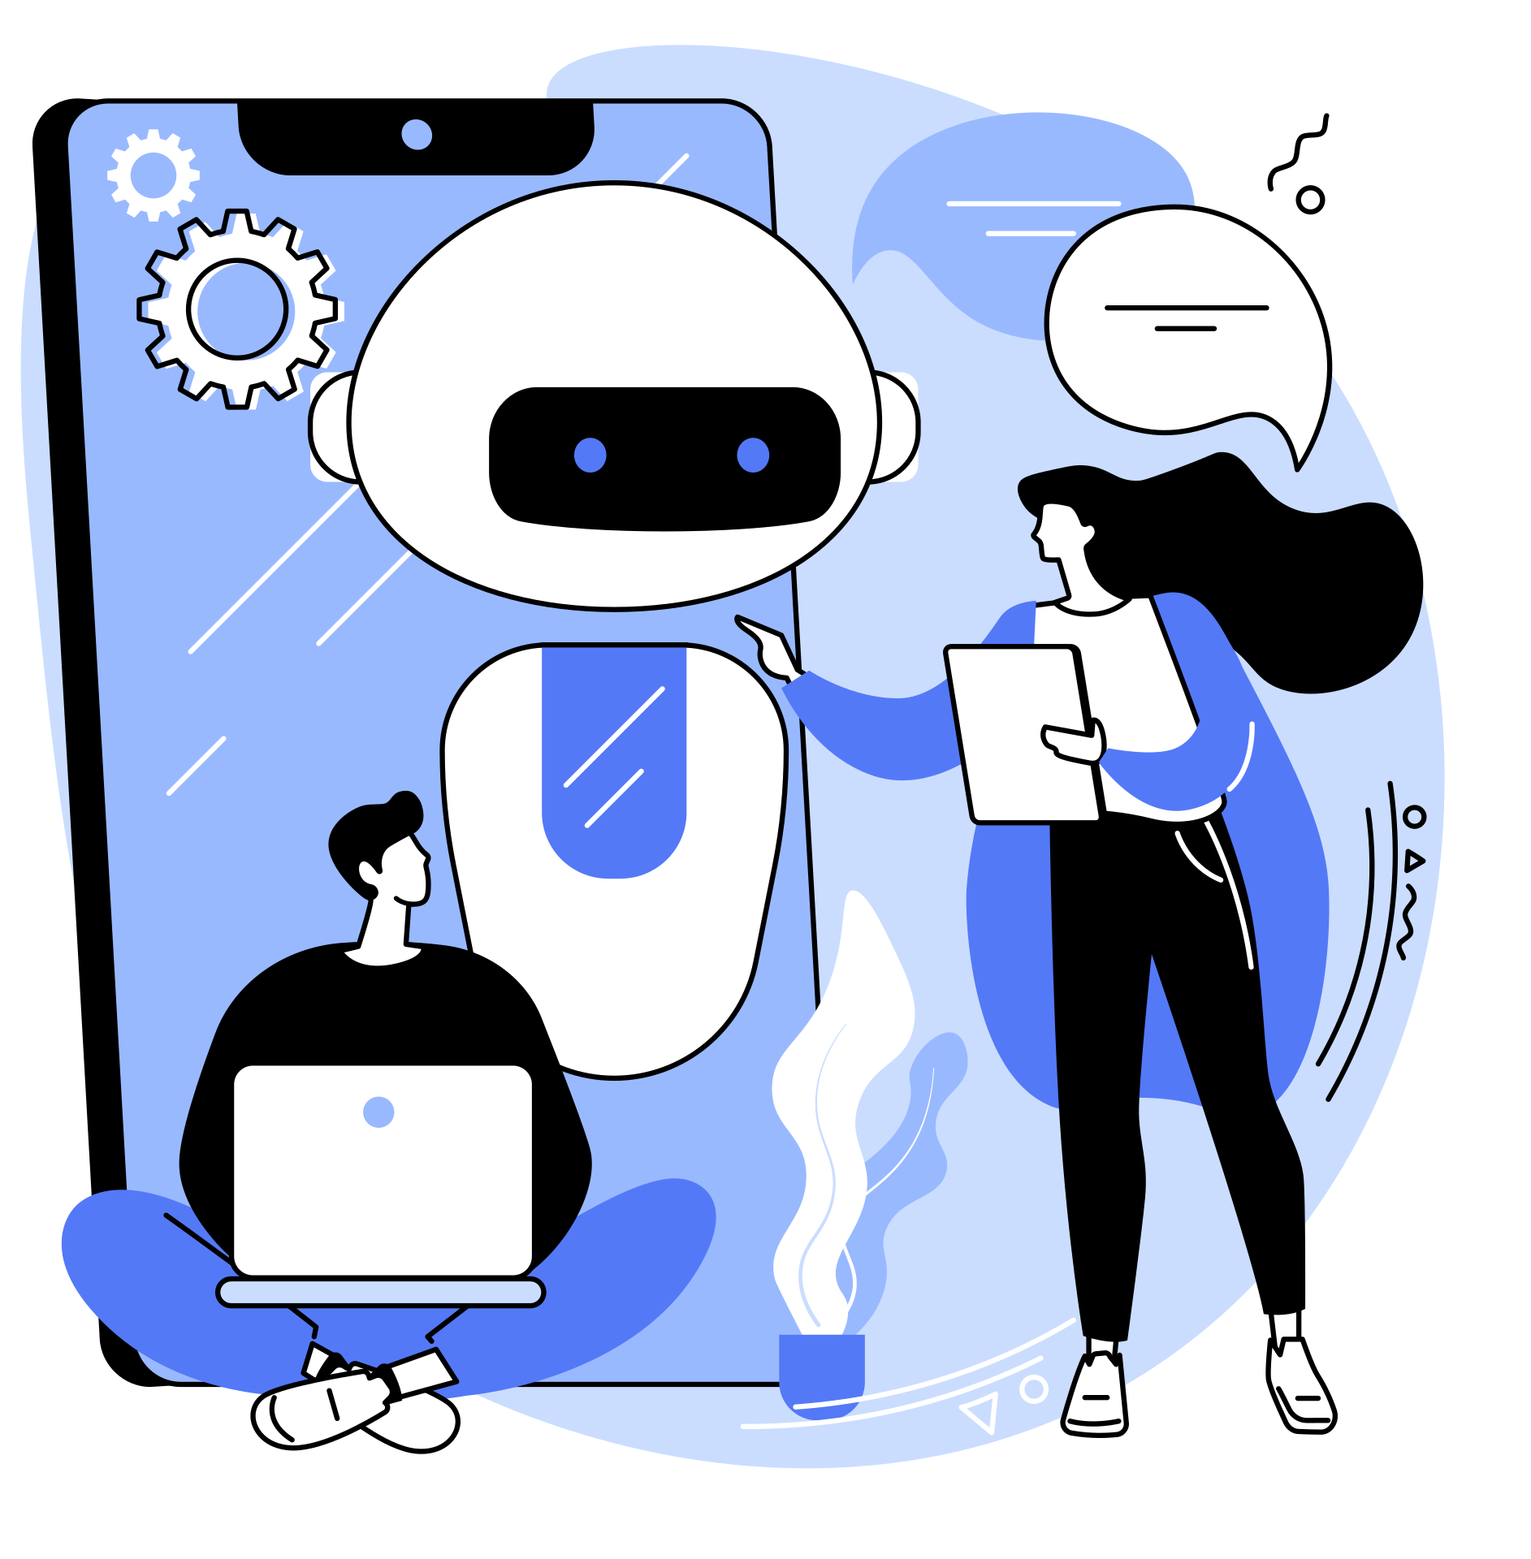
A 2-DAYS NATIONAL LEVEL HACKATHON ON
AI in education
Team name: EdTech.ai
Team Leader: Tilak Gupta
Date of Submission: 31 Aug 2025
College: SISTec GN

Slide 2

Problem Statement
Current educational tools are fragmented and lack personalization.
1
Students struggle with organizing, planning, and learning efficiently.
2
No single platform provides AI-driven solutions to cover all aspects of a learner’s journey.
3
Need for adaptive, intelligent, and accessible educational support.

Slide 3

Proposed Solution
EdTech.ai Hub: A one-stop microservice platform powered by AI
Offers a modular suite of learning and productivity tools.
Uses AI to enhance engagement, personalization, and learning efficiency.
Microservice architecture ensures scalability and integration flexibility.

Slide 4
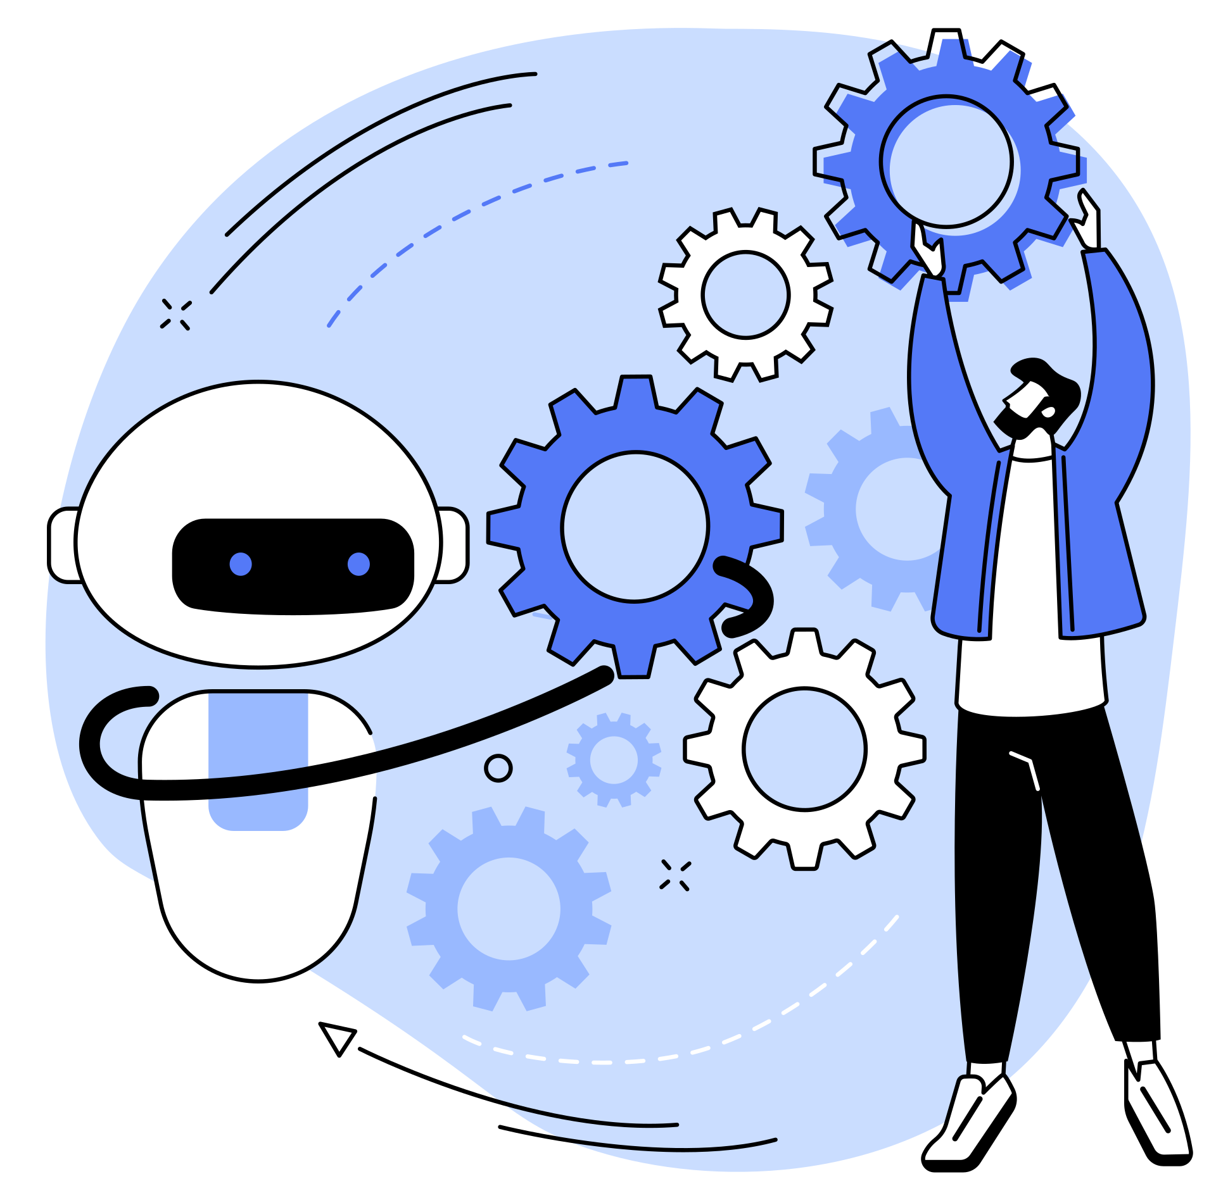
Key Features (Services)
To-Do List & Study Planner
Progress Tracker
AI-Powered Mentorship
Notes Summarizer & Flashcards
Generate Notes from YouTube Video
Handwritten Notes Analyzer
Quiz Generator (from notes/topics)
AI Interview Preparation

Slide 5

How AI Powers the Platform
Briefly explain how AI is used in each service:
NLP for summarizing and quiz generation.
CV (Computer Vision) for analyzing handwritten notes.
LLMs for generating flashcards, interview questions.
Recommendation Systems for personalized mentorship & planning.

Slide 6
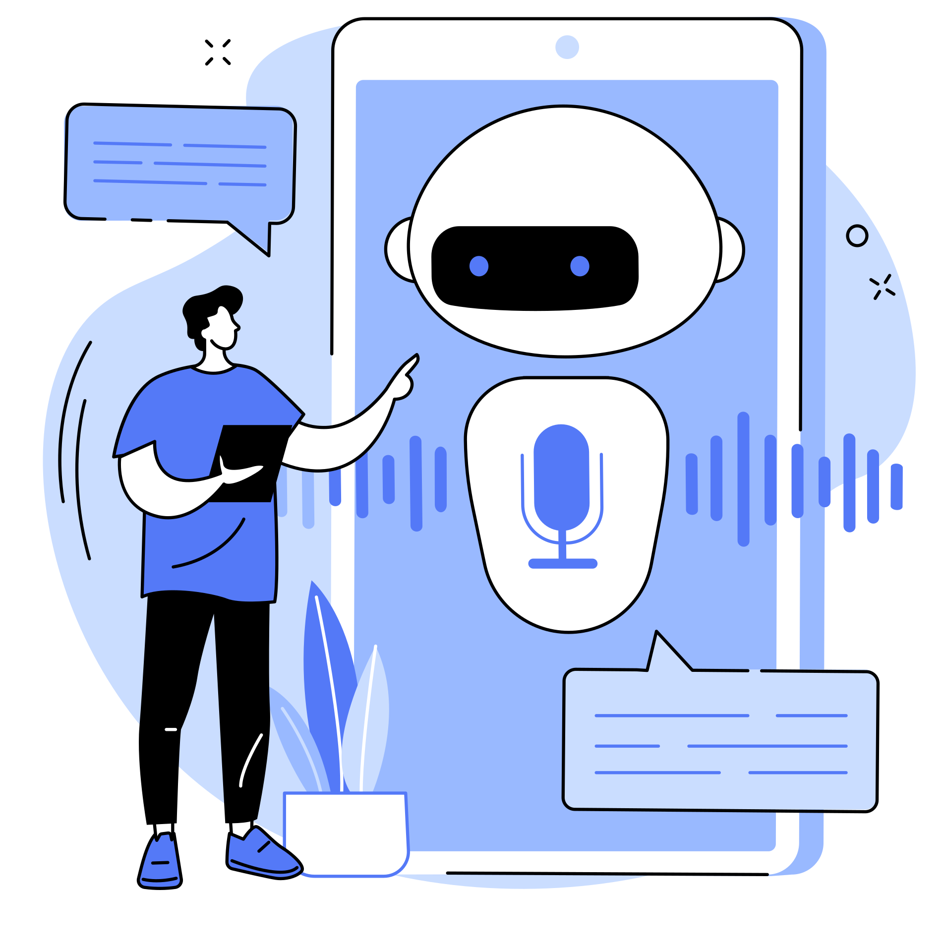
Challenges in Education Today
Lack of personalized study support
Difficulty in time management and planning
Scattered, unstructured notes across multiple sources
Limited feedback on conceptual mistakes
Exam preparation struggles (lack of revision aids)
Lack of effective mentorship

Slide 7
How EdTech.ai Solves Them
Personalized study planning & tracking
Feedback from handwritten notes (error detection)
Automated note summarization & flashcards
Instant quiz generation from notes/topics
AI-driven mentorship & career guidance
Mock interview simulations for preparation

Slide 8
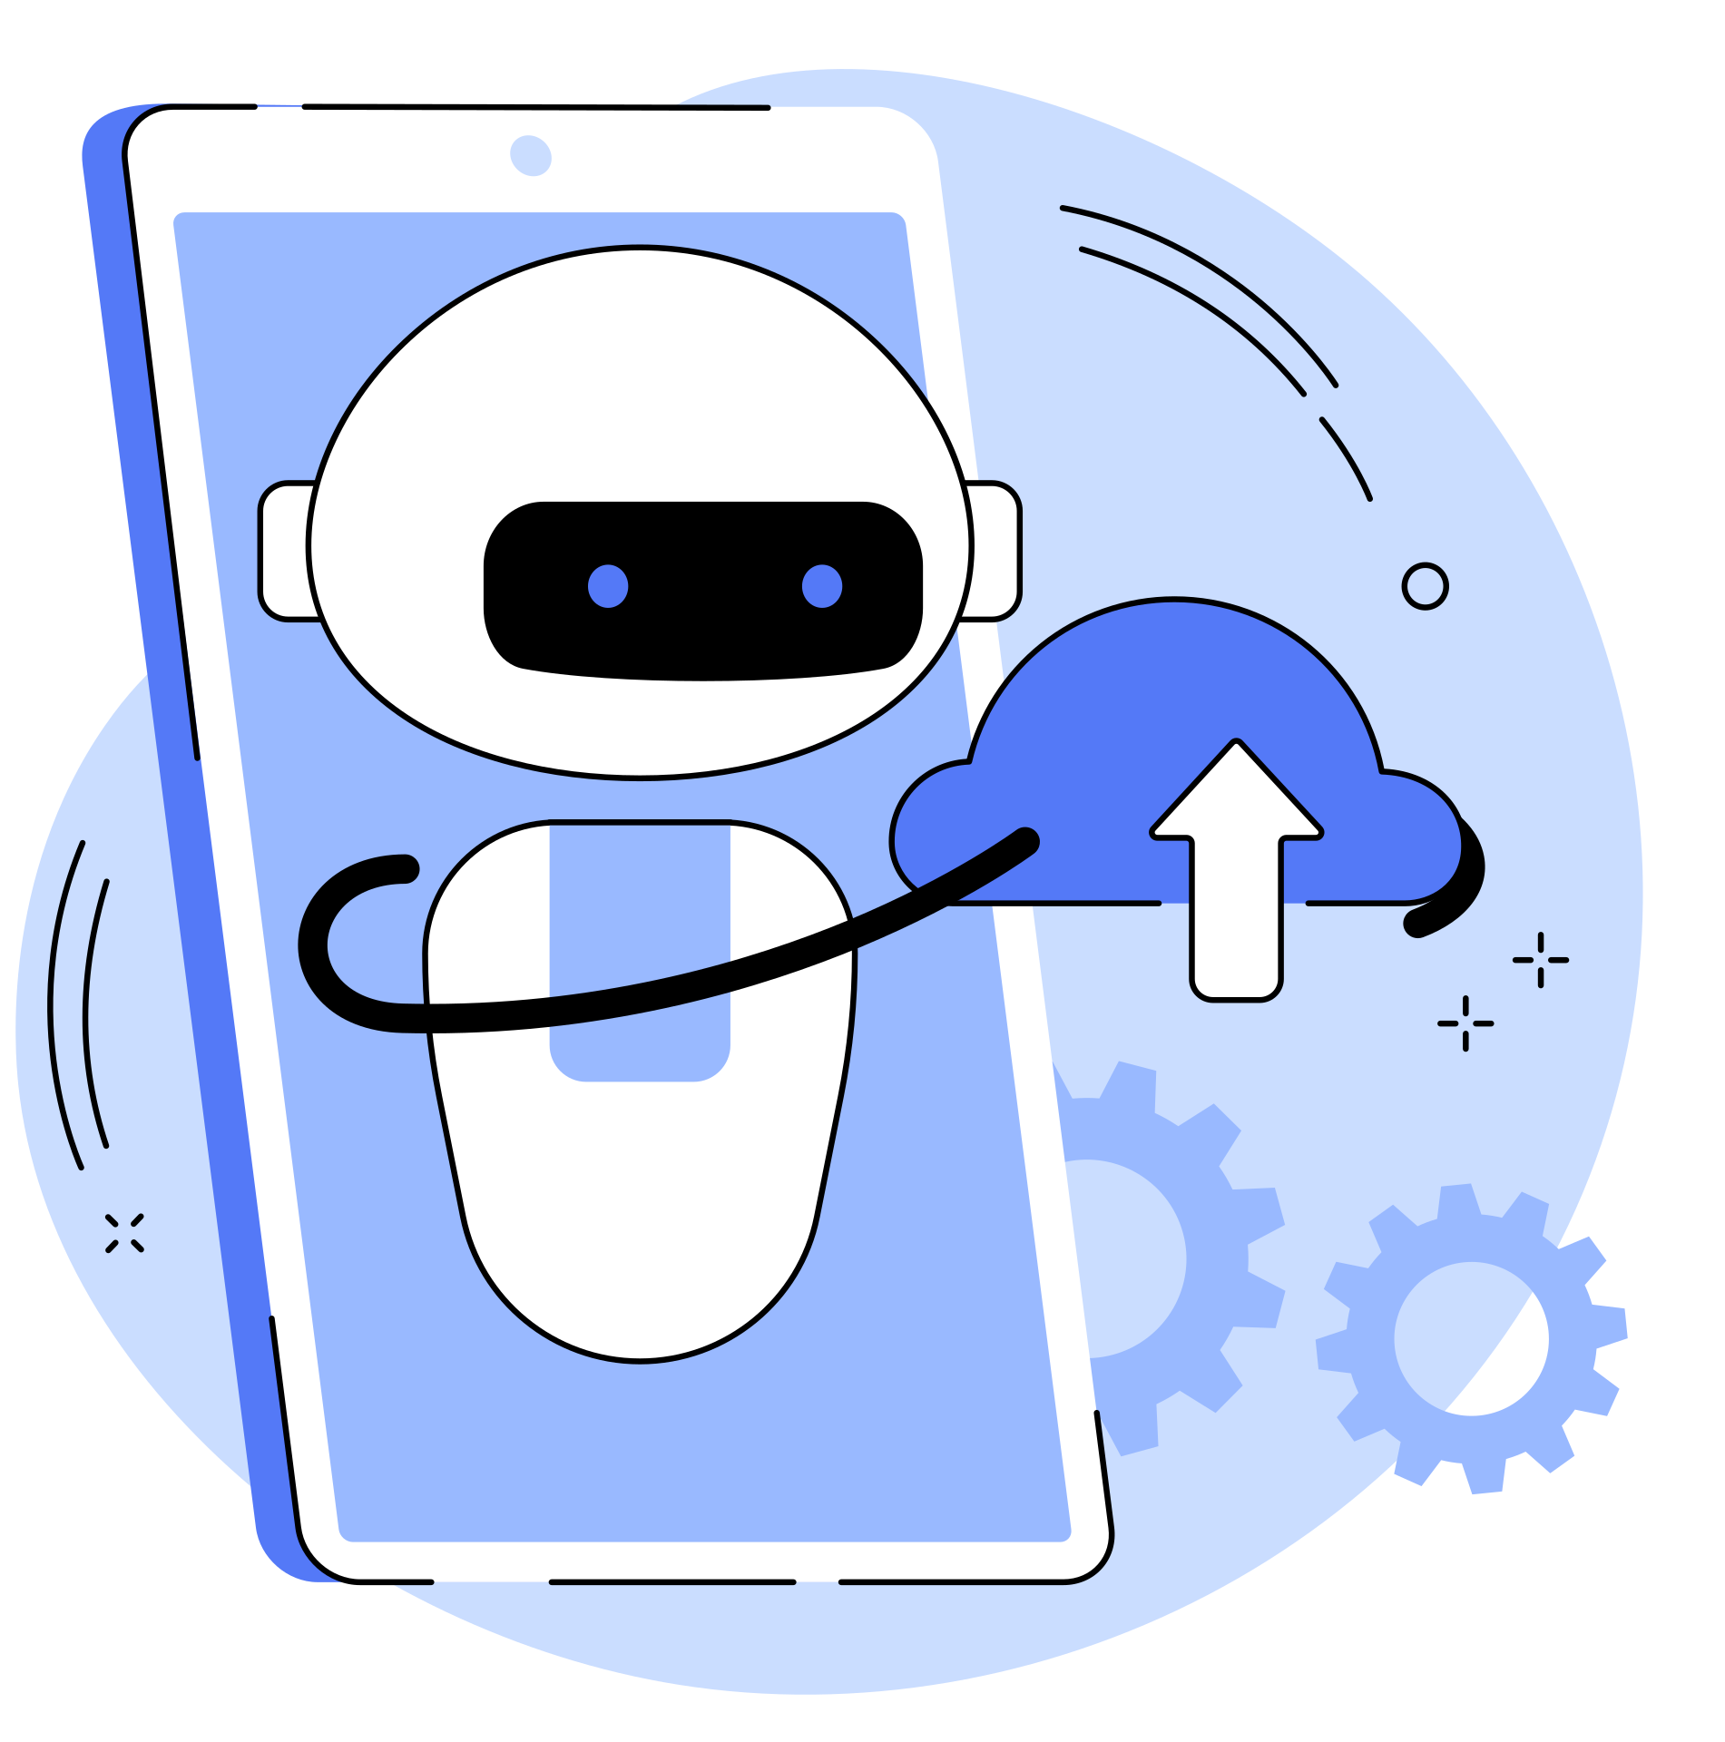
Future Add-ons & Scalability
Collaborative study groups with AI moderators
Gamification of study plans (XP, rewards, leaderboards)
AR/VR immersive classrooms
Integration with existing LMS & coaching platforms
Scalable mentorship network powered by recommendation systems

Slide 9
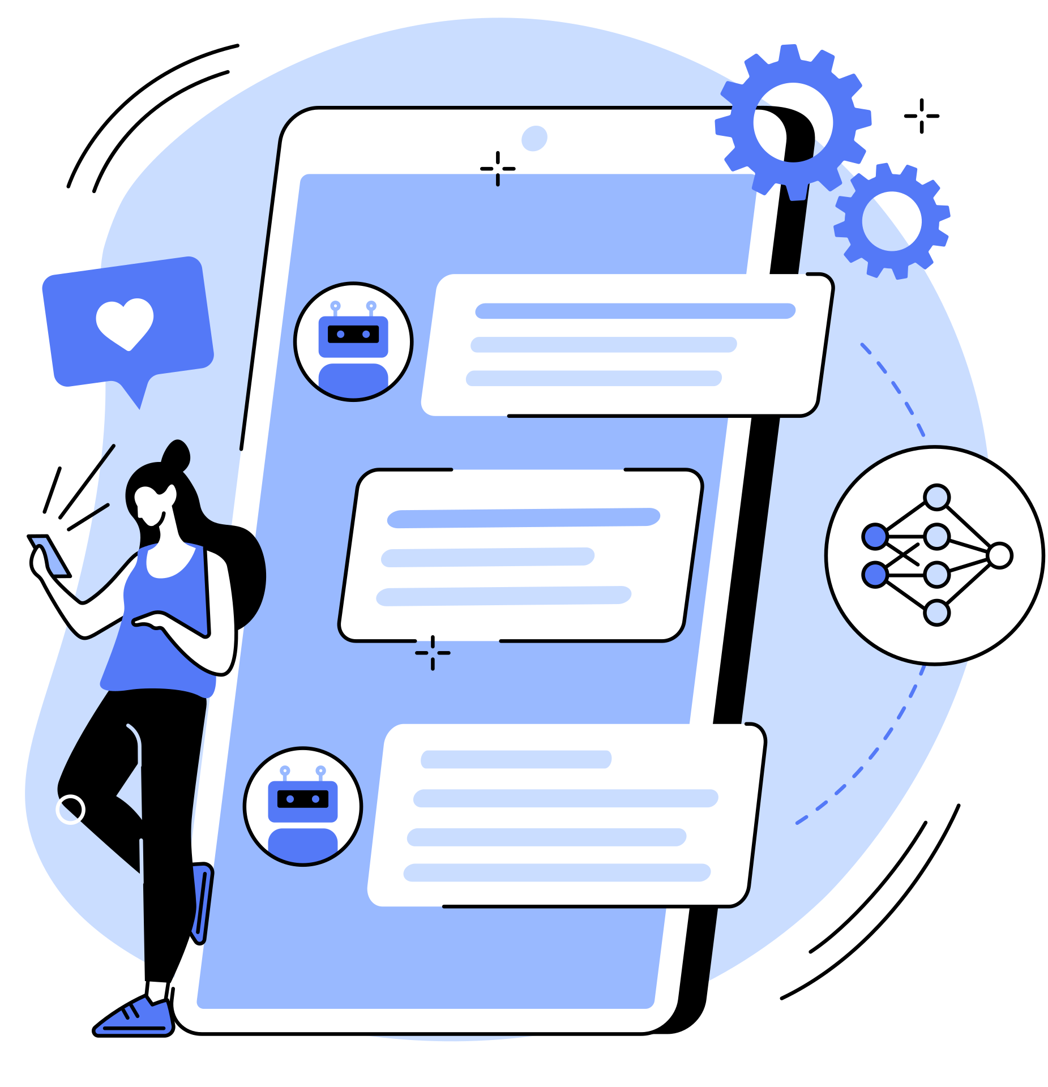
THANK YOU FOR LISTENING!

