Slide 1

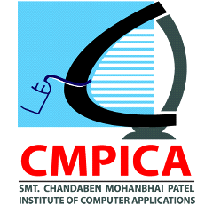
FACE DETECTION SYSTEM
Smt. Chandaben Mohanbhai Patel Institute of Computer Applications
By Praveen Chauhan (16BCA013) Viplavi Panchal (16BCA032) Tilak Pandya (16BCA034)
Under Guidence Of Abhilash Shukla

Slide 2
INDEX
SR. NO. | TOPICS
1 | About Topic
2 | Project Profile
3 | Objective
4 | Frontend & Backend Tools
5 | Scope of the System
6 | Diagrams
7 | Screen Layouts
8 | Future Enhancement
9 | Limitations
10 | Work Flow
11 | References

Slide 3
About Topic
Uses biometrics to map facial features.
Create data-set, train model and check faces.
Compares the faces
Create one simple system application.
Open data-set and Check History.

Slide 4
Project Profile
Project title: Face Detection System
Team Size: 3
Type of Application: System Application
Front end: Python
Tools used: Pycharm Idle
Important Libraries: Opencv, Tkinter, os, numpy, Playsound, Image, datetime, Webbrowser, random
Submitted to: CMPICA charusat

Slide 5
Objective
Learning Objective: Main Purpose of This System is to Learn something different and demanding.
System Objective: Our purpose is detect and recognize the face of users then give the appropriate result.
Make it Simple: when user interact with system, it seems easier and simple to use.
Prototype: Ultimately we’ve just created one prototype that can be used in different applications or different products.

Slide 6
FrontEnd & Backend Tools
JetBrains PyCharm (Front end) | Python (Front end) | OpenCV (Important Llibrary)
Cross-platform IDE that works on Windows, macOS, and Linux to Develop applications in Python. | Easy to Learn and Use | OpenCV (Open Source Computer Vision) is a library of programming functions for real-time computer vision.
Develop Django, Flask and Pyramid applications. | It’s Expressive, Expressive, Interpreted, Cross-platform and Object-Oriented Language | Prove to be flexible enough for the project as it can accurately detect a face in real time.
Also supports HTML ,CSS, JavaScript, and XML. | Large and broad libraries. | faces are being detected, it takes a snapshot of the live footage and sends it to the recognition system.

Slide 7
Scope of System List of the Application that uses our Prototype:
PREVENT RETAIL CRIME
UNLOCK PHONES
SMARTER ADVERTISING
FIND MISSING PERSONS
HELP THE BLIND
PROTECT LAW ENFORCEMENT
AID FORENSIC INVESTIGATIONS
RECOGNIZE VIPS AT SPORTING EVENTS
TRACK SCHOOL ATTENDANCE
FACILITATE SECURE TRANSACTIONS
VALIDATE IDENTITY AT ATMS

Slide 8
Diagrams

Slide 9
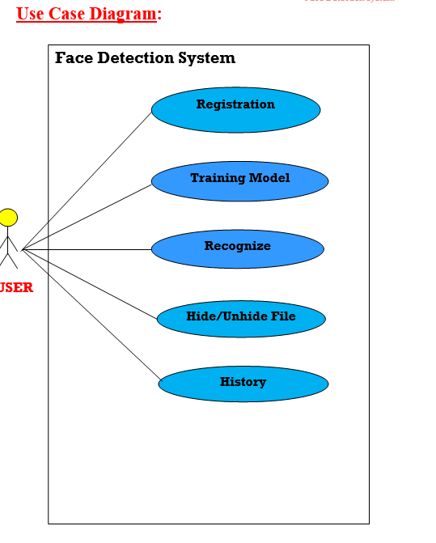

Slide 10
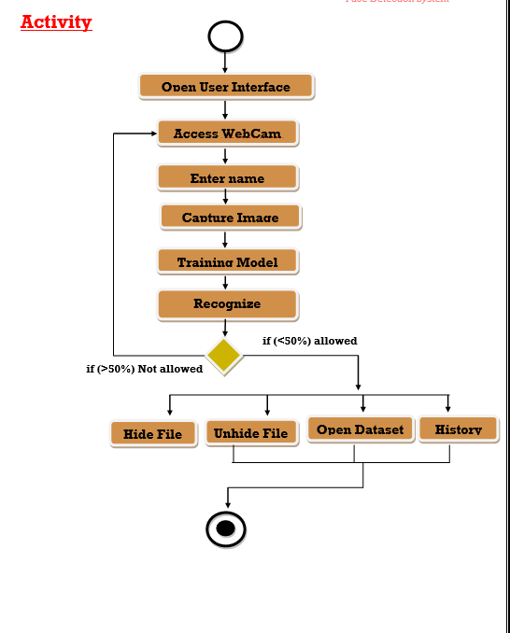

Slide 11
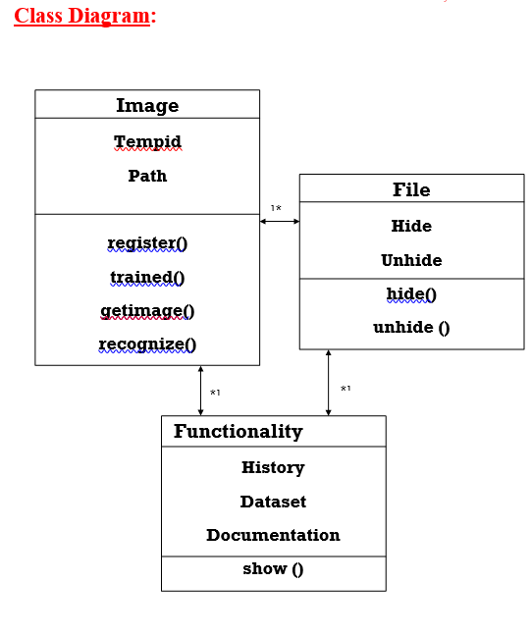

Slide 12
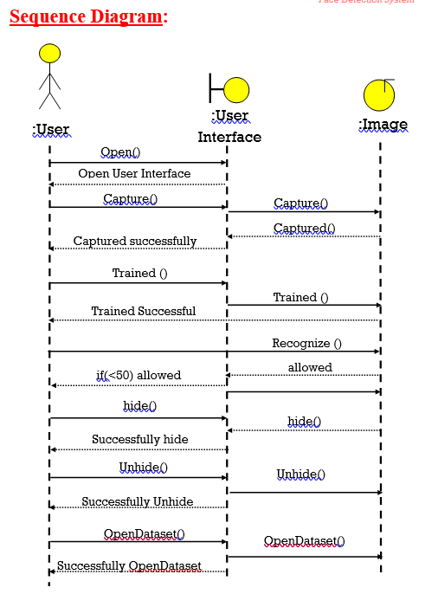
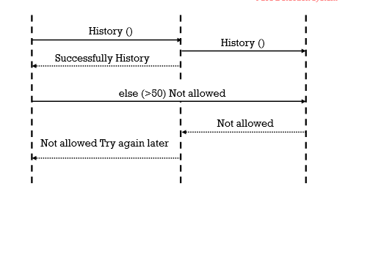

Slide 13
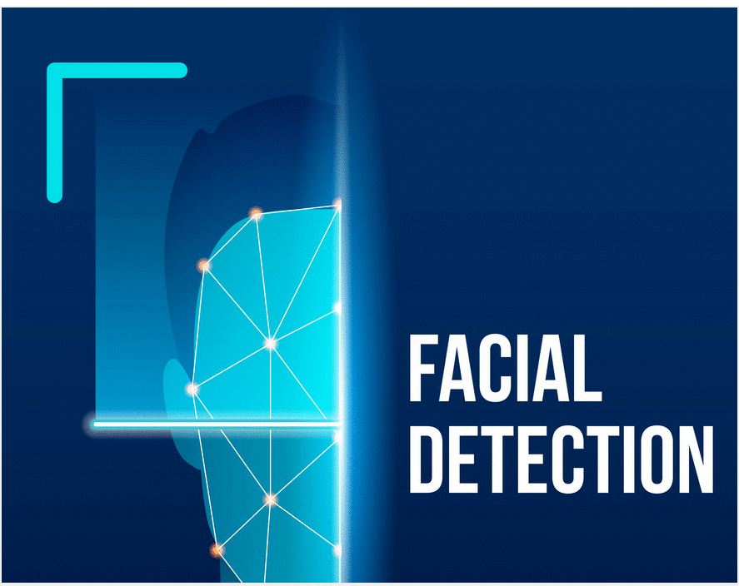
Screen Layout
Splash Screen:

Slide 14
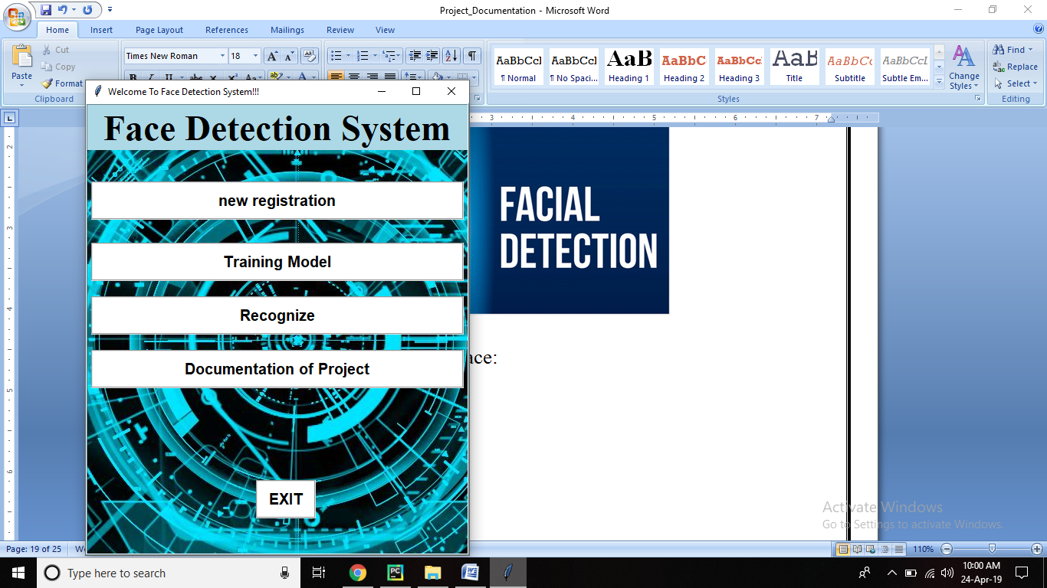
Graphical User Interface:

Slide 15
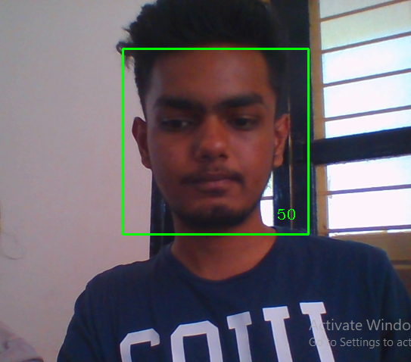
Webcam Access:

Slide 16
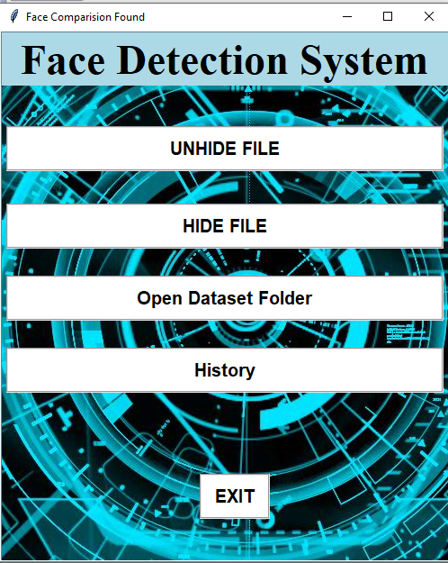
Recognize UI:
Hide or Unhide File:

Slide 17
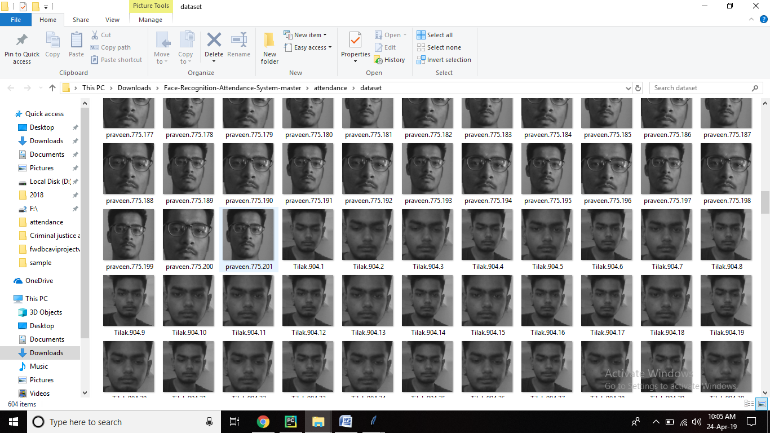
Dataset:

Slide 18
Future enhancement
Use in Computer visionary activities.
Recognize people in real-time and in much less constrained situations.
Cameras and microphones today are very small, light-weight and have been successfully integrated with wearable systems. Audio and video based recognition systems have the critical advantage that they use the modalities humans use for recognition.
Researchers are beginning to demonstrate that unobtrusive audio-and-video based person identification systems can achieve high recognition rates without requiring the user to be in highly controlled environments.
According to Oracle's Hotel 2025 report, there is growing enthusiasm for facial recognition systems that could be used to identify and even interact with guests, with 72% of hotel operators expecting to deploy such technology in the next four years.

Slide 19
Limitations
Data Processing and Storage Can Limit
Different Face Angles Can Throw Off
Poor Image Quality Limits
Small Image Sizes Make More Difficult
Accuracy Issue

Slide 20
Work Flow
Face detection attendance system
Started Preparation
Not reliable in real life
Changed topic to face detection system
Comparison of 2 images
Learn and Create User Interface
Change Algorithm to “Live face detection”
Complete Minor Project

Slide 21
References
Python
Core Python Programming – Dr. R. Nageswara Rao
https://www.learnpython.org/
OpenCV
Learning OpenCV – Gary Bradski & Adrian Kaebler
https://docs.opencv.org/master/d9/df8/tutorial_root.html
Software Engineering
Software Engineering - IAN SOMMERVILLE – PG77
https://www.wisdomjobs.com/e-university/software-engineering-tutorial-338.html
System Analysis & Designing
SAD – TATA MCGRAW-HILL – JETFREY L. WHITTEN
https://www.tutorialspoint.com/system_analysis_and_design/

Slide 22
THANK YOU

