Slide 1
Sentiment Analysis Assignment
Students:
Tilak Pandya (200534318)
Kishan Patel (200527734)

Slide 2
Contents
Data Source
Web scrapping
Sentiment Analyze Of The Collected Data
Ingest Data to Preferred Database
Evaluate Results
Challenges
References
Github Link

Slide 3
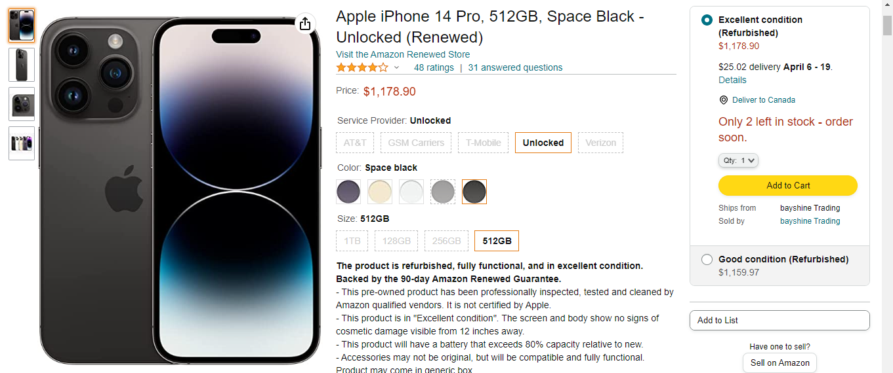
Data Source
First, we need to select the data sources from where we will collect text data.
As a part of Data source, we choose Amazon product reviews for sentimental analysis.
We collected user’s names, ratings, reviews and description as part of this process.
https://www.amazon.com/Apple-iPhone-512GB-Space-Black/dp/B0BN93JTWW/ref=sr_1_1?crid=2XJ5LNJ2NJ8LS&keywords=iphone%2B14%2Bpro&qid=1679312726&sprefix=iphone%2B14%2Bpro%2Caps%2C118&sr=8-1&th=1

Slide 4
Web scrapping
It is data scraping used for extracting data from websites.
We implemented python script for this process.
Using BeautifulSoup, we convert HTML convert into text.
That text will be stored in csv.

Slide 5
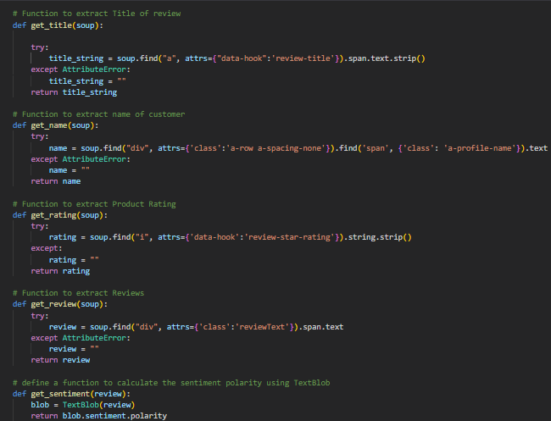
Web scrapping

Slide 6
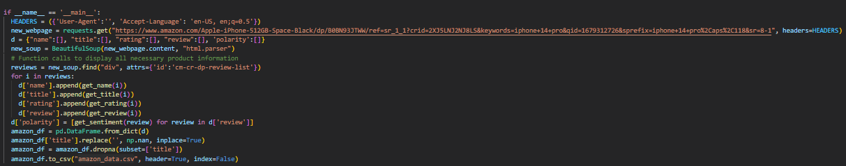

Slide 7
Sentiment Analyze Of The Collected Data
Fetch sentiment polarity using text blob and save in csv.
Value of sentimental polarity will be between -1 to 1.
Value closer to 1 will show positive impact and value closer to -1 will show negative impact of product.

Slide 8
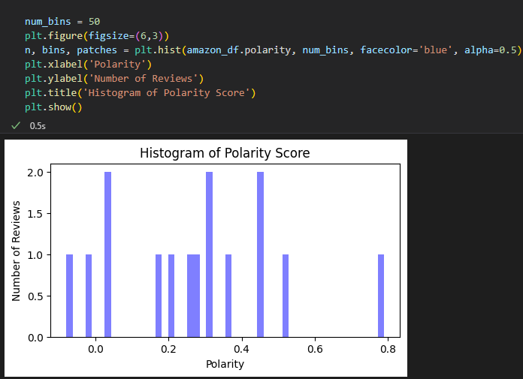
Sentiment Analyze Of The Collected Data

Slide 9
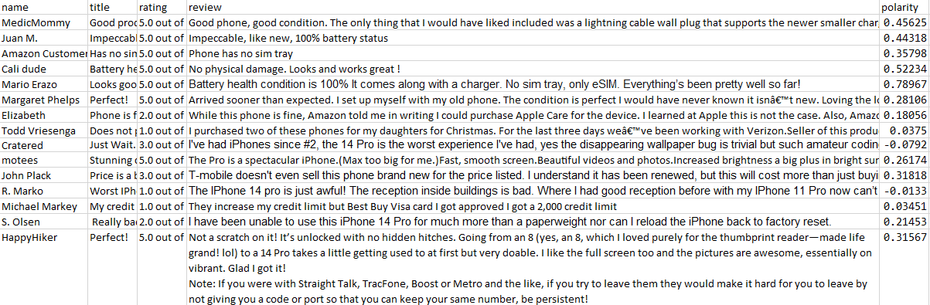

Slide 10
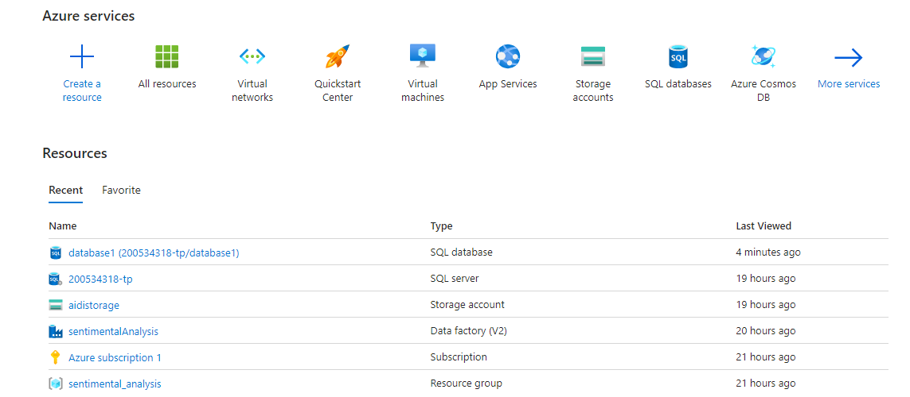
Ingest Data to Preferred Database

Slide 11
Ingest Data to Preferred Database
We will use ADF to ingest data from Amazon product review to Azure Blob storage. ADF is a cloud-based data integration service that allows us to create, schedule, and manage data pipelines. We will use the following steps to ingest data using ADF:
Create a data factory in Azure portal.
Create a dataset for Amazon product review in ADF.
Create a dataset for Azure Blob storage in ADF.
Create a pipeline to copy data from Amazon product review CSV to Azure Blob storage.
Publish the pipeline.

Slide 12
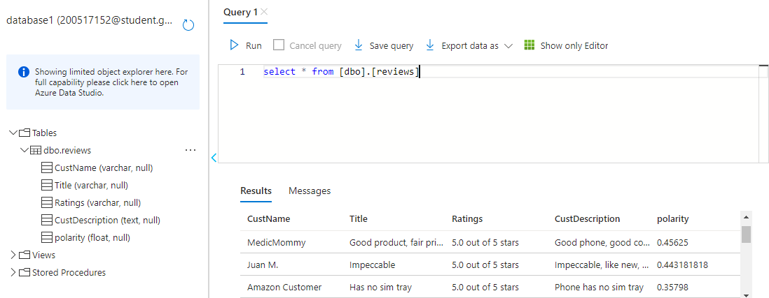

Slide 13
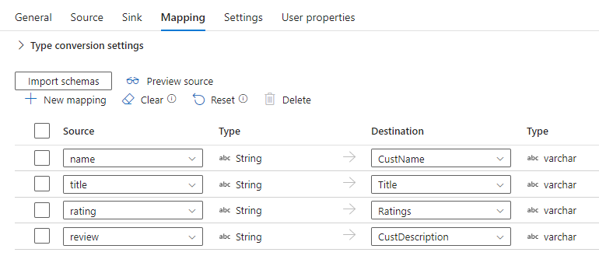
As we can see, We get the data of csv into the database table named ‘reviews’.
We mapped the CSV columns with table columns.

Slide 14
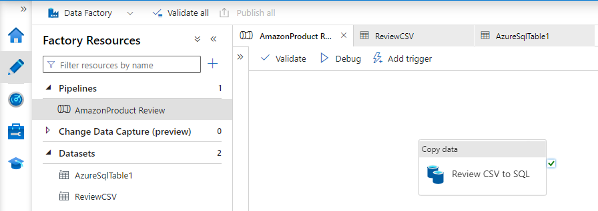
ADF Pipeline

Slide 15
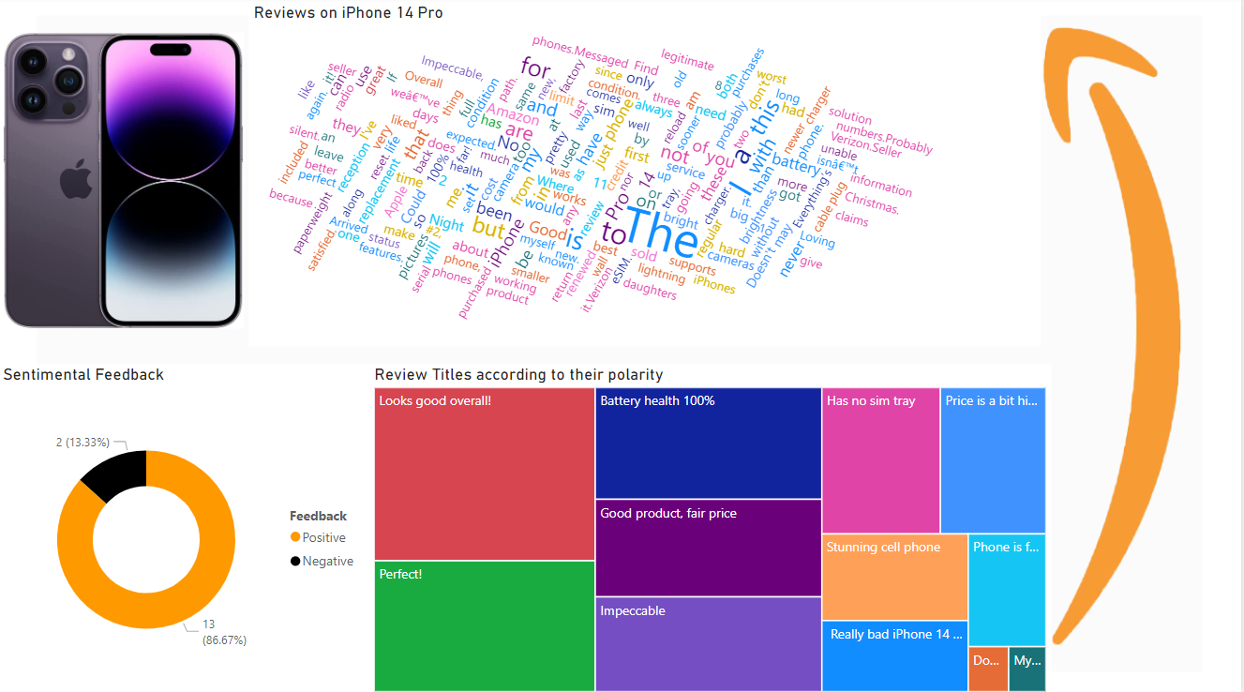
Evaluate Results

Slide 16
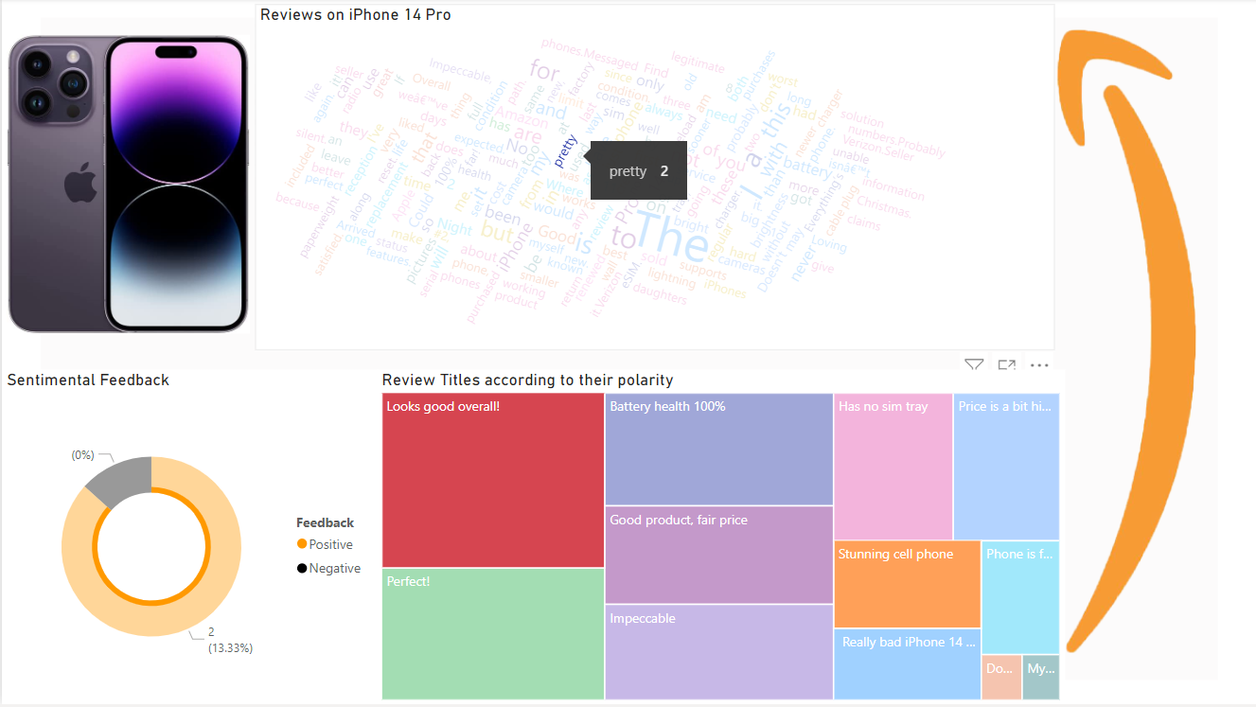
Evaluate Results

Slide 17
Challenges
Web Scrapping: Getting product reviews from amazon from different pages was difficult because initially it took to logging page instead of second page of the pagination.
Data Ingestion: While working on Data Ingestion in Azure data factory, getting error because we need to add IP address in network firewall settings.
Credentials: Login credentials that we entered while creating new dataset was showing incorrect due to IP Address configuration. It was solved by referring online solution.

Slide 18
Conclusion
In this presentation, we explained how to create a Sentiment Analysis of amazon product reviews solution using python textblob library and Azure cloud services. We discussed the architecture, data sources, code/libraries used, ADF, evaluation, and challenges. Our solution provides a powerful tool for businesses to understand customer.

Slide 19
References
Sentiment Analysis on Amazon Reviews: https://towardsdatascience.com/sentiment-analysis-on-amazon-reviews-45cd169447ac
Sentiment analysis of Amazon product reviews based on NLP: https://ieeexplore.ieee.org/document/9513125
Azure Data Factory documentation: https://learn.microsoft.com/en-us/azure/data-factory/

Slide 20
Github Repository Link
https://github.com/tilakpandya/sentimental_analysis

Slide 21
THANK YOU

