Slide 1
Smart Education
PIP2001 Capstone Project
Review-0
Batch Number:CSE120
Under the Supervision of,
Dr. G.Shanmugarathinam
Professor ,
School of Computer Science and Engineering
Presidency University
Roll Number | Student Name
20211CSE0531 | Tilakraj Ratnanj Revankar
20211CSE0532 | Siddhant Chavan
20211CSE0547 | Poorvika P
Name of the Program: CSE
Name of the HoD: Dr. Asif Mohammed H.B
Name of the Program Project Coordinator: Mr. Amarnath J.L
Name of the School Project Coordinators: Dr. Abdul Khadar A

Slide 2
Content
Problem Statement
Analysis of Problem Statement
Timeline of the Project

Slide 3
Problem Statement Number:
Category: Software
Problem Description: Smart Education is a concept that describes learning in the digital age. It enables learners to learn more effectively, efficiently, flexibly, and comfortably by integrating technology into education. This approach leverages artificial intelligence, cloud computing, and smart devices to enhance the learning experience.
Difficulty Level: Simple.

Slide 4
Analysis of Problem Statement
Technology Stack:
Programming Languages: Python, JavaScript
Frontend: React.js, HTML, CSS
Backend: Node.js, Django (Python)
Database: MySQL, Firebase
Cloud Services: AWS, Google Cloud
AI/ML Frameworks: TensorFlow, OpenAI GPT
APIs: Google Classroom API, Text-to-Speech API

Slide 5
Analysis of Problem Statement
Components:
User Authentication Module – Secure login system for students and teachers.
Personalized Learning Module – AI-driven recommendations based on student progress.
Interactive Content Delivery – Video lectures, quizzes, and gamified learning.
Real-Time Doubt Resolution – AI-based chatbot for instant student queries.
Performance Analytics Dashboard – Tracks student progress and suggests improvements.
Collaboration Tools – Online classrooms, discussion forums, and peer assessments.

Slide 6
Analysis of Problem Statement (contd...)
Software Requirements:
Operating System: Windows
Development Environment: Visual Studio Code, PyCharm
Databases: MySQL, NoSQL
Libraries/Frameworks: Flask, NumPy, Pandas, Matplotlib, React.js

Slide 7
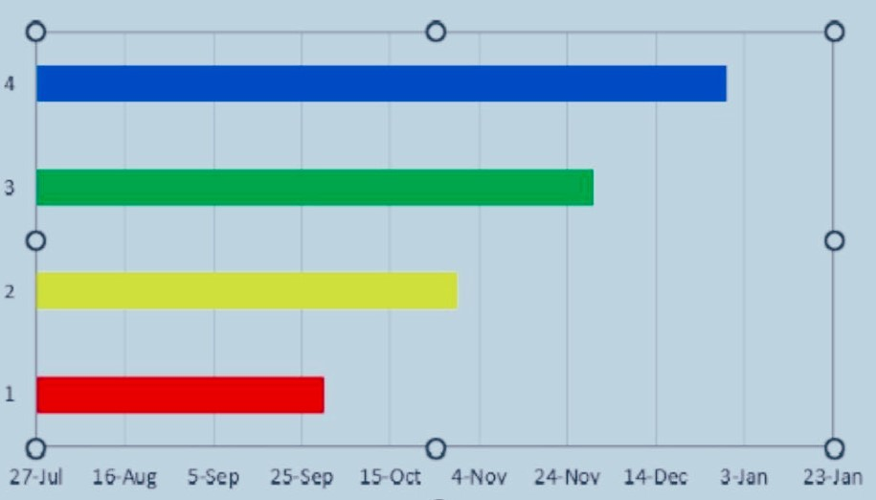
Timeline of the Project (Gantt Chart)

Slide 8


