Slide 1

Machine Learning with Python
EMAIL SPAM DETECTION
[INTERNSHIP PROJECT]
TILAKRAJ SINGH RAO: 1RN17IS109
ISE DEPARTMENT
VII SEMESTER

Slide 2
INTRODUCTION
Spam e-mails can be not only annoying but also dangerous to consumers.
Spam e-mails can be defined as :
Anonymity
Mass Mailings
Unsolicited:
Spam e-mail are message randomly sent to multiple addressees by all sorts of groups, but mostly lazy advertisers and criminals who wish to lead you to phishing sites.

Slide 3
Project Goal
The objective of identification of Spam e-mails are :
• To give knowledge to the user about the fake e-mails and relevant e-mails
• To classify that mail spam or not.

Slide 4
SCOPE OF THE PROJECT
It provides sensitivity to the client and adapts well to the future spam techniques.
It considers a complete message instead of single words with respect to its organization.
It increases Security and Control.
It reduces IT Administration Costs.
It also reduce Network Resource Costs.

Slide 5
PROBLEM STATEMENTS
Unwanted e-mails irritating internet connection
Critical e-mail message are missed and / or delayed. Millions of compromised computers
Billions of dollars lost worldwide
Identity theft
Spam can crash mail servers and fill up hard drives

Slide 6
DOCUMENT PREPROCESSING
1. GET DATA [ BUILD THE CORPUS ] -
It’s a sample text provided by NLTK (Natural Language Toolkits)
It’s a Large Collection of Words or Sentences
We start with this corpus, or collection of text, containing spam and non-spam emails. The data includes a label column (v1) and a text column (v2). This is the data our model will read to associate messages with class.
Sounds easy enough, but computers can’t read and learn as we do! However, machines are excellent calculators. So let’s convert our text into a structure our machines can do math with, vectors.
After some basic text cleaning to handle casing and non-alpha characters, we may begin.

Slide 7
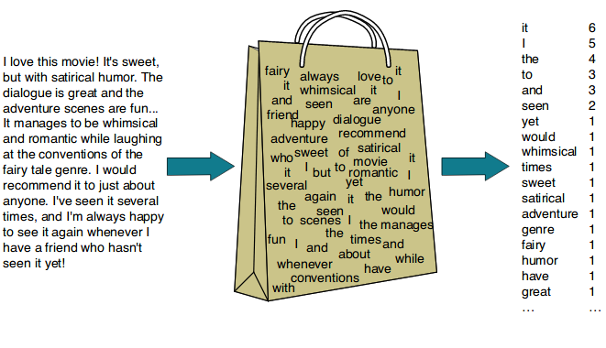
CORPUS
A bag-of-words model allows us to extract features from textual data. As we know, an algorithm doesn’t understand language. Thus, we need to use a numeric representation for the words in the corpus. This numeric representation can later be fed to any algorithm for further analysis.

Slide 8
2.TOKENIZATION
Given a sequence of characters and a defined length, tokenization is the task of chopping the document up into pieces, called tokens, of that specified length.
A Token is not necessarily a term or word. A token is an instance of a sequence of characters in some particular documents that are grouped as a useful semantic unit for processing. In other words, a token is the meaningful bit of language we want our model to learn from.
The list of tokens becomes input for further processing such as parsing or text mining.

Slide 9
3.STOP WORD REMOVAL
Sometimes, the extremely common word which would appear to be of very little value in helping select documents matching user need are excluded from the vocabulary entirely.
An example of a stop word is “a”, “is”,
“this”, “it”. While the example of alpha numeric words is “lucky123”, “80”, “7a32b”. An example of
punctuation is “,”, “?”, “!”. A general approach to noise removal is to prepare a list of noise words/tokens
(stop words, punctuation), then iterates the text by tokens, removes tokens which are present in noise word list.

Slide 10
4.STEMMING
Stemming is one way to normalize the word form. Stemming is a basic rule-based process for removing .
suffixes from words ("ing", "ly", "es", "s", etc.). For example the words "argue", "argued", "argues", "arguing", have stem "argue".

Slide 11
5.VECTORIZATION : MAPPING WORDS TO NUMERIC VALUES
Scikit-learn Count Vectorizer provides a simple way to both tokenize a collection of text documents and build a vocabulary of known words.
Any document we see can be encoded as a fixed-length vector with the length of the vocabulary of known words. The value in each position in the vector could be filled with a count or frequency of each word in the document.
Sentences to Vectors with Count Vectorizer.
For us, this gives each email a vector of integers. The vector will be the length of the number of distinct words in the corpus. Given a verbose corpus, these vectors can become quite long and cumbersome during calculations.
This leads us to our next idea, how can we shrink the corpus without losing much meaning

Slide 12
6.BUILD OUR VOCABULARY
List of Distinct Words across all Documents or training data and when we combine all those words into list , that list is called Vocabulary .
Now we assign Numbers to each words .

Slide 13
DEVELOPING THE MODEL
Now that our dataset is ready with its attributes, we pass it through any algorithm of our choice. Here, after splitting the dataset into training and test sets, I’ve used a simple Naive Bayes classifier for demonstration. You can use any algorithm of your choice depending on the dataset.
from sklearn.model_selection import train_test_split
X_train, X_test, y_train, y_test = train_test_split(X, y)
from sklearn.naive_bayes import Multinomial
classifier = Multinomial()
classifier.fit(X_train, y_train)
y_pred = classifier.predict(X_test)

Slide 14
Language used
Python programming language
Machine learning is the kind of programming which gives computer the capability to automatically learn from data without being explicitly programmed. In simple words, ML is a type of artificial intelligence that extract patterns out of raw data by using an algorithm or method. Python is a perfect choice for the field of machine learning and data science. It is a minimalistic and intuitive language with a full-featured library line (also called frameworks) which significantly reduces the time required to get the results.

Slide 15
Algorithm/technique used
NAÏVE BAYS CLASSIFIER
Simple probabilistic classifier that calculates a set of probabilities by counting the frequency and combination of values in a given dataset.
Represent as a vector of feature values.
It is very useful to classify the e-mails properly.
The precision and recall of this method is known to be very effective

Slide 16
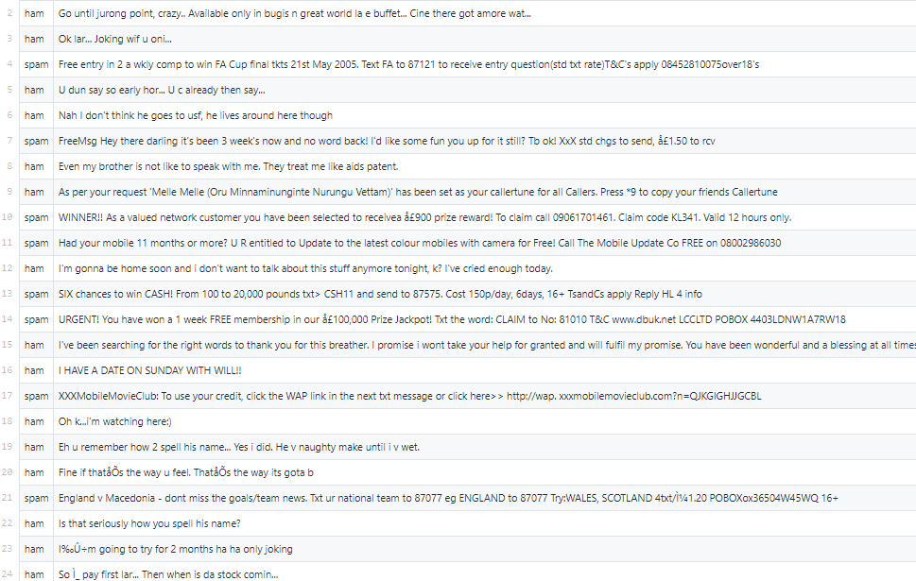
DATASET used

Slide 17
OUTPUT PARAMETERS
Any external email can be detected and classified as spam email. So the users will be aware of such email.
Mails are classified into spam and non spam.
From the classified data we have calculated the accuracy as 97.8 %

Slide 18
STEP BY STEP GUIDE TO THE PROJECT

Slide 19
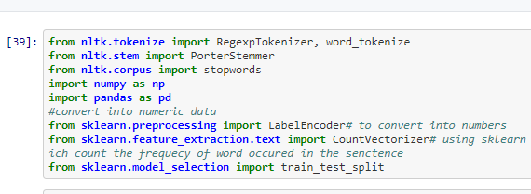
IMPORT LIBRARIES

Slide 20
STEP-1
At first we import the dataset using read_csv function of pandas library.
The read_csv function takes in the location of the dataset as the parameter.
The dataset is loaded onto the program after the correct location has been provided
After the loading of the dataset we remove unwanted columns using drop function available in library “pandas”.

Slide 21
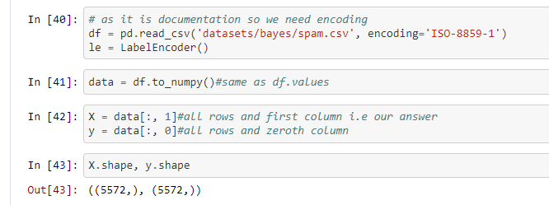

Slide 22

STEP 2.TOKENIZATION

Slide 23
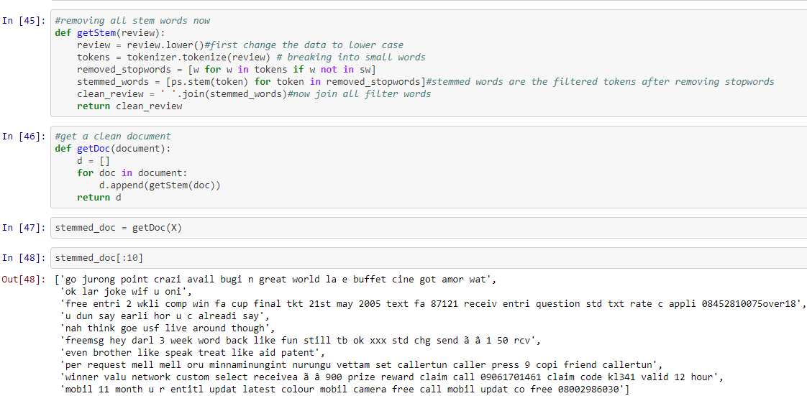
STEP3.STEMMING AND STOPWORDS REMOVAL

Slide 24
Step-4
Since our dataset had both the training attributes as well as the output class we separate the output class from the parameters
All the attribute names except the output class (which was stored under the column name class) is stored in a list called columns using simple for loop logic
The output class is stored under the variable name target
After this the dataset is separated into training part and testing part with 75% of the dataset taken as the training set.
The model is trained using the fit function and the prediction values are found.
Using the prediction values the accuracy score and the classification report are found.
The accuracy score and the classification report were as shown on the previous slide.

Slide 25
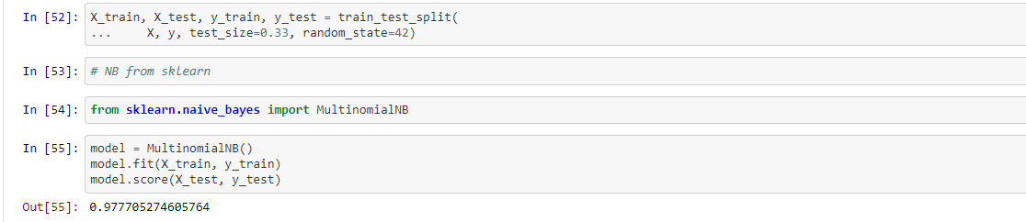

Slide 26
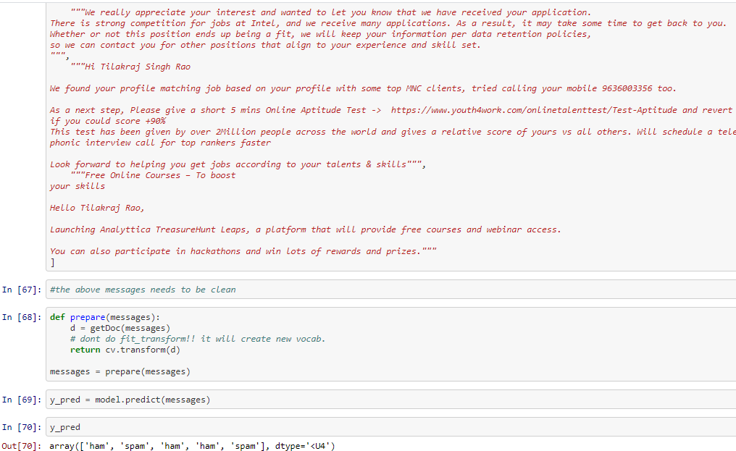
Step-5
The results turned out as shown below.

Slide 27
CONCLUSION
E-mail spam filtering is an important issue in the network security and machine learning techniques;.
Naïve Bayes classifier that used has a very important role in this process of filtering e-mail spam.
The quality of performance Naive Bayes classifier is also based on datasets that used. As can see, dataset that have fewer instances of e-mails and attributes can give good performance for Naïve Bayes classifier.
Naive Bayes classifier also can get highest precision that give highest percentage spam message manage to block if the dataset collect from single e-mail accounts.

Slide 28
REFERENCES
[1]Clemmer, A. (2012). How Bayesian algorithm works. [online] Available at: https://www.quora.com/How-do-Bayesian-algorithms-work-for-theidentification-of-spam [Accessed 16 Aug. 2017].
[2]What is Email Spam?. (2017). [Blog] comm100. Available at: https://emailmarketing.comm100.com/email-marketing-ebook/emailspam.aspx [Accessed 27 Aug. 2017].
[3]G. He, Spam Detection, 1st ed. 2007.
[4] bot2, V. (2017). Email Spam Filtering : A python implementation with scikit-learn. [online] Machine Learning in Action. Available at: https://appliedmachinelearning.wordpress.com/2017/01/23/email-spamfilter-python-scikit-learn/ [Accessed 30 Aug. 2017].

Slide 29
THANK YOU

