Slide 1


CAPSTONE PROJECT
Migration Pressure Index of Indian States
Presented By
Student Name: Tilak Yogesh gupta
College Name: thakur college of engineering & technology
Department: Masters of computer applications
Email ID: tilakygupta@gmail.com

Slide 2
OUTLINE:
Problem Statement
Proposed System/Solution
System Development Approach
Algorithm & Deployment
Result
Conclusion
Future Scope
References

Slide 3
Problem Statement:
India has over 45.6 crore internal migrants — 38% of the total population. Between 2001 and 2011, the migrant population grew by 45%, yet no unified open-data dashboard exists that combines push and pull factors to map migration pressure at the state level. Key issues: Bihar unemployment is 16.4% and daily wage is just Rs.250 — vs Delhi's Rs.650 (2.6x difference). No composite Migration Pressure Index (MPI) combining unemployment, poverty, literacy deficit, wage gap, drought, and infrastructure deficit existed for policymakers. Ministry of Labour, NITI Aayog, and state governments lacked a real-time interactive tool to identify high-pressure migration zones and design targeted interventions.

Slide 4
Proposed Solution:
An interactive 5-page Power BI dashboard computing a composite Migration Pressure Index (MPI) score (0-100) for 30 Indian states. MPI Formula: MPI = (0.25 x Unemployment) + (0.20 x Poverty) + (0.15 x Literacy Deficit) + (0.20 x Wage Gap) + (0.10 x Drought) + (0.10 x Infrastructure Deficit). All indicators Min-Max normalized.
Dashboard Pages:
Page 1 National Overview: Filled map of India coloured by MPI + KPI cards + region slicer.
Page 2 Push Factors: Unemployment, poverty, wage, literacy charts showing why people leave.
Page 3 Pull Factors: Urban GDP, infrastructure, in-migration charts showing why migrants arrive.
Page 4 Migration Flows: Source-to-destination heatmap matrix + top corridor bar chart.
Page 5 Trend Analysis: 2001 vs 2011 MPI decade comparison with key insight text box.
Data Sources:
6 CSV datasets from NDAP (ndap.niti.gov.in): Census 2011 D-Series, PLFS Unemployment, BPL Poverty, NFHS-5 Infrastructure, CMIE Daily Wages, Trend 2001-2011.
Published to Power BI Service (app.powerbi.com). GitHub repository with all 6 datasets, PBIX file and README uploaded.

Slide 5
System Approach:
Tools Used: Microsoft Power BI Desktop (dashboard design), Power Query (data cleaning and ETL), DAX - Data Analysis Expressions (calculated columns and measures), Star Schema (6-table data model linked via State column).
Data Preparation (Power Query): Load 6 CSVs individually via Get Data > Text/CSV. Trim whitespace on State column. Fix data types (Text/Whole Number/Decimal). Remove blank rows. Rename tables: MigrationIndex, MigrationFlows, PushFactors, PullFactors, MigrationReasons, TrendData.
Data Model (Star Schema): MigrationIndex is the central fact table. 5 Many-to-One relationships via State column. Cross filter direction: Single. Data Category for State column set to State or Province for map rendering.

Slide 6
Algorithm & Deployment:
MPI Calculation Algorithm using DAX in Power BI:
Step 1 - Normalize each indicator (Min-Max to 0-1 scale):
UnempNorm=(Unemp-2)/(20-2), PovNorm=(Poverty-6)/(37-6), LitNorm=(100-Literacy)/(100-63), WageNorm=(680-Wage)/(680-220), DrNorm=Drought/4, InfrNorm=(88-Infra)/(88-22)
Step 2 - Apply weights and compute final score:
MPI = ROUND((0.25xUnempNorm + 0.20xPovNorm + 0.15xLitNorm + 0.20xWageNorm + 0.10xDrNorm + 0.10xInfrNorm) x 100, 0)
Step 3 - Classify each state:
MPI_Category = IF(MPI>=70, Critical, IF(MPI>=55, High, IF(MPI>=40, Moderate, IF(MPI>=28, Low, Minimal))))
Deployment:
Published to Power BI Service (app.powerbi.com). Navigation buttons, Region slicer, Migration_Type slicer on all 5 pages. Drill-through to State Detail page. Public embed link generated. GitHub repo with 6 CSV datasets, PBIX file, README and PPTX uploaded.

Slide 7
Result: Key Dashboard Insights
Highest MPI State: Bihar — Score 82 (Critical)
74.2% out-migration rate | 16.4% unemployment | Rs.250 average daily wage | Eastern India high-pressure zone
Lowest MPI State: Delhi — Score 22 (Minimal)
68.4% in-migration rate | Rs.650 daily wage | Rs.1,98,400 urban GDP per capita | Best infrastructure index 88
Largest Migration Corridor: UP to Delhi — 57 Lakh Migrants
Bihar to Delhi: 47 Lakhs | Bihar to Maharashtra: 37 Lakhs | Total tracked flows: 398.8 Lakhs across all corridors
Wage Gap = #1 Driver of Migration (2.6x difference)
Scatter plot confirms strong negative correlation: lower wage = higher MPI. Wage gap stronger predictor than unemployment or poverty alone.
The Aspiration Paradox: MPI fell -5.63 pts yet migration GREW +44.9%
Bihar MPI fell from 89 (2001) to 82 (2011) — yet out-migration rose sharply. Structural wage gap persists even when living conditions improve slightly.
Dashboard Link: [Your Power BI Service Link] | GitHub: [Your GitHub Link]

Slide 8
Data Architecture & Model:
Data Model: Star Schema with 6 interlinked tables. MigrationIndex is the central fact table linked to all 5 dimension tables via the State column using Many-to-One relationships. Table 1 — MigrationIndex (Central Fact Table): State, Region, MPI_Score, Migration_Type, Unemployment_Rate, Rural_Poverty_Ratio, Literacy_Rate, Avg_Daily_Wage, Out_Migration_Rate, In_Migration_Rate, migrants, Infrastructure_Index, Drought_Frequency. Table 2 — MigrationFlows: Source_State, Destination_State, Migrants_Lakhs, Year, Primary_Reason, Male_Migrants, Female_Migrants, Corridor (calculated column). Table 3 — PushFactors: State, Year, Unemployment_Rate_Pct, Rural_Poverty_Pct, Literacy_Rate_Pct, Avg_Daily_Wage_INR, NREGA_Dependency_Pct, Push_Score_Normalized. Table 4 — PullFactors: State, Urban_GDP_PerCapita_INR, Infrastructure_Index, In_Migration_Rate, Pull_Score_Normalized, Hospital_Beds_Per1000, Internet_Access_Pct. Table 5 — MigrationReasons: State, Employment_Pct, Marriage_Pct, Education_Pct, Family_Pct, Disaster_Pct, Total_Migrants_Lakhs. Table 6 — TrendData: State, MPI_2001, MPI_2011, MPI_Change, OutMigration_2001_Lakhs, OutMigration_2011_Lakhs, Migration_Growth_Pct, Wage_2001, Wage_2011.

Slide 9
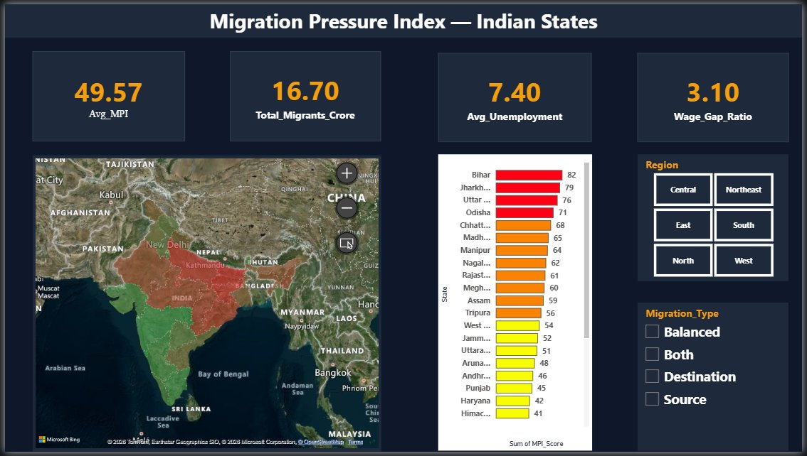
Result: Page 1 — National MPI Overview
Filled map of India colored by MPI score (red=Critical, green=Minimal) | Avg MPI: 49.57 | Total Migrants: 16.70 Crore | Avg Unemployment: 7.40% | Wage Gap Ratio: 3.10x | Bihar tops with MPI 82, Delhi lowest at 22

Slide 10
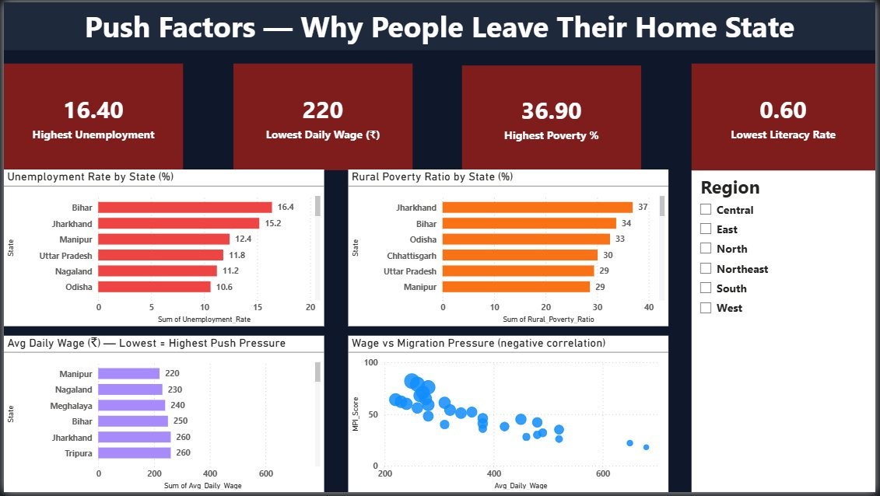
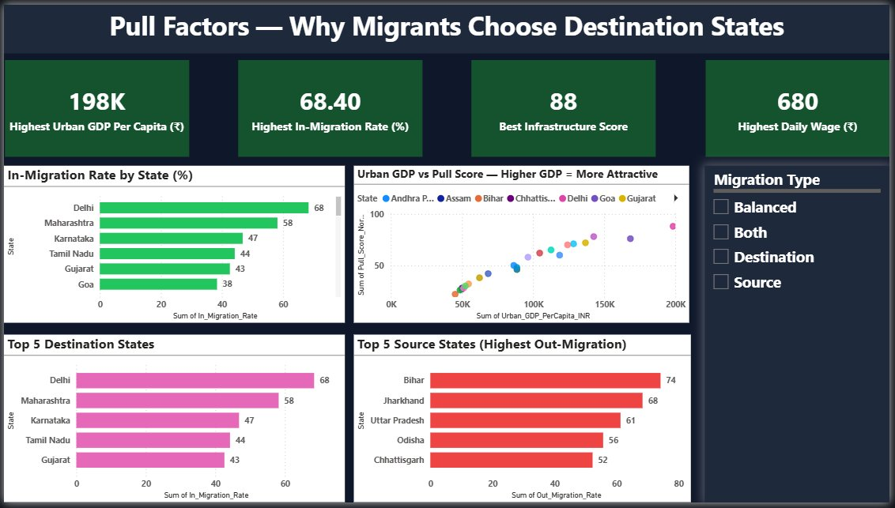
Result: Pages 2 & 3 — Push & Pull Factors
Push Factors (left): Bihar highest unemployment 16.4%, Jharkhand highest poverty 36.9%, Manipur lowest wage Rs.220 | Pull Factors (right): Delhi 68.4% in-migration, Goa highest wage Rs.680, Delhi best infrastructure score 88

Slide 11
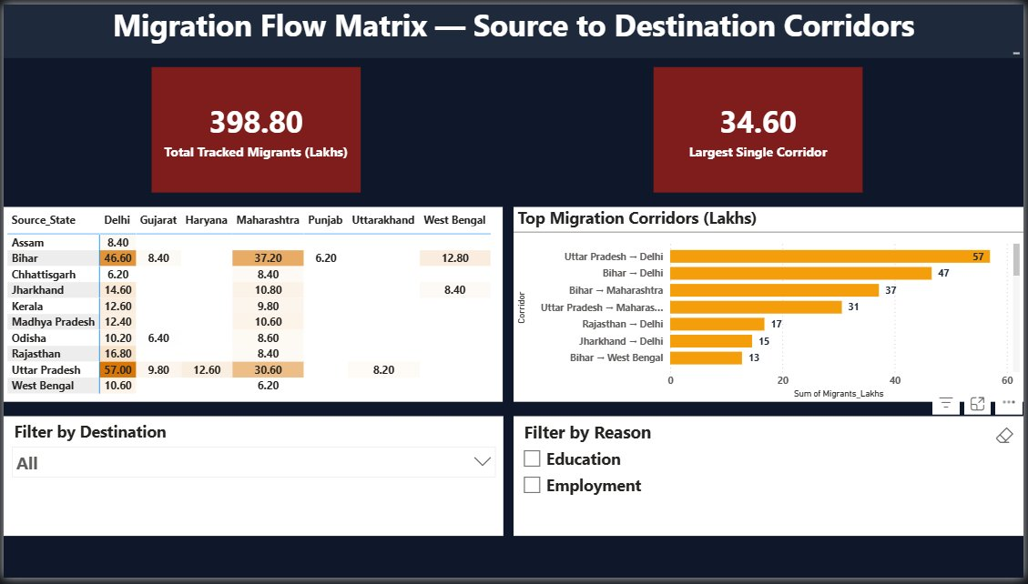
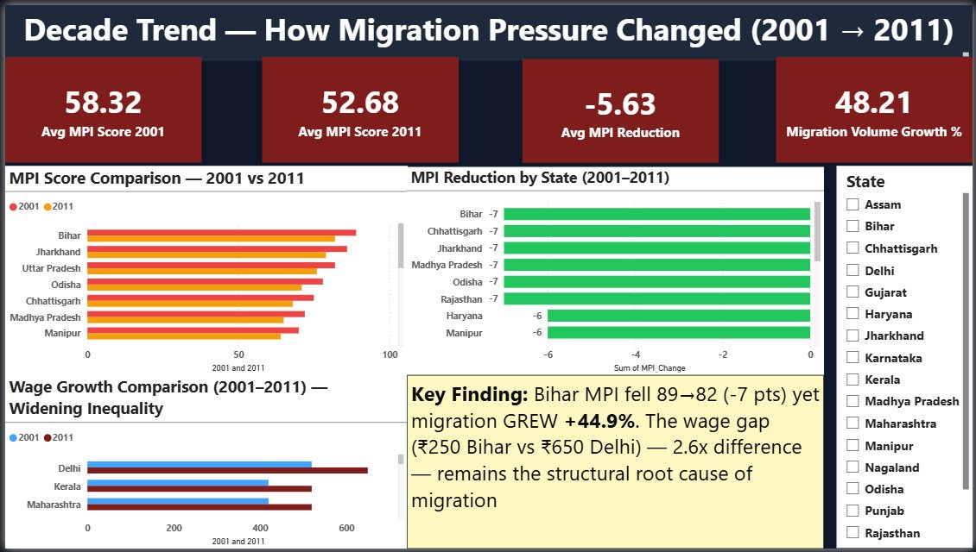
Result: Pages 4 & 5 — Migration Flows & Trends
Migration Flows (left): UP to Delhi 57L is #1 corridor, Bihar to Delhi 47L #2, total 398.8 Lakhs tracked | Trends (right): Avg MPI fell 58.32 to 52.68 (-5.63 pts) yet migration GREW +44.9% — wage gap persists

Slide 12
Conclusion:
The Migration Pressure Index Dashboard is the first open-data composite indicator combining 6 push and pull factors across 30 Indian states in a single interactive Power BI report — directly actionable for NITI Aayog and the Ministry of Labour. Key findings: Bihar (MPI 82), Jharkhand (MPI 79), UP (MPI 76) are the highest-pressure source states. Delhi (MPI 22), Goa (MPI 18), Maharashtra (MPI 26) are dominant destinations. The wage gap (2.6x between Bihar and Delhi) is a stronger predictor of migration than unemployment or poverty alone. Marginal MPI improvements fail to suppress aspirational migration — wage parity and job creation in source states must be targeted directly.

Slide 13
Future scope:
District-level granularity: Extend MPI to district level using NSSO data for more precise policy targeting within states. Real-time data integration: Connect to live CMIE and PLFS APIs for auto-refresh of unemployment and wage data monthly. Climate-migration layer: Add drought index, flood frequency, and crop failure data to quantify climate-driven displacement. Azure ML Predictive Model: Forecast future MPI scores based on economic policy scenarios using Azure Machine Learning. What-If Policy Simulator: Add Power BI What-If parameters to simulate impact of wage increases or job creation on MPI scores in real time. Mobile layout and multi-country expansion: Adapt the MPI framework for South Asian migration corridors (India-Bangladesh, India-Nepal).

Slide 14
References:
1. Census of India 2011 — D-Series Migration Tables (D-01, D-04, D-07). Office of Registrar General, India. censusindia.gov.in 2. National Data and Analytics Platform (NDAP), NITI Aayog. ndap.niti.gov.in 3. Periodic Labour Force Survey (PLFS) Annual Report 2020-21. Ministry of Statistics and Programme Implementation. mospi.gov.in 4. National Family Health Survey NFHS-5 (2019-21). International Institute for Population Sciences, Mumbai. rchiips.org/nfhs 5. Centre for Monitoring Indian Economy (CMIE) — State-wise Unemployment and Wage Data. cmie.com 6. Economic Survey 2022-23, Ministry of Finance, Government of India. 7. PRS Legislative Research — Internal Migration in India. prsindia.org 8. Microsoft Power BI Documentation. docs.microsoft.com/power-bi
GitHub: [Click Here]
LinkedIn URL: [Click Here]
Power BI Project Link: [Click Here]

Slide 15
Thank You

