Slide 1
Software Architecture Fall 2019
Introducing Software Architecture: Become a Software Architect, Design Thinking Fundamentals, Introduction to Quality Attributes
Lecture 2 – Alexey Kanatov

Slide 2
Agenda
What Software Architects Do?
Design Thinking Fundamentals
Introduction to Quality Attributes
Summary

Slide 3
What Software Architects Do?
Software architects have a distinct set of responsibilities and are seemingly at the center of everything.
They sometimes write some code, but architects design more than only algorithms and discuss code.
They aren’t product managers, but architects make sure the software meets its business goals.
They aren’t project managers, but architects decide when and how software is delivered.

Slide 4
What Software Architects Do? Focus on Big picture

Slide 5
What Software Architects Do? (Responsibilities)
Define the Problem from an Engineering Perspective: In addition to product features there is another kind of requirements called a quality attributes that architects care the most about. Also architects keep an eye out for design constraints and features that might force the architecture down a specific path.
Partition the System and Assign Responsibilities: Architects partition the software system so they can develop a strategy for achieving quality attributes and other system requirements to make software system to be more reliable, available, and scalable. Partitioning a system is important as it makes things easier to reason about, easier to test, and easier to design. As the system was de-compositioned the architect is to ensure that everything can come back together again.
Keep an Eye on the Bigger Picture: Thinking about the system as a whole means architects deal with more than just technology. People, processes, business needs, and many other technical and nontechnical factors play a part in the final software system. Software design is a constant struggle to find the right balance between the things you want and the reality you must accept. This means you must think about and make trade-offs.
Decide Trade-offs among Quality Attributes (prioritization): Say high availability is an important quality attribute for your stakeholders and you need your software to respond to 99.9% of requests. One way to promote availability is to introduce redundant elements. Designing for this is simple, but there’s a catch. You now must purchase twice the hardware, which doubles your costs. In this case, you traded costs to get higher availability. It is common in software development to give up something you want to get something you need. Architects identify the trade-offs and work with stakeholders to decide which compromises make the most sense.
Manage Technical Debt (Identify the design gap and manage it): Software architects know all the details about the system and they are to manage technical debt - the gap between your software system’s current design and the design you need it to have so you can continue to deliver value. You can measure the amount of technical debt by estimating the effort required to close that gap. All software has technical debt. Technical debt is an inevitable byproduct of success. The best software development teams use technical debt strategically to ship faster and regularly pay debt down so they can continue shipping value over time. Architects make technical debt visible and help stakeholders decide which actions to take to manage it.
Grow the Team’s Architecture Skills (technical leadership development): Software architects are teachers and mentors for their teams. Architecture design is a social activity. Skills development is crucial to the team’s success.

Slide 6
The 4 Principles of Design Thinking
Human rule. All design is social in nature. Design is an inherently human-focused endeavor. We design software for people. We design software with people. Communication is crucial.
Ambiguity rule. Preserve ambiguity. Before we solidify a design decision, we can use ambiguity to keep options open. Since the goal of software architecture is to arrange structures that promote desired quality attributes, we’ll focus our attention there. A minimalist architecture only shows how high-priority quality attributes are achieved and reduces risks for promoting those quality attributes. All other design decisions are left open for downstream designers to determine. Design decisions that do not directly influence a quality attribute or reduce risks threatening our ability to deliver software are more about detailed design than architecture. Such decisions can safely be left open for downstream designers to settle outside the architecture.
Redesign rule. All design is redesign. (Design reuse) The redesign rule encourages us to look to think about what we already know by exploring patterns and past designs. As time goes on and as we build more software, our institutional knowledge about how to design great software improves. Other teams have probably seen a problem similar to the one you face currently. Hopefully, someone documented a pattern you can use as a starting point for your architecture. Maybe someone built a framework designed to solve your exact problem? When designing software architectures, we’ll spend more time refining existing designs than we’ll be creating new ones.
Tangibility rule. Make ideas tangible to facilitate communication. While the structures in the architecture can exist in code, this does not make the architecture any more tangible. Code is difficult to read and does not make discussions about quality attributes, coarse-grained components, design rationale, or the consequences of our decisions any easier. If we want to share an architecture with others, then we need to make it real in a way code by itself will not allow. There are many ways to make architecture tangible. Draw it. Make it come alive in the code you write. Build prototypes that let people experience structures and quality attributes. Create simple models that show how some part of the architecture works. Create relatable metaphors. Act out parts of the control flow of the system.

Slide 7
Adopt a Design Mindset
Understand the Problem: Actively seek information from stakeholders and work to describe the problem. Define requirements. Learn your customers and their needs.
Explore Ideas: Create multiple design concepts and identify engineering approaches for solving a problem. Explore software architectures to find one which has desired quality attributes.
Make It Real: Create models (prototypes) to share and test idea. Write documents and share them.
Evaluate Fit: Evaluate all or part of the architecture, even only a single model, concept, or idea. The most common approach is to walk through a piece of the architecture with different scenarios, but we can also test design decisions directly by running experiments or examining the risks surrounding a decision.

Slide 8
Adopt a Design Mindset: questions to consider
When have you worked with people to understand a problem? Did you follow a particular method?
How have you collaborated with others to explore ideas and generated alternatives?
Looking beyond code, how do the things you make change how you interact with stakeholders and teammates?
How do you evaluate your designs? What techniques have you used to test solution hypotheses?

Slide 9
Adopt a Design Mindset: Think, Do, Check
Do Execute the plan. Create something tangible that quickly and cheaply uncovers information needed to check our thinking and share our ideas.
Check Critically examine what we accomplished during the do step so we can decide our next move. The insights coming out of the check step tell us what to do next. Repeat at the think step.
Think What do we hope to learn? What questions do we need answered? What are our top risks? Thinking involves creating a plan to learn what we need to answer specific questions or reduce risks.

Slide 10
4 models of SW development processes
Waterfall model. It organizes the life cycle into a series of connected sequential activities, each with entry and exit conditions and a formalized relationship with its upstream and downstream neighbors. The process began with requirements specification, followed by design, then implementation, then integration, then testing, then installation, all followed by maintenance. Feedback paths from later to earlier steps allowed for the revision of artifacts (requirements documents, design documents, etc.) on an as-needed basis, based on the knowledge acquired in the later stage. And then the cycle continued.
Iterative model. It considers software development as a series of short cycles (called iterations) through the steps—some requirements lead to some design, which can be implemented and tested while the next cycle’s worth of requirements are being captured and designed. Each iteration should deliver something working and useful. The trick here is to uncover early those requirements that have the most far-reaching effect on the design; the corresponding danger is to overlook requirements that, when discovered later, will capsize the design decisions made so far. Well known iterative process is called the Unified Process (RUP) which defines 4 phases of each iteration: inception, elaboration, construction, and transition.
Agile. Group of SW development methodologies, the best known - Scrum, Extreme Programming, and Crystal Clear. These methodologies are all incremental and iterative. What distinguishes Agile practices is early and frequent delivery of working software, close collaboration between developers and customers, self-organizing teams, and a focus on adaptation to changing circumstances (such as late-arriving requirements). All Agile methodologies focus on teamwork, adaptability, and close collaboration. These methodologies typically eschew substantial up-front work, on the assumption that requirements always change, and they continue to change throughout the project’s life cycle.
Model-driven development. It is based on the idea of automatic program code generation based on the models of the domain created by humans. Humans create a platform-independent model (PIM), which is combined with a platform-definition model (PDM) to generate running code. In this way the PIM is a pure realization of the functional requirements while the PDM addresses platform specifics and quality attributes.

Slide 11
Architecture in a SDLC context: activities
All of SDLC processes include design among their obligations, and because architecture is a special kind of design, architecture finds a home in each one.
Changing from one development process to another in the middle of a project requires the architect to save useful information from the old process and determine how to integrate it into the new process.
No matter what software development process or life-cycle model you’re using, there are activities that are involved in creating a software architecture, using that architecture to realize a complete design, and then implementing or managing the evolution of a target system or application.
The process you use will determine how often and when you revisit and elaborate each of these activities.
Making a business case for the system
Understanding the architecturally significant requirements
Creating or selecting the architecture
Documenting and communicating the architecture
Analyzing or evaluating the architecture
Implementing and testing the system based on the architecture
Ensuring that the implementation conforms to the architecture

Slide 12
Systems and software engineering — Systems and software Quality Requirements and Evaluation (SQuaRE) — System and software quality models
Software products and software-intensive computer systems are increasingly used to perform a wide variety of business and personal functions. Realization of goals and objectives for personal satisfaction, business success and/or human safety relies on high-quality software and systems. High-quality software products and software-intensive computer systems are essential to provide value, and avoid potential negative consequences, for the stakeholders.
Software products and software-intensive computer systems have many stakeholders including those who develop, acquire, use, or who are customers of businesses using software-intensive computer systems. Comprehensive specification and evaluation of the quality of software and software-intensive computer systems is a key factor in ensuring value to stakeholders. This can be achieved by defining the necessary and desired quality characteristics associated with the stakeholders' goals and objectives for the system. This includes quality characteristics related to the software system and data as well as the impact the system has on its stakeholders. It is important that the quality characteristics are specified, measured, and evaluated whenever possible using validated or widely accepted measures and measurement methods. The quality models in this International Standard can be used to identify relevant quality characteristics that can be further used to establish requirements, their criteria for satisfaction and the corresponding measures.

Slide 13
ISO/IEC 25010:2011: SYSTEMS AND SOFTWARE QUALITY REQUIREMENTS AND EVALUATION
ISO/IEC 2503n – Quality Requirements Division. The International Standards that form this division help specify quality requirements, based on quality models and quality measures. These quality requirements can be used in the process of quality requirements elicitation for a software product to be developed or as input for an evaluation process.
URL to the standard https://www.iso.org/standard/35733.html

Slide 14
Architecture and Requirements
Requirements for a system come in a variety of forms: textual requirements, mockups, existing systems, use cases, user stories, and more. No matter the source, all requirements encompass the following categories:
Functional requirements. These requirements state what the system must do, and how it must behave or react to runtime stimuli.
Quality attribute requirements. (how) These requirements are qualifications of the functional requirements or of the overall product. A qualification of a functional requirement is an item such as how fast the function must be performed, or how resilient it must be to erroneous input. A qualification of the overall product is an item such as the time to deploy the product or a limitation on operational costs.
Constraints. (don’t) A constraint is a design decision with zero degrees of freedom. That is, it’s a design decision that’s already been made. Examples include the requirement to use a certain programming language or to reuse a certain existing module, or a management decision to make your system service oriented. These choices are arguably in the purview of the architect, but external factors (such as not being able to train the staff in a new language, or having a business agreement with a software supplier, or pushing business goals of service interoperability) have led those in power to dictate these design outcomes.
What is the “response” of architecture to each of these kinds of requirements?
Functional requirements are satisfied by assigning an appropriate sequence of responsibilities throughout the design. Assigning responsibilities to architectural elements is a fundamental architectural design decision.
Quality attribute requirements are satisfied by the various structures designed into the architecture, and the behaviors and interactions of the elements that populate those structures.
Constraints are satisfied by accepting the design decision and reconciling it with other affected design decisions.
Notes:
Example car design

Slide 15
Architecture and Quality Attributes
Quality attributes
For nearly all systems, quality attributes such as performance, reliability, security, and modifiability are every bit as important as making sure that the software computes the correct answer. A software system’s ability to produce correct results isn’t helpful if it takes too long doing it, or the system doesn’t stay up long enough to deliver it, or the system reveals the results to your competition or your enemy. Architecture is where these concerns are addressed. For example:
If you require high performance, you need to
Exploit potential parallelism by decomposing the work into cooperating or synchronizing processes.
Manage the interprocess and network communication volume and data access frequencies.
Be able to estimate expected latencies and throughputs.
Identify potential performance bottlenecks.
If your system needs high accuracy, you must pay attention to how the data elements are defined and used and how their values flow throughout the system.
If security is important, you need to
Legislate usage relationships and communication restrictions among the parts.
Identify parts of the system where an unauthorized intrusion will do the most damage.
Possibly introduce special elements that have earned a high degree of trust.
If you need to support modifiability and portability, you must carefully separate concerns among the parts of the system, so that when a change affects one element, that change does not ripple across the system.
If you want to deploy the system incrementally, by releasing successively larger subsets, you have to keep the dependency relationships among the pieces untangled, to avoid the “nothing works until everything works” syndrome.
Input
System
Output
Correctness

Slide 16
Architecture Books vs. ISO ☺
Books – quality attributes | ISO – product quality model
Performance | Performance
Security | Security
Usability | Usability
Testability | Compatibility
Modifiability | Maintainability
Availability | Reliability
Interoperability | Functional suitability
Variability, portability, development distributability, scalability and elasticity, deployability, mobility, and monitorability | Portability

Slide 17
Specifying Quality Attribute Requirements
Six-part scenarios allow to describe quality attribute requirements. Architects are to consider all 6, but some may be omitted when irrelevant.
Source of stimulus. This is some entity (a human, a computer system, or any other actuator) that generated the stimulus.
Stimulus. The stimulus is a condition that requires a response when it arrives at a system.
Environment. The stimulus occurs under certain conditions. The system may be in an overload condition or in normal operation, or some other relevant state. For many systems, “normal” operation can refer to one of a number of modes. For these kinds of systems, the environment should specify in which mode the system is executing.
Artifact. Some artifact is stimulated. This may be a collection of systems, the whole system, or some piece or pieces of it.
Response. The response is the activity undertaken as the result of the arrival of the stimulus.
Response measure. When the response occurs, it should be measurable in some fashion so that the requirement can be tested.

Slide 18
Availability: general scenario
Availability refers to a property of software that it is there and ready to carry out its task when needed.
Availability =
reliability + recovery

Slide 19
Availability
Particular scenario
Tactics to ensure the quality (control availability)

Slide 20
Availability tactics
A failure occurs when the system no longer delivers a service that is consistent with its specification. A fault (or combination of faults) may cause a failure.
Availability tactics, therefore, are designed to enable a system to endure system faults so that a service being delivered by the system remains compliant with its specification. The tactics should keep faults from becoming failures or at least bound the effects of the fault and make repair possible. Availability tactics may be categorized like this:
fault detection, fault recovery, and fault prevention.

Slide 21
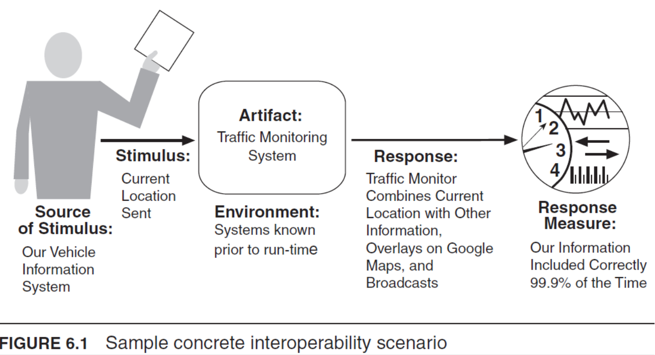
Interoperability
Interoperability focuses on how two or more systems can usefully exchange meaningful information via interfaces in a particular context. The definition includes not only having the ability to exchange data (syntactic interoperability) but also having the ability to correctly interpret the data being exchanged (semantic interoperability).

Slide 22
Interoperability tactics

Slide 23
Interoperability tactics

Slide 24
Modifiability: Change happens! Focus on the cost and risk of the change
Architect has to consider:
What can change? the functions that the system computes, the platform (the hardware, operating system, middleware), the environment in which the system operates, the qualities the system exhibits (its performance, its reliability, and even its future modifications), and its capacity (number of users supported, number of simultaneous operations).
What is the likelihood of the change? Although anything might change, the architect has to make the tough decisions about which changes are likely, and hence are to be supported, and which are not.
When is the change made and who makes it? Most commonly in the past, a change was made to source code. That is, a developer had to make the change, which was tested and then deployed in a new release. Now, however, the question of when a change is made is intertwined with the question of who makes it. An end user changing the screen saver is clearly making a change to one of the aspects of the system.
What is the cost of the change?
The cost of introducing the mechanism(s) to make the system more modifiable
The cost of making the modification using the mechanism(s) (develop GUI builder instead of making manual changes)

Slide 25
Modifiability tactics
Tactics to reduce the cost of making a change:
making modules smaller
increasing cohesion (separating responsibilities that do not serve the same purpose)
reducing coupling (encapsulating, using an intermediary, restricting dependencies, co-locating related responsibilities, refactoring, and abstracting common services. )
deferring binding (an architecture that is suitably equipped to accommodate modifications late in the life cycle will cost less)

Slide 26
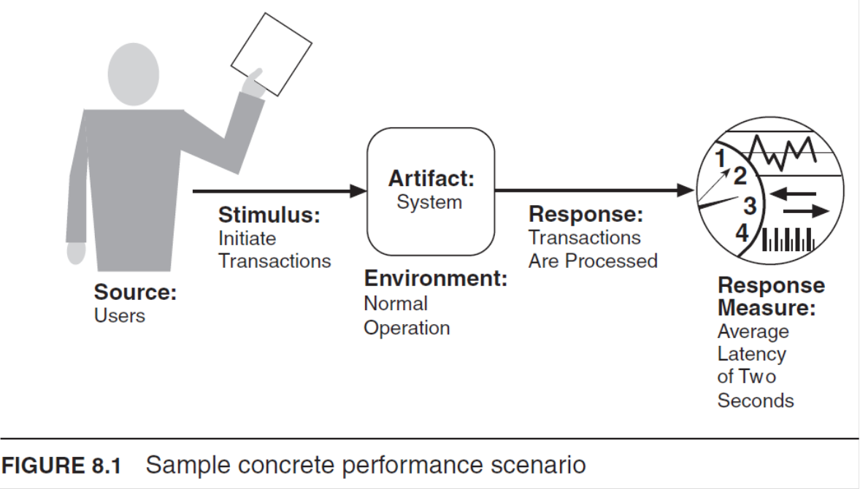
Performance. It’s about time.
Historically, performance has been the driving factor in system architecture. As such, it has frequently compromised the achievement of all other qualities. Nevertheless, all systems have performance requirements, even if they are not expressed.
Performance is often linked to scalability—that is, increasing your system’s capacity for work, while still performing well. Technically, scalability is making your system easy to change in a particular way, and so is a kind of modifiability.
Ability of the software system to meet timing requirements. When events occur—interrupts, messages, requests from users or other systems, or clock events marking the passage of time—the system, or some element of the system, must respond to them in time. Characterizing the events that can occur (and when they can occur) and the system or element’s time-based response to those events are essential things for performance.

Slide 27
Performance tactics
The goal of performance tactics is to generate a response to an event arriving at the system within some time-based constraint. The event can be single or a stream and is the trigger to perform computation.
At any instant during the period after an event arrives but before the system’s response to it is complete, either the system is working to respond to that event or the processing is blocked for some reason. This leads to the two basic contributors to the response time: processing time (when the system is working to respond) and blocked time (when the system is unable to respond).

Slide 28
Performance tactics
Performance is about the management of system resources in the face of particular types of demand to achieve acceptable timing behavior.
Performance can be measured in terms of throughput and latency for both interactive and embedded real-time systems, although throughput is usually more important in interactive systems, and latency is more important in embedded systems.
Performance can be improved by reducing demand or by managing resources more appropriately. Reducing demand will have the side effect of reducing fidelity or refusing to service some requests. Managing resources more appropriately can be done through scheduling, replication, or just increasing the resources available.

Slide 29
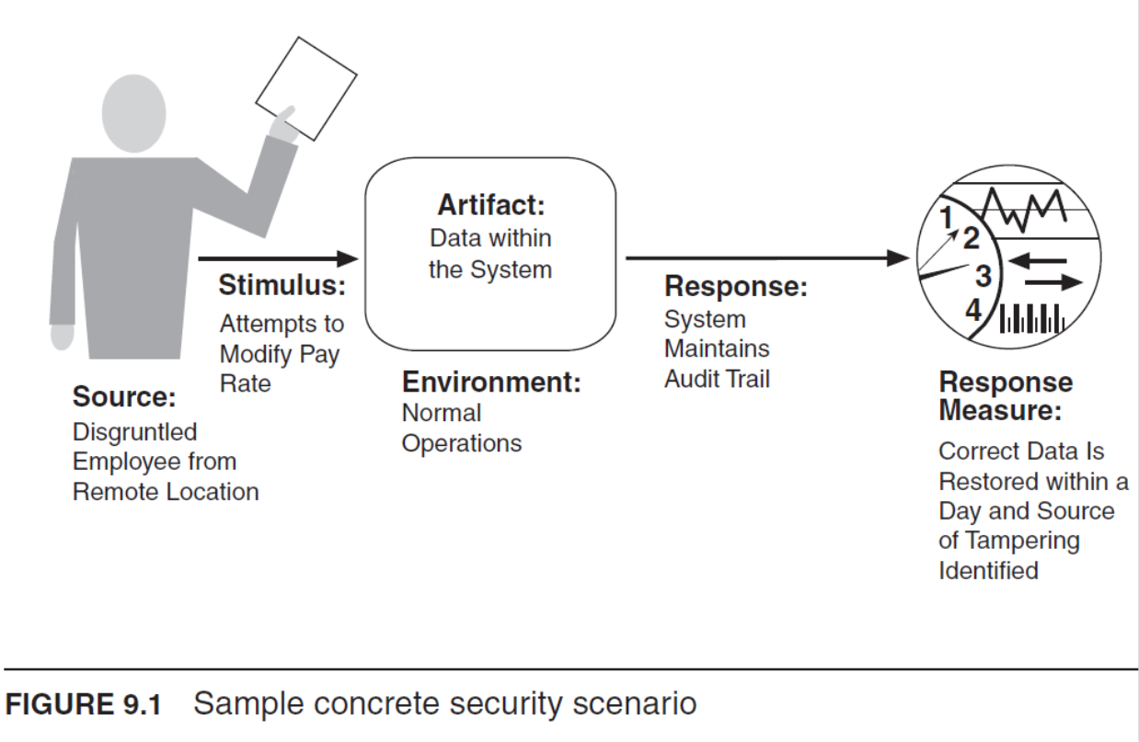
Security
Security is a measure of the system’s ability to protect data and information from unauthorized access while providing access to authorized parties. Security can be characterized with
Confidentiality keeps data away from those who should not have access while granting access to those who should.
Integrity ensures no unauthorized modifications to or deletion of data
Availability guarantees the system is accessible to those who are entitled to use it.
Authentication verifies the identities of the parties to a transaction and checks if they are truly who they claim to be.
Nonrepudiation guarantees that the sender of a message cannot later deny having sent the message, and that the recipient cannot deny having received the message.
Authorization grants a user the privileges to perform a task.

Slide 30
Security – tactics

Slide 31
Testability
Software testability refers to the ease with which software can be made to demonstrate its faults through (typically execution-based) testing. Specifically, testability refers to the probability, assuming that the software has at least one fault, that it will fail on its next test execution. Intuitively, a system is testable if it “gives up” its faults easily. If a fault is present in a system, then we want it to fail during testing as quickly as possible.
For a system to be properly testable, it must be possible to control each component’s inputs and then to observe its outputs.
Frequently this control and observation is done through the use of a test harness, which is specialized software (or in some cases, hardware) designed to exercise the software under test. The test harness can provide assistance in executing the test procedures and recording the output.
Testing is carried out by various developers, users, or quality assurance personnel. Portions of the system or the entire system may be tested. The response measures for testability deal with how effective the tests are in discovering faults and how long it takes to perform the tests to some desired level of coverage. Test cases can be written by the developers, the testing group, or the customer. The test cases can be a portion of acceptance testing or can drive the development as they do in certain types of Agile methodologies.
Ensuring that a system is easily testable has payoffs both in terms of the cost of testing and the reliability of the system.

Slide 32
Testability - scenario

Slide 33
Testability - tactics
The goal of tactics for testability is to allow for easier testing when an increment of software development is complete:
Add controllability and observability to the system.
Limit complexity in the system’s design

Slide 34
Testability - tactics

Slide 35
Usability: ease of use, user support
Usability focuses on:
Learning system features. If the user is unfamiliar with a particular system or a particular aspect of it, what can the system do to make the task of learning easier?
Using a system efficiently. What can the system do to make the user more efficient in its operation? This might include the ability for the user to redirect the system after issuing a command. For example, the user may wish to suspend one task, perform several operations, and then resume that task.
Minimizing the impact of errors. What can the system do so that a user error has minimal impact? For example, the user may wish to cancel a command issued incorrectly.
Adapting the system to user needs. How can the user (or the system itself) adapt to make the user’s task easier? For example, the system may automatically fill in URLs based on a user’s past entries.
Increasing confidence and satisfaction. What does the system do to give the user confidence that the correct action is being taken? For example, providing feedback that indicates that the system is performing a long-running task.

Slide 36
Usability - tactics

Slide 37
Summary
What Software Architects Do: looking for trade off between needs of business, technology and users (customers)
Design Thinking Fundamentals: Understand, Explore, Make, Evaluate
Key quality attributes and how to describe them: Availability, Interoperability, Modifiability, Performance, Security, Testability, Usability

