Slide 1
Online Farmers

Slide 2
The idea

Slide 3
Technologies
React Technologies
Node JS
MongoDB
Google Cloud Storage

Slide 4
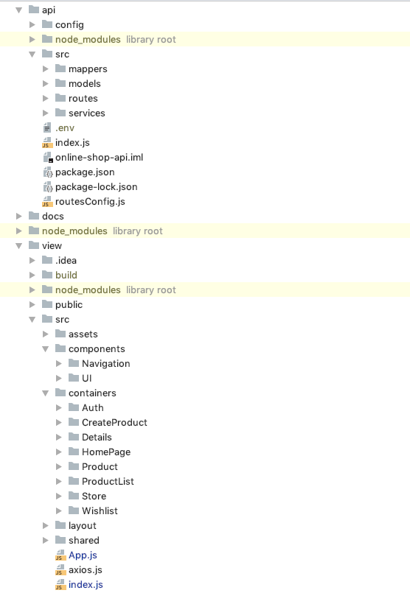
File Structure

