Slide 1


A31-MEDITRACK
SIRS
PROJECT
GUILHERME SOARES 96392
TILDE EINE 108444

Slide 2

CONTENT
01
SECURE DOCUMENTS
02
INFRASTRUCTURE
03
SECURE CHANNELS AND KEY DISTRIBUTION
04
SECURITY CHALLENGE
05
RESULTS AND CONCLUSIONS

Slide 3
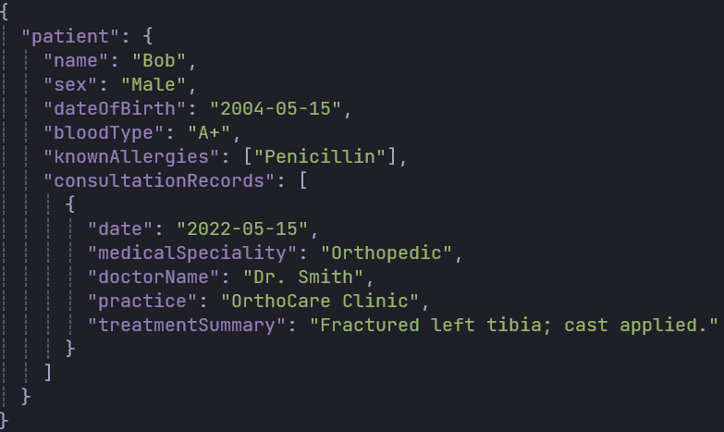
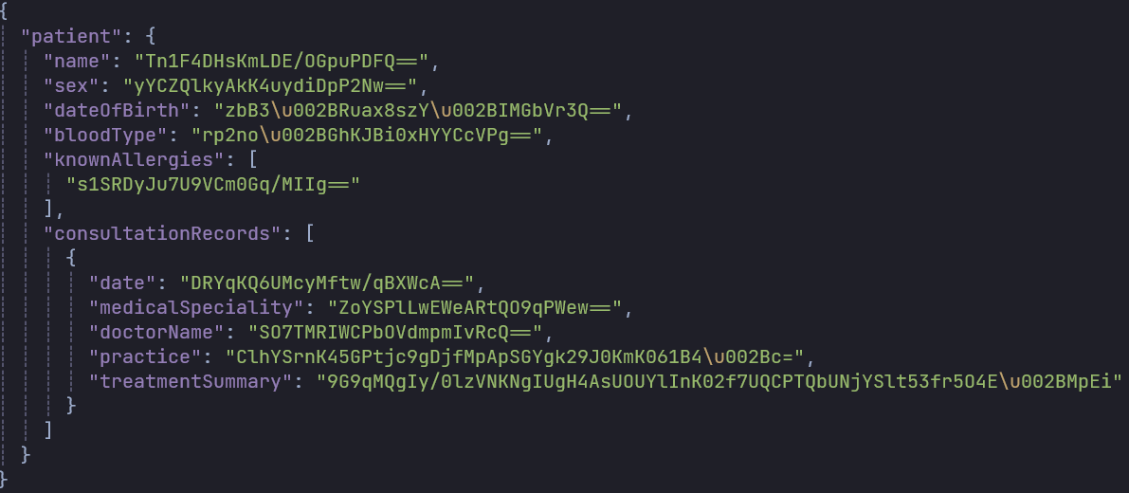

SECURE DOCUMENTS
Notes:
Our cryptographic library, CryptoLib, was designed to provide the security requirements of the MediTrack Electronic Health Records (EHR) system. The main objectives for this section were to ensure the authenticity and confidentiality of patient data and metadata in the documents.
We made two key design choices in this phase:
Hybrid Cryptography - We use a mix of asymmetric and symmetric cryptography to provide confidentiality for the documents through encryption.
Symmetric Cryptography: We chose symmetric cryptography through AES with CBC-mode to encrypt the content of the documents itself, as symmetric cryptography is more efficient than asymmetric cryptography, and therefore better suited for larger amounts of data. However, we need a safe way to make sure the sender and recipient share this symmetric key. For this key exchange, we use asymmetric cryptography.
Asymmetric Cryptography: A unique symmetric key is generated for each document we call protect() on. This key, as well as the CBC-mode Initialization Vector, is then encrypted using the receiver's public key. This allows a safe exchange of keys for each document that is protected.
Digital signatures - To provide authenticity for the documents, each document is signed before the encryption step. The user who calls protect() provides an authentication key, which is their private key, to sign the document. After the receiver calls unprotect() with their private key allowing him to decrypt the data, he then verifies the document authenticity by calling check() with the sender's public key.

Slide 4
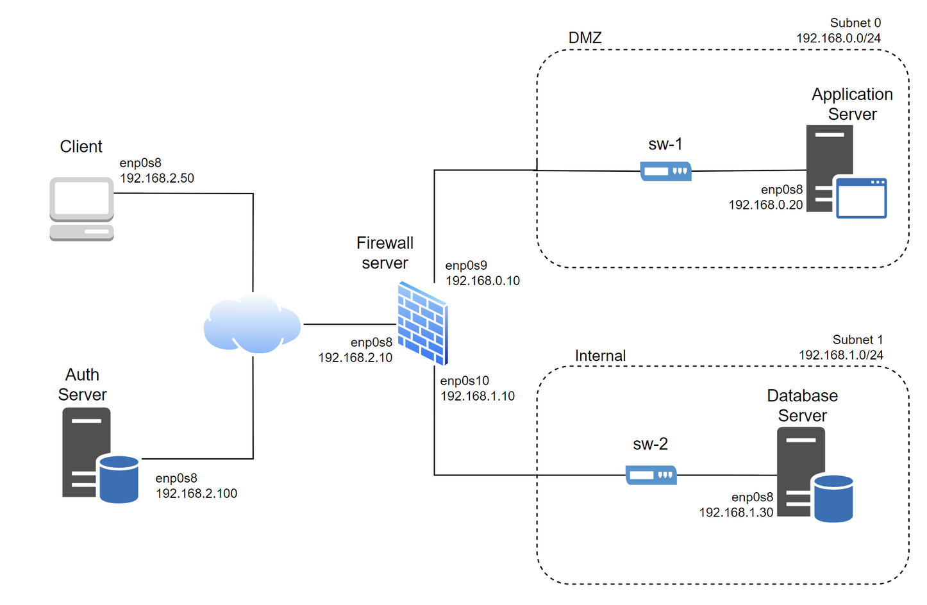
INFRASTRUCTURE
Machines
Client - Physician or patient
App server - Secure documents, .NET
Database - MySQL
Auth server - Key distribution, .NET
Firewall - iptables, NAT
Notes:
Tilde
- Describe setup. What are the different machines, and what do they run?
Our network setup contains two external machines, the client and the authentication server, and a firewall server acting as a bridge between the external and internal networks. The internal networks consist of one DMZ network, where the application server is, and one internal network where we find the database. The application server is the component of our system that ties together the other components to create a functioning MediTrack system.
The setup of our external machines is pretty simple. Each one is running a dotnet program to communicate with the other devices in the system.
The firewall server runs iptables for firewall configurations and Network Address Translation (NAT). We decided to go with iptables for all the firewall configurations, because it is easy to set up and could be used for both the firewall rules and the NAT rules. We first started using ufw for the rules, because of the simplicity of the program, but had some difficulties combining this with the NAT and therefore decided to move over to all iptables for the firewall server.
The application server runs the .NET program we developed and contains the main functionality of the secure documents section. We chose to use this technology due to the teams familiarity with #C and the .NET-framework, which provides a robust and scalable environment for the main program. Since this was the framework chosen for the main secure documents functionality, we continued using this for the communicating programs on the client and authentication server as well.
For the database server, we are using MySQL. Again, this was selected mainly due to the teams familiarity with the system, as well as the widespread use it already has leading to a big community and therefore it is easy to find information on using the system. It is also easy to set up, as well as compatible with our .NET application.
Finally, we decided to use Vagrant to build and configure this infrastructure. We decided to do this to make the setup and configuration of the infrastructure quick and easy to replicate across different devices. This allowed us to ensure that we all had the exact same setup running across the team, as well as easily destroy and re-build machines if we met issues. However, there were some drawbacks to this approach, mainly connected to our own lack of experience with Vagrant. This created some issues that stole a lot of time from the overall development of the project, as we had to resolve some technical issues with Vagrant. However, we learned a lot from this approach, and think it is overall a good strategy for these types of projects.

Slide 5

SECURE CHANNELS
Secure Channels
SSL/TLS
Client - App server
App server - Auth server
Client - Auth server
App server - Database
Document encryption
Key Distribution
Handled by authentication server
Everyone has their own private and public keys upon setup, as well as pre-signed certificates (self-signed)
Consult the authentication server to get physician public keys
Verifying signatures
Notes:
Tilde
Communication security in this system is based mainly on three things
Encrypting the EHR's, as per the secure documents section
Use of TLS/SSL for communication between devices
The firewall server (?)
These three things together work to ensure confidentiality for our system. On top of this, the digital signatures detailed in the section on secure document design also provide authenticity for the communications.
The use of both TLS/SSL and encryption of the EHR's works to provide security in layers. Not only is the sensitive content of the health records encrypted, but the communication channel they are transferred over is also encrypted. This adds an extra layer of security. To implement TLS/SSL we generate multiple certificates. One self-signed certificate for the Authentication Server and one self-signed certificate for the MediTrack Server. To ensure confidentiality between the MediTrack Server and the database storing the patient records, we created another certificate placed at the DB signed by the MediTrack Server. This way every time our server makes a DB request, the data will be confidential.
The firewall adds security for the application server and database server through the use of NAT and firewall rules. We set the rules to drop as default, and only allow specific traffic that matches flows we expect to see from the legitimate communications.
Key distribution
For this system, we imagined that the private keys for the doctors and the patients would be integrated with their identity cards. The private keys for the different servers are already set up on the servers, which is done during the Vagrant provisioning step. The public keys are all managed by the authentication server, whose purpose is to be a trusted source for public keys. We assume that the authentication server is an external, national server ran by some national authority that updates and secures it. Therefore, we decided to not create a fully secured server for the authentication server, and instead just build a simple external server that demonstrates the same functionality of providing public keys, as well as providing the specializations for doctors.
For the communication between the client and the server, symmetric keys are exchanged during communication setup, using the public keys provided by the authentication server.

Slide 6





SECURITY CHALLENGE
DIGITAL SIGNATURES
CONTROLLED SHARING
EMERGENCY OVERRIDE
Physicians sign their consultations.
Verified every time the signed consultation is requested.
Required the setup of an authentication server to keep track of physician public keys.
A physician only has access to patients' consultation records with the same speciality as themselves.
When sending EHR’s, the consultations that don’t match the physician’s speciality are encrypted with a random key.
When there is an emergency all consultation records are made available to the physician who requested them.
Ideally, we would use a trusted authority to classify what is an emergency.
Notes:
The security challenge introduced these requirements:
Digital signatures by the physician on their consultations.
Controlled sharing, where patients can choose to keep parts of their medical records confidential.
An emergency override for the controlled sharing
The first requirement of digital signatures was already supported by our CriptoLib. However, we needed a way to keep track of the physicians' public keys to easily verify the consultation records signatures . This required us to expand our system by adding an authentication server, representing a trusted National Authority, to keep track of the physician public keys. This way both the client and the server can verify the authenticity of consultation records (in the case of the Client) and API requests in the case of the Meditrack Server.
To implement controlled sharing we decided that the scope should be that physicians can only access the consultation records that are relevant to their speciality. To visualize this functionality in action we return the remaining records encrypted, to show that the controlled sharing is working as intended. We also looked at the alternative of having a symmetric key for each speciality that would be kept for example in the authentication server for all the doctors of this speciality. We could have used this setup, but decided to go with our solution for simplicity.
The urgency requirement was implemented using a boolean flag. Ideally in the real world, this flag would have to be signed/authorized by an external trusted entity, so the server is sure that it is in fact an emergency.

Slide 7

MAIN RESULTS
Successful implementation of secure documents for EHR’s, complete with digital signatures and both symmetric and asymmetric cryptography.
We set up a fully automated functioning infrastructure, with a firewall server between the external and internal machines, using Vagrant.
We set up secure channels with TLS/SSL and asymmetric encryption.
We successfully implemented controlled sharing.
Notes:
Tilde
We were able to create a fully functioning system for securing the EHR’s, complete with digital signatures and using both symmetric and asymmetric cryptography.
We were also able to set up a functioning infrastructure using vagrant to build and configure our VMs. The infrastructure successfully implements a firewall that implements some security for the external requests going to the DMZ with the application server, and which only allows the application server to communicate through the firewall and to the internal network containing the database.
We successfully set up TLS/SSL to provide secure communications between the client and application server, and the application server and authentication server, using a self-signed CA. We were also able to set up a public key infrastructure that allows us to use asymmetric encryption for setting up the symmetric keys for client-to-application communication, which also provides a way to verify the physician's signatures to ensure the authenticity of the system.
Finally, we were able to implement the controlled sharing, both as a specialization-based sharing of patient records using our authentication server, and with an emergency override of this encryption by having the option of using an emergency flag.
Requirements:
"The protected document must ensure the authenticity and confidentiality of the patient data and metadata". We fully satisfy this requirement, as a document that has been protected has been encrypted using AES CBC-mode, and the symmetric key for decrypting this will not be available to anyone other than the client and the intended recipient, ensuring confidentiality. For the authenticity, it is ensured by the public key cryptosystem we use where doctors sign their consultation records. This means that an attacker can't construct a fake consultation record, as they would not be able to generate a valid keypair with a signature, and would not have the private key of any physicians, per our attacker model.
"Each consultation record should be digitally signed by the physician in a non-repudiable way". We fully satisfy this requirement, as we use a public key infrastructure with the authentication server that contains the public keys for valid keypairs, and we implement the digital signatures. Since it is not possible to validate a fake keypair, the public key infrastructure makes the signatures non-repudiable for the physician.
One obvious enhancement if we were to continue working on this project or deploy it to be used by patients and physicians would be to make a web interface to make it more user-friendly. Even though we are used to using the terminal at this point, most people are not, and this would be too high of an entry barrier for many users, especially from older generations.
We would also have to implement some sort of verification of the urgency flag, to ensure that it is not being abused when there is no emergency. A part of extending this functionality could also be to implement some sort of log for who invokes it and when, as well as a notification for patients whenever their records were accessed with the emergency flag. This would help reduce the chances of it being abused.
To conclude, this project has allowed us to get valuable hands-on experience with deploying a range of different security mechanisms on a computer, and on a network. From developing a custom C# library that can perform fundamental security operations like encryption, decryption, signatures and validation, to designing and building a complete network infrastructure and implementing security functions on this. These practical tasks for the project have forced us to really get to know some of the most basic security mechanisms that are implemented in a network, like implementing a firewall and building a NAT table, as well as setting up certificates and a CA to enable SSL/TLS communications. Having to implement this in a project ourselves has given us a deeper understanding of the course topics and related practical technologies that we would not have gotten from lectures alone.

