Slide 1
EXECUTIVE ANALYTICS REVIEW
Commercial Sales,
Profitability & Customer Analytics
The most important insights, analytical features and management actions
Sample Superstore | 2014–2017 | 9,994 transaction rows
Notes:
[Sources]
- Commercial Sales, Profitability & Customer Analytics workbook — READ_ME and EXECUTIVE_SUMMARY tabs; presentation scope and dataset metadata
- Dataset: Sample Superstore, 9,994 transaction rows, 2014–2017.

Slide 2
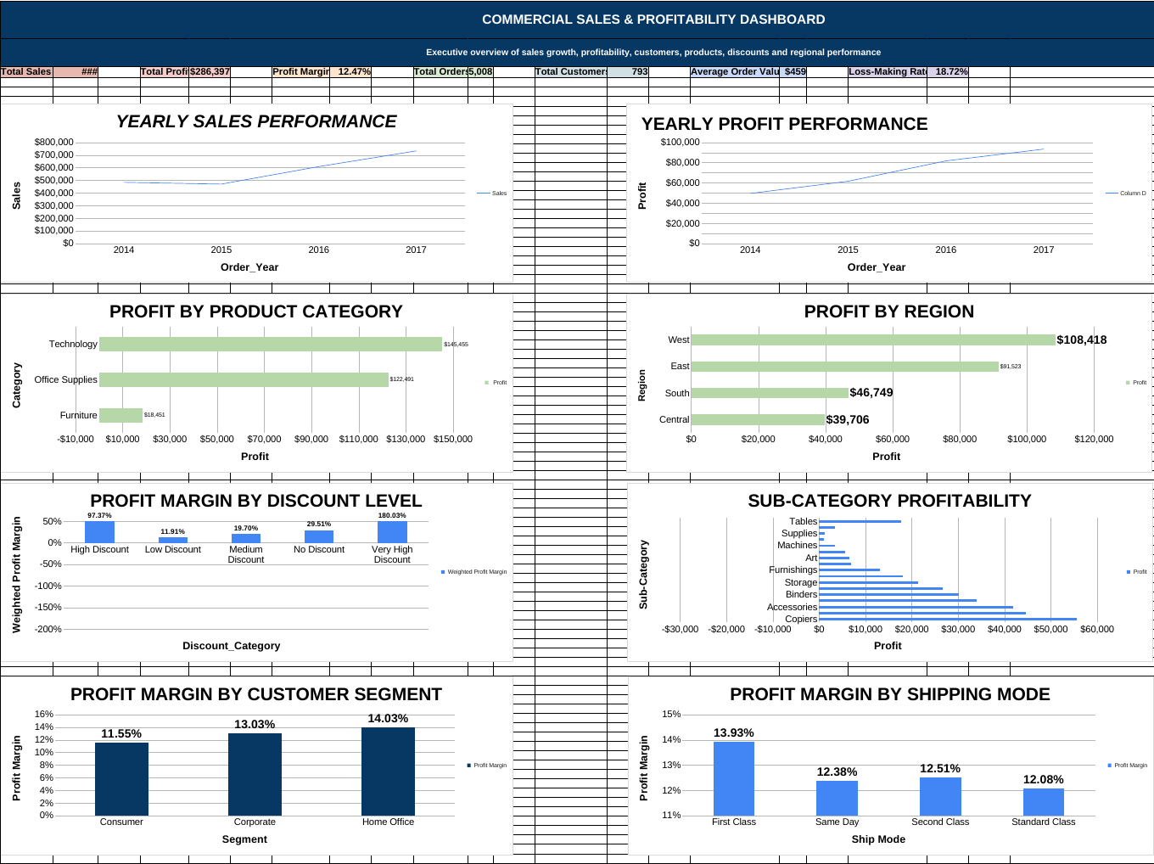
WORKBOOK SCOPE
From 9,994 rows to management decisions
An end-to-end analytics workflow
01
Prepare
Raw data preservation, cleaning and validation
02
Engineer
14+ features for time, margin, discount, loss and order value
03
Analyze
Pivots across products, customers, regions, discounts and shipping
04
Communicate
Business questions, dashboard, executive summary and actions
8 linked sheets • 21 cleaned fields • 14+ analytical features
02
Notes:
[Sources]
- Commercial Sales, Profitability & Customer Analytics workbook — READ_ME, CLEAN_DATA, FEATURE_ENGINEERING, PIVOT, BUSINESS_ANALYSIS, DASHBOARD and EXECUTIVE_SUMMARY tabs; dashboard image is rendered from the workbook
- Dataset: Sample Superstore, 9,994 transaction rows, 2014–2017.

Slide 3
EXECUTIVE SNAPSHOT
Scale is healthy; revenue quality is the opportunity
The workbook reports positive growth and profit at scale, but the margin outcome varies sharply by product, discount, region and customer.
$2.30M
$286.4K
12.47%
Total sales
Total profit
Weighted profit margin
5.0K orders
793 customers
18.72% loss-making lines
2014–2017
03
Notes:
[Sources]
- Commercial Sales, Profitability & Customer Analytics workbook — DASHBOARD and EXECUTIVE_SUMMARY KPI blocks; totals, margin, customers and loss-making rate
- Dataset: Sample Superstore, 9,994 transaction rows, 2014–2017.

Slide 4
GROWTH
Growth accelerated, but 2017 profit lagged sales
$733.2K
2017 sales — the four-year high
+20.36%
2017 sales growth
+14.24%
2017 profit growth — 6.1 pts behind sales
04
Notes:
[Sources]
- Commercial Sales, Profitability & Customer Analytics workbook — PIVOT yearly performance and BUSINESS_ANALYSIS rows 13–14; annual sales, profit and year-over-year growth
- Dataset: Sample Superstore, 9,994 transaction rows, 2014–2017.

Slide 5
SEASONALITY
Q4 generates 51.6% of sales
$352.5K
November — highest monthly sales
$43.4K
December — highest monthly profit
Implication
Align inventory, staffing and campaigns to Sep–Dec—while protecting peak-period margin.
05
Notes:
[Sources]
- Commercial Sales, Profitability & Customer Analytics workbook — PIVOT monthly seasonality and EXECUTIVE_SUMMARY seasonality finding; monthly sales and December profit
- Dataset: Sample Superstore, 9,994 transaction rows, 2014–2017.

Slide 6
PRODUCT ECONOMICS
Furniture carries scale without profit
17.40%
Technology margin; 50.79% of total profit
2.49%
Furniture margin; only 6.44% of profit
$207.0K
Tables sales—yet the sub-category loses money
06
Notes:
[Sources]
- Commercial Sales, Profitability & Customer Analytics workbook — PIVOT category and sub-category performance; BUSINESS_ANALYSIS rows 19–22; sales share, profit share and margins
- Dataset: Sample Superstore, 9,994 transaction rows, 2014–2017.

Slide 7
PRODUCT RISK
Three sub-categories are loss-making
Priority recovery
Tables
−$17.7K profit
−8.56% margin
Also review
Bookcases and Supplies are negative; Machines produces $189.2K sales at only 1.79% margin.
07
Notes:
[Sources]
- Commercial Sales, Profitability & Customer Analytics workbook — PIVOT sub-category performance and BUSINESS_ANALYSIS rows 21–22; profit and margin by selected sub-category
- Dataset: Sample Superstore, 9,994 transaction rows, 2014–2017.

Slide 8
DISCOUNT RISK
Profit turns negative beyond Low Discount
29.51%
No Discount margin
−$135.4K
Combined profit from Medium, High and Very High discount buckets
Management rule
Use Low Discount as the default ceiling; require explicit approval and economics above it.
08
Notes:
[Sources]
- Commercial Sales, Profitability & Customer Analytics workbook — PIVOT discount strategy analysis and EXECUTIVE_SUMMARY discount risk; weighted margins and bucket profit
- Dataset: Sample Superstore, 9,994 transaction rows, 2014–2017.

Slide 9
LOSS EXPOSURE
One in five transactions destroys value
1,871
loss-making transaction lines out of 9,994
$468.7K
sales attached to loss-making lines — 20.40% of revenue
−$156.1K
profit impact; profitable lines generate +$442.5K
09
Notes:
[Sources]
- Commercial Sales, Profitability & Customer Analytics workbook — PIVOT profitable versus loss-making transactions and EXECUTIVE_SUMMARY loss exposure; transaction count, sales and profit
- Dataset: Sample Superstore, 9,994 transaction rows, 2014–2017.

Slide 10
CUSTOMER & GEOGRAPHY
Margin quality varies by region and segment
Regional margin
Segment margin
West contributes 37.86% of profit; Central contributes only 13.86% despite 21.82% of sales.
Home Office is smallest by sales but most margin-efficient; Consumer supplies scale at lower margin.
10
Notes:
[Sources]
- Commercial Sales, Profitability & Customer Analytics workbook — PIVOT regional and customer segment performance; BUSINESS_ANALYSIS rows 26–29; weighted margins and contribution shares
- Dataset: Sample Superstore, 9,994 transaction rows, 2014–2017.

Slide 11
CUSTOMER PROFITABILITY
Revenue rank can hide customer losses
#1 profit
Tamara Chand: $9.0K profit at 47.14% margin
#1 sales
Sean Miller: $25.0K sales but −$2.0K profit
Commercial implication
Rank accounts on both revenue and profit; repair pricing, mix or discount exposure in high-sales loss-makers.
11
Notes:
[Sources]
- Commercial Sales, Profitability & Customer Analytics workbook — PIVOT customer profitability and BUSINESS_ANALYSIS row 30; sales, profit, margin and customer rankings
- Dataset: Sample Superstore, 9,994 transaction rows, 2014–2017.

Slide 12
MANAGEMENT PRIORITIES
Four actions improve revenue quality
Focus the operating cadence on where profit is created—or lost.
01
Control discounts
Low Discount as the default ceiling; approval and deal economics above it.
02
Recover Furniture
Start with Tables; review price, mix, cost and discount leakage before scaling.
03
Customer quality
Rank accounts on sales and profit; repair high-sales, weak-profit relationships.
04
Plan for Q4
Align capacity to Sep–Dec and protect margin through the peak-demand period.
Track monthly
Discount mix • Loss-making rate • Category margin • Customer profit • Regional margin
12
Notes:
[Sources]
- Commercial Sales, Profitability & Customer Analytics workbook — BUSINESS_ANALYSIS recommended actions and EXECUTIVE_SUMMARY priorities 1–6; synthesized into four operating priorities
- Dataset: Sample Superstore, 9,994 transaction rows, 2014–2017.

