Slide 1



“Library Management System.”
Submitted by: Tile Omkar
Submission type : Individual.
Name: Batch : 12
LMS Id :
Program : Axis Bank Fintech program
Date: 28/05/2023

Slide 2


Table of content
Introduction
Project Overview
Architecture Design
User Interface Design
Back-end Development
Front-end Development
Conclusion
Future Work
References

Slide 3
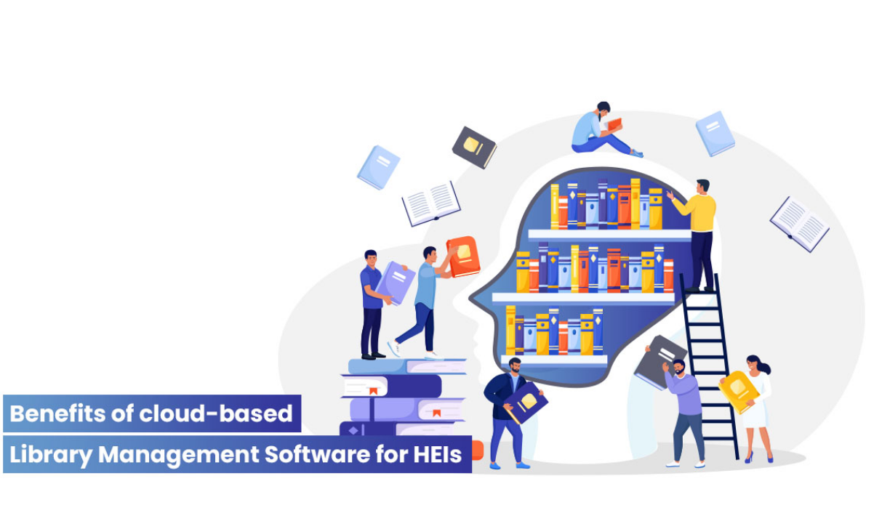
Introduction
A Library Management System is a comprehensive software solution designed to automate and manage various activities within a library.
It helps librarians in organizing, cataloging, and tracking resources,issuing, as well as managing user information, and administrative tasks.
A library management system enhances efficiency, accessibility, and user experience in libraries.

Slide 4
Project Overview-2
IMPLEMENTED FUNCTIONALITIES
1. Login:
Role based Authentication for user and Librarian.
2. Librarian Operations.
Managing Users.
Managing Books
Deleting Users.
Adding new Books.
Deleting Books
3. . User Operations.
Registration
Borrowing Books
Book Search Operation.
Accessing Book Table.
Returning Book.
4. User Management:
Maintain a comprehensive database of library users including student and faculty.
Manages user registration, authentication.
View user borrowing history.

Slide 5
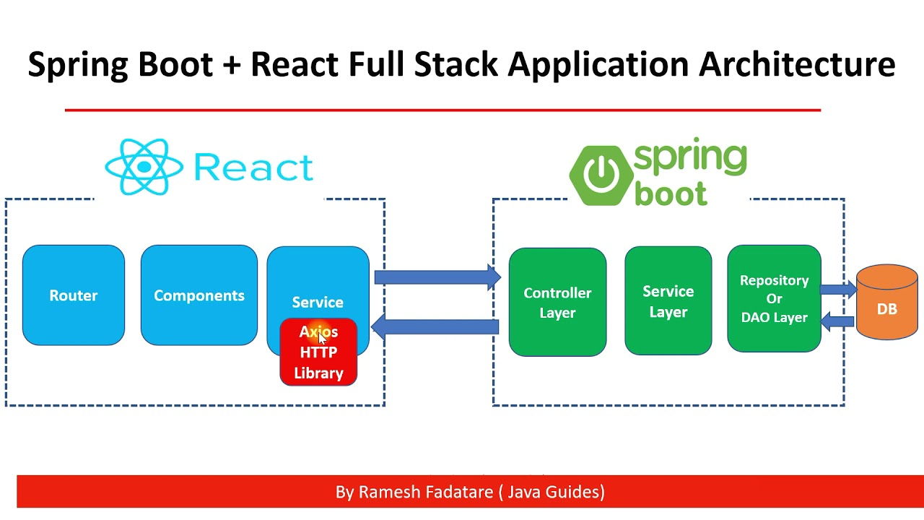
ARCHITECTURE DE SIGN OF FULL-STACK APPLICATION
Full-Stack development involves developing all the components of the application, including front-end, back-end, and database portions. It often includes debugging web applications. The developer takes into consideration the full development operations right from conceptualization to final product. Here, the developers deal with:
Front end: the appearance of the website or application
Back end: Database and app infrastructure that works under the hood

Slide 6


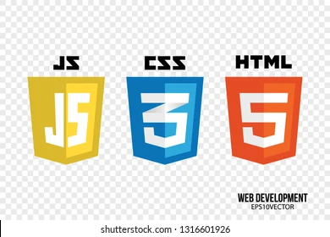

Project Overview-3
TECHNOLOGIES USED
Front-End:
_{ReactJS}
React makes it painless to create interactive UIs. Design simple views for each state in your application, and React will efficiently update and render just the right components when your data changes.
Visual Studio Code:
Visual Studio Code is a lightweight but powerful source code editor which runs on your desktop .
Axios:
Axios is a promise-based HTTP library that lets developers make requests to either their own or a third-party server to fetch data. It offers different ways of making requests such as GET , POST , PUT/PATCH , and DELETE .
React-Toastify :
This tool allows you to add toast notifications to your application with ease and can also be used to set notifications and alerts.

Slide 7



Project Overview-3
TECHNOLOGIES USED
2) Back-End:
Spring boot (JAVA):
Spring Boot helps developers create applications that just run. Specifically, it lets you create standalone applications that run on their own, without relying on an external web server
Dependencies: Spring dev tools, Spring Security,
Spring JPA , MySQL driver, Lombok, Spring Web.
Eclipse IDE :
Eclipse is an integrated development environment (IDE) used in computer programming. It contains a base workspace and an extensible plug-in system for customizing the environment. It is the second-most-popular IDE for Java development.
3) Database:
MySQL (SQL Yog):
SQLyog Ultimate is the best MySQL GUI for database developers. Compare and synchronize data, manage SQL queries, and keep your database safe.

Slide 8

Project Overview-3
TECHNOLOGIES USED
4) Other Tools:
The Postman API client :
It is the foundational tool of Postman, and it enables you to easily explore, debug, and test your APIs while also enabling you to define complex API requests for HTTP, REST, SOAP, GraphQL, and WebSockets.

Slide 9
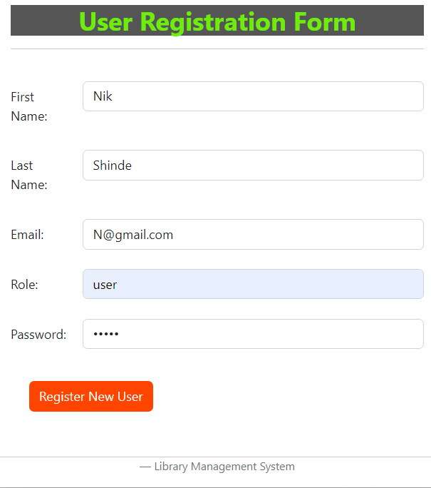
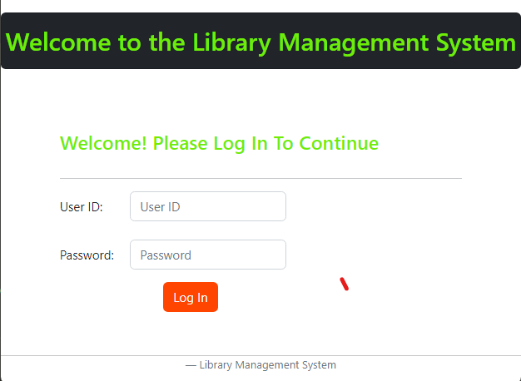
User Interface Design – Login and Registration of User
In user module, user can register himself. After Registration user can log in with own userid and password. Registered users is provided credentials (such as a userID or e-mail address, and a password) to the system in order to prove their identity: this is known as logging in.

Slide 10
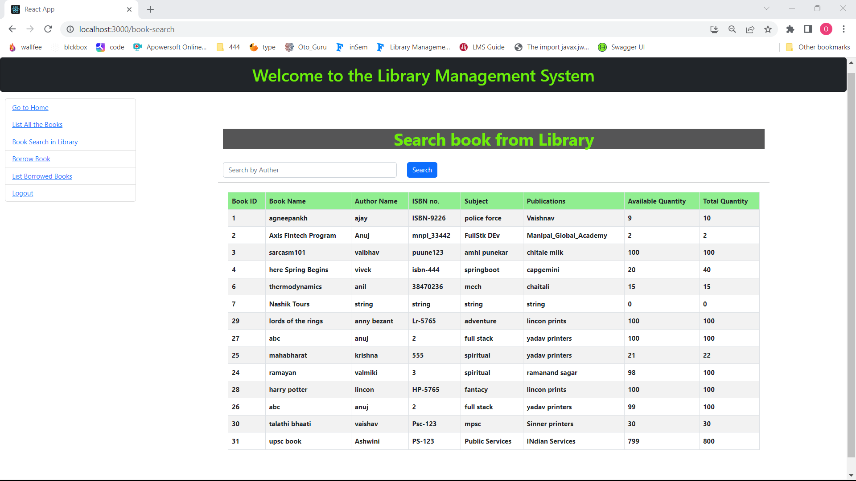
User Interface Design – User operation Book Search

Slide 11
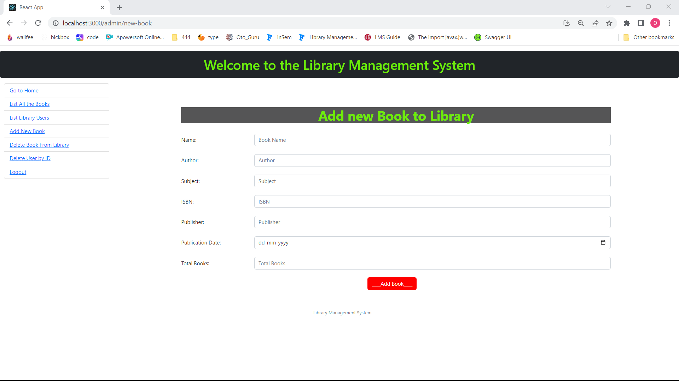
User Interface Design – Admin operation Add Book
This is Admin operation for adding the new book to the Library.

Slide 12
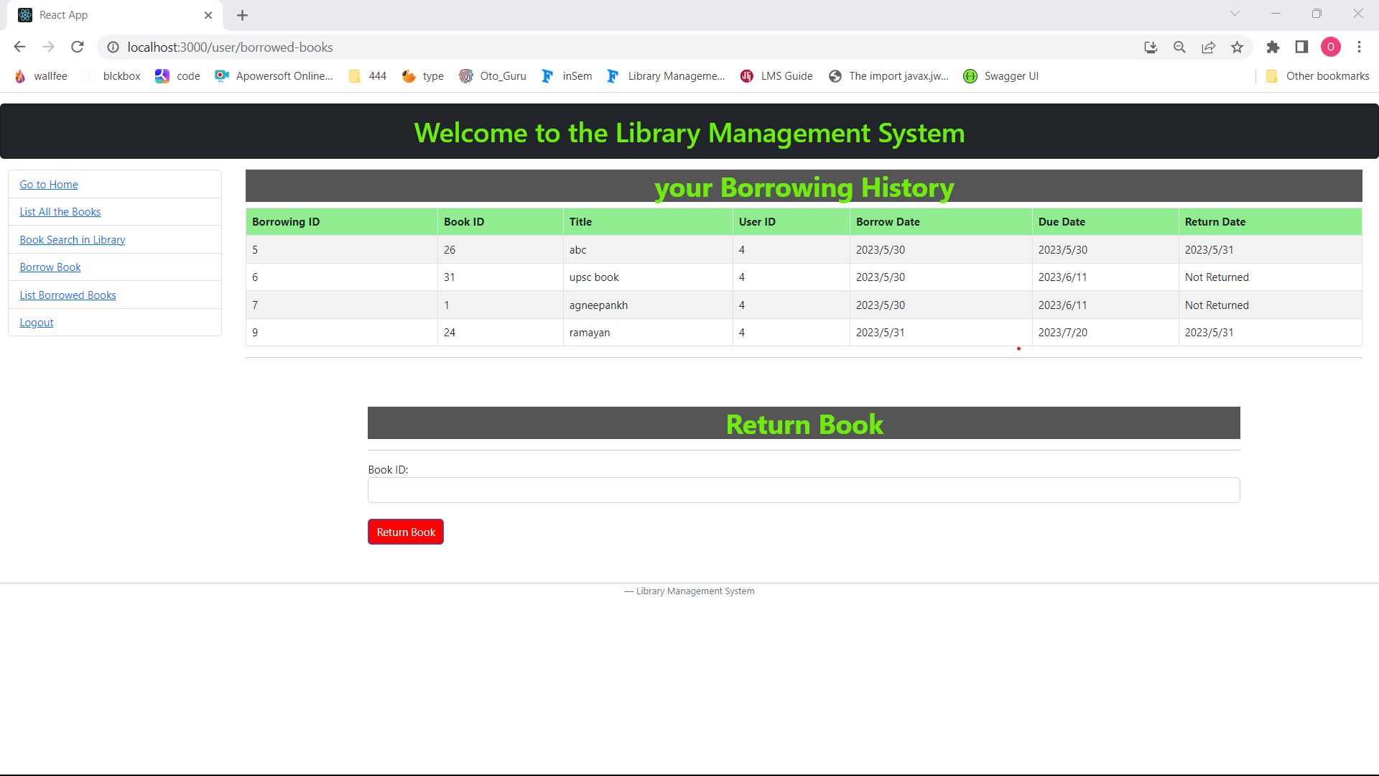
User Interface Design – User operation Book Search
This is the Borrowed History of the User and another component named ReturnBook to return the book using the book id

Slide 13
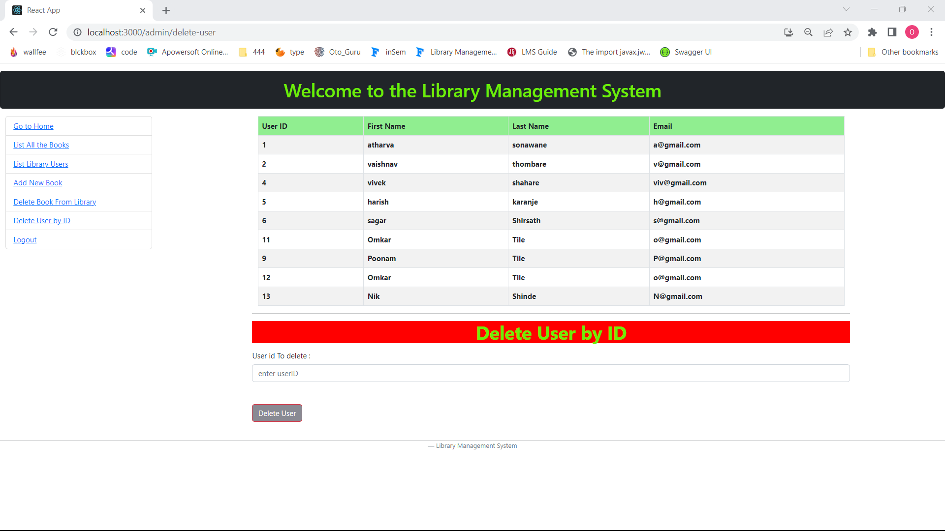
User Interface Design – Admin operation Delete User
This is Admin operation for deleting the user from Library.

Slide 14
Back-end Development
Spring Boot: Spring Boot is a matured Java framework built on the top of Spring framework. Spring Boot has defaults for almost everything. However, it still lets us to chose what to configure.
The very first step will be creating the application database for springboot application.
Once the database is ready, create different Models required for the library management System.
USER
BOOK
BORROWING etc.

Slide 15
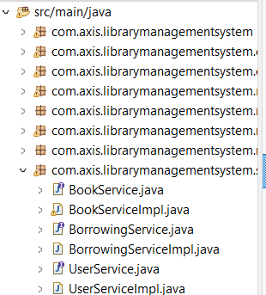
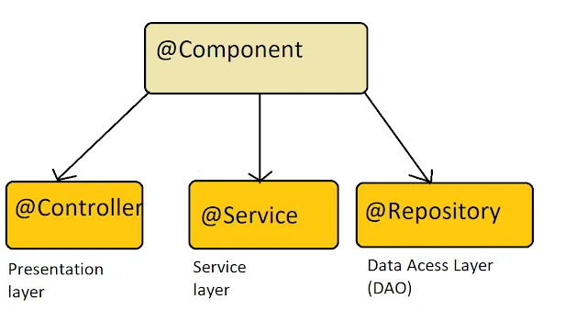
Back-end Development
Next Step in Back-end development is creating Repositories and Services for the models in order to perform various functionalities to respective models.
The Services classes contains the access to the model classes and performs Get, Set functions to handle the flow of the data.
The controllers of the project:
1.User Controller
2.Book Controller
controllers are used for making or building a web controller. In spring boot, we have to add the required dependency by which we can use this inside the application; also, we have to use the spring boot framework's annotation to make any class a controller.

Slide 16
Back-end Development - Server Setup
in Back-end development is it is important that we must setup accurate connection to database as well as other necessary settings.
Here is my Application.properties file configuration.:
server.port=9010
server.tomcat.relaxed-path-chars=|,{,},[,]
#DARABASE enTRY SEPCIFICATIONS
spring.datasource.driver-class-name=com.mysql.jdbc.Driver
spring.datasource.url=jdbc:mysql://localhost:3307/library_app
spring.datasource.username=root
spring.datasource.password=root
spring.datasource.name=library_app
#hybernate
spring.jpa.database-platform = org.hibernate.dialect.MySQL5Dialect
spring.jpa.generate-ddl=true
spring.jpa.hibernate.ddl-auto = update

Slide 17
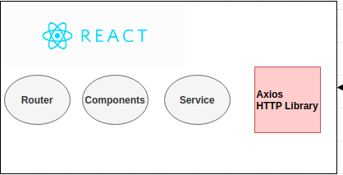
Front-end Development
React is used to build user interfaces (UI) on the front end. As we know, React is a JavaScript-based library that does not have the ability to make HTTP requests; thus, we need to use third-party libraries to achieve this.
REACT SERVICE :
import axios from 'axios'
const LIBRARY_BASE_API="http://localhost:9010/api/user/getAllUsers"
class User_Service
{
getUserList()
{
return axios.get(LIBRARY_BASE_API)
}
}
var userService=new User_Service()
export default userService
This is the general development Architecture Of
react front-end Application

Slide 18
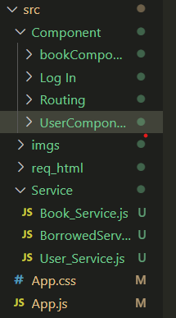
Front-end Development
The LMS is a simple web application consisting of two parts: an admin management section and a user interface for viewing the books in the library. The application is built using React.
The various operations and the user interface is integrated using the different libraries provided int the React.
Components in Library Management System :
1.User Components.
2.Book Components.
3.Login Functions.

Slide 19
Conclusion
The Library Management System is much more user-friendly, faster in operation and easy to manage than the manual one. Through the use of it, the librarian can manage the whole data of the library in a single database in different tables with a much more security than the traditional way
I have also implemented All the Necessary basic Functionalities for Application to work.
Here are some listed below :
1. Login
2. Librarian Operations.
3. User Operations.
4. User Management

Slide 20
Future Work
Future work that can be done to improve the Library management Application, including additional features, enhancements, and optimizations.
1.Fine Management
In this section we will be implementing the fine that will be collected from the users of the library who crossed the duedate to return a book.
2.Reports Generation
in this module we will be adding functionality to generate reports based on users, books, fine collected and the borrowing history.
3. Testing of Application.
4. Deployment of Application

Slide 21
References
React Documentation:
https://legacy.reactjs.org/docs/getting-started.html
SpringBoot:
https://www.baeldung.com/spring-boot
https://www.javatpoint.com/spring-boot-tutorial
Youtube :
https://www.youtube.com/watch?v=ZsKOQ7HmsSE
https://youtu.be/TjnWtDWFZFc
Other :
https://exlibrisgroup.com/products/alma-library-services-platform/
https://koha-community.org
https://evergreen-ils.org/
https://www.sirsidynix.com/symphony/

