Slide 1
WSA MERN Stack Internship
Project Name:- Online Food Delivery
Name:-Tile Rahul Dattu
Class & dept : TE (Information Technology)
College : Dr. Vithalrao Vikhe Patil College Of Engineering, Ahmendnagar

Slide 2
Overview
A MERN stack internship involves hands-on learning
of Mongo DB, Express.js, React, and Node.js for web
development. Interns gain proficiency in database management,
server-side and front-end development, API integration, and
version control with tools like Git. They learn problem-solving skills,
testing, and debugging techniques, ensuring application stability.
Deployment on platforms like Heroku or AWS is covered, as well as
agile practices and effective team collaboration. Continuous learning
about industry trends and best practices is encouraged. Overall, the internship
provides a comprehensive experience in building modern web applications
using the MERN stack.

Slide 3
Goal of Internship
The primary goal of a MERN stack internship is to provide individuals with a comprehensive understanding and practical experience in modern web development using MongoDB, Express.js, React, and Node.js. Interns aim to become proficient in creating dynamic, scalable web applications. This encompasses proficiency in database management, server-side scripting, and front-end interface design.
Interns also focus on seamless API integration, enabling efficient data flow within applications. They develop expertise in version control using tools like Git, ensuring collaborative and organized coding practices. Problem-solving skills are honed, allowing them to address real-world challenges and optimize application performance.
Moreover, the internship emphasizes testing and debugging techniques, crucial for maintaining code quality and application stability. Deployment on cloud platforms like Heroku or AWS is highlighted, preparing interns for real-world deployment scenarios.
Additionally, interns are encouraged to adopt agile methodologies, fostering effective project management and teamwork. This includes honing communication and collaboration skills with team members, designers, and stakeholders. Ultimately, the goal is to cultivate versatile, adept developers poised to contribute effectively in the dynamic field of modern web development.

Slide 4
What is MERN stack ?
The MERN stack is a popular web development framework that consists of four main technologies:
1. MongoDB: A NoSQL database that stores data in a flexible, JSON-like format. It's designed for scalability and fast querying of large datasets.
2. Express.js: A web application framework for Node.js. It simplifies the process of building robust and scalable web applications by providing a set of tools and features for handling HTTP requests, routing, and middleware.
3. React: A JavaScript library for building user interfaces. It allows developers to create dynamic and interactive front-end components for web applications.
4. Node.js: A JavaScript runtime environment that allows developers to run JavaScript on the server-side. It's known for its event-driven, non-blocking I/O model, making it efficient for building real-time, high-performance applications.
Together, these technologies form the MERN stack, enabling developers to build full-stack web applications from the database to the user interface, all using JavaScript. This stack has gained popularity for its flexibility, scalability, and the ability to rapidly build and deploy modern web applications.

Slide 5
Project Requirement
Creating a food delivery website using the MERN stack is an exciting project.
Here are the specific requirements you might consider:
1. User Authentication 2.User Roles
3. Restaurant Listings 4. Menu Display
5. Order Placement 6. Order History
7. Real-time Updates 8. Rating and Reviews
9. Payment Integration 10.Location Services
11. Order Tracking 12.Admin Dashboard
13.Notifications 14.Responsive Design
15.Security 16.Performance Optimization
17.Testing 18.Deployment
19.Documentation 20.Legal and Compliance

Slide 6
Technology Stack
To build a food delivery app using the MERN (MongoDB, Express.js, React, Node.js) stack, you'll need a combination of these technologies along with some additional tools and frameworks to handle specific functionalities. Here's a breakdown:
1. MERN Stack
- MongoDB
- Express.js
- React
- Node.js
2. Additional Technologies and Tools
- Redux
- Socket.io (Optional)
- Payment Gateway Integration
- Geolocation Services (Optional)
- WT (JSON Web Tokens)
- Third-party APIs
- Maps API
- SMS/Email API
- Image Storage and CDN (Content Delivery Network)
- Deployment and Hosting.
- Version Control (Git)
- Testing Frameworks (e.g., Jest, Mocha)
- Documentation Tools
- Security Measures

Slide 7
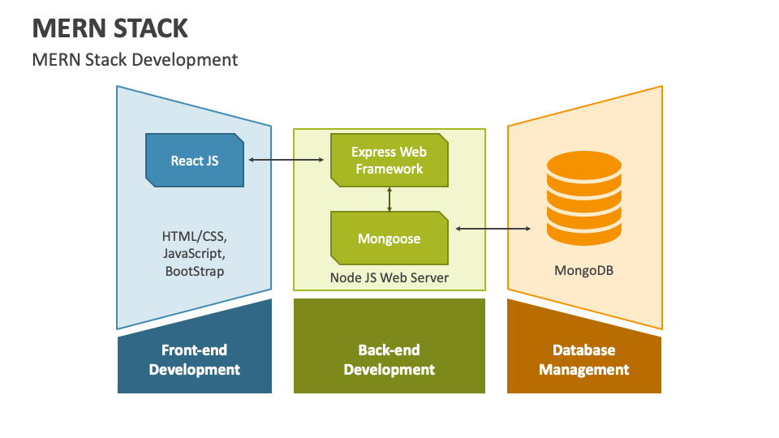
Architecture and Design

Slide 8
Implementation of Project
Building a food delivery website using the MERN stack involves several steps. Here's a simplified outline to get you started:
Step 1: Set Up Your Development Environment
Step 2: Create a New React App
Step 3: Set Up Server with Express.js
Step 4: Establish Connection to MongoDB
Step 5: Define API Routes
Step 6: Implement React Components
Step 7: User Authentication (Optional)
Step 8: Integrate a Payment Gateway (Optional)
Step 9: Styling and UI/UX
Step 10: Implement Real-time Updates (Optional)
Step 11: Testing
Step 12: Deployment
Step 13: Documentation and Optimization

Slide 9
Conclusion
In conclusion, creating a food delivery website using the MERN stack offers a robust foundation for building a dynamic and interactive platform. MongoDB, Express.js, React, and Node.js collectively empower developers to manage data, handle server logic, and create an engaging user interface. Integrating additional technologies like payment gateways and real-time updates enhances functionality. Thorough testing, secure authentication, and efficient deployment further ensure a seamless user experience. By adhering to best practices and considering scalability, this project showcases the potential of modern web development tools in meeting the demands of a competitive market.

Slide 10
Thank You,
Dear Web Stack Academy,
I wanted to express my heartfelt thanks for providing me with the valuable opportunity to intern at your esteemed web stack academy. I am eager to learn and contribute to your team. Looking forward to a productive and enriching experience.
Warm regards,
Rahul Dattu Tile

