Slide 1
Management
Parking
By Sotiris Simas
http://ww.simasware.com/

Slide 2
It is a Web application (Java) that can be used by all operators of Parking for the management of their activities …
Released under the GPLv2
https://github.com/tiliSoft/ParkingManagement
By Sotiris Simas

Slide 3

Technical Details
MySQL
Middleware
Java Interface
HTML5
Bootstrap
JQuery
AJAX
CSS3
DHTMLX
Front-end
Back-end
Communication Format: JSON
By Sotiris Simas

Slide 4
Session Scheme
MySQL
Browser
JBoss 7.1
JDBC
1. Username + password
Library
RawConnection
login.jsp
check_signin
3. Create Session
5. Redirect
Session
4. HTTPS/JSON: { ‘result’: true }
2. HTTPS/JSON: { ‘username’: ‘pippo’, ‘password’: ‘MyPass’ }
search.jsp
6. HTTPS/JSON: { ‘username’: ‘pippo’}
check_signout
7. Invalidate Session
8. HTTPS/JSON: { ‘result’: true }
10. Redirect
9. ALERT
Session terminated successfully
By Sotiris Simas

Slide 5
Some screenshots…
By Sotiris Simas

Slide 6
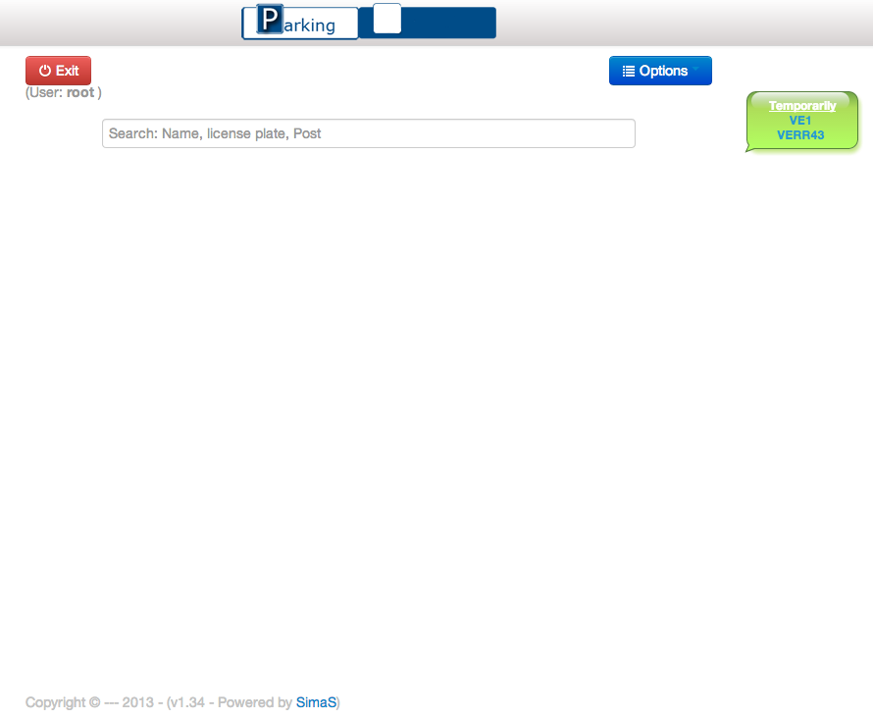
Home / Search Page
By Sotiris Simas

Slide 7
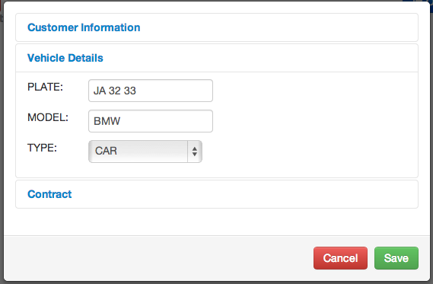
Create New Contract
By Sotiris Simas

Slide 8
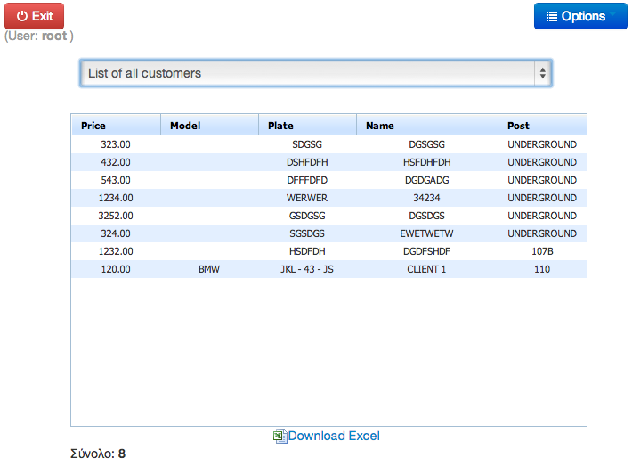
List of All Customers
By Sotiris Simas

Slide 9
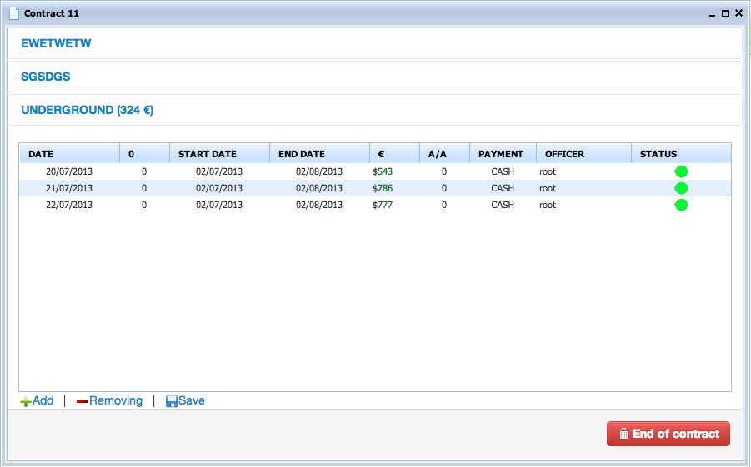
ShowContract
By Sotiris Simas

Slide 10
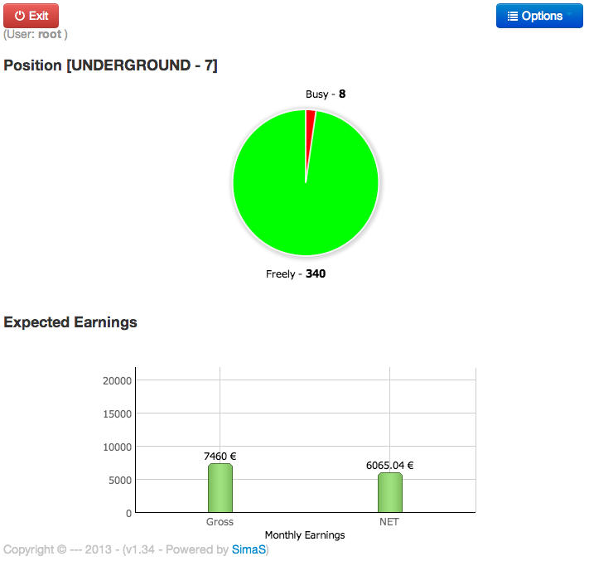
OverView
By Sotiris Simas

Slide 11
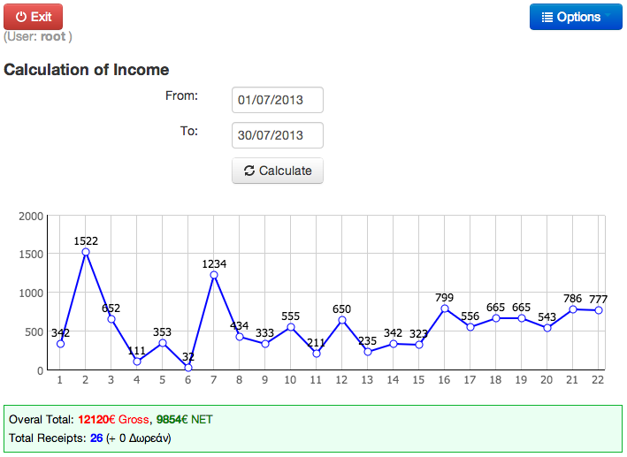
Income Earning
By Sotiris Simas

Slide 12
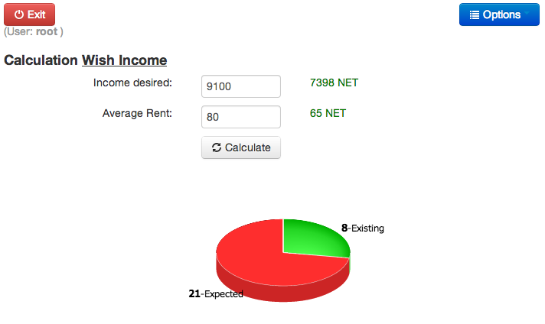
Calculation Wish Income
By Sotiris Simas

Slide 13
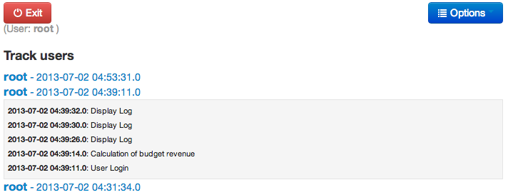
Track Users
By Sotiris Simas

Slide 14
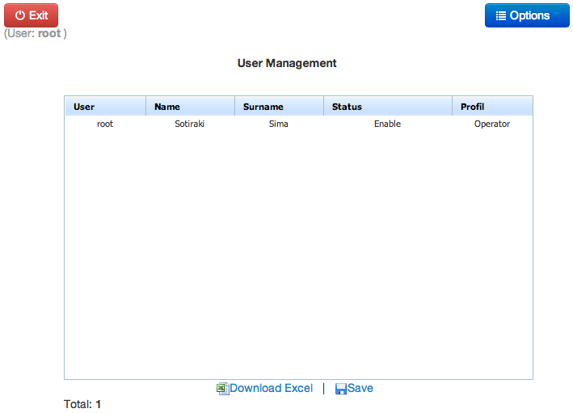
User Management
By Sotiris Simas

