Slide 1
NASM ASSEMBLER
& COMPILE WITH GCC
http://www.asmlove.co.kr
어셈러브
refered to ‘PC Assembly Language’ by Paul A. Carter
http://www.drpaulcarter.com/

Slide 2
INDEX
INTRODUCTION
  About ASMLOVE
  Why assembly?
NASM (Netwide Assembler)
EXAMPLE CODE
C CALLING CONVENTIONS
REVIEW OF C VARIABLE STORAGE TYPES

Slide 3
INTRODUCTION
  About ASMLOVE
  Why assembly?

Slide 4
The Introduce of ASMLOVE
Since 2001.8
Documentation & programming about assembly
Dedicated at INTEL PROCESSOR
Independent of OS
Also we are interested in OS kernel and making OS.
We mainly have offline seminars.

Slide 5
Main purpose of ASMLOVE
Get a better understanding of how computer really work at a lower level rather than in high level languages.
We want to make much more efficient product with understanding both of hardware and software .
We are not only interested in PC but also embedded system and micro-controller.

Slide 6
Why should we learn assembly?
Sometimes (never all) code written in assembly can be faster and smaller than compiler generated code.
ex) MMX/SSE tech.
Assembly allows access to direct hardware features of the system that might be difficult or impossible to use from a higher level language.
ex) small controller, boot-loader

Slide 7
Why should anyone learn assembly at all?
(cont’d)
Learning to program in assembly helps one gain a deeper understanding of how computers work.
Learning to program in assembly helps one understanding better how compilers and high languages like C work.
In fact, everyone rarely program in assembly because it takes too much time and very hard to port to other platforms.
But we uses the ideas we learn from assembly.

Slide 8
NASM (Netwide Assembler)

Slide 9
Netwide Assembler (NASM)
http://nasm.sourceforge.net/
It supports a range of object file formats, including Linux and NetBSD/FreeBSD a.out, ELF, COFF, Microsoft 16-bit OBJ and Win32.
Its syntax is designed to be simple and easy to understand, similar to Intel's but less complex.
It supports Pentium, P6, MMX, 3DNow!, SSE and SSE2 opcodes, and has macro capability.

Slide 10
Netwide Assembler (NASM)
(cont’d)
Get the example code and document
  http://sourceforge.net/project/showfiles.php?group_id=6208
  http://www.drpaulcarter.com/pcasm/redir.php?file=pcasm-book.pdf
    Table of Contents
      Introduction
      Basic Assembly Language
      Bit Operations
      Subprograms
      Arrays
      Floating Point
      Structures and C++

Slide 11
Netwide Assembler (NASM)
(cont’d)
NASM install
  http://www.asmlove.co.kr/asmtuto/nasm98bw.exe
Example Source
  http://www.asmlove.co.kr/study/gio/aboutNASM_src.zip

Slide 12
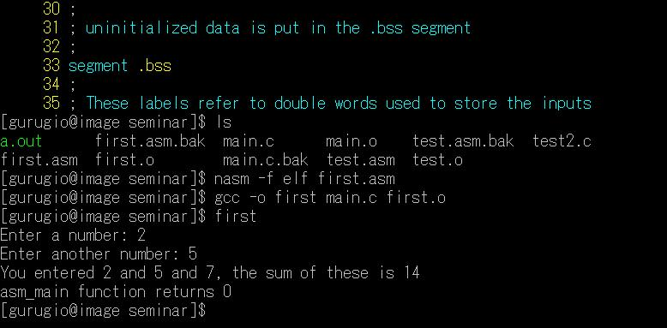
Netwide Assembler (NASM)
(cont’d)

Slide 13
Netwide Assembler (NASM)
(cont’d)
Data directives (different to MASM)
  L1 db 0 ; byte
  L2 dw 1000 ; word
  L3 db 110101b ; byte
  L4 db 12h ; byte
  L5 db 17o ; byte
  L6 dd 1A92h ; double word
  L7 resb 1 ; uninitialized byte
  L8 db 'A' ; ascii code = 'A'
  L9 db 0,1,2,3 ; 4 bytes
  L10 db 'w', 'o','r','d',0 ;string
  L11 db 'word', 0
  L12 times 100 db 0 ; 100 bytes of zero
  L13 resw 100 ; 100*2(word bytes)

Slide 14
Netwide Assembler (NASM)
(cont’d)
Data directives (different to MASM)
  Mov al, [L1] ;copy byte at L1
  Mov eax, L1 ;eax = address of byte at L1
  Mov [L1], ah ; copy ah into byte at L1
  Mov eax, [L6] ; copy double word
  Add eax, [L6] ; eax = eax + double word at L6
  Add [L6], eax ; double word at L6 += eax
  Mov al, [L6] ; copy first byte of double word at
L6 into al
  Mov [L6], 1 ; operation size is not specified
  Mov dword [L6], 1 ; store a 1 at L6

Slide 15
EXAMPLE CODE

Slide 16
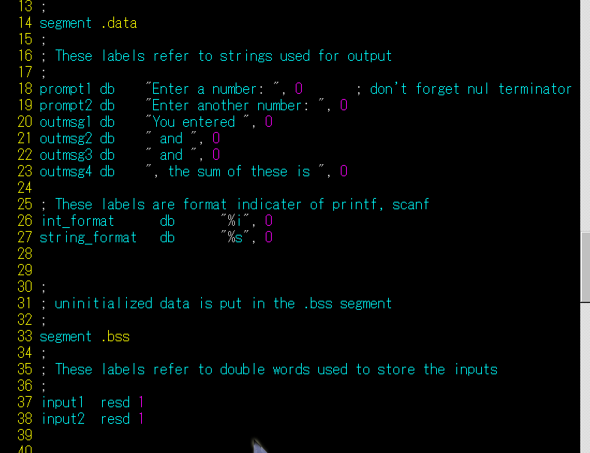
Example code

Slide 17
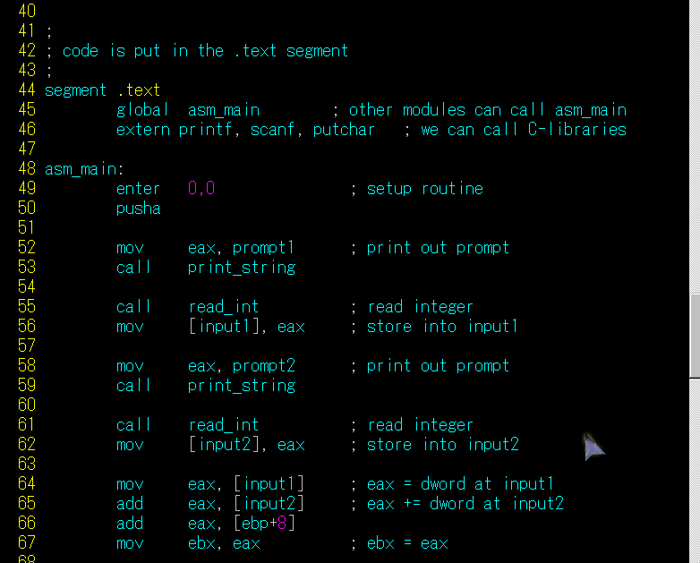

Slide 18
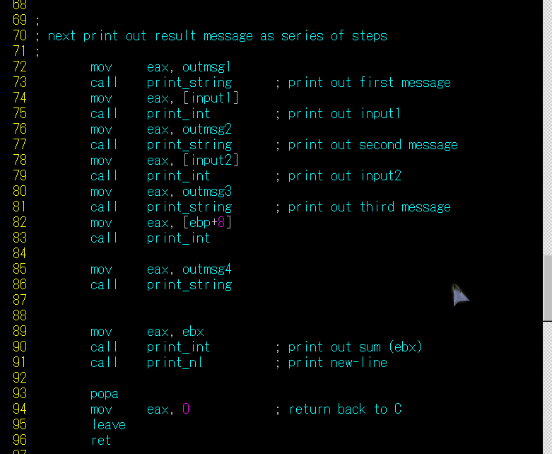

Slide 19
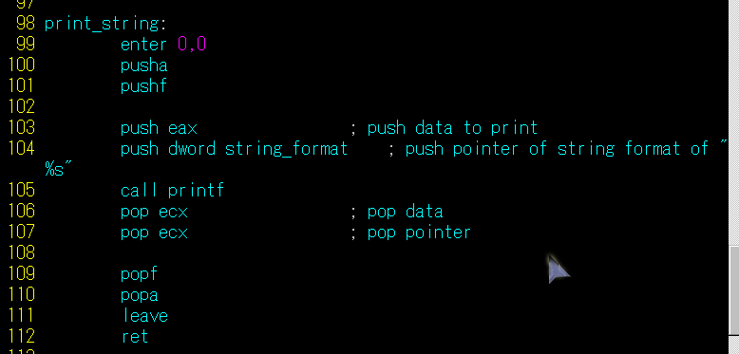
Example code
(cont’d)

Slide 20
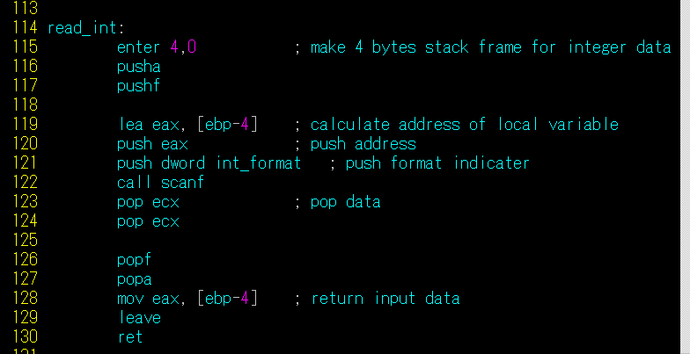
Example code
(cont’d)

Slide 21
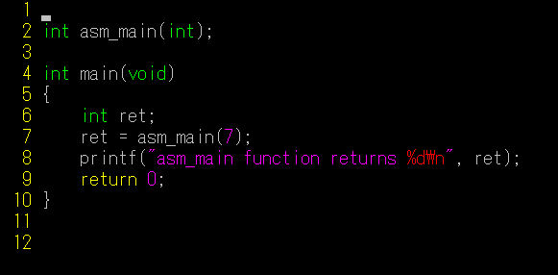
Example code
(cont’d)

Slide 22
C CALLING CONVENTIONS

Slide 23
C Calling conventions
The code that calls a subprogram and the subprogram itself must agree on how data will passed between them.
These rules on how data will be passed are called calling conventions.
C calling conventions
For high-level code to interface with assembly language, the assembly language code must use the same conventions as the high-level language.

Slide 24
C Calling conventions
(cont’d)
PUSH : add data to the stack
POP : removes data
SS : the segment that contain the stack
ESP : top of the stack

Slide 25
C Calling conventions
(cont’d)
Data can only be added in double word units
PUSH
  inserts a double word on the stack by subtracting 4 from ESP
  And then stores the double word at [ESP]
POP
  reads the double word at [ESP]
  And then adds 4 to ESP
STACK
  can be used as a convenient place to store data temporarily
  Also used for making subprogram calls, passing parameters and local variables.

Slide 26
C Calling conventions
(cont’d)
Call subprogram
CALL
  Make an unconditional jump to a subprogram
  And pushes the address of the next instruction on the stack
RET
  Pops off an address
  And jumps to that address.
When using this inst. It is very important that one manage the stack correctly so that the right number is popped off by the RET.

Slide 27
C Calling conventions
(cont’d)
ENTER - Make Stack Frame (80188+)
  Usage: ENTER locals,level
  Modifies flags: None
  Modifies stack for entry to procedure for high level language.
  "locals" specifies the amount of storage to be allocated on the stack.
  “level" specifies the nesting level of the routine. For the C calling convention level must be zero.
  Paired with the LEAVE instruction, this is a efficient method of entry and exit to procedures.

Slide 28
C Calling conventions
(cont’d)
LEAVE - Restore Stack for Procedure Exit
  Usage: LEAVE
  Releases the local variables created by the previous ENTER instruction by restoring SP and BP to their condition before the procedure stack frame was initialized.

Slide 29
C Calling conventions
(cont’d)
The parameters on the stack are not popped off by the subprogram.
  Since they have to pushed on the stack before the CALL instruction, the return address would gave to be popped off first
  Often the parameters will have to be used in several places in the subprogram. Usually they can not be kept in an register for the entire subprogram and would have to be stored in memory.

Slide 30
C Calling conventions
(cont’d)
main()
ret = asm_main(7);
asm_main
enter 0, 0
add eax, [ebp+8]
7
1008h
asm_main(7)
push 7
call asm_main
Add esp, 4
ESP = 1008h
100Ch

Slide 31
C Calling conventions
(cont’d)
main()
ret = asm_main(7);
asm_main
enter 0, 0
add eax, [ebp+8]
Return address
7
1004h
call asm_main
1008h
ESP = 1004h
100Ch

Slide 32
C Calling conventions
(cont’d)
main()
ret = asm_main(7);
asm_main
enter 0, 0
add eax, [ebp+8]
EBP
Return address
7
1000h
enter 0, 0
push ebp
mov ebp, esp
1004h
1008h
ESP = 1000h
100ch
EBP = 1000h

Slide 33
C Calling conventions
(cont’d)
main()
ret = asm_main(7);
read_int
enter 4, 0
lea eax, [ebp-4]
Local variable
EBP
Return address
7
9FCh
1000h
enter 0, 0
push ebp
mov ebp, esp
1004h
1008h
ESP = 9FCh
100ch
EBP = 1000h

Slide 34
C Calling conventions
(cont’d)
Local variable
EBP
Return address
7
9FCh
1000h
Leave
mov esp, ebp
pop ebp
1004h
1008h
ESP = 1004h
100ch

Slide 35
C Calling conventions
(cont’d)
Local variable
EBP
Return address
7
9FCh
1000h
1004h
1008h
ret
pop eip
ESP = 1008h
100ch

Slide 36
C Calling conventions
(cont’d)
Local variable
EBP
Return address
7
ret = asm_main(7);
mov eax, 7
push eax
call asm_main
add esp. 4
mov [ebp-4], eax
9FCh
1000h
1004h
1008h
100ch
ESP

Slide 37
C Calling conventions
(cont’d)
Local variable
Local variable
EBP
Return address
parameter
parameter
Local variables
ebp-4h
ebp-8h
ebp-Ch
ESP
EBP
Function parameter
ebp+8h
ebp+Ch
ebp+10h

Slide 38
C Calling conventions
(cont’d)
Interfacing Assembly with C
  Inline assembly code must be written in the format the compiler uses.
  So different compilers require different formats.
  Assembly routines are used.
    Direct access hareware features
    Assmebly libraries (MMX, linux/win)

Slide 39
C Calling conventions
(cont’d)
Saving registers
  C assumes that a subroutine maintains the values of the following registers
  EBX, ESI, EDI, EBP, CS, DS, SS, ES
  Usually these registers save at stack.
  use ‘PUSHA/POPA’ ‘PUSHF/POPF’

Slide 40
C Calling conventions
(cont’d)
Labels of functions
  Most C compilers prepend a single underscore character at the beginning of the names of functions and global/static variables. (asm_main => _asm_main)
  The linux gcc compiler does not prepend any character.

Slide 41
C Calling conventions
(cont’d)
Passing parameters
  The arguments of a function are pushed on the stack in the reverse order.
  The rules of the C calling conventions were specifically written to take any number of arguments.
  In printf function , always the address of format string is at EBP+8, not matter how many parameters are passed.
  So printf code can look at the format string to determine how many parameters should have been passed and look for them on the stack.
  Printf(“x = %d\n”);
    Print out the double word value at [EBP + 12]

Slide 42
C Calling conventions
(cont’d)
Calculating address of local variables
  Linker find the address of a label defined in the data or bss segments.
  Calculating the address of a local variable or parameter on the stack is not straightforward.
  lea eax, [ebp-8]
  => EAX holds the address of second local variable.

Slide 43
C Calling conventions
(cont’d)
Returning values
  Return values are passed via registers.
  All integral types (char, int, enum..) are returned in the EAX (extended to signed/unsigned 32 bit).
  Pointer values are also stored in EAX.
  Floating point values are stored in the ST0.

Slide 44
C Calling conventions
(cont’d)
Example code
  sub3.asm

Slide 45
REVIEW OF C VARIABLE STORAGE TYPES

Slide 46
Review of C variable storage types
Global
  Defined outside of any function and are stored at fixed memory locations (data/bss segments) and exist from the beginning of the program until the end.
  If declared as static, only the functions in the same module can access them. (not external)
Static
  Local variables of a function but stored at fixed memory likes data/bss.
  Only be accessed by in the function they are defined in.
Automatic
  Allocated in stack, unallocated when the function returns.

Slide 47
Review of C variable storage types
Register
  Just dependent to compiler
Volatile
  This keyword tells the compiler that the value of the variable may change any moment.
  Often a compiler might store the value of a variable in a register temporarily and use the register in place of the variable in a section of code
  It can not do these types of optimizations with volatile variables
  A common example of a volatile variable would be one could be altered by two threads of a multi-threaded program.

