Slide 1
Warum wir eine Datenkultur benötigen
Till Grallert

Slide 2
Drei Thesen

Slide 3
1. Wir leben im Zeitalter der Digitalität und Berechenbarkeit
Datafizierung markiert den epistemischen Wandel von einer Welt in der Daten ein engdefinierter Teil der Ergebnisse von Forschungsprozessen waren hin zu einem Status Quo in dem alle Forschungsprozesse immer schon durch Informations- und Kommunikationstechnologien vermittelt sind.
Gesellschaft und Wissenschaft sind bereits datafiziert
Notes:
“epoch of computationality” orginates with Berry
Unsere Interaktion mit der Welt ist immer schon durch ICTs vermittelt
Digital history, then, accepts that the human cultural record is being datafied and we need computational methods in order to make historical arguments (cf. Arguing with Digital History working group 2017, 2; Lässig 2021, 6)
Digital history also addresses the age of abundance, as postulated by Roy Rosenzweig, and epitomised by the recent advances in generative AI and LLMs, which will create an infinite amount of absolutely plausible and convincing yet utterly false sources

Slide 4
2. “analog” war (vor) gestern
Die Unterscheidung zwischen analog und digital hat ihren analytischen Wert verloren
We think of the ‘digital’ as a previous historic movement when computation as digitality was understood in opposition to the analogue, rather than complementary […]
Berry and Fagerjord (2017), 2

Slide 5
3. Algorithmen und Infrastrukturen sind Akteure
Algorithmen sind Teil des sozialen Geflechts
Today, algorithms are such an intrinsic and fundamental part of how daily life is experienced that some scholars even argue that we live in “algorithmic cultures” […]. This evocative notion points to the increasing difficulty of separating algorithms from the activities that make up culture. It also evinces the complex ways in which human agency and algorithmic actions are intertwined […]
Siles (2023), 1

Slide 6
Was tun?

Slide 7
Geschichtswissenschaft im Zeitalter der Berechenbarkeit
To make sense of datafication we need cultural change within the discipline

Slide 8
Status quo
very little computational research
limited understanding of the epistemoloigcal and ontological dimentions of datafication
limited understanding of the concept of research data and their enourmous potential for historical research
limited practical computational skills
constantly and rapidly evolving environment -> generative AI, ML
resentment towards “the digital”
Aims
Establish a robust and sustainable data culture in order to emerge from our self-incurred immaturity
make sense of the new episteme
develop the necessary skills to conduct historical research
negotiate new understandings of history as a discipline

Slide 9
What do we mean by data culture?
broad sense
Data culture as a disciplinary culture, in which (research) data and computational methods form an integral part of historical research and reasoning.
This requires:
fundamental theoretical, epistemological, and ontological knowledge of datafication
reflection on its implications for all parts of the research process
ongoing discussion on the necessary changes within the discipline
narrow sense
Data culture as quotidian practices, skill sets, and disciplinary protocolls for handling (research) data and computational research.
This requires:
orientation
training
support
Notes:
broad:
(research) data cannot, anymore, be perceived as an appendix / addendum to the “actual” research process
narrow
orientation: guidelines, best practices, white papers
through and by example
training: across the board
support: technical, ethical, judicial

Slide 10
Data, data everywhere
All digital information is data …
Data are forms of information, a larger concept that is even more difficult to define. Epistemological and ontological problems abound, resulting in many books devoted to explicating information and knowledge
Borgman (2015), 18

Slide 11
[Datafication/modeling] is the work of abstracting discrete values from a phenomenon or artifact. These values may be expressed in numbers or texts and are necessarily a reduction of complex materials into a form for computation.
Drucker (2021), 3
Data need to be imagined as data to exist and function as such, and the imagination of data entails an interpretive base.
Gitelman (2013), 3
… and all data is modelled
Notes:
Data literacy as part of data culture
data are always a concrete embodyment and a socio-technological stack: serialisation
If we subscribe to social constructivism then all models are historically situated
Data and models are situated in historical processes of knowledge production
Models have three characteristics (Stachowiak 1973)
Mapping/ replacing: model for something
Reduction: abstracts aspects of interest
Purpose: models have a purpose for something
drucker: capta

Slide 12
NFDI4Memory and Digital history at HU Berlin

Slide 13
Nationale Forschungsdateninfrastruktur (NFDI)
today
Association with more than 260 member institutions from all academic disciplines: research institutes, universities, GLAM, academic associations …
26 independent consortia (five-year funding), among them four from the humanities and social sciences:
NFDI4Culture
NFDI4Objects
Text+
NFDI4Memory
back story
2016–18: Council for Information Infrastructures recommends creating a national research data infrastructure
sustainable infrastructure for research data
bottom-up and federated
centered around data providers and users
disciplines and domain experts “at the helm”
organised into disciplinary communities
2018- : NFDI
three rounds of applications: 2020, 2021, 2022
funded by the federal and state governments
organised by the Deutsche Forschungsgemeinsschaft

Slide 14
NFDI4Memory
NFDI Consortium for the historically oriented humanities (2023–)

Slide 15
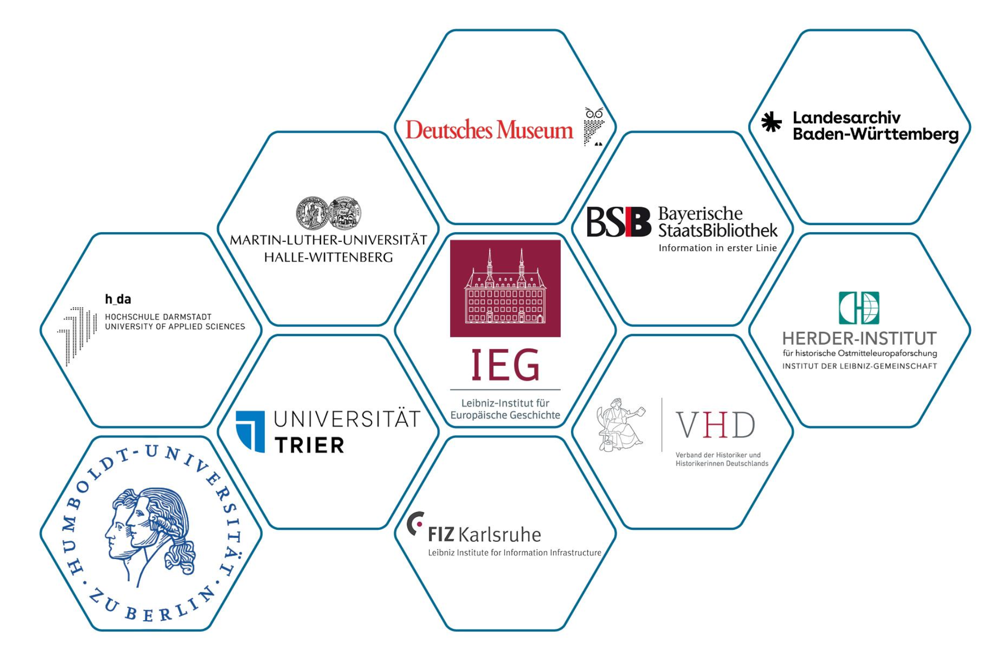
Unites research, memory and information infrastructure institutions in a digital research infrastructure
Drives forward the digital transformation of the historically oriented humanities
Develops digital historical source criticism for the humanities and for the NFDI
11 Co-applicants: lead 6 task areas
81 Participants: contribute ideas, expertise and networks
Notes:
NFDI4Memory
since 2023
one of 26 consortia, one of four consortia in the humanities and social sciences
at HU: task area “data culture”, together with VHD

Slide 16
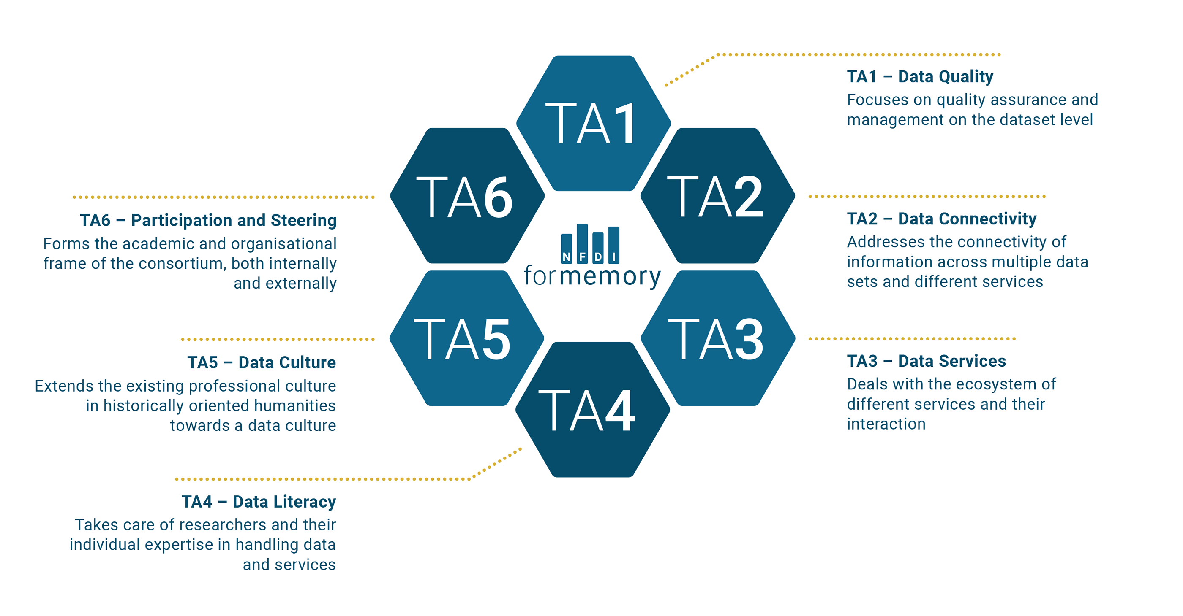
NFDI4Memory
Task areas

Slide 17
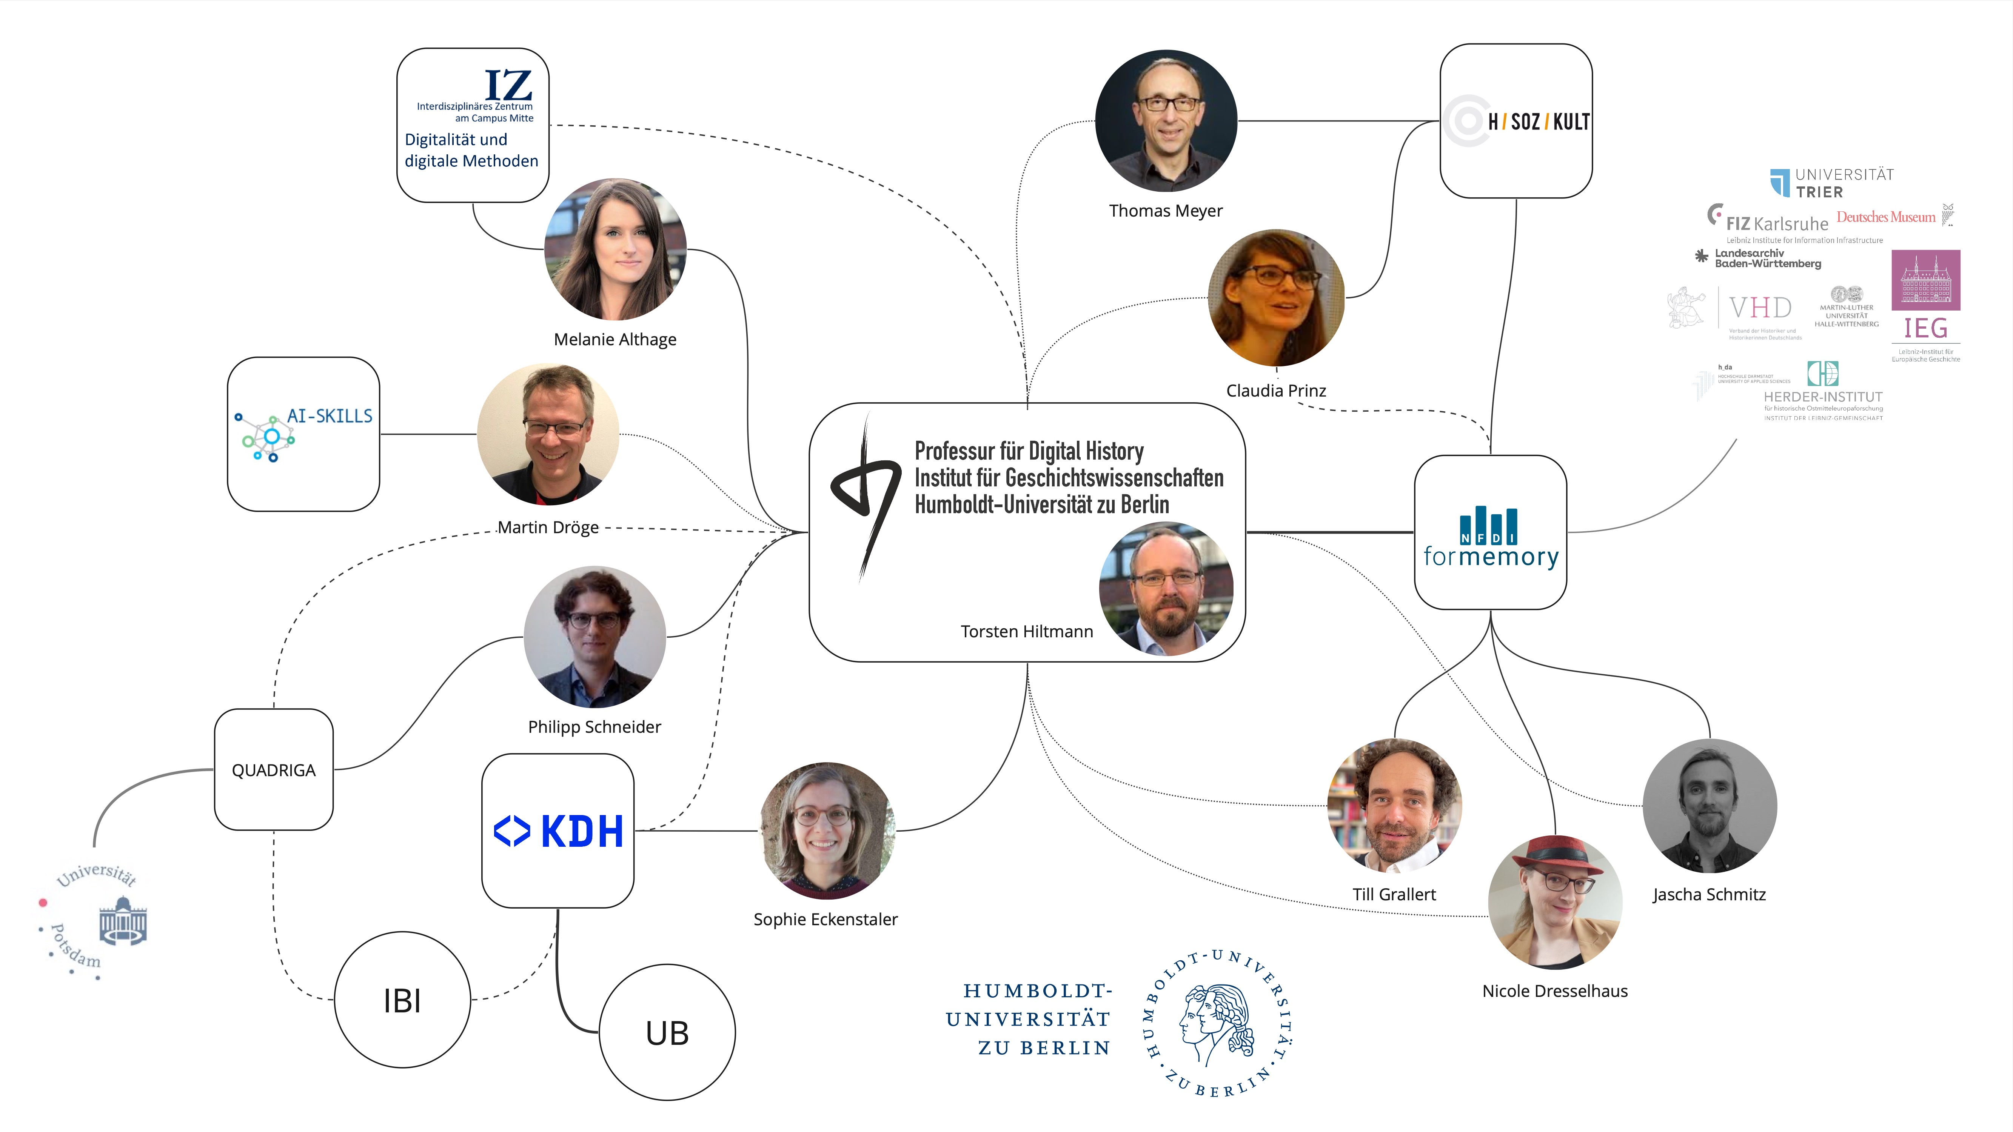
Digital history at HU Berlin
Notes:
Chair of Digital History:
Torsten Hiltmann, since 2020
Since 2018: MA specialisation programme Digital History as part of the MA in History
Algorithmic thinking,
methodological competence through
theoretical foundations, and
critical reflection in a historical context
HSozKult
since 1996 at the IfG
information and communications platform
announcements, reviews
IZ
since 2024
collaboration of all DH initiatives at HU in order to increase visibility and collaboration

Slide 18
Data culture by way of an example

Slide 19
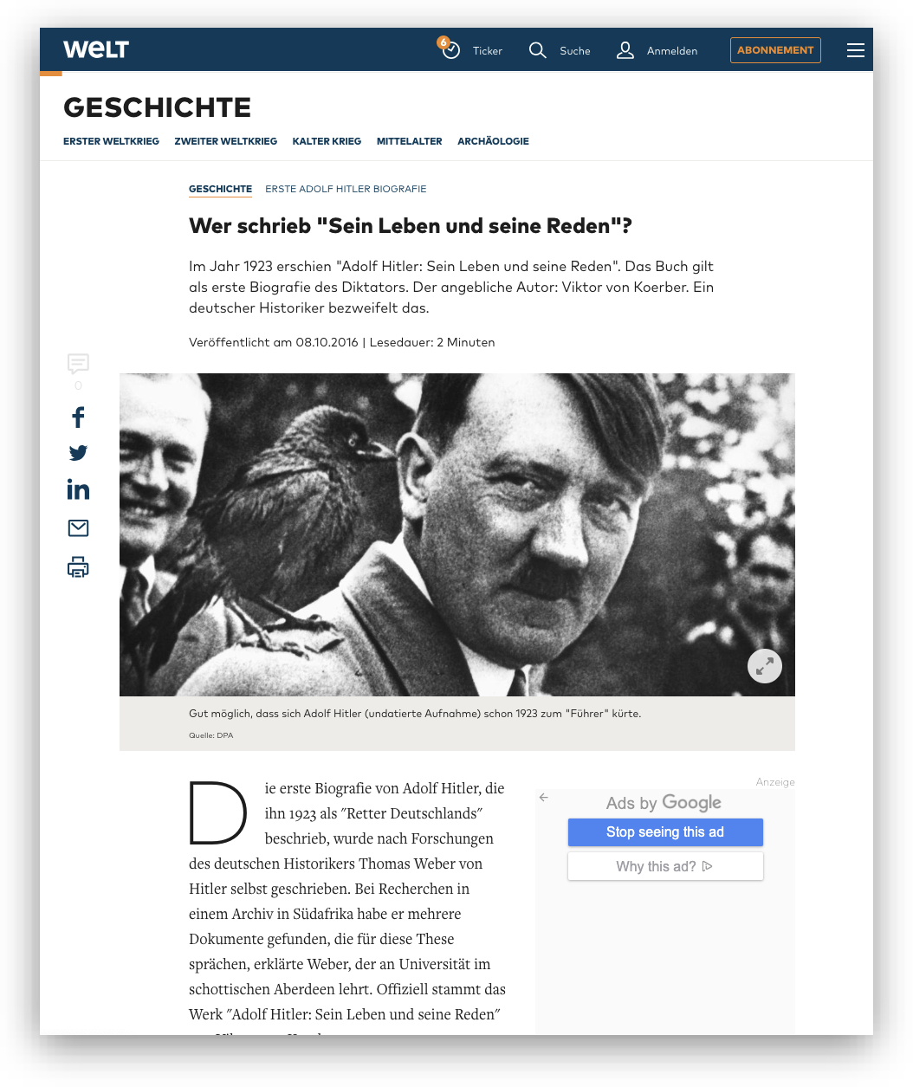
Who wrote “Sein Leben und seine Reden?”
Research question
Who wrote Adolf Hitler’s short biography published as part of Koerber (1923)?
Background
The book is an important source for research on the early phase of National Socialism and the rise of Adolf Hitler
Hypothesis of Hitler’s authorship stoked up considerable public controversy in the 2010s
Context
MA seminar “Who wrote it? Authorship Attribution as a method of Digital History” 2023
Research paper
Screenshot of a journalistic peace on the “discovery”
Notes:
historical background
1923: Hitlerputsch of 9. November in Munich, Bürgerbräukeller. Consequences: prison sentence, writing “mein Kampf”
book was published immediately after the coup with 70.000 copies. read as handbook to the court proceedings
public controversy in the 2010s
Thomas Weber (Aberdeen)
“found” “new” documentes in South Africa, in which Koebers admits to Hitler’s authorship
The hypothesis garners much attention and is reported as a fact
Othmar Plöckinger (Hg. der kritischen Edition von “Mein Kampf”): doubtful
Winfried Meyer (Berlin)
provides a source critique of Weber’s hermeneutic (and source critique)
extremely eccelctic choice of sources
a qualitative stilistic analysis indicates a high degree of similarity with Koebers’s writing
argues that Koebers ennunciations post 1945 must be read as an attempt at distancing himself from his Nazi past

Slide 20
Methods and tool criticism
Designing a research project
Are there computational methods to investigate the question of authorship?
What are the epistemological implications and consequences of applying a specific method and its concrete implementation for our research project?
What are the infrastructural requirements for using concrete tools?
Notes:
infrastructures are always socio-technical
requirements
knowledge
skills
access to hard- and software
licences
data formats etc.

Slide 21
Methods and tool criticism
Stilometric authorship attribution

Slide 22
background …
Authorship signal is prevalent in most frequent features (MFF)
comparative method
sharp decline in reliability below a mininmal text length (>2500 tokens)
… workflow …
compute frequencies of features for every text
compare all frequencies
validate through voting (consensus) of multiple iterations

Slide 23
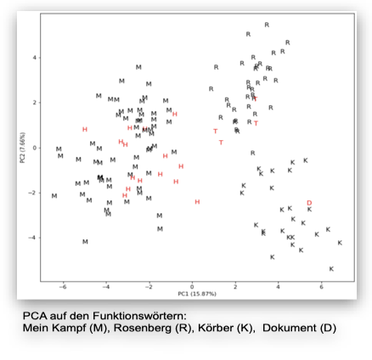
… decisions all along the way
corpus building
pre-processing to turn the corpus into a data set
feature extraction
feature count
statistical analysis
presentation and visualisation
PCA of MFF
Notes:
comparative method
most frequent features (MFF) as reliable indicator of authorship
sharp decline in reliability below a mininmal text length (>2500 tokens)
text in question is 3461 tokens long
corpus building: requires detailed historical domain knowlege
Hitler:
42 essays and 3 Denkschriften
55000 Tokens
Koerber:
5 texts from 1917–24
c.96000 Tokens
Rosenberg
4 texts, 1920–24
127000 Tokens
pre-processing to turn the corpus into a data set:
OCR,
orthographic normalisation,
removing pronomina
sampling
feature extraction: which kind of MFF? Characters, words, n-grams?
feature count:
how many MFF?
iteration?
statistical analysis:
which distance measure?
cluster analysis, PCA?
presentation and visualisation:
dendrogramm
bootstrapped consensus network
scatterplot

Slide 24
How to publish datafied historiography?
How to publish the historical narrative, the data set, methodological discussions, computer code for analysis and visualisation, and our interpretation of the results?
Which levels of transparency, reproducability, and interactivity shall be reached (and for how long)?
How stable should publications be?
How to review such new historiographies (both pre and post publication)?

Slide 25
ethical and legal dimensions of data culture
legal dimension
are we allowed to datafy, save, and process copyrighted or censored material?
which research data can we publish to ensure transparency and reproducability?
which research data do we have to publish?
ethical dimension
should we make racist material accessible and visible?
which research data should we publish to ensure transparency and reproducability?
should we and can we prevent the decontextualisation of published data?
which expense of natural and social resources is justified?
Notes:
ethical dimensions:
stilometry works on a bag of words. Sequence of tokens is irrelevant.
we can, therefore, publish a derivate format for replication studies without being able to re-constitute the texts from the derivate format

Slide 26
How do we foster data culture?

Slide 27
Measures
M1: questioning knowledge orders
expert group on cultural change in the historically oriented humanities
round tables with academic associations
international workshops with GHI Paris and Washington
travel grants for Early Career Researchers (twice per year)

Slide 28
field survey of computational methods in the historically oriented humanities
Registry of methods, tools, publications on Wikidata
Data Stories (Clio Guides) introducing and reflecting on computational methods
Developing collaborative case studies with the community
M2: Methods Innovation Lab

Slide 29
M3: ethical and legal frameworks
expert group on ethical and legal questions
guidelines and FAQs
VH|D|igital lecture series

Slide 30
expert group
developing criteria for evaluating the quality of data sets and data papers
developing workflows
Exemplary implementation on H-Soz-Kult
M4: Publishing and reviewing cultures

Slide 31
M5: Engaging the community
interdisziplinary summer schools
FAIR Data Fellowships
Clio Online 2.0
NFDI4Memory graduate network Digital History, annual retreats

Slide 32
Conclusion

Slide 33
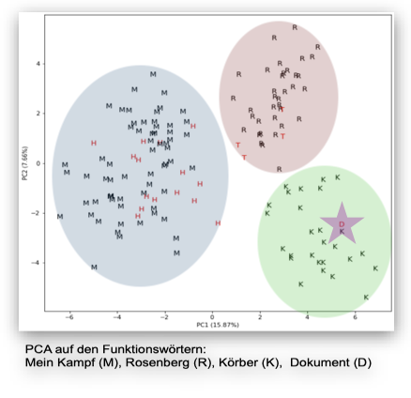
making sense of the new episteme
shifting epistemologies
added value of datafication: new answers, new questions
algorithmicity: allows for frequent testing of hypotheses
shifting knowledge orders
knowledge as being formalised and embodied in algorithms, models, corpora
changing forms of traceability and transparency, potential for replication
shifting discipline?
new modes of working: interdisciplinary collaboration
new skills: require novel training and qualifications
new forms of output: require novel indicators of reputation
new hiring processes?
PCA of MFF on our data set. Not how the text in question (D) is savely within Koerber’s corner (K).
Notes:
epistomoligical and methodological changes
added value from datafication: increasing our options through a changing perspective on the information to be extracted from sources
expanding hermeneutics through datafied approaches (as hermeneutical instruments)
algorithmicity: chances and challenges of explorative scaling as an approach to research questions
grounded with the processes of knowledge producation and narration within academic history
expanding source criticism into computational source criticism?
changing knowledge orders
knowledge as being formalised and embodied in algorithms, models, and corpora
changing forms of traceability and transparency, potential for replication
new skills, formats of output, and genuine research
changing courses of study and qualification
changing indicators of reputation
changing hiring processes

Slide 34
Thank you
This work was created as part of the NFDI consortium 4Memory (www.4memory.de).
We gratefully acknowledge the financial support of the German Research Foundation (DFG) – project number 501609550.

Slide 35
Bibliography
Arguing with Digital History working group. 2017. “Digital History and Argument.” White paper. https://rrchnm.org/argument-white-paper/.
Berry, David M, and Anders Fagerjord. 2017. Digital Humanities: Knowledge and Critique in a Digital Age. Cambridge; Malden: Polity.
Borgman, Christine L. 2015. Big Data, Little Data, No Data: Scholarship in the Networked World. MIT Press.
Drucker, Johanna. 2021. The Digital Humanities Coursebook: An Introduction to Digital Methods for Research and Scholarship. 1st ed. Abingdon: Routledge. https://doi.org/10.4324/9781003106531.
Gitelman, Lisa, ed. 2013. “Introduction.” In “Raw Data” Is an Oxymoron, 1–14. Cambridge: MIT Press.
Koerber, Adolf-Viktor von, ed. 1923. Adolf Hitler - Sein Leben und seine Reden. München: Deutscher Volksverlag. http://archive.org/details/AHSeinLebenSeineReden.
Lässig, Simone. 2021. “Digital History: Challenges and Opportunities for the Profession.” Geschichte und Gesellschaft 47 (1): 5–34. https://doi.org/gkhrjp.
Siles, Ignacio. 2023. Living with Algorithms: Agency and User Culture in Costa Rica. Boston: MIT Press.
Stachowiak, Herbert. 1973. Allgemeine Modelltheorie. Wien: Springer.

