Slide 1
Machine Intelligence 2
Exercise Sheet 3
Authors:
Jens Krenzin - 319308
Till Rohrmann - 343756

Slide 2
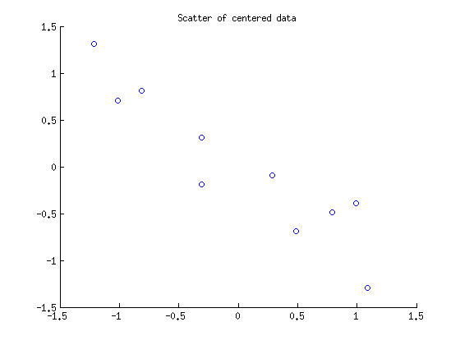
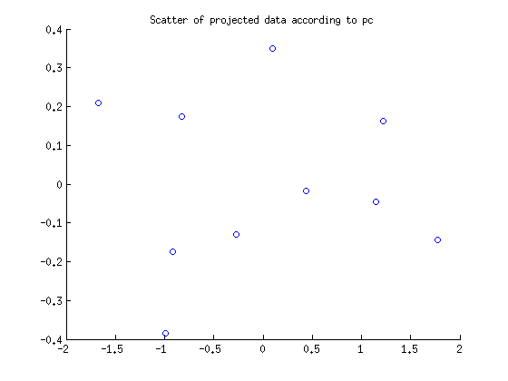
3.1 PCA toy data

Slide 3
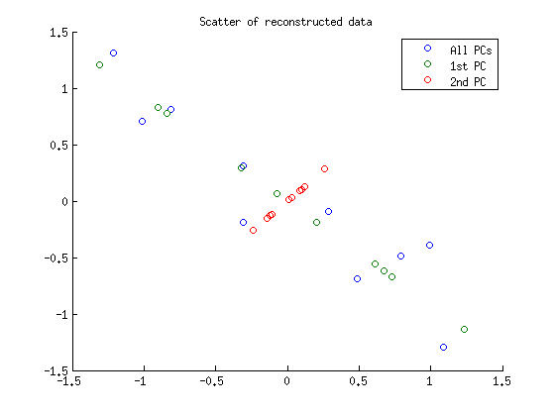
3.1 PCA toy data

Slide 4
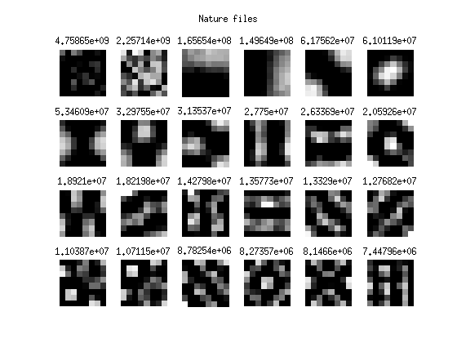
3.2 PCA image data

Slide 5
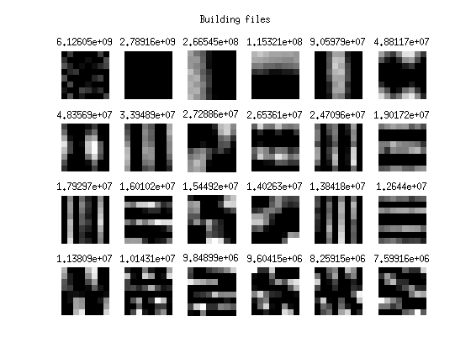
3.2 PCA image data

Slide 6
3.2 PCA image data
The PCs of the buildings group show a quite regular structure (horizontal and vertical lines) as one would expect from human-made objects
The PCs of the nature group are more complex and resemble more biological structures
In order to represent the different images with the PCs, one should keep the PCs with the highest eigenvalues and thus variance
In the nature and the buildings group the variance of the 21st PC is by a factor of 1000 smaller than the highest value. Thus one should keep the first 20 PCs.

Slide 7
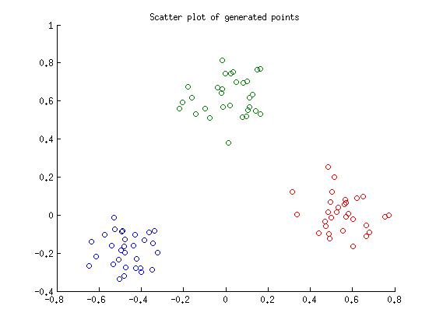
3.3 Kernel PCA

Slide 8
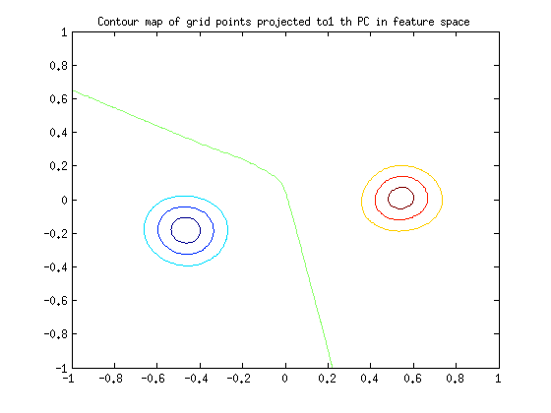
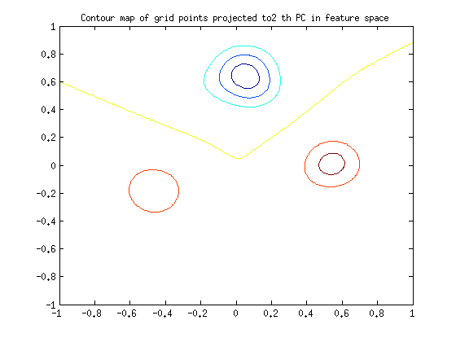
3.3 Kernel PCA
1st PC
2nd PC

Slide 9
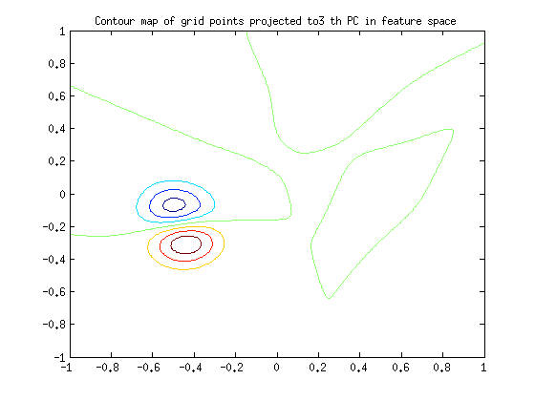
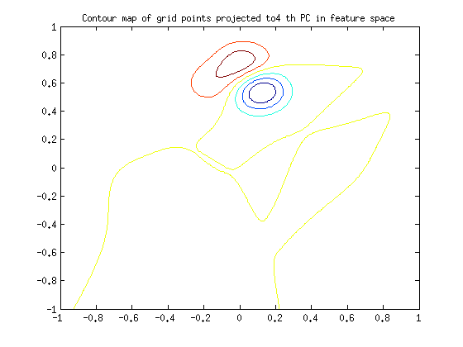
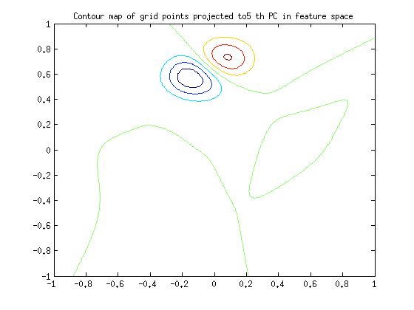
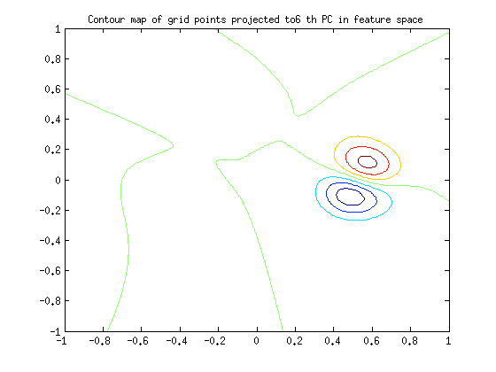
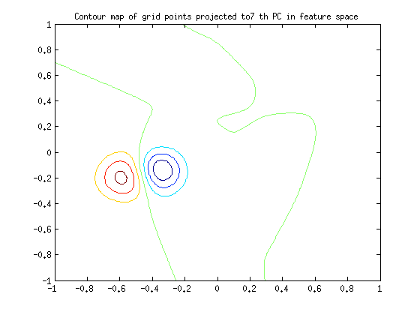
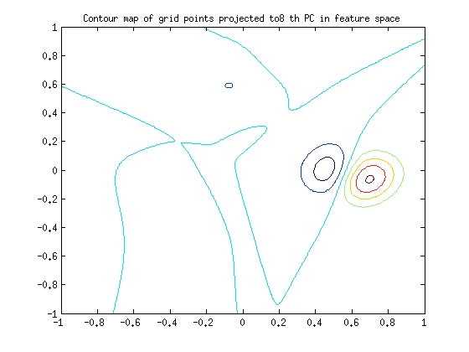
3.3 Kernel PCA

Slide 10
3.3 Kernel PCA
It is possible to categorize the 3 different heaps in the feature space by projecting onto the first 2 PCs → first 2 PCs in feature space capture the characteristics of the dataset sufficiently
Moreover, by using further PCs one can separate the heaps into subheaps

