Slide 1
Exercise Sheet 7
Kurtosis, negentropy,
and the independent components of image patches
Till Rohrmann - 343756
Jens Krenzin - 319308

Slide 2
Problem 7.1
Kurtosis Toy Data

Slide 3
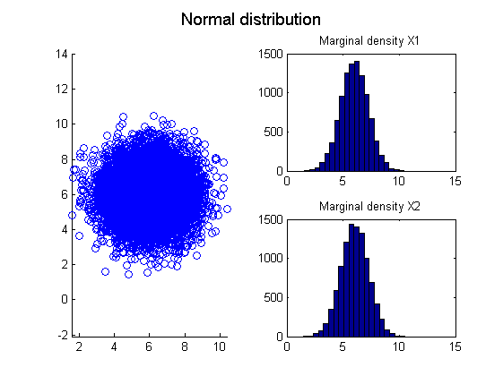
Problem 7.1 Kurtosis Toy Data
Loaded datasets

Slide 4
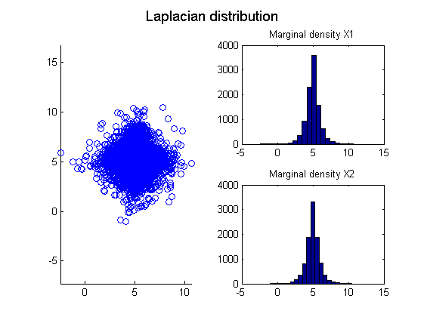
Problem 7.1 Kurtosis Toy Data
Loaded datasets

Slide 5
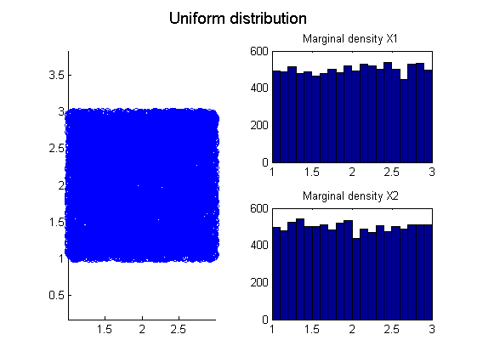
Problem 7.1 Kurtosis Toy Data
Loaded datasets

Slide 6
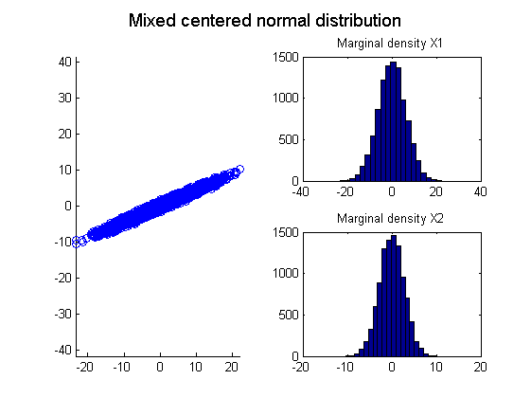
Problem 7.1 Kurtosis Toy Data
Mixed data

Slide 7
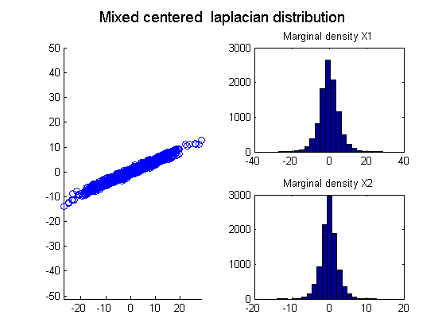
Problem 7.1 Kurtosis Toy Data
Mixed data

Slide 8
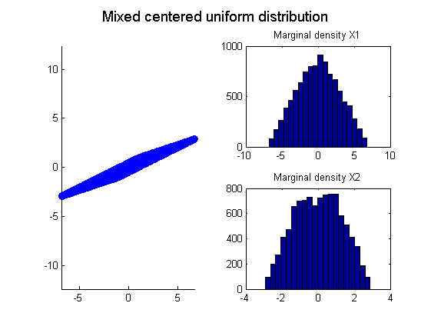
Problem 7.1 Kurtosis Toy Data
Mixed data

Slide 9
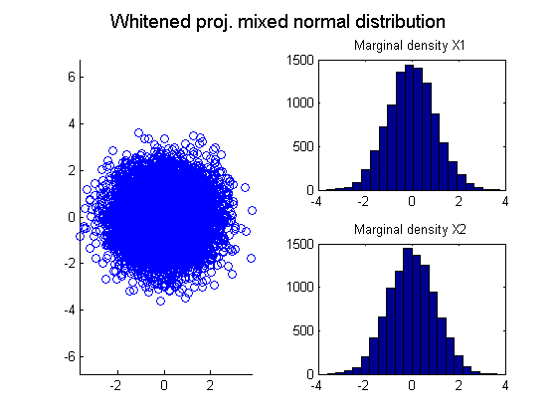
Problem 7.1 Kurtosis Toy Data
Whitened mixed data in PC space

Slide 10
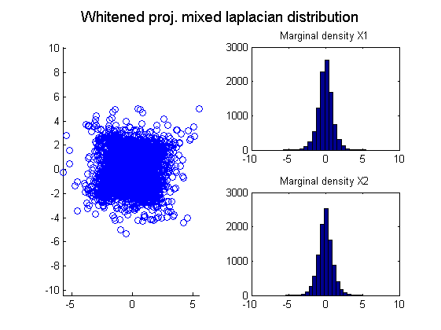
Problem 7.1 Kurtosis Toy Data
Whitened mixed data in PC space

Slide 11
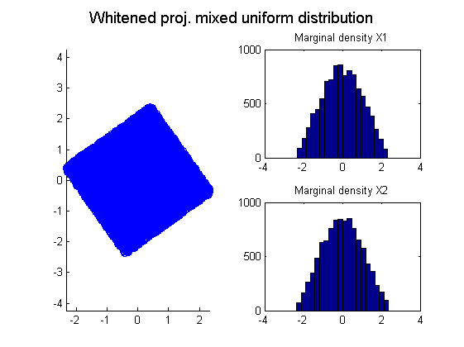
Problem 7.1 Kurtosis Toy Data
Whitened mixed data in PC space

Slide 12
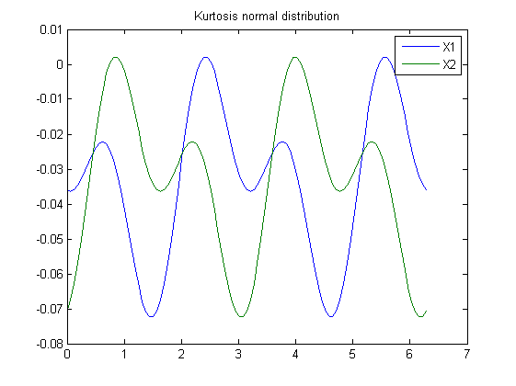
Problem 7.1 Kurtosis Toy Data
Kurtosis function – normal distribution

Slide 13
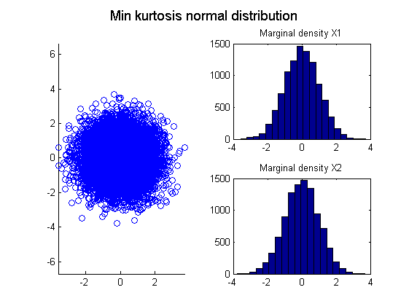
Problem 7.1 Kurtosis Toy Data
Kurtosis function – normal distribution

Slide 14
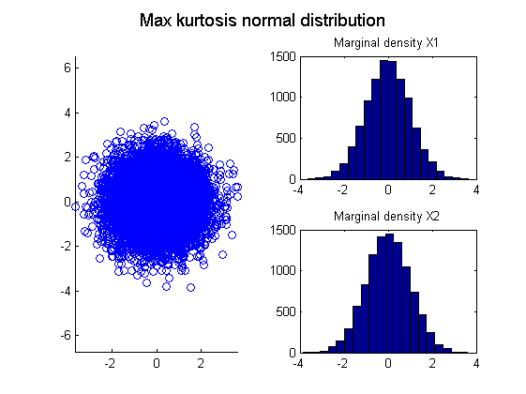
Problem 7.1 Kurtosis Toy Data
Kurtosis function – normal distribution

Slide 15
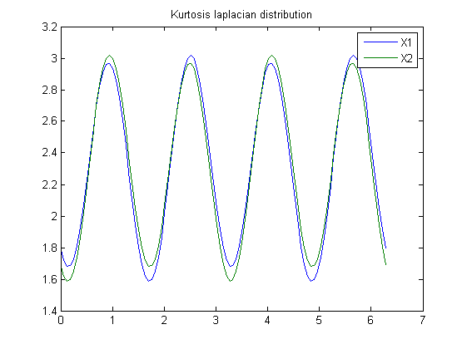
Problem 7.1 Kurtosis Toy Data
Kurtosis function – laplacian distribution

Slide 16
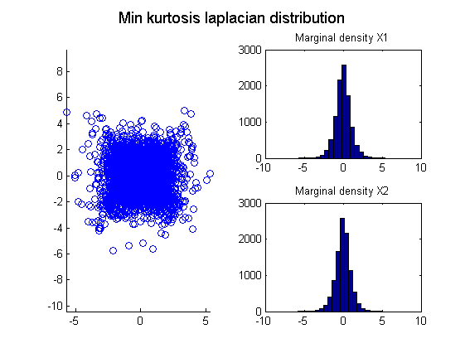
Problem 7.1 Kurtosis Toy Data
Kurtosis function – laplacian distribution

Slide 17
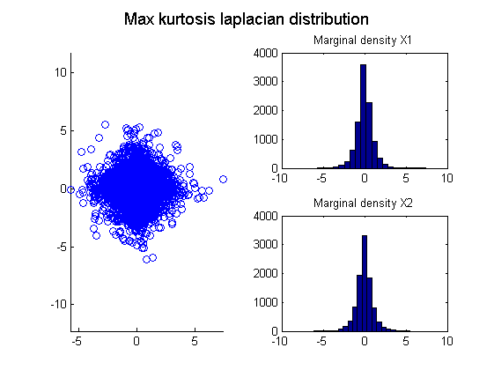
Problem 7.1 Kurtosis Toy Data
Kurtosis function – laplacian distribution

Slide 18
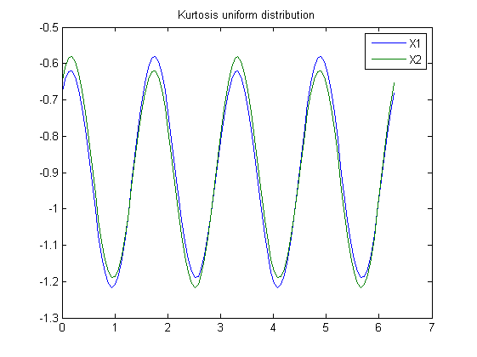
Problem 7.1 Kurtosis Toy Data
Kurtosis function – uniform distribution

Slide 19
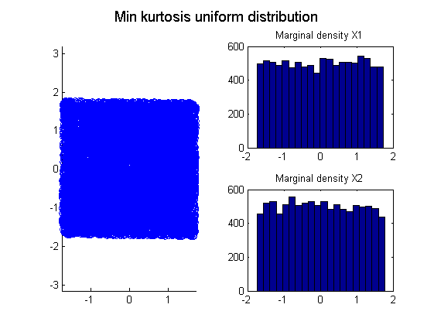
Problem 7.1 Kurtosis Toy Data
Kurtosis function – uniform distribution

Slide 20
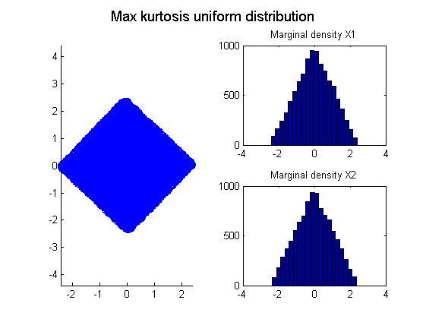
Problem 7.1 Kurtosis Toy Data
Kurtosis function – uniform distribution

Slide 21
Problem 7.2
Toy Signal Seperation

Slide 22
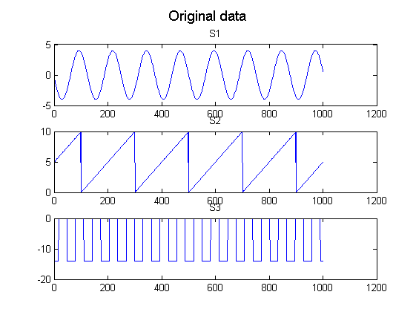
Problem 7.2 Toy Signal Seperation
Generated signals

Slide 23
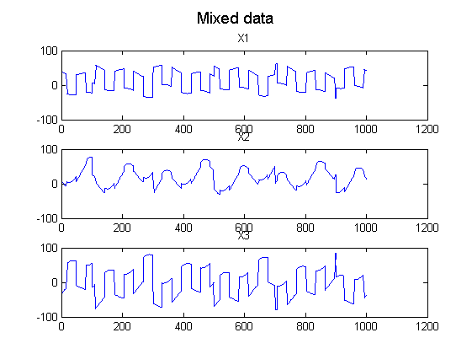
Problem 7.2 Toy Signal Seperation
Mixed signals

Slide 24
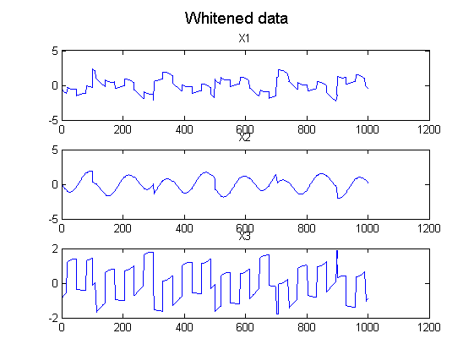
Problem 7.2 Toy Signal Seperation
Whitened mixed signals

Slide 25
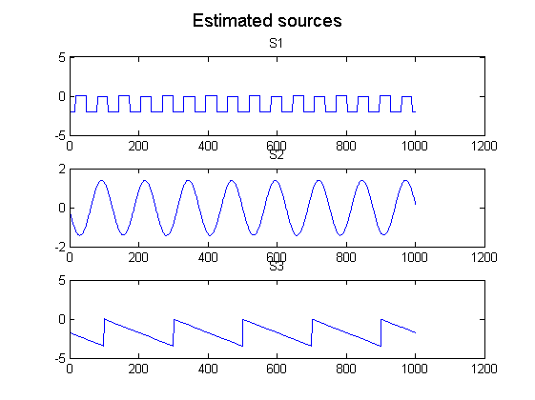
Problem 7.2 Toy Signal Seperation
Estimated sources

Slide 26
Problem 7.2 Toy Signal Seperation
Comparison

Slide 27
Problem 7.3
ICA on Image Patches

Slide 28
Problem 7.3 ICA on Image Patches
TODO

