Slide 1
Exercise Sheet 3
Probability Density Estimation
Till Rohrmann - 343756
Jens Krenzin - 319308

Slide 2
Problem 3.1 Toy Data

Slide 3
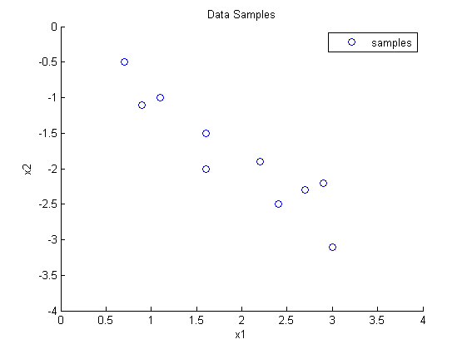
Problem 3.1 Toy Data
a) Scatter Plot:

Slide 4
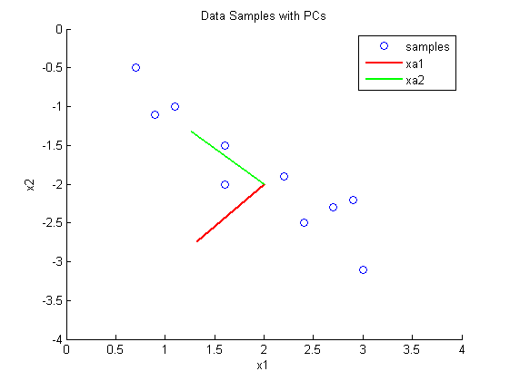
Problem 3.1 Toy Data
b) Scatter Plot with eigenvectors:

Slide 5
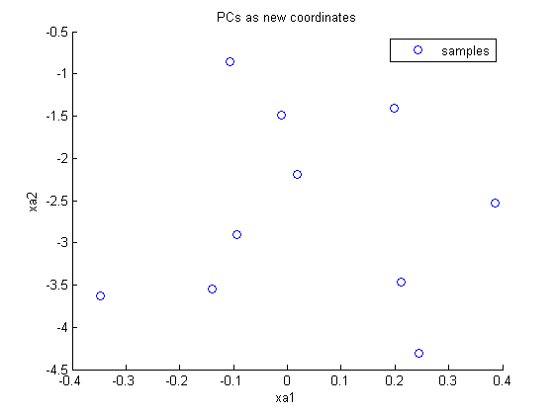
Problem 3.1 Toy Data
b) Scatter Plot of toy data with PCs as coordinates:

Slide 6
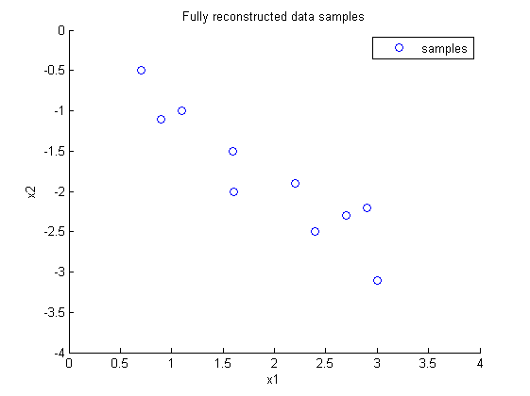
Problem 3.1 Toy Data
c) Fully reconstructed data:

Slide 7
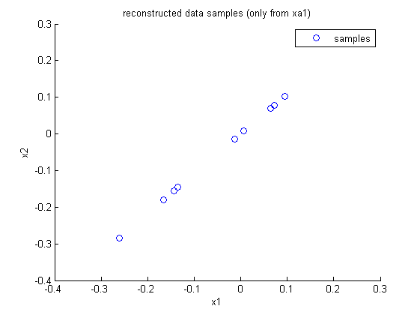
Problem 3.1 Toy Data
c) Reconstructed data (only using xa1):

Slide 8
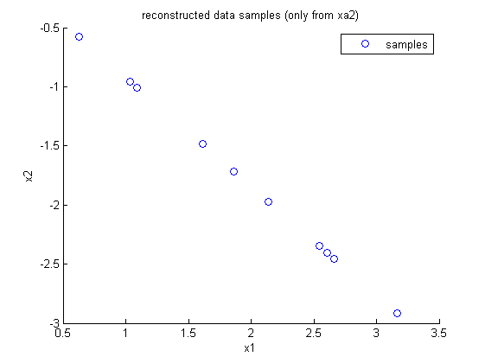
Problem 3.1 Toy Data
c) Reconstructed data (only using xa2):

Slide 9
Problem 3.2 PCA: Image Data

Slide 10

Problem 3.2 PCA: Image Data
b) PCs of used image patches (shown as 8*8 image patch)
Category: Nature
Shown PCs: 24
3
8
- More horizontal and vertical lines
- More homogenous structure

Slide 11

Problem 3.2 PCA: Image Data
b) PCs of used image patches (shown as 8*8 image patch)
Category: Buildings
Shown PCs: 24
3
8
- More diagonal lines
- More inhomogenous structure

Slide 12
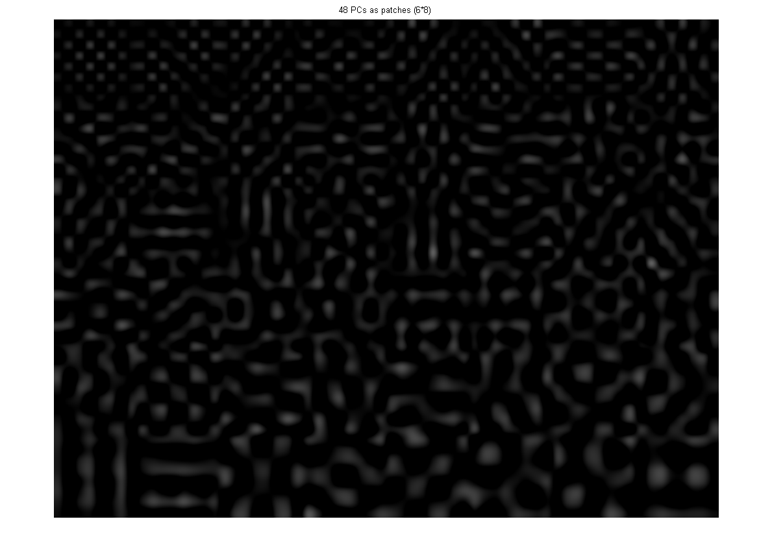
Problem 3.2 PCA: Image Data
b) PCs of used image patches (shown as 8*8 image patch)
6
8
Category: Nature
Shown PCs: 48

Slide 13
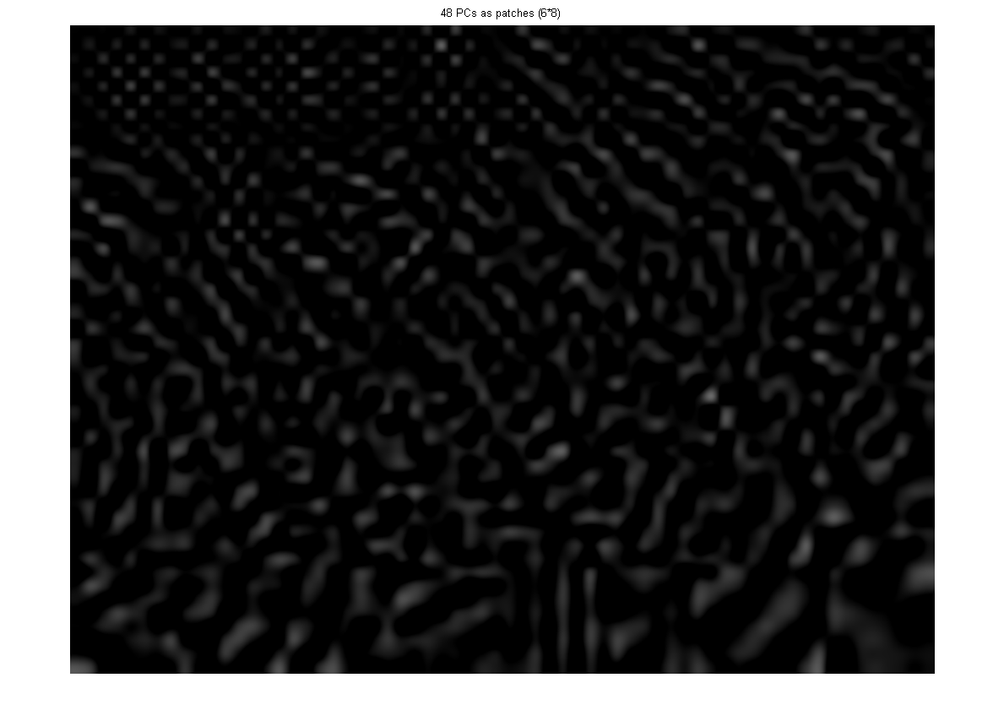
Problem 3.2 PCA: Image Data
b) PCs of used image patches (shown as 8*8 image patch)
6
8
Category: Buildings
Shown PCs: 48

Slide 14
Problem 3.3 Kernel PCA: Toy Data

Slide 15
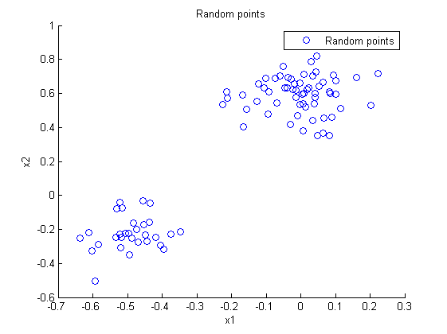
Problem 3.3 Kernel PCA: Toy Data
Used distributions:
N([-0.5,-0.2],0.1)
N([0,0.6],0.1)
N([0.5,0],0.1)
a) Toy data:

Slide 16
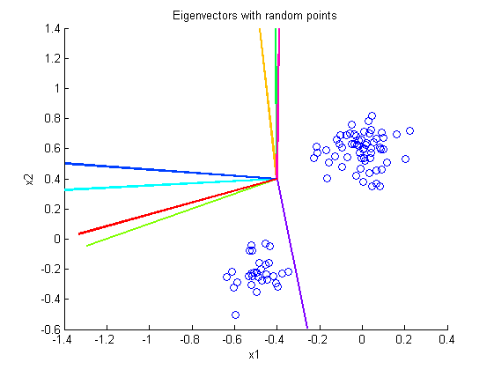
Problem 3.3 Kernel PCA: Toy Data
b) Kernel PCA with RBF Kernel:
- Colored Lines are eigenvectors

Slide 17
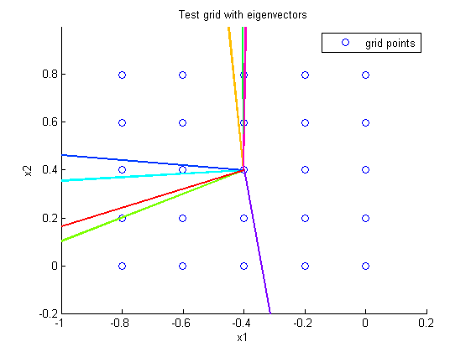
Problem 3.3 Kernel PCA: Toy Data
c) Used Test Grid with eigenvectors:
- Every point has a number
two groups
of eigenvectors
1
2
3
4
5
6
7
8
9
10
11
12
13
14
15
16
17
18
19
20
21
22
23
24
25

Slide 18
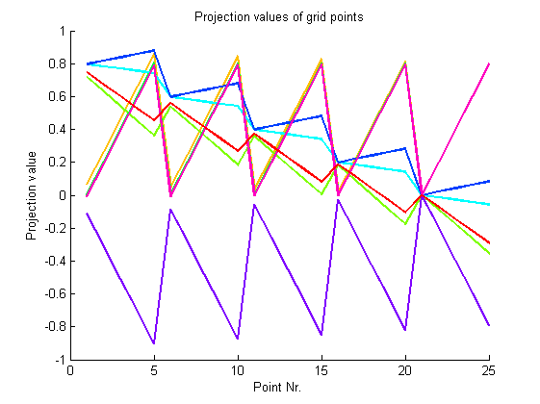
Problem 3.3 Kernel PCA: Toy Data
c) Projections of the eigenvectors:
- Projections values
show a common behavior
(2 groups)
variances of projection values
are all high enough to distinguish
projection values
sometimes one or two outliers
occur which show an uncommon
Behaviour (here: the purple one)
-> The RBF Kernel is just an
estimation for the scalar products!
Outliers can occur!
One Outlier

