Slide 1
Exercise Sheet 6
Density Transformations and ICA
Till Rohrmann - 343756
Jens Krenzin - 319308

Slide 2
Problem 6.2
Random Number Generation

Slide 3
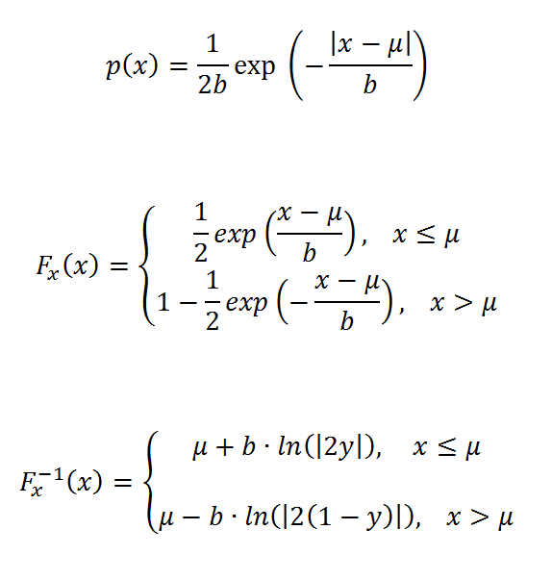
Problem 6.2 Random Number Generation
Formulas:

Slide 4
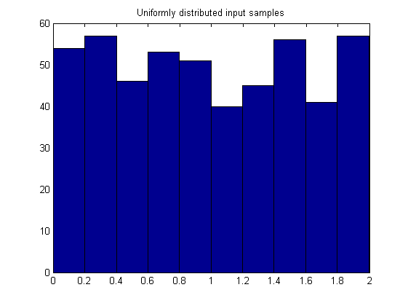
Problem 6.2 Random Number Generation
500 Uniformly distributed input samples:

Slide 5
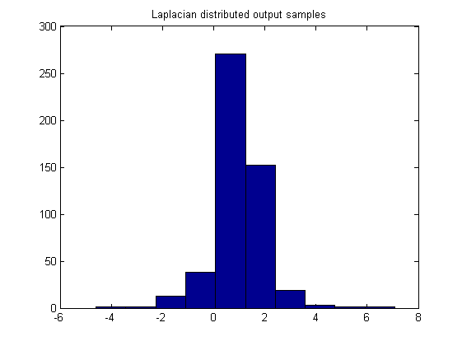
Problem 6.2 Random Number Generation
500 Laplacian distributed output samples:
mean = 1
variance = 2

Slide 6
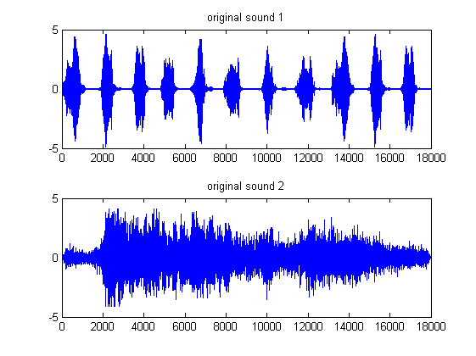
Problem 6.3 ICA
Original sounds:

Slide 7
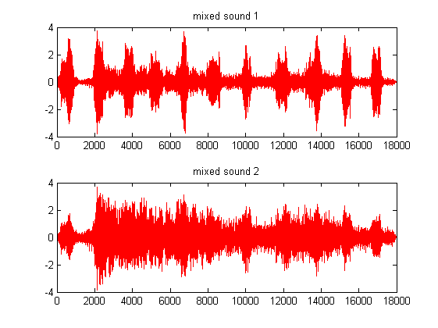
Problem 6.3 ICA
Mixed sounds:

Slide 8
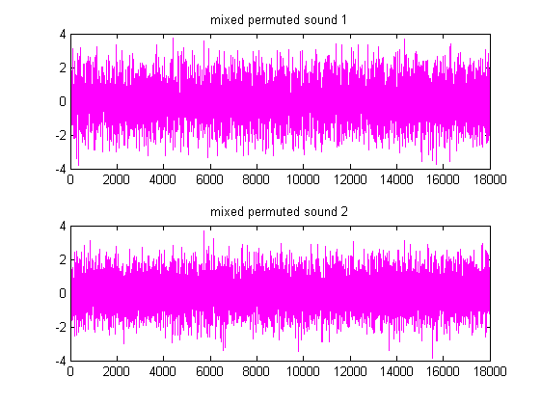
Problem 6.3 ICA
Mixed permuted sounds:

Slide 9
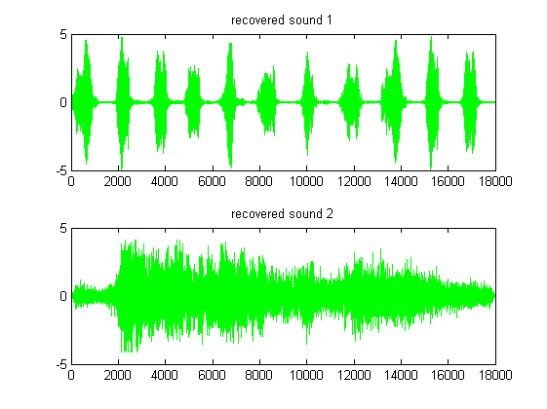
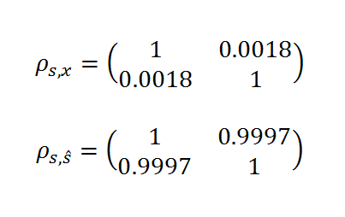

Problem 6.3 ICA
Recovered sounds:
Correlations:
Learning rate:

Slide 10
Problem 6.3 ICA
Comparison

