Slide 1
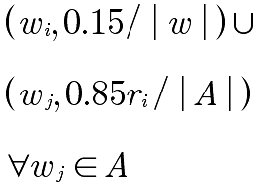
rank
flatMap
join
groupBy
reduce
adj. list

