Slide 1

NEST::initiative
A simulator for spiking neural network models that focuses on:
Dynamics
Size
Structure
of neural systems rather than on the exact morphology of individual neurons

Slide 2
Ideal use cases
ideal for networks of spiking neurons of any size, for example:
Models of information processing e.g. in the visual or auditory cortex of mammals
Models of network activity dynamics, e.g. laminar cortical networks or balanced random networks
Models of learning and plasticity.

Slide 3
Why should I use
NEST :
Provides over 50 neuron models
Provides over 10 synapse models
Provides many examples that help you getting started with your own simulation project.
Offers convenient and efficient commands to define and connect large networks
...

Slide 4
Achievements
1.86e9 neurons, 11.1e12 synapses
  All 8 cores of 82,944 processors of the K Computer
  ~ 13 minutes build the network
  ~ 40 minutes to simulate
    To simulate 1s of biological time

Slide 5
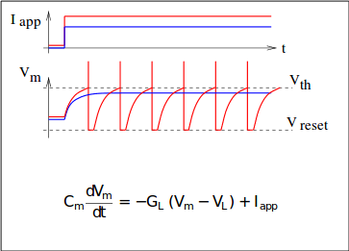
Neuron & Synapse Models
INTEGRATE AND FIRE (IAF) NEURON MODELS with current- and conductance- based synapses
ADAPTIVE-EXPONENTIAL IAF (Brette and Gerstner, 2005)
MAT2 NEURON MODEL (Kobayashi et al., 2009)
HODGKIN-HUXLEY TYPE NEURON MODELS with one compartment
Simple MULTI-COMPARTMENT NEURON MODELS
STATIC AND PLASTIC SYNAPSE MODELS (STDP, STP, dopamine)

Slide 6
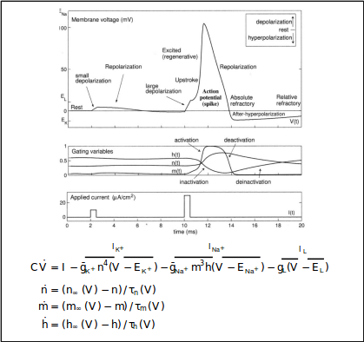
Neuron & Synapse Models
INTEGRATE AND FIRE (IAF) NEURON MODELS with current- and conductance- based synapses
ADAPTIVE-EXPONENTIAL IAF (Brette and Gerstner, 2005)
MAT2 NEURON MODEL (Kobayashi et al., 2009)
HODGKIN-HUXLEY TYPE NEURON MODELS with one compartment
Simple MULTI-COMPARTMENT NEURON MODELS
STATIC AND PLASTIC SYNAPSE MODELS (STDP, STP, dopamine)

Slide 7
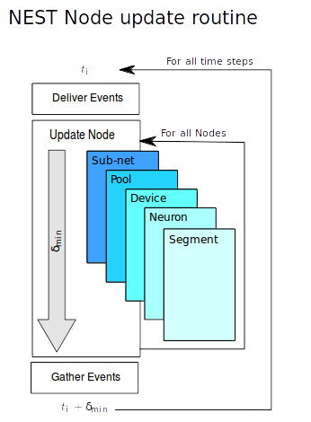
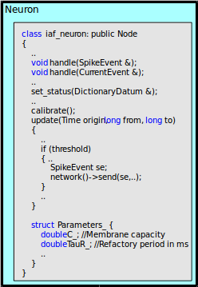
Object-oriented Code - Nodes

Slide 8
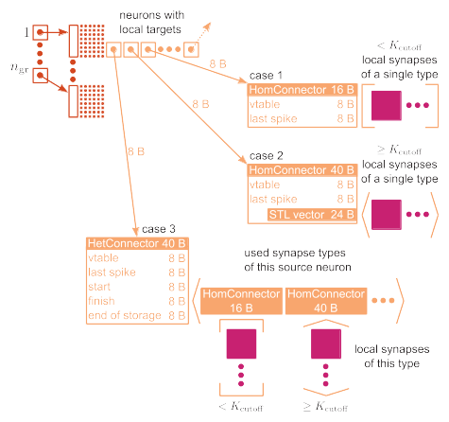
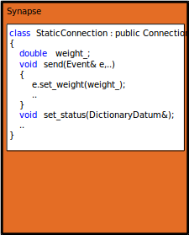
O-o Code - Connections

Slide 9
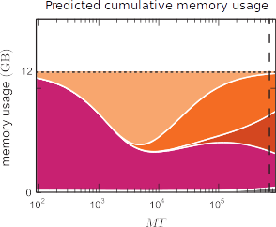
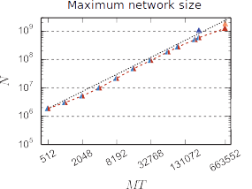
Memory Consumption
Threads/Node T=8
Synapses/Neuron 11,250
K
JUQUEEN
Pink: synapse objects
Orange: components of connection infrastructure
  Dark orange: sparse Table
  Orange: intermediate infrastructure containing exactly 1 synapse
  Light orange: intermediate infrastructure containing more than 1 synapse

Slide 10
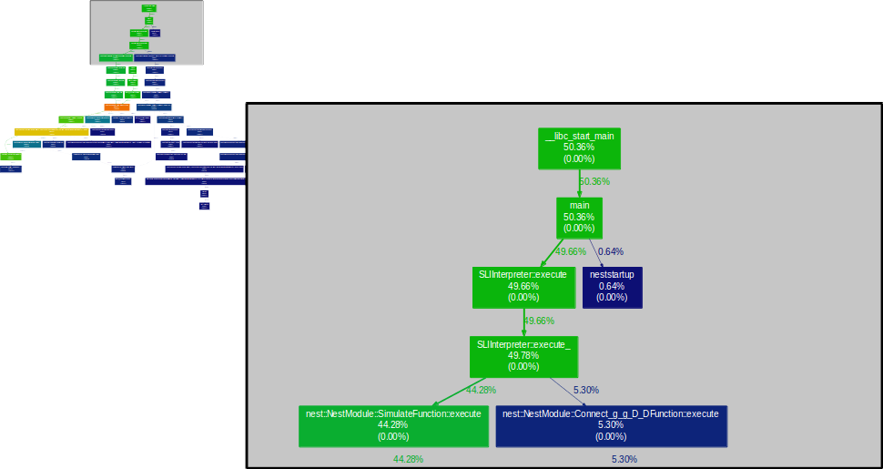
Call graph

Slide 11
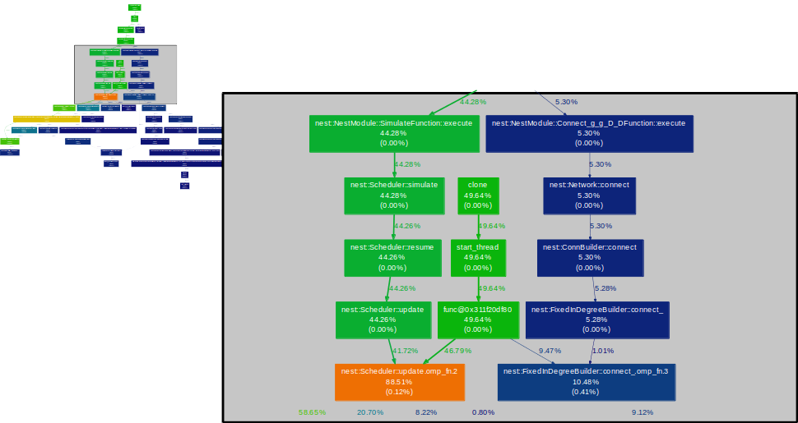
Call graph

Slide 12
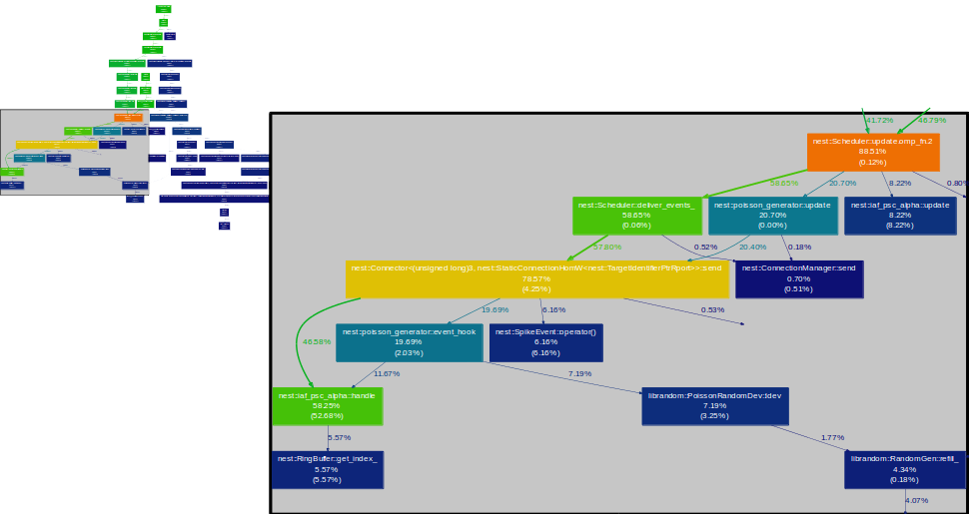
Call graph

Slide 13
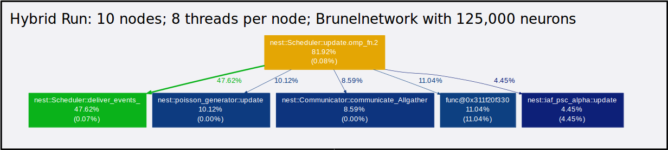
Call graph

Slide 14
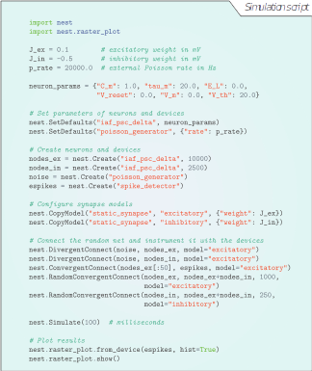
How to use PyNest

Slide 15
To Do
Building and executing mouse brain model using NEST
  Adapt Csabas PyNest script to Michaels HDF5 data format
  Run Simulation
Define design space to support NeuroRobotics on a distributed platform
  Definition of 3 use cases
  Network latency/bandwidth requirements
Testing BG/Q latency/bandwidth requirements using a simple ping pong iperf test
Adding automated mouse brain model test using BBP Jenkins

Slide 16
Literature
Kunkel, Susanne, et al. "Spiking network simulation code for petascale computers." Frontiers in neuroinformatics 8 (2014).
  http://www.frontiersin.org/Journal/Abstract.aspx?s=752&name=neuroinformatics&ART_DOI=10.3389/fninf.2014.00078
NEST: The Neuronal Simulation Tool; NEST Brochure; 2014
  http://www.jara.org/fileadmin/user_upload/JARA-HPC/Dokumente/Projekte_Broschueren/JARA_NEST_AnsichtWeb.pdf
Gerstner, Wulfram, et al. Neuronal dynamics: from single neurons to networks and models of cognition. Cambridge University Press, 2014.

