Slide 1

NESTProxy
Simulating IO behavior of NEST
Till Schumann (Till.Schumann@rwth-aachen.de)
Sebastian Lührs
Wolgang Frings
Alex Peyser
Wolfram Schenck
Kay Thust
Jochen Martin Eppler

Slide 2

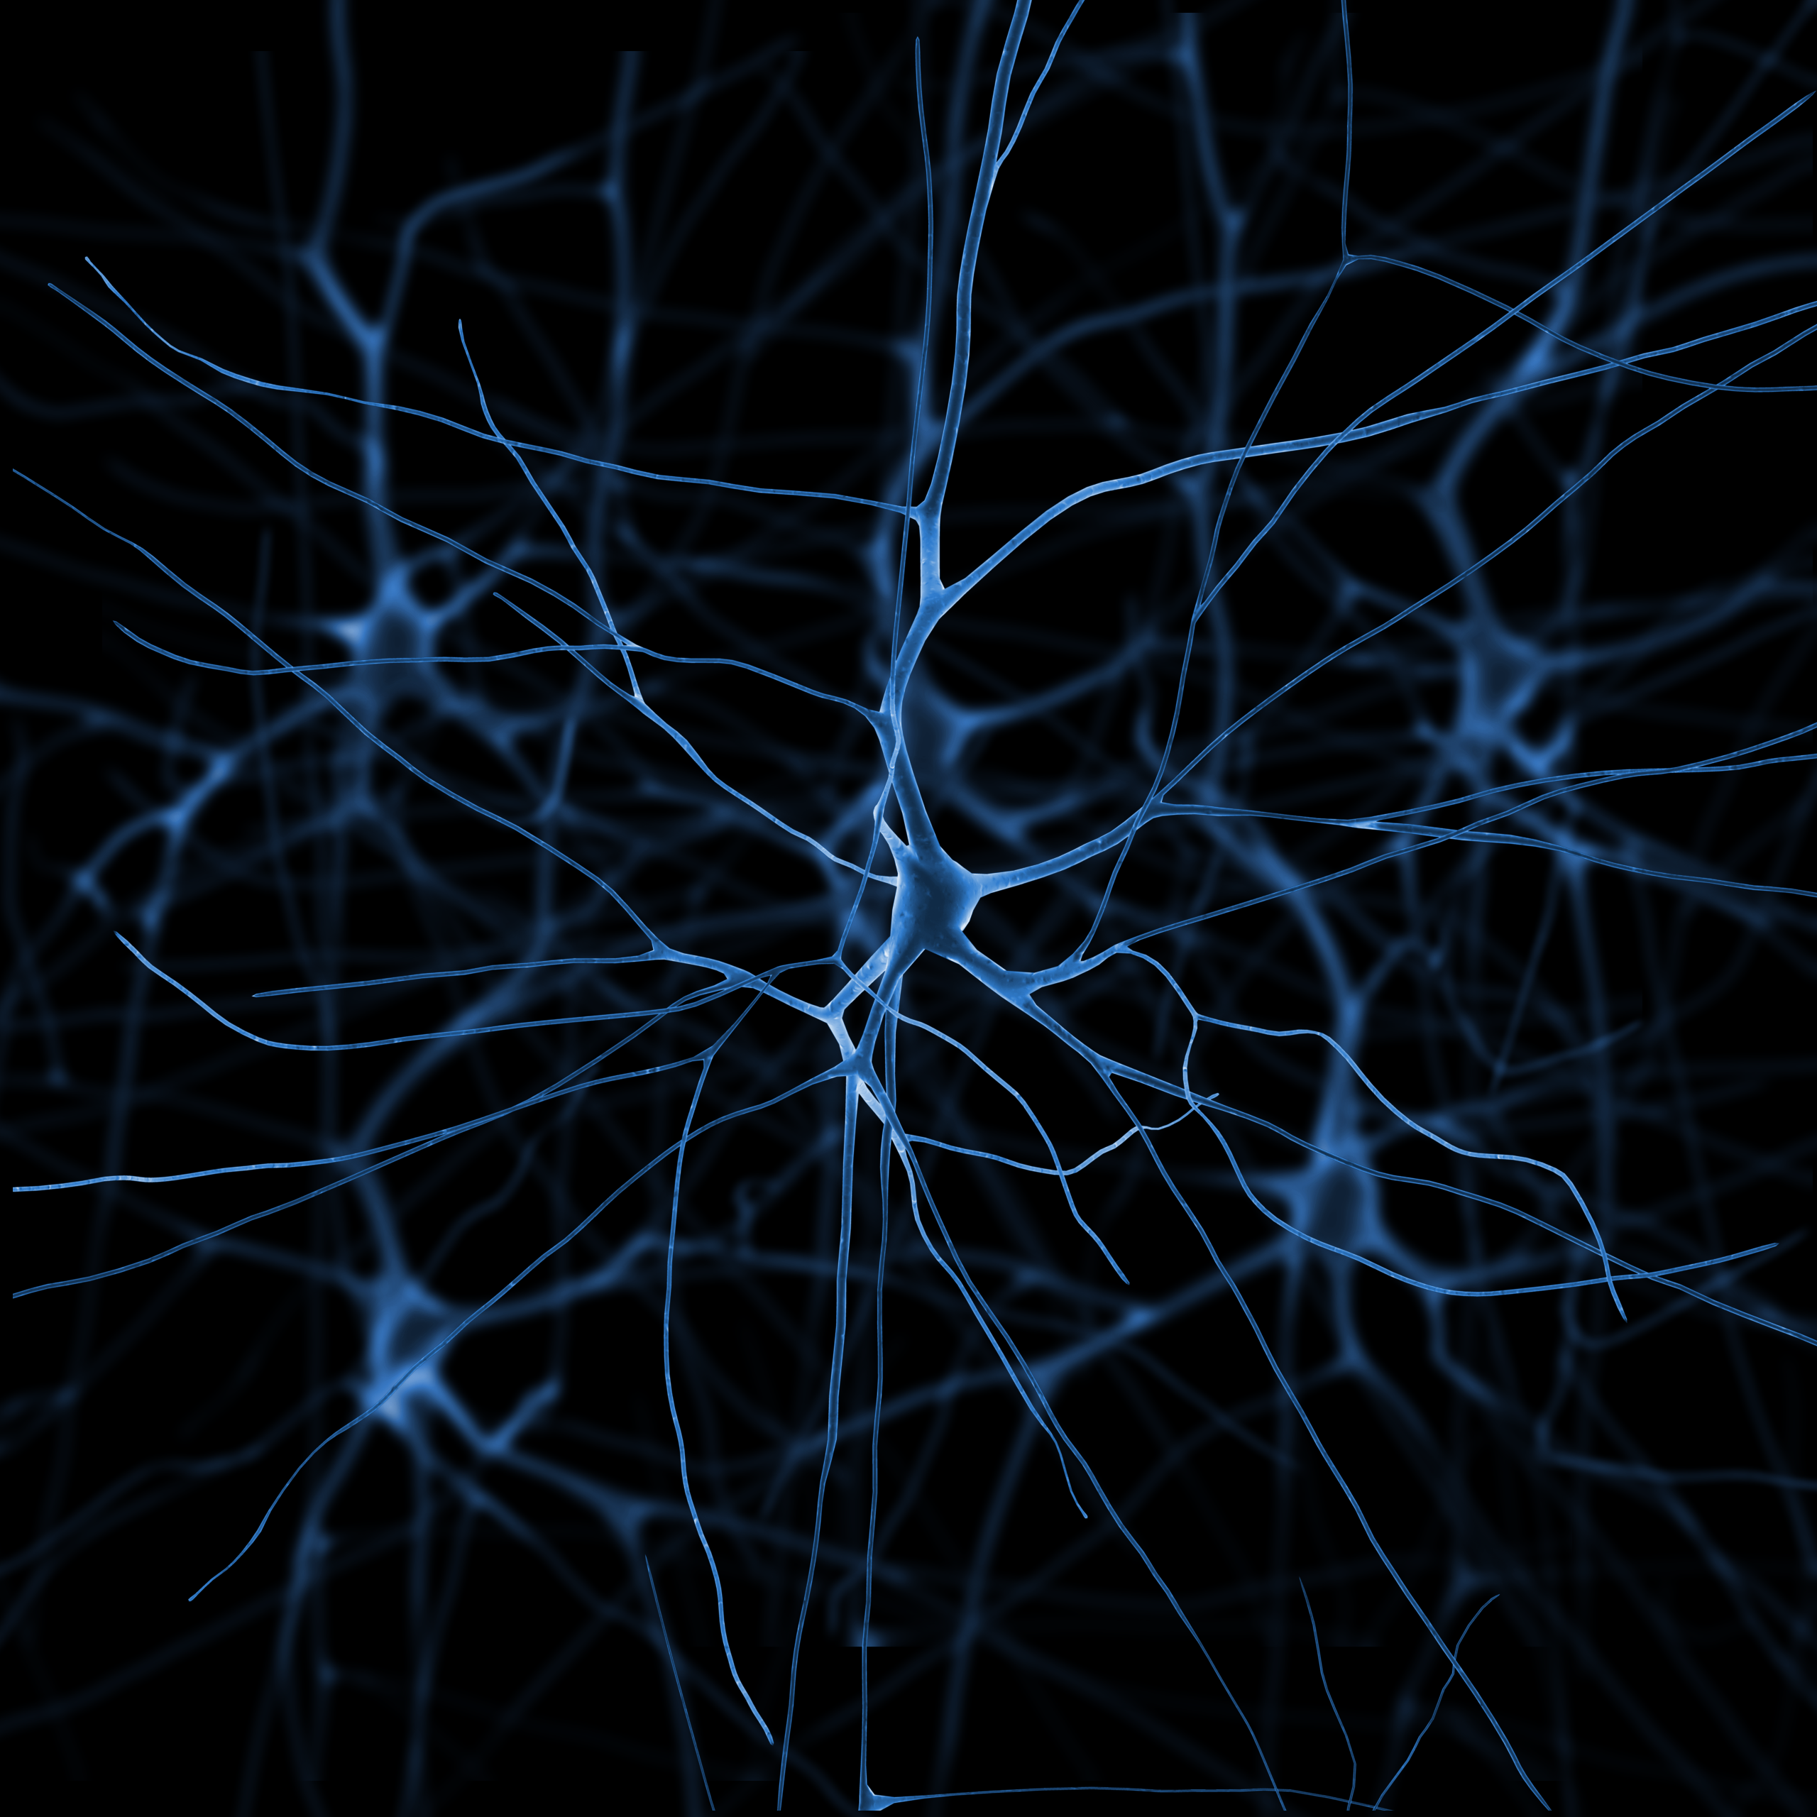
Computational neuroscience
Study of brain function and information processing in neuronal circuits
interdisciplinary field of neuroscience, cognitive science, psychology, engineering, computer science, mathematics and physics
YIC Conference Aachen 2015

Slide 3
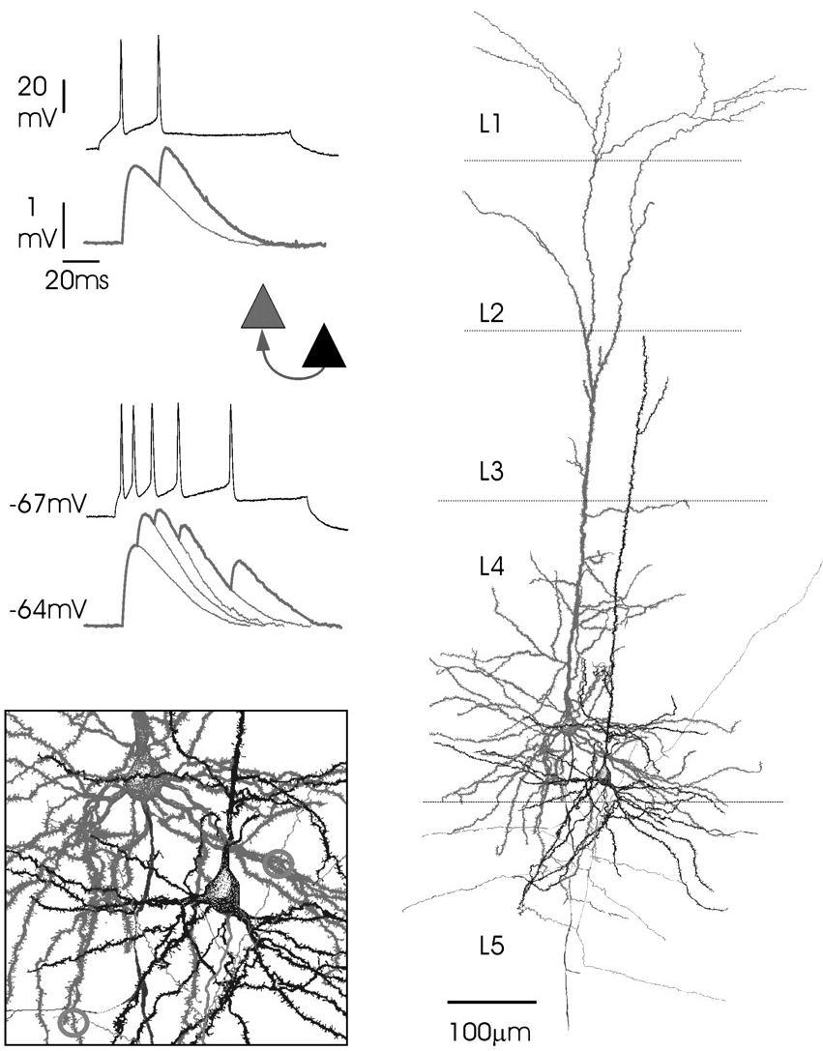
Fundamentals of biological neural networks
Neurons are the basic processing units of the brain
They connect through synapses and form complex networks
Neurons actively maintain a potential across the membrane
Communication between neurons is mediated by spikes
Information is encoded in the spike time, not in the shape
YIC Conference Aachen 2015

Slide 4
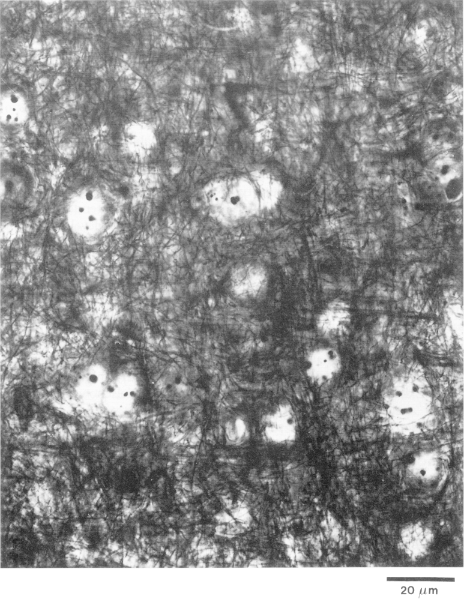
Complexity of biological neural networks
To understand the brain, it is necessary to study networks
The networks are very complex
Locally, each neuron has ~ 10⁴ synapses
Each neuron is connected to 10% of the local neighbors
→ Networks containing all local synapses have at least 10⁵ neurons and 10⁹ synapses
→ This corresponds to 1 mm³ of cortex
YIC Conference Aachen 2015

Slide 5
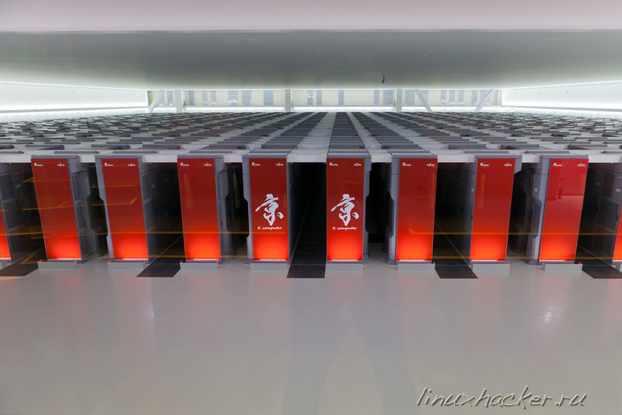
NEST simulator
NEST Initiative has developed it over the past 20 years
for spiking neural network models
to simulate the dynamics of interactions between nerve cells
from small networks on local machines up to large brain-scale circuits using the full capabilities of the world’s leading supercomputers
1.73 billion neurons
10.4 trillion synapses
82,944 processors
1 PB main memory
40 minutes / second
used by approx. 250 people
published under GPL
www.nest-simulator.org
YIC Conference Aachen 2015

Slide 6
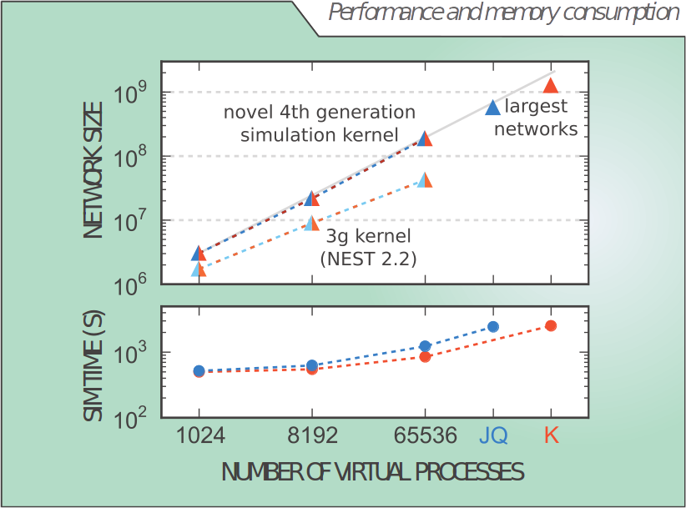
Boundaries of neuronal simulations
Juqueen missing!!
K missing!!!
YIC Conference Aachen 2015

Slide 7
Motivation
Using results of large scale simulation for analysis
  Storing all neuron activity to disk is not possible, but it is essential for post analysis
  1 mm³ contains already 10⁵ neurons and 10⁹ synapses
  → Massively parallel IO task
Optimize IO without the overhead of NEST simulation
  → Develop IO Proxy of NEST
YIC Conference Aachen 2015

Slide 8
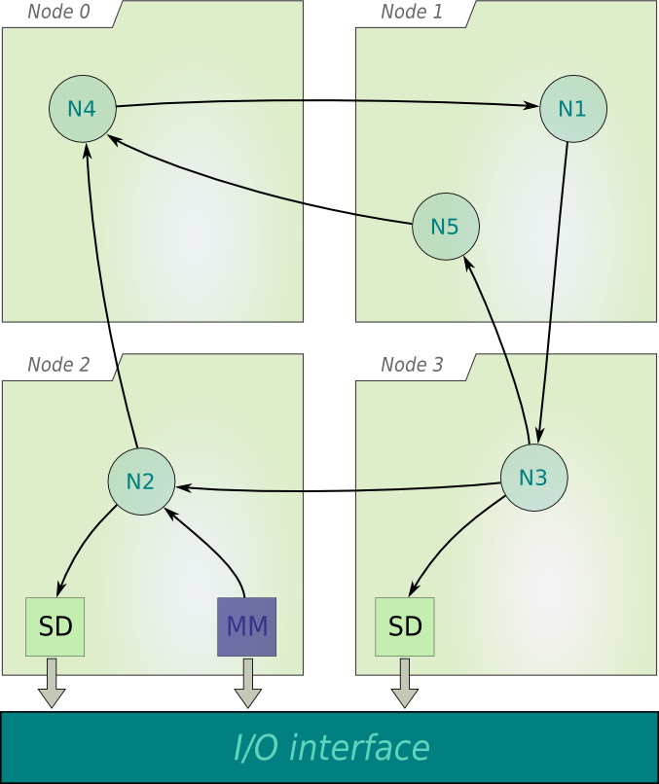
NEST: highly parallelized application
Hybrid parallelization
MPI
OpenMP
YIC Conference Aachen 2015

Slide 9
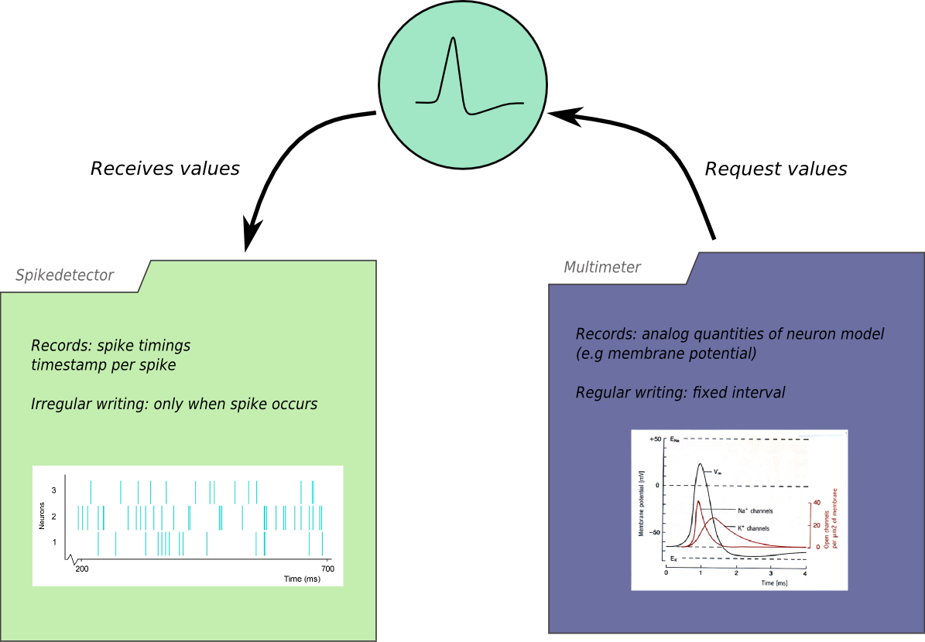
NEST IO: Recording devices
YIC Conference Aachen 2015

Slide 10
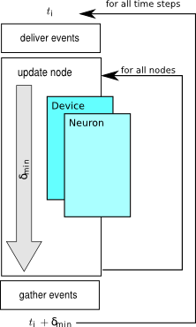
NEST: Inside
Iterations:
Deliver events
Update nodes
  Iterate over all nodes
Gather events
YIC Conference Aachen 2015

Slide 11
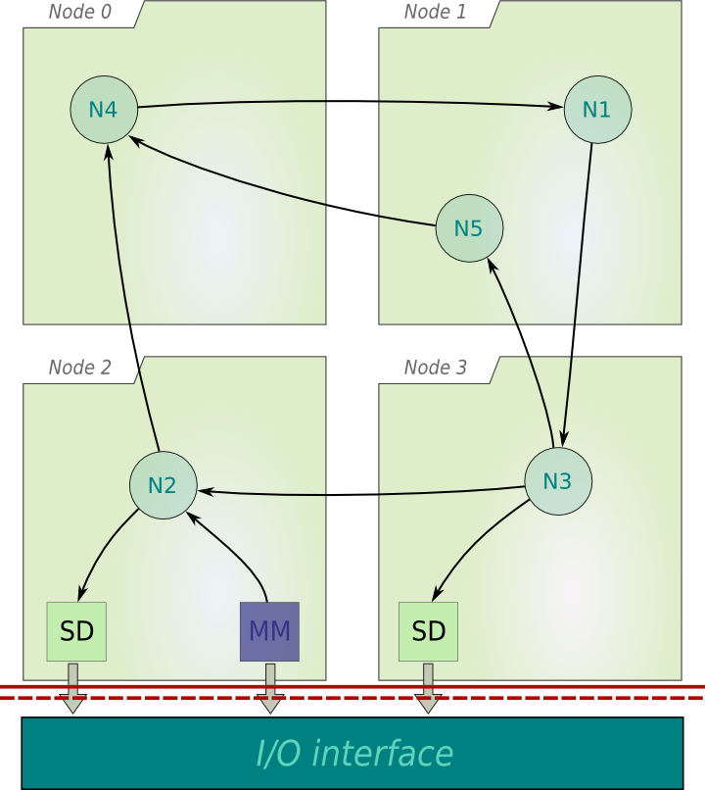
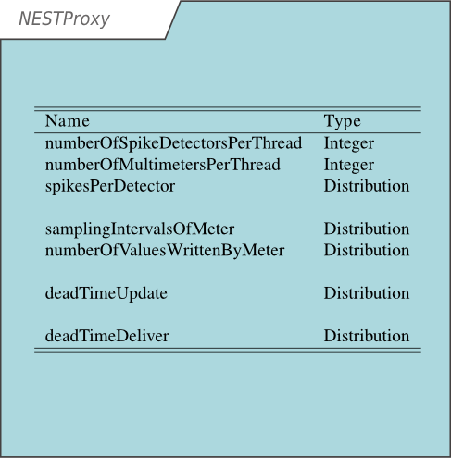
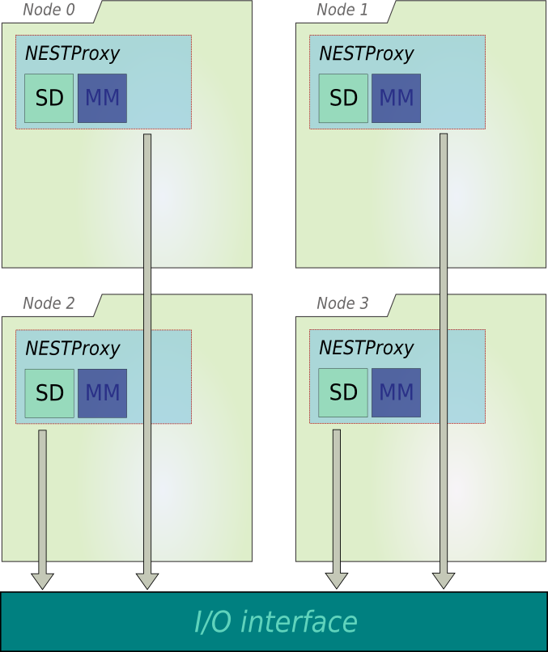
NEST → IO Proxy
Use Score-P to instrument NEST
Run standard use cases with instrumented NEST
Extract IO calls
YIC Conference Aachen 2015

Slide 12
NEST → IO Proxy
Analyze IO calls
Fit stochastic distributions to measurements
YIC Conference Aachen 2015

Slide 13
NEST → IO Proxy
Run NESTProxy with given stochastic parameters
Analyze NESTProxy output
YIC Conference Aachen 2015

Slide 14
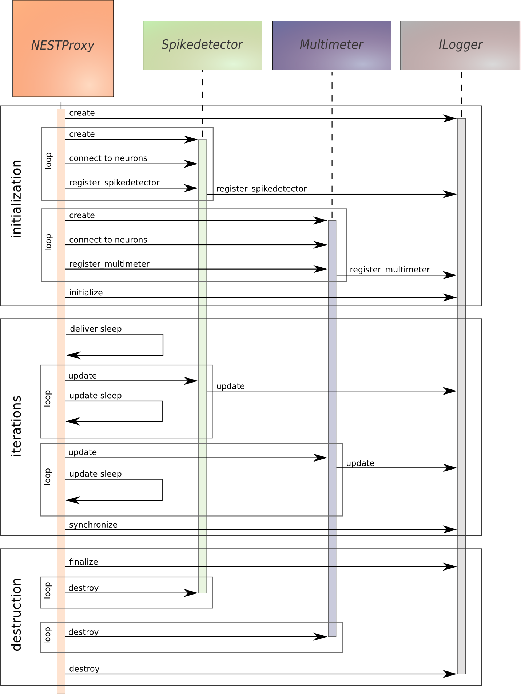
NESTProxy: Iterations
YIC Conference Aachen 2015

Slide 15
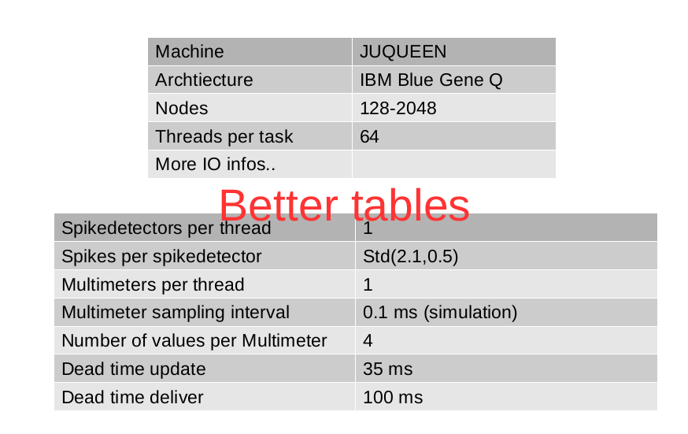
NESTProxy: Simulation run
YIC Conference Aachen 2015

Slide 16
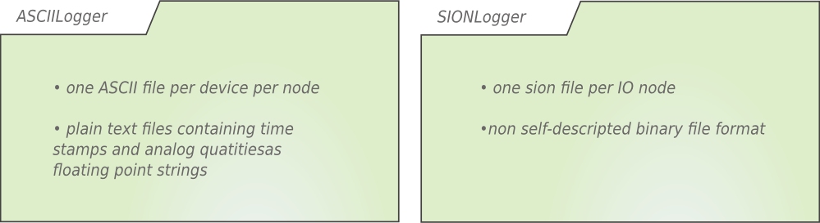
NESTProxy: Simulation on JUQUEEN
Machine | JUQUEEN
Architecture | IBM Blue Gene Q
Nodes | 128-2048
Threads per task | 64
YIC Conference Aachen 2015

Slide 17

NESTProxy: Profit
Results help to choose IO driver for specific system and simulation
Results help to predict IO writing time to use full IO capacity
Results help to optimize IO driver for specific systems
Results help IO developers to optimize their libraries

Slide 18
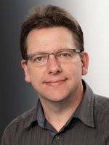
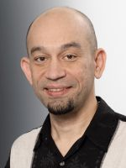
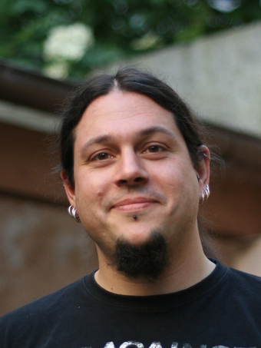
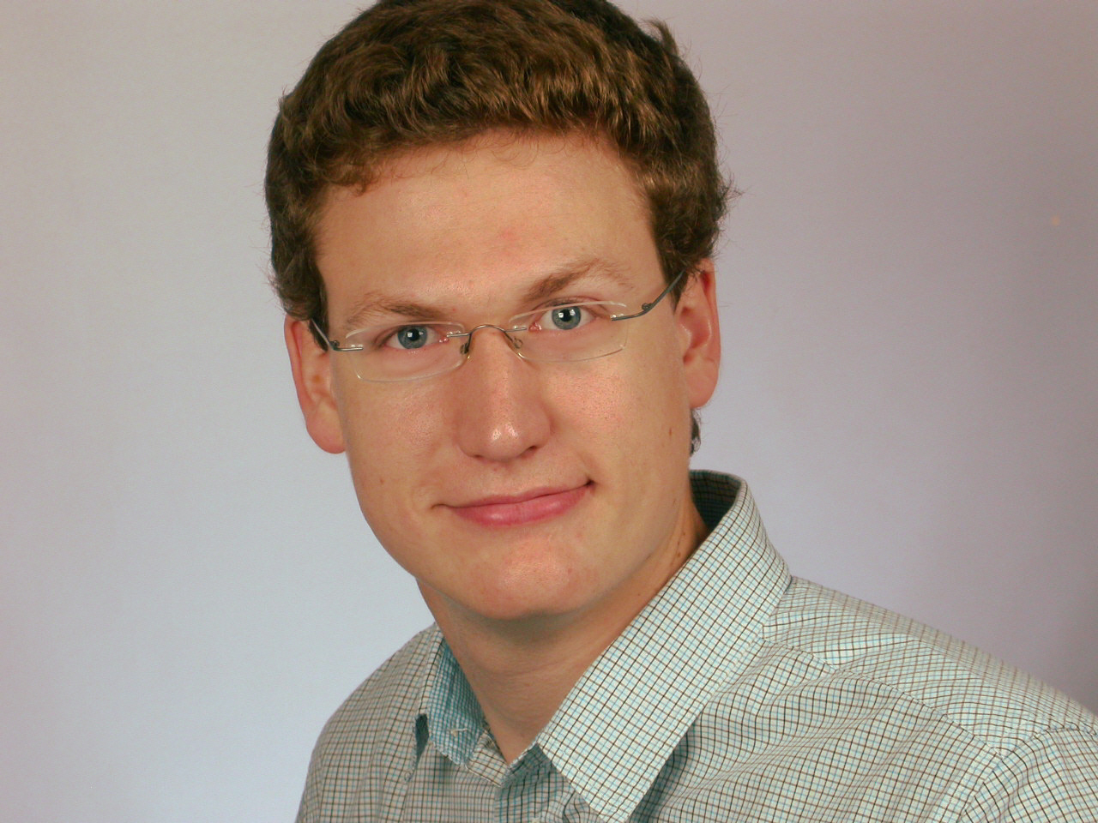
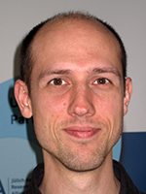
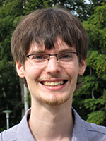

Acknowledgments
Institute of Neuroscience and Medicine (INM-6), Computational and Systems Neuroscience
Institute for Advanced Simulation (IAS-6)
Jülich Supercomputing Centre
Institute for Advanced Simulation
Simulation Lab Neuroscience - Bernstein Facility for Simulation and Database Technology
Institute for Advanced Simulation
YIC Conference Aachen 2015

Slide 19


Funded by
Helmholtz Association through the Helmholtz Portfolio Theme ”Supercomputing and Modeling for the Human Brain”
EPFL Blue Brain Project
YIC Conference Aachen 2015

