Slide 1
Picking the Right Holiday Flat A demo of prediction and statistical inference using open data
Antrittsvorlesung, January 2021
Study Program Data Science
Prof. Dr. Tillmann Schwörer

Slide 2
Motivation: We are all in need of holidays. But realistically we should be planning for a domestic holiday. → Picking „best“ holiday apartment in Berlin
Hedonic Pricing Model: Internal and external factors affecting an item‘s price in the market
Relevancy for Seller, Buyer, Public: location, characteristics of the object, characteristics of the public infrastructure, price? Demonstrate how fundamental statistcal methods can be used to extract knowledge and make wiser decisions.
Wealth Open Data

Slide 3

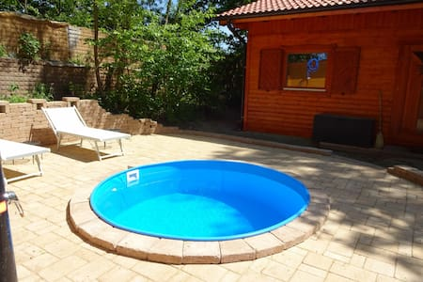


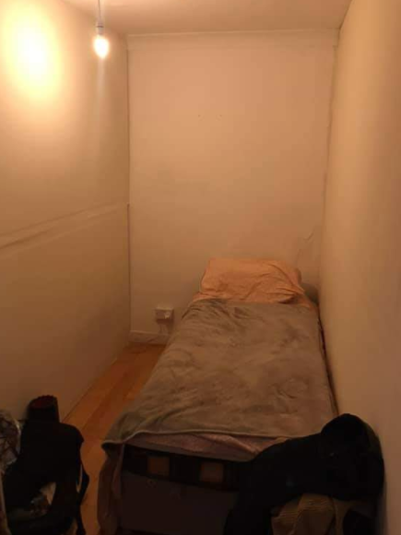
€€€

Slide 4
Hedonic Pricing Model
Estimate the price of holiday apartments based on people‘s willingness to pay for certain internal and external factors
Internal factors:
Size, number of beds
Amenities: tv, wifi, cooking facilities, bathroom, garden, terrace
Design, architecture, old building
Communication and service
External factors
Centrality, access to public transport
Distance to touristic attractions, spots for recreational activities, shops, restaurants and cafés
Noise, pollution, and security

Slide 5
Data
Internal factors:
Data on approx 20.000 Airbnb apartments in Berlin from August 2020
Source: http://insideairbnb.com/about.html
Original attributes: prices, location, review scores, number of beds, …
Derived attributes:
Tags → Section of binary Variables (TV, WiFi, Pool, …)
Free text description → Extract size, Altbau indicator

Slide 6
Data
10+ ways of writing the same: m², m2, sq.m, square meter, m.sq., …
Not to be confused with square inches, square feet, etc.
„You can see beautiful sunsets from the window and you also have a balcony. It's 28 m2 in a 100 m2 apartment near Mitte, Prenzlauer Berg, …”
Both bedrooms comprise approximately 25 sqm each.
Feature Engineering can be hard ;-)

Slide 7
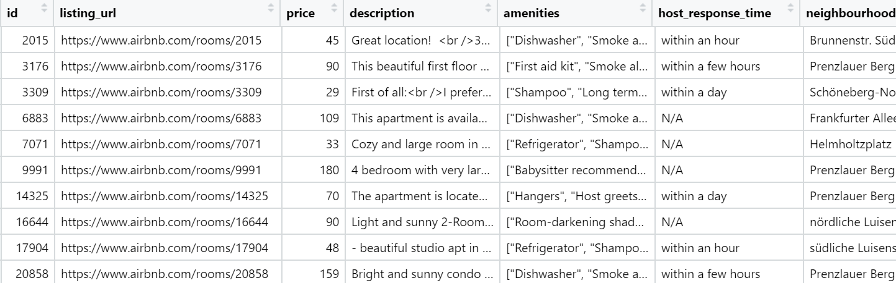
Data

Slide 8
Data
External Factors:
Source: Open Streetmap, Overpass API
Tagged (bus station, café, …) and georeferenced (longitude, latitude) data on almost everything
For each airbnb apartment we derive:
distance in m to closest tram or train stop
number of restaurants within radius 300m
number of attractions (museum, gallery, zoo) within 1000m
…

Slide 9

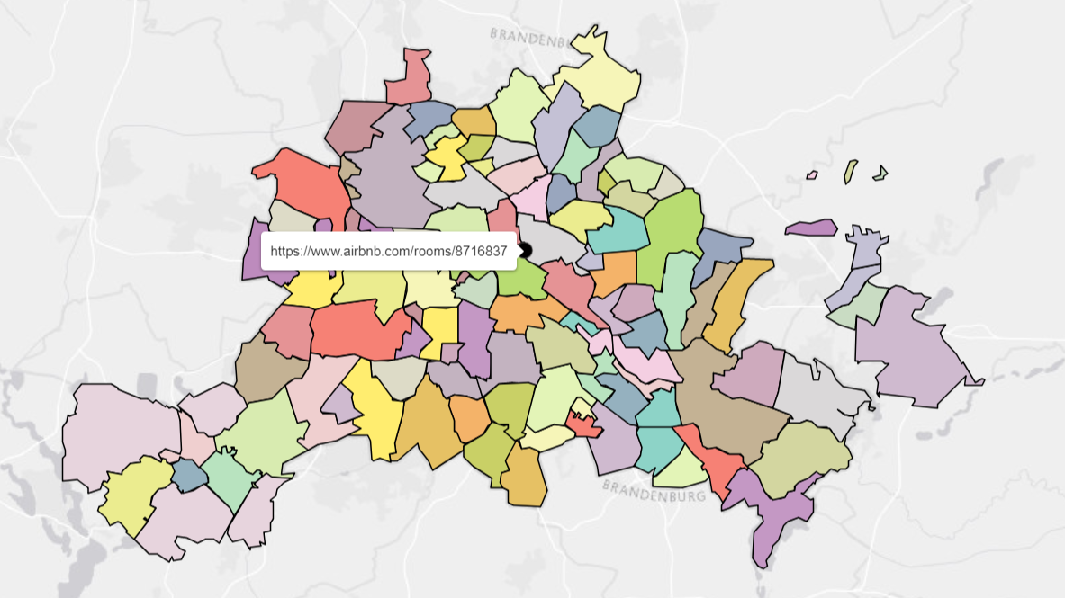



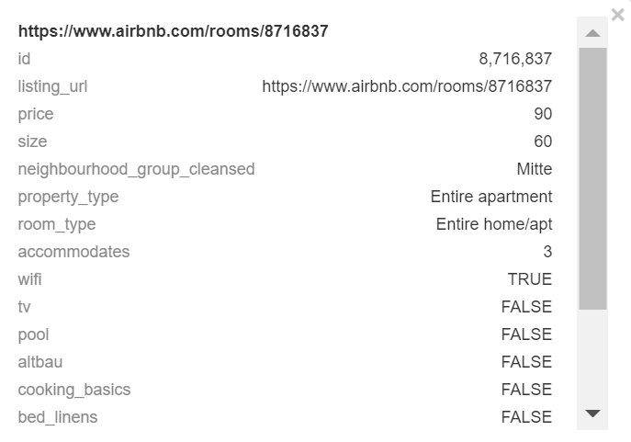



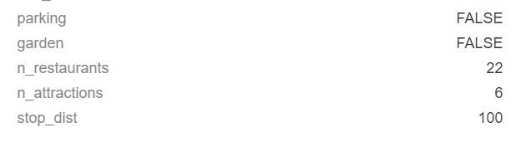
90$

Slide 10
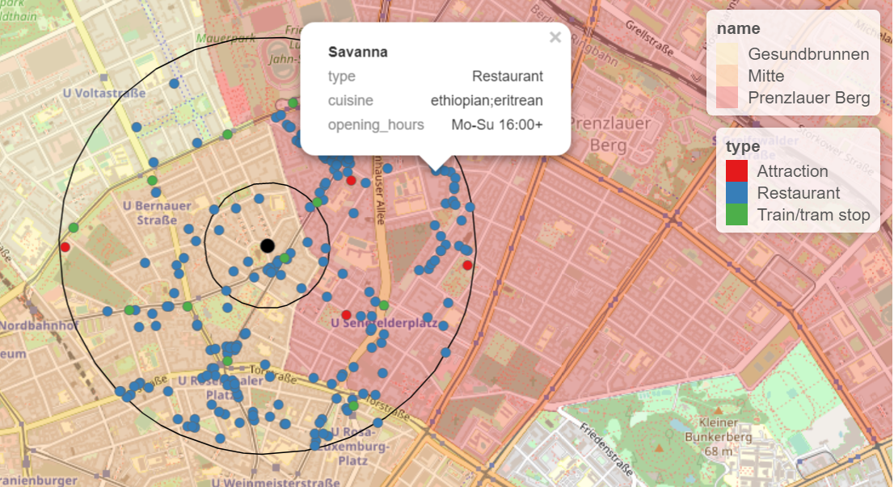
700m
300m
Restaurants within 300m = 22
Attractions within 1000m = 5
Distance to nearest stop = 101m

Slide 11
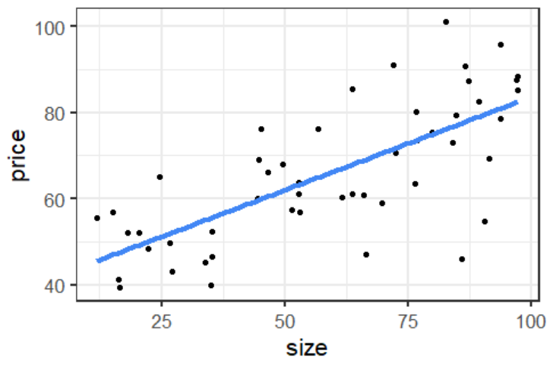
Conceptual approach
Actual Price = 86$
Error = 18$
Predicted Price = 68$
Each additional 1 m² increases price by 0.50 $
63 m²

Slide 12
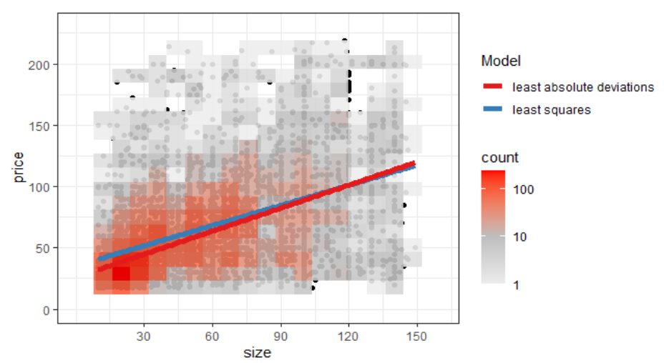
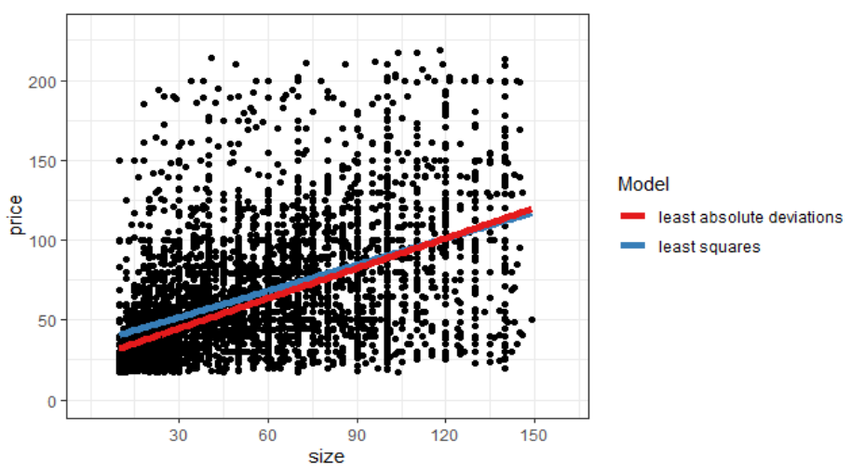
In practice: a lot of „noise“

Slide 13
Entire Apartment: $ 32.28 * 1
Accomodates: $ 9.87 * 3
WiFi: $ 1.66 * 1
Attractions: $ 0.73 * 5
Restaurants: $ 0.29 * 22
Stop Distance: $ 0 * 150
Total predicted price = $ 75

Slide 14
Final perspectives
Concrete use case: application project with IB.SH
Thinking in terms of data science products:
How can we (or someone else) actually use our results?
90% of the time spend on data assembly and feature engineering
Open data and open source software

