Slide 1
Picking the right holiday flat
A demo of prediction and statistical inference using open data

Slide 2

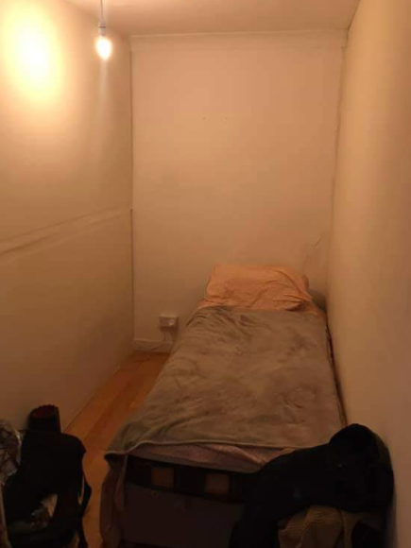
Seite <number>
Präsentationsname

Slide 3
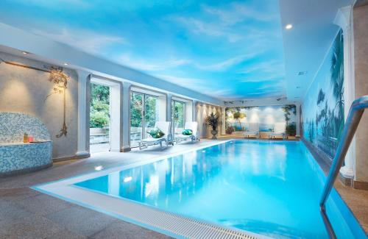
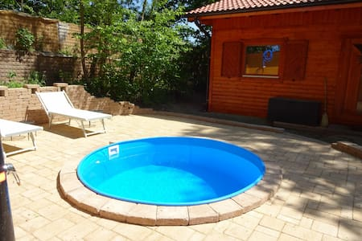
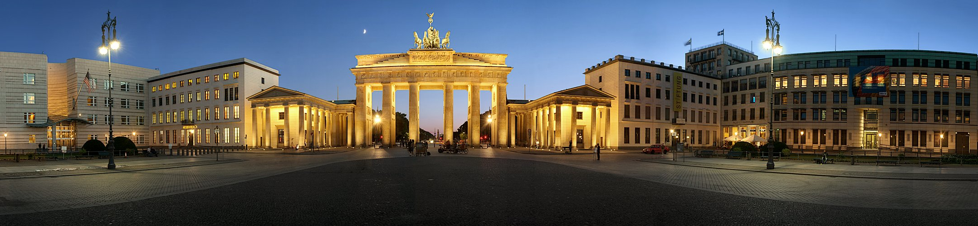
Seite <number>
Präsentationsname

Slide 4
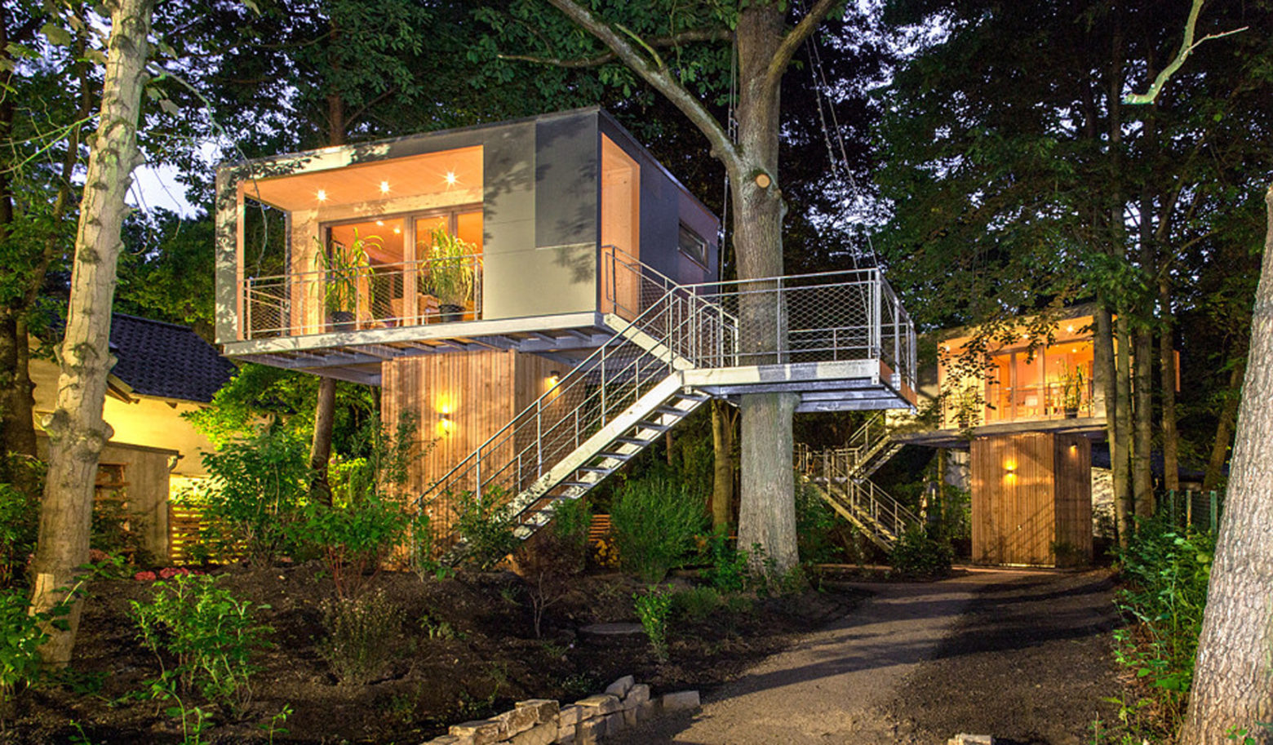
Seite <number>
Präsentationsname

Slide 5
Relevant for citizen, tourist, investor, city planner: where to live / sleep / invest / build?
Access to public transport, schools, medical services, shops and restaurants, recreational areas, tourist attractions, urban Planner:
Noise, pollution, security,neighborhoud
Centrality, close to tourist attractions, recreational areas, shopping and restaurants
Distance to public transport stops
Seite <number>
Präsentationsname

Slide 6
Housing market and urban planning
Citizen: where to live?
Tourist: where to sleep?
Real Estate Investor: where to invest?
City planner: how to regulate land use and where to build infrastructure?
Prof. Dr. Tillmann Schwörer

