Slide 1
Picking the Right Holiday Flat A demo of prediction and statistical inference using open data
Antrittsvorlesung an der Fachhochschule Kiel
Prof. Dr. Tillmann Schwörer

Slide 2
Introduction
Goals:
How can we find ourselves the best holiday apartment?
Open data and open source software
Creative combination of existing data and technologies
Extending the aproach to further use cases
Agenda:
Question
Data
Statistical analysis
Demo application

Slide 3

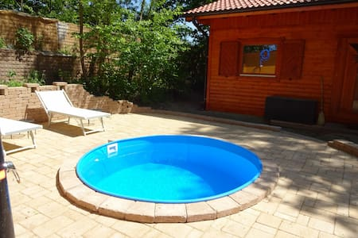
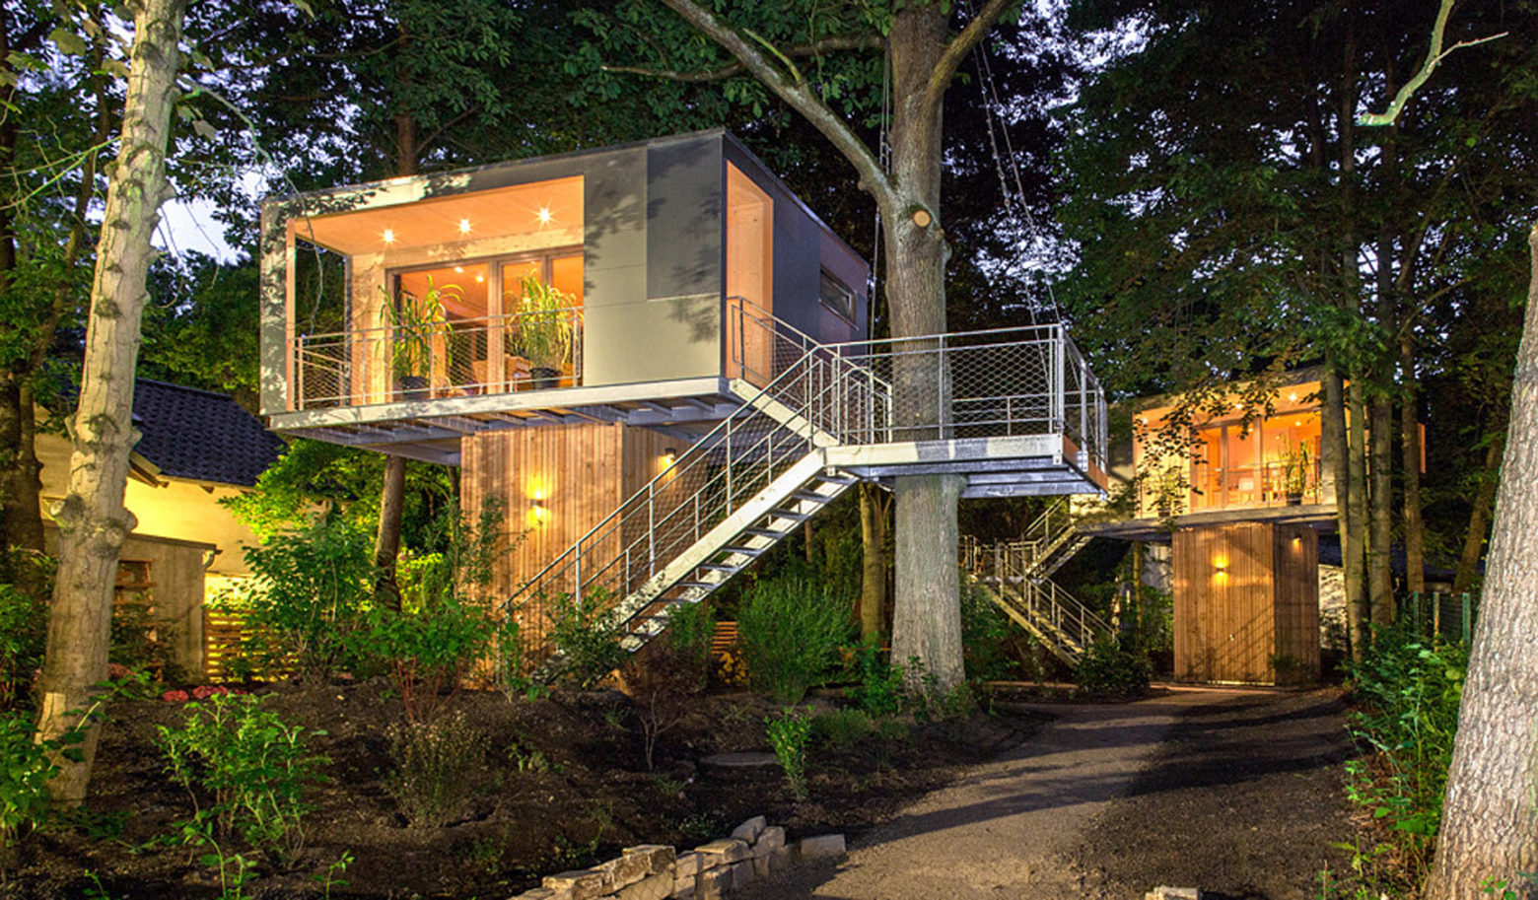

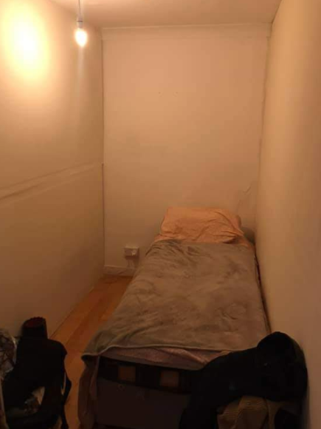
€€€

Slide 4
Hedonic Pricing Model
Estimate the price of holiday apartments based on people‘s willingness to pay for certain internal and external factors
Internal factors:
Size, number of beds
Amenities: tv, wifi, cooking facilities, bathroom, garden, terrace
Interior design
Service
External factors
Centrality, access to public transport
Distance to touristic attractions, shops and restaurants
Noise, pollution, and security

Slide 5
Data
Internal factors:
Data on approx 20.000 Airbnb apartments in Berlin from August 2020
Source: http://insideairbnb.com/about.html
Original attributes: prices, location, review scores, number of beds, …
Derived attributes:
Tags → Selection of binary variables (TV, WiFi, Pool, …)
Free text description → Size and „Altbau“

Slide 6

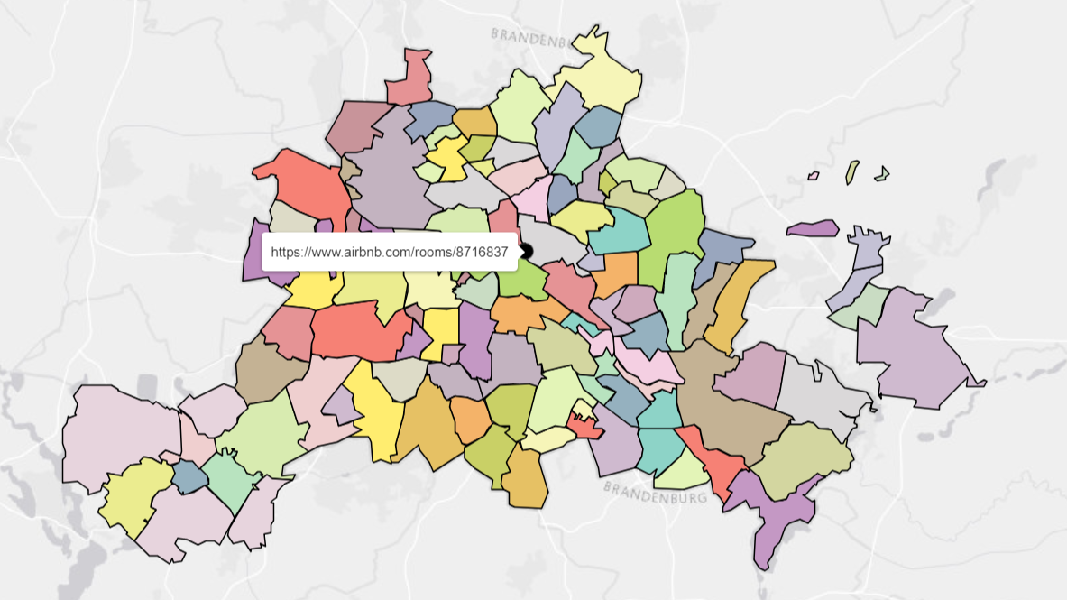



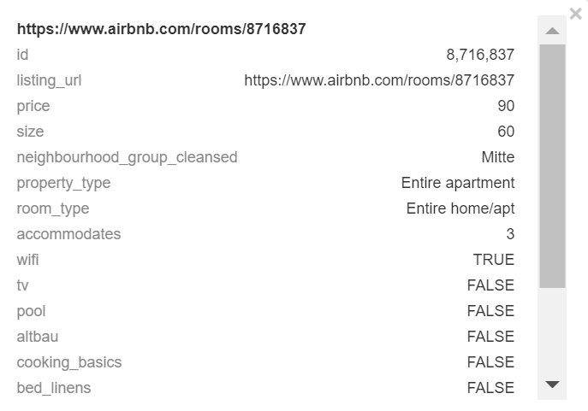



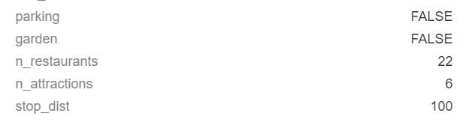
90$

Slide 7
Data
10+ ways of writing the same: m², m2, sq.m, square meter, m.sq., …
Not to be confused with square inches, square feet, etc.
„You can see beautiful sunsets from the window and you also have a balcony. It's 28 m2 in a 100 m2 apartment near Mitte, Prenzlauer Berg, …”
Both bedrooms comprise approximately 25 sqm each.
Feature Engineering can be hard ;-)

Slide 8
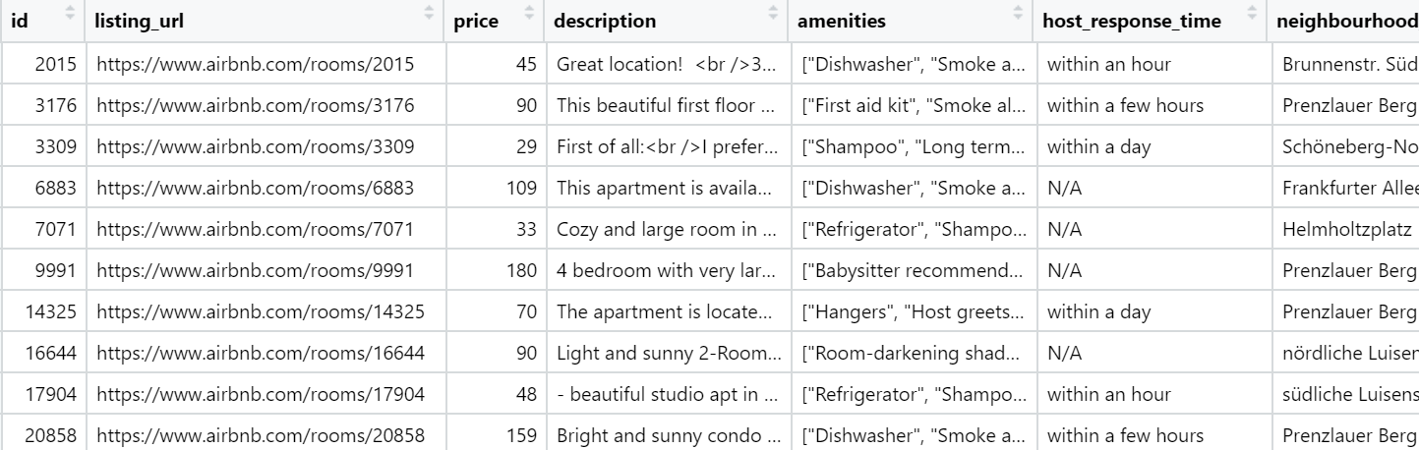
Data

Slide 9
Data
External Factors:
Source: Open Streetmap, Overpass API
Tagged (bus station, café, …) and geocoded (longitude, latitude) data on almost everything
For each airbnb apartment we derive:
distance in m to closest tram or train stop
number of restaurants within radius 300m
number of attractions (museum, gallery, zoo) within 1000m
…

Slide 10
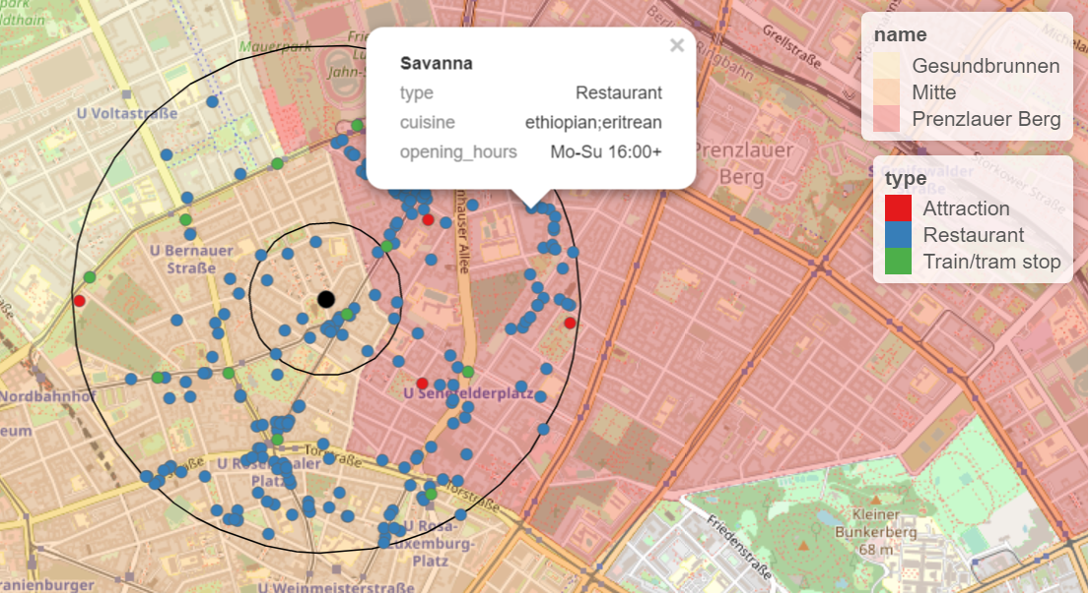
700m
300m
Restaurants within 300m = 22
Attractions within 1000m = 5
Distance to nearest stop = 101m

Slide 11
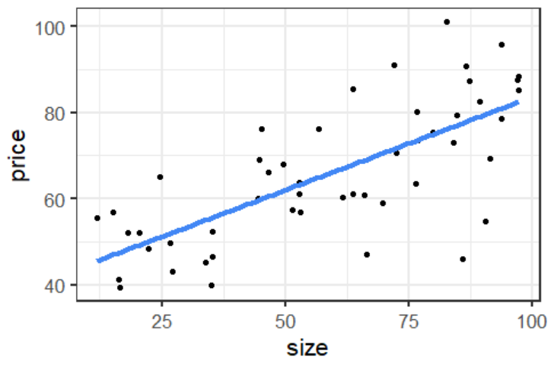
Conceptual approach
Actual Price = 86$
Error = 18$
Predicted Price = 68$
Each additional 1 m² increases price by 0.50 $
63 m²

Slide 12
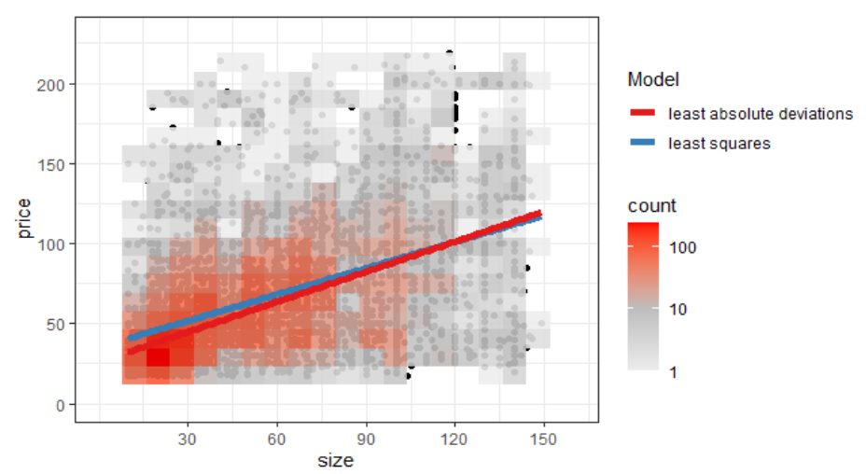
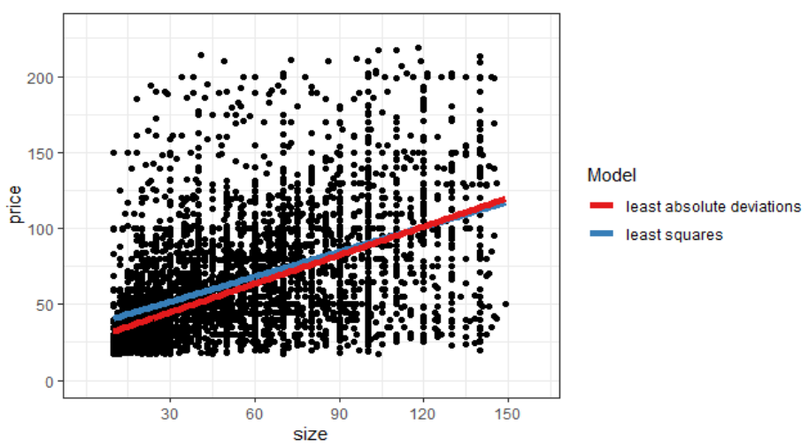
In practice: a lot of „noise“

Slide 13



Slide 14
Demo Application

Slide 15
Final perspectives
Insights for guests and apartment hosts
Extensible to housing market in general
Relevancy for urban planning: → application project with IB.SH
90% of the time spend on data assembly and feature engineering

