Slide 2

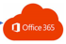
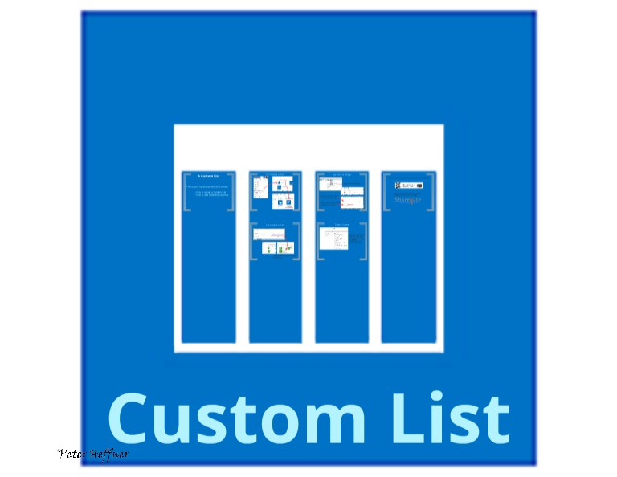



SharePoint List
Modern Pages
Application Configuration
Enrollment Screen
ESRABenefeciaryWelcomeDetail Webpart
ESRABenefeciaryDetail Webpart
Stipend Request
Beneficiary
Mobile Device Plan Configuration
Policy Configuration
SharePoint Team Site

Slide 3
SharePoint List
Modern Pages
Application Configuration
Approve/Reject Screen
ESRAPendingRequests Webpart
ESRACompletedRequests Webpart
Stipend Request
Manager/Reviewer
Policy Configuration
SharePoint Team Site

Slide 4


SharePoint List
Scheduled Jobs
Stipend Request
Delete invalid Gilead users from the system
Add/Delete User from Azure active directory group
Weekly pending Notifications to Powerusers
Payroll report - monthly
Reminders for expiration/re-enrollment

Slide 5

SharePoint List
Scheduled Jobs
Stipend Request
Add/Delete User from Azure active directory group
Add Remove SendEmails
Reminder Notifications
Payroll report - monthly

Slide 6

Modern Pages
SharePoint List
Manage Pending Requests Screen
ESRAManagePendingRequests Webpart
Policy Configuration
Manage Requests Screen
ESRAManageRequests WebPart
Stipend Request
Settings Screen
ESRASettingTabs Webpart
Application Configuration
Request on behalf
ESRARequestOnBehalf Webpart
Mobile Device Plan Configuration
Manage Power Users Screen
ESRAManagePowerUsers Webpart
Power user
SharePoint Power user Group
Payroll Screen
ESRAPayrolReport Webpart
Reports Screen
ESRAReportTabs Webpart
Payroll Document Library
Enrollment Screen
Powerbi Enrollment Webpart
Stipend Request
SharePoint Team Site
Summary Screen
Powerbi Summary Webpart

Slide 7
Modern Pages
SharePoint List
Manage Pending Requests Screen
ESRAManagePendingRequests Webpart
Stipend Request
Manage Requests Screen
ESRAPowerUserPendingRequests WebPart
ESRAPowerUserCompletedRequests
Settings Screen
ESRASettingTabs Webpart
Application Configuration
Power user
ESRARequestOnBehalf Webpart
ESRACreateBulkStipends Web Part
Mobile Device Plan Configuration
Manage Power Users Screen
ESRAExportGroupUsers
Policy Configuration
SharePoint Power user Group
SharePoint Team Site

Slide 8
Modern Pages
SharePoint List
Payroll Screen
ESRAPayrolReport Webpart
Payroll Document Library
Reports Screen
ESRAReportTabs Webpart
Enrollment Screen
ESRAEnrollmentReport Webpart
Stipend Request
Power user
Summary Screen
ESRAStipendSummary Webpart
SharePoint Team Site

Slide 9
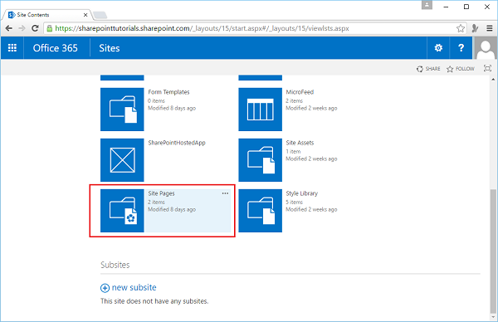

Slide 11
